Slide 1
Why you should buy my mix tape and follow me on social media
BUY MY BIOME WOODLAANDS/SHRUBLANDS
By Hamna Ghaffar

Slide 2
A little bit of Info
Shrub land habitats contain thickets of shrubs and young trees mixed with scattered grasses and wildflowers.
Shrub land habitats are almost always temporary ( due to Humans)
exist on land for a short period of time.
shrub lands are made up of shrubs or short trees. Which is great if you are a midget and are sick and tired of tall things such as humans and trees
Many shrubs thrive on steep, rocky slopes. There is usually not enough rain to support tall trees which is why they don’t grow as many
Scrublands' are open so grasses and other short plants grow between the shrubs.

Slide 3
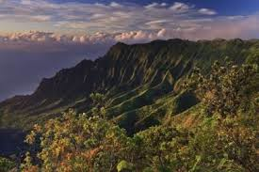
PICS SO YOU KNOW WHAT IM TALKING ABOUT

Slide 4
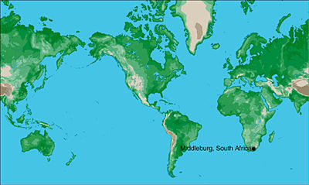
Location
West coastal regions between 30° and 40° North and South latitude

Slide 5
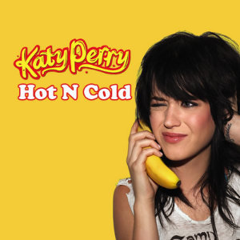
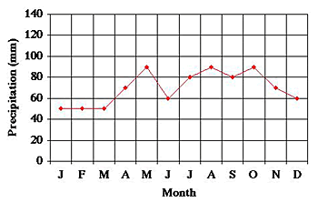
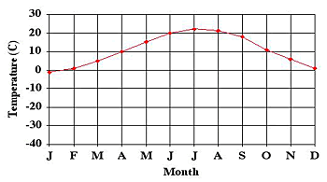
Temperature and precipitation
Woodlands are hot in the summer but cool and moist in the winter
A lot of this has to depend on where the shrub land is located
200 to 1,000 mm of rain per year ( pretty fair)
average temperatures: range from below zero to about 20 degrees C.
Temperate, UniDeciduous Forest
Staunton, Virginiated States

Slide 6
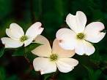
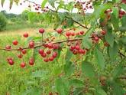
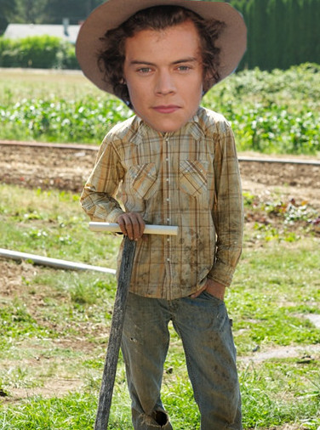
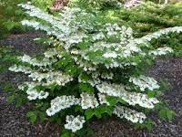
Soil Quality + Vegetation
If you hate farmers as much as I do They you shouldn't’t move to wood/shrub lands
Because the soil is fertile with rich nutrients and minerals
Typical plants include dogwood, Viburnum, pin cherry

Slide 7
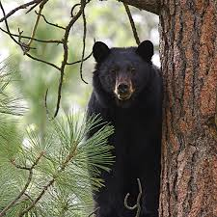
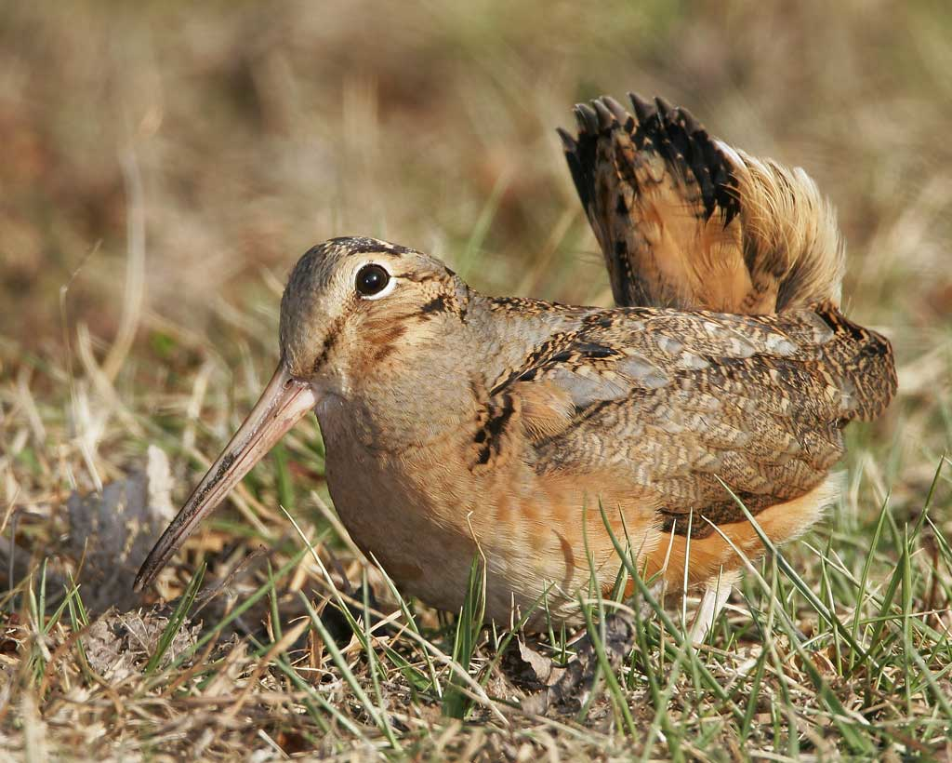
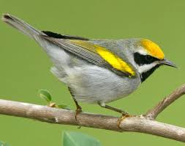
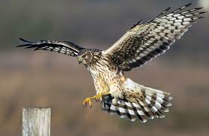
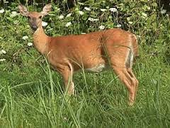
Why waste a trip to the pet store
Scrublands' offer many exotic animals such as
The black racer snake
Black bears
White tailed dears
American woodcock
Northern harrier
Golden winger warbler

Slide 8
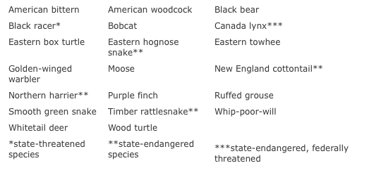

Slide 9
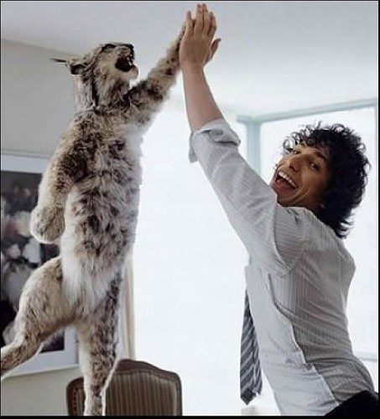
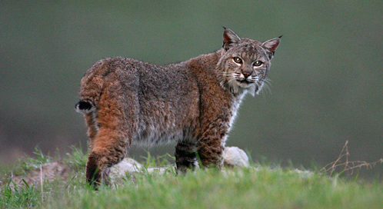
Hana's PET STORE PART 2
And last but not least A BOB CAT! This cat is so important it deserves its own slide!
Because a cat that can name itself is pretty cool
Also the name Bob just sounds so important
*Disclaimer, just because the cat names itself that doesn't’t mean its not going to attack your face like any other cat out there.
But still IT NAMES ITSELF!

Slide 10
Climate change
Many tree species are adapted to particular temperature and moisture conditions. As these conditions change, habitats become unsuitable for saplings to grow. Which is a problem
and because trees are so long-lived, the effects may not be noticeable for many years.
Deforestation is also a major threat to Woodlands

Slide 11
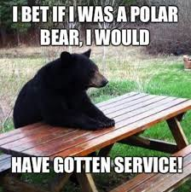
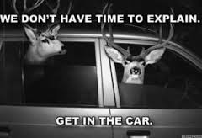
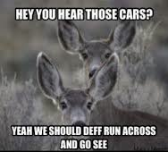

Slide 12
SOURCES
http://earthobservatory.nasa.gov/Experiments/Biome/bioshrubland.php
http://extension.unh.edu/Scrublands'#wildlife
http://www.climatehotmap.org/global-warming-effects/plants-and-animals.html

