Slide 1
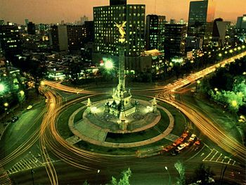
Mexico City
Wendy Carmona

Slide 2
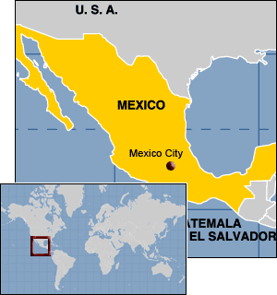
Where in the world ? (map)
This is where it is located.

Slide 3
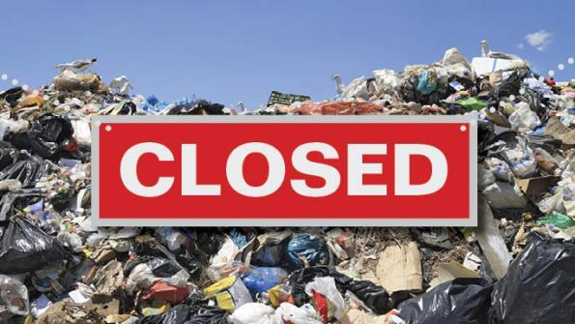
What is the issue ?
Bordo Poniente was Mexico’s largest landfill.
It was shut down December 2011.
The government shut it down without thinking of an alternative way to dispose of Mexico’s City garbage.
So now the cities surrounding Mexico City do now want to take in their garbage.

Slide 4
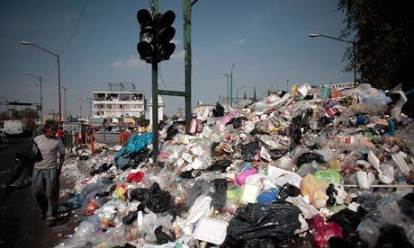
Why does it matter ?
The waste is coming from Mexico’s metropolitan area.
Bordo Poniente received 12,600 tons of garbage a day.
The dump had about 70 million tonnes of waste.
Caused water and air pollution.
71 million dollars are going towards site clean up.

Slide 5
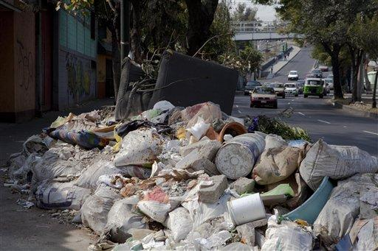
How is this issue affecting the environment ?
Only 15 % of Mexico’s waste was being recycled.
Valuable materials are being thrown out when they can be recycled.
Goal: 60 %
Lots of stray animals they are eating from the garbage.
Rat infestation.
Contaminated view.

Slide 6
Social Concerns
Mexico has high temperatures so the waste is rotting. People living in that area have to deal with the smell.
Government wasn’t really interested in trying to solve the problem.
Environmental injustice because people located near the illegal dumping areas are poor and don't have any say in the situation.
Garbage trucks just don’t have a place to take the garbage.

Slide 7
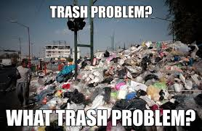
Economic concerns
Farmers markets are being payed by federal government.
Waste has to be separated - gov't paid job.
Trucks travel cost. To transport waste.
29 kilometers

Slide 8
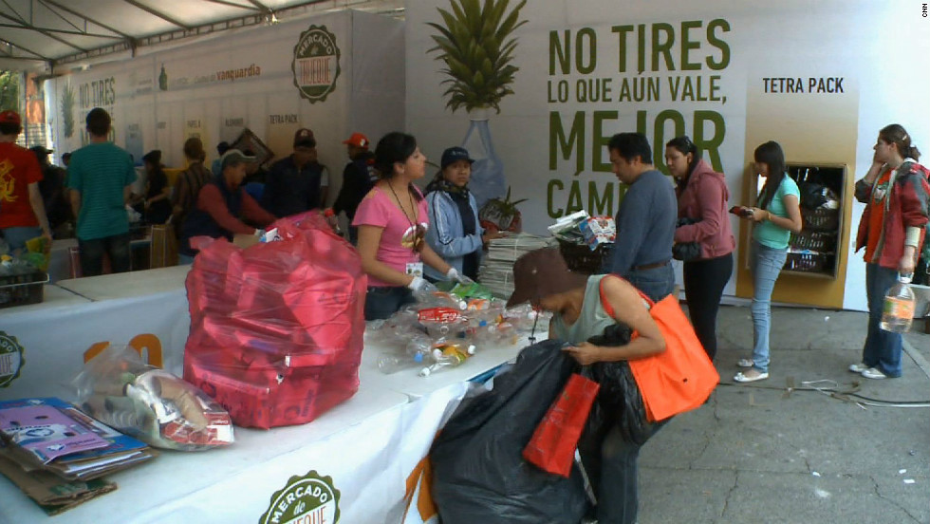
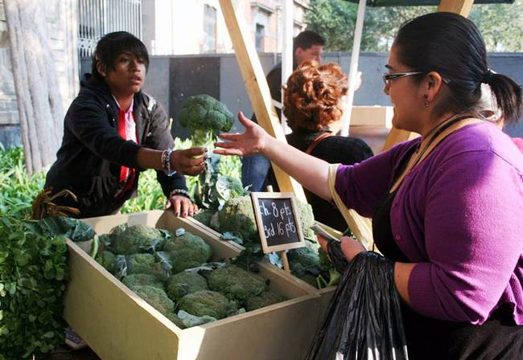
What is being done to help the problem ?
Gave out garbage bins.
Mercado de Trueque
Trash for Food
Trash weighed and given vouchers these can be used in farmers market.
300 “green points”

Slide 9
Sources
http://www.governing.com/topics/economic-dev/sustainable-communities/gov-mexico-city-recycling-incentive-more-food.html
http://www.theguardian.com/environment/2012/jan/09/waste-mountain-mexico-city
http://www.ipsnews.net/2012/01/no-one-wants-mexico-citys-garbage/
http://www.cnn.com/2012/06/19/world/americas/mexico-city-barter-scheme/
http://cities-today.com/how-mexico-city-has-turned-garbage-into-fuel/

