Slide 1
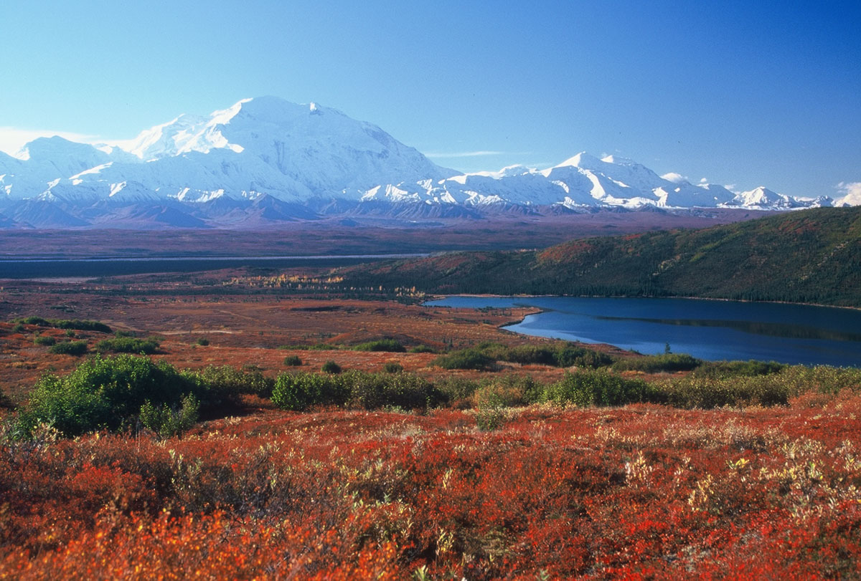
TUNDRA
Come and Experience the Beauty
Presented by: Mahnoor Zaheer

Slide 2
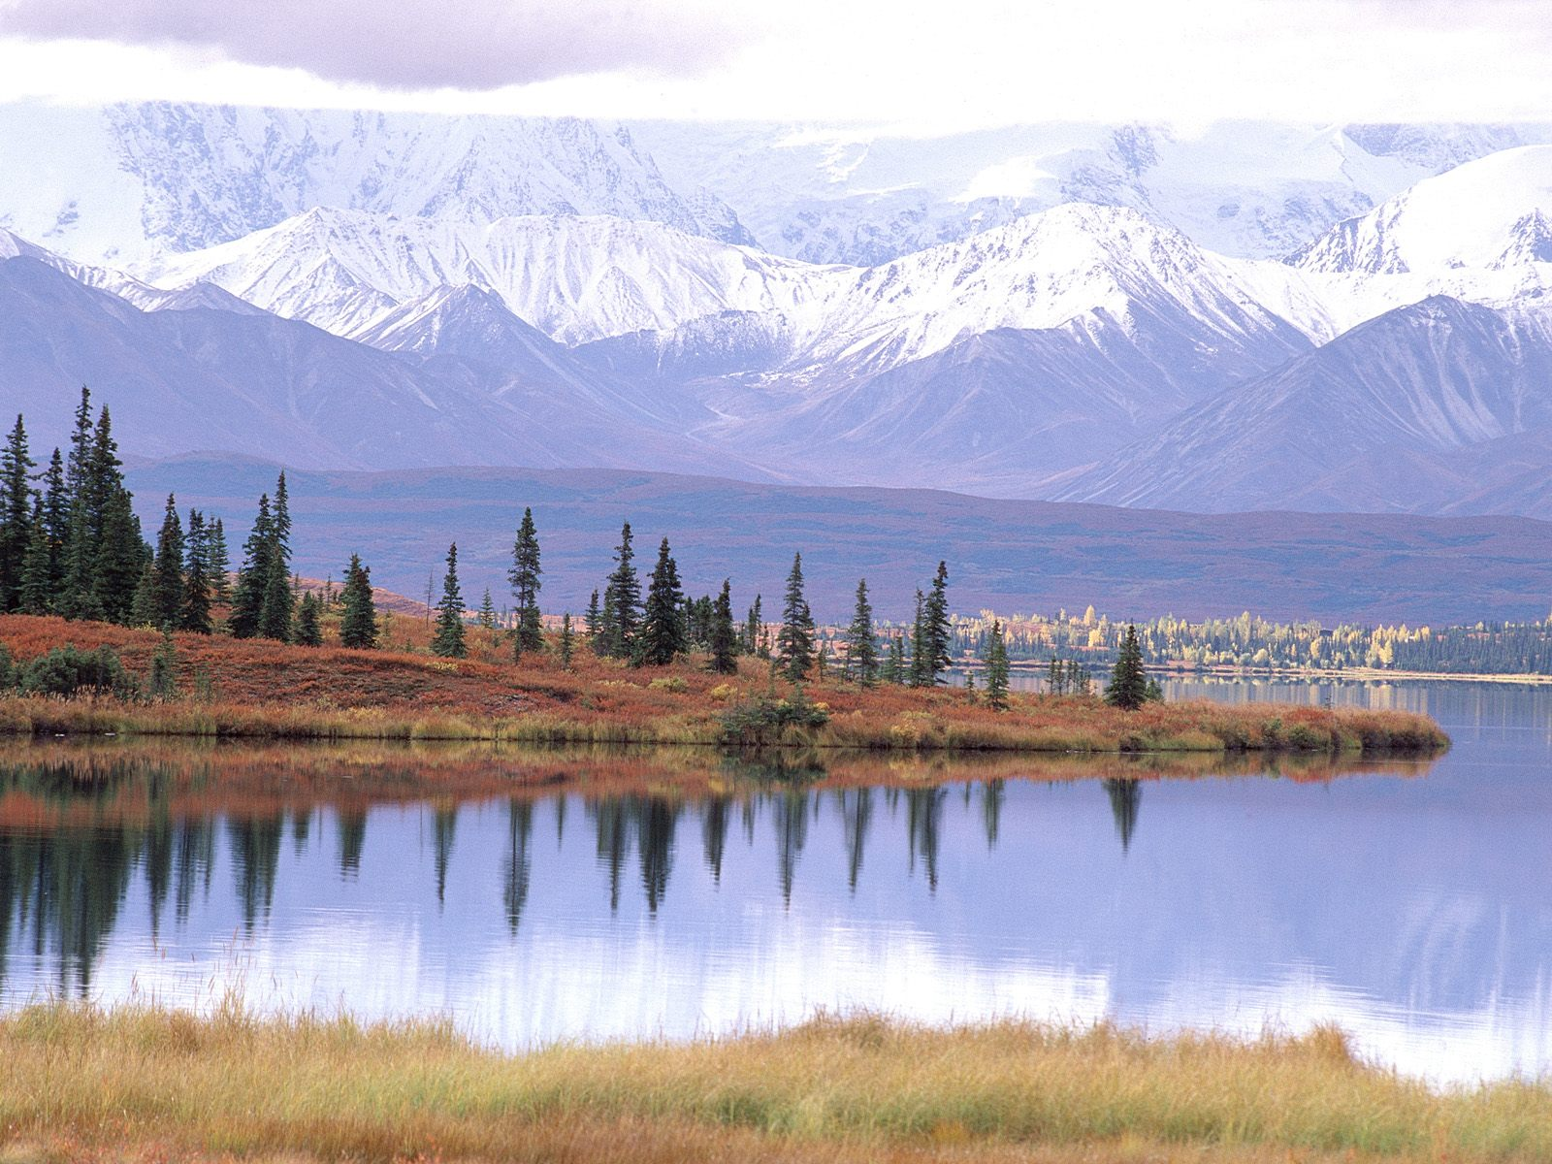
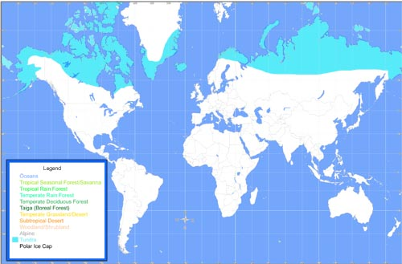
WHERE WOULD YOU FIND THIS BIOME?
Parts of Alaska
Greenland
Iceland
Norway
Russia
Canada

Slide 3
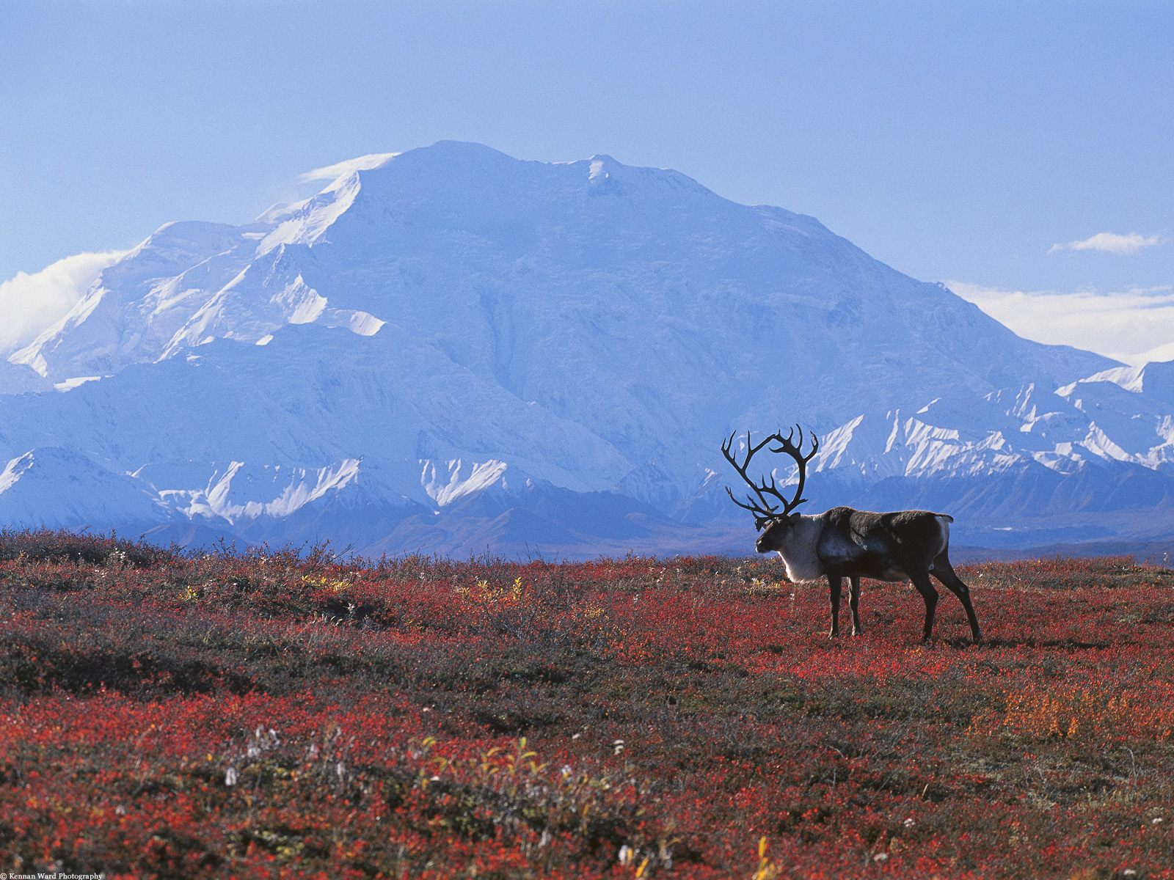
CLIMATE
The Tundra is the worlds coldest and driest biome.
The main seasons in the Tundra are winter and summer, spring and fall have short periods that fall between winter and summer.
During the Winter…
The average annual temperature is -18 degrees Fahrenheit.
There are times when the sun barely rises during winter and during this time the temperature at night can drop to -94 degrees Fahrenheit.
During the Summer…
The sun almost shines 24 hours a day!
Average summer temperatures range from 37 to 60 degrees Fahrenheit.

Slide 4
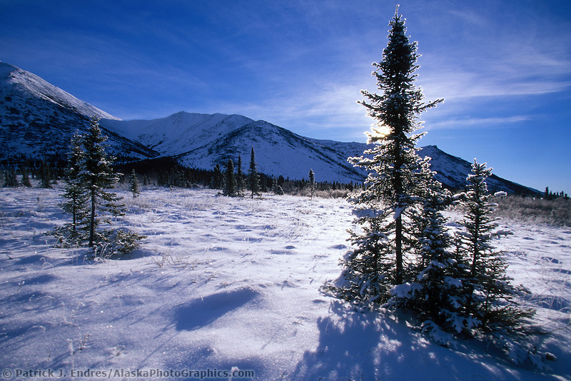
PERCIPITATION
Only about 6 to 10 inches of snow fall every year.
If areas of the tundra are closer to the ocean or other large bodies of water there can be up 20 inches of snow per year.
Below the soil is a frozen layer called the permafrost.
During the summer the permafrost softens to let the plants come up and reproduce. Causing the melting water to form lakes and marshes.

Slide 5
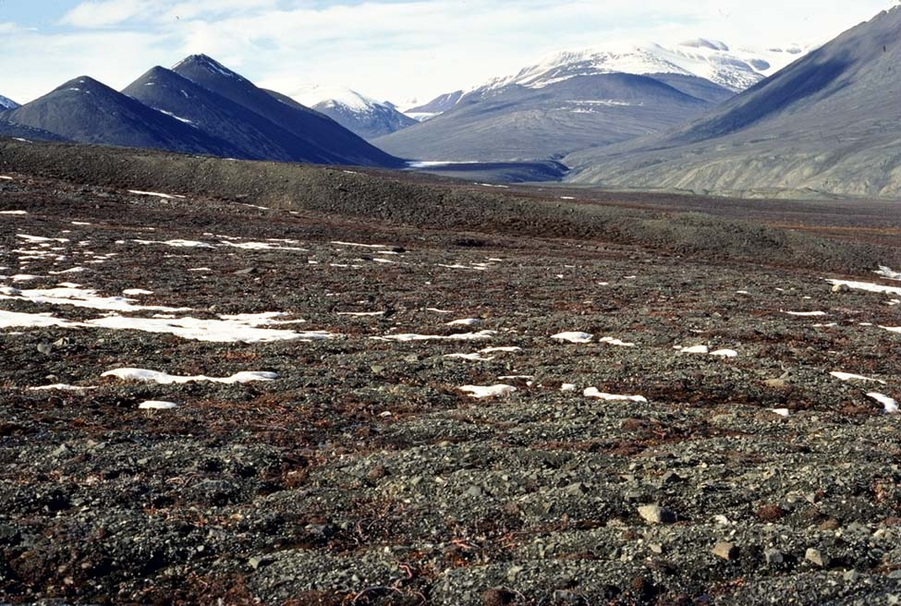
Soil Quality
Tundra has a poor quality of soil.
The poor quality of soil causes the soil to be very low in nutrients and minerals hindering a variety of vegetation.
The soil becomes frozen due to the cold temperatures of tundra causing the plants to not grow there roots deeply into the ground.
For plants to grow in the tundra, they have developed thick roots over thousands of years to survive with the poor quality of soil.

Slide 6
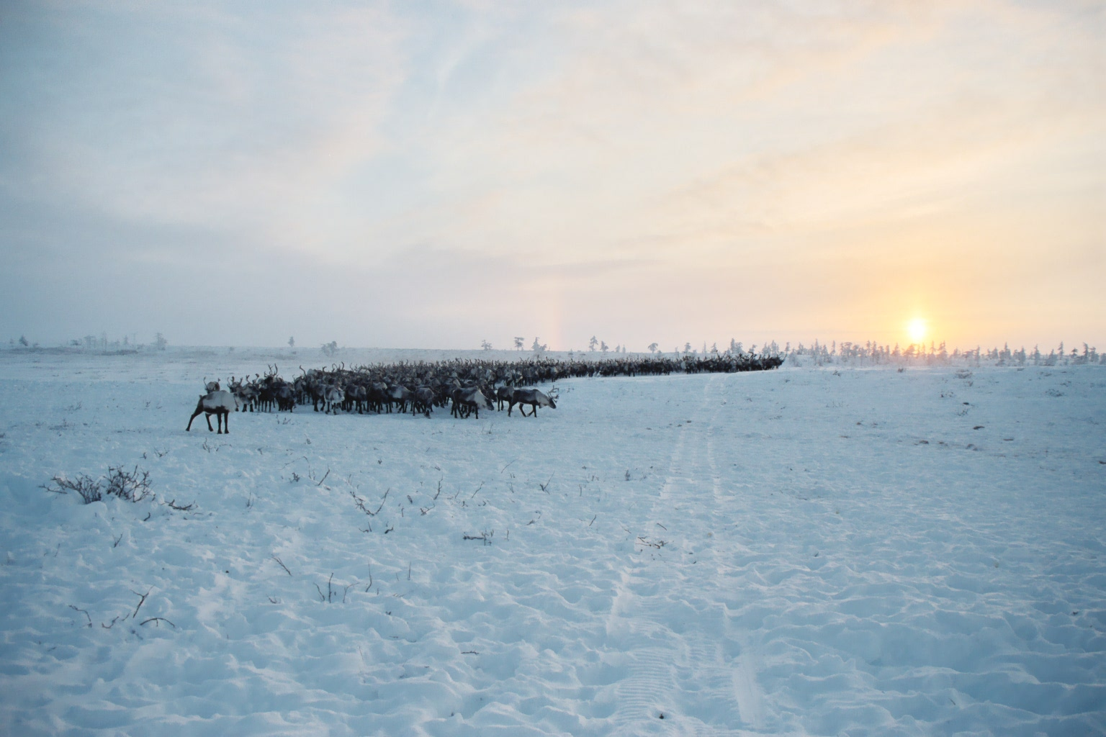
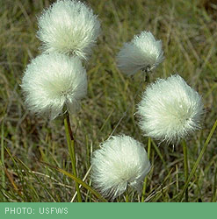
VEGETATION
Examples of vegetation:
Cotton Grass
The frozen soil causes not many trees to exist as there is not enough nutrition available for trees to take up.
The average hieght of the plants is 3 inches, and the growth period is very short for plants: 45 to 90 days.

Slide 7
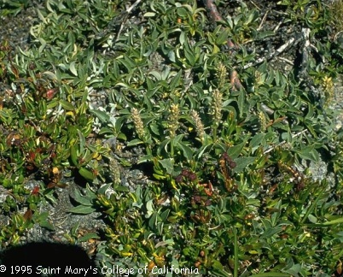
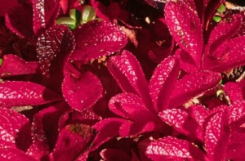
Artic Willow
Purple Saxifrage

Slide 8
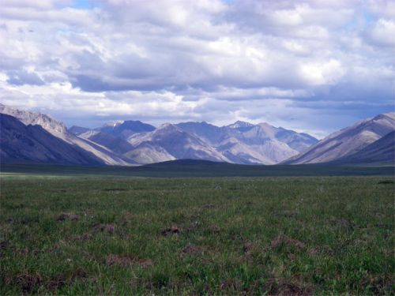
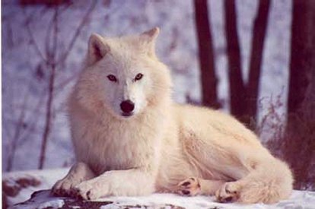
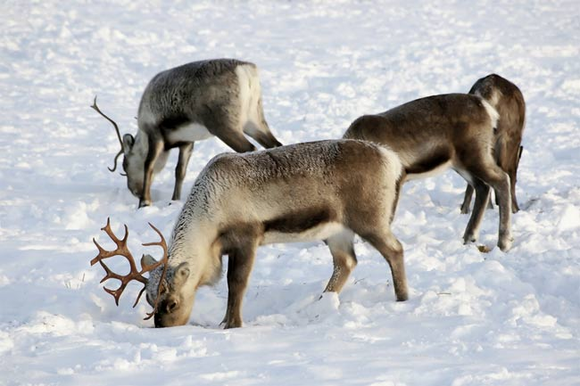
ANIMALS
Tundra Wolf
Polar Bear
Reindeers

Slide 9
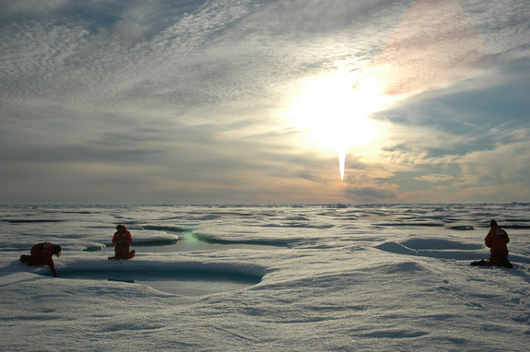
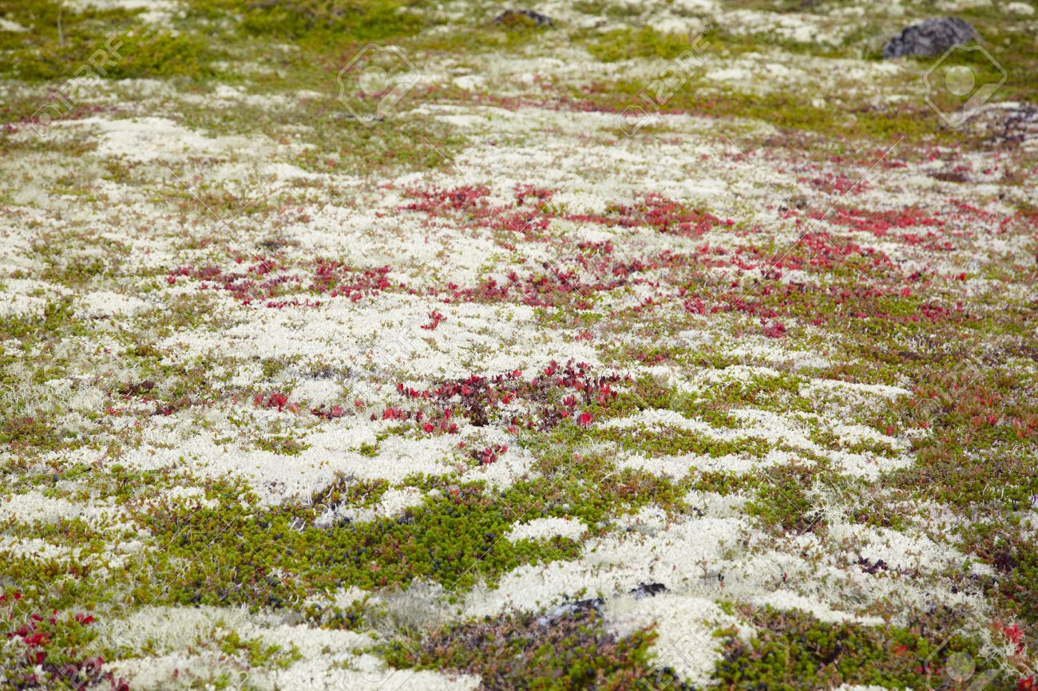
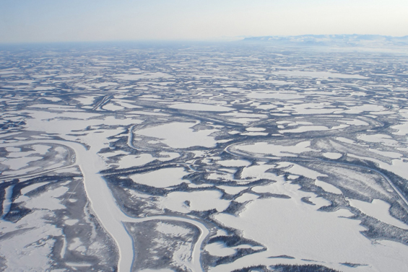
HOW TUNDRA IS BEING AFFECTED BY CLIMATE CHANGE?
As the temperature is increasing, more snow is melting, leading to areas in the tundra biome which originally only contained small shrubs to now have trees generating.
As permafrost melts carbon is being released, the carbon has been trapped in these frozen sheets of ice for thousands of years. The increase in temperature is causing them to melt and become a carbon contributor.
Smog clouds caused by air pollution are contaminating lichen which is a significant food source for many animals in the tundra.

Slide 10
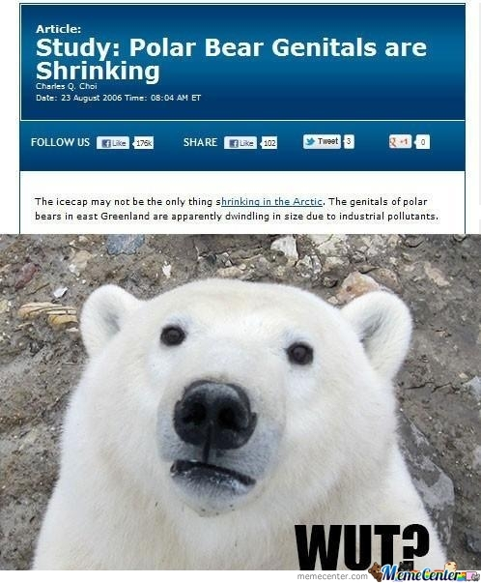
INTERESTING FACTS
Tundra is the youngest biome, it formed 10, 000 years ago!
The word tundra comes from a Finnish word tunturia meaning treeless land.
There are days when the sun shines for 24 hours.
The tundra biome covers about 20% of the Earths surface.
Plants in the tundra biome often grown in clusters to help protect themselves from the harsh winter winds.

Slide 11
CITATIONS
http://traveltips.usatoday.com/cities-tundra-100001.html
http://environment.nationalgeographic.com/environment/habitats/tundra-profile/
http://www.blueplanetbiomes.org/tundra.htm
http://www.blueplanetbiomes.org/tundra_climate.htm
http://tundralpine.weebly.com/soil.html
http://www.aitc.sk.ca/saskschools/arctic/Aplants2.html
http://environment.nationalgeographic.com/environment/habitats/tundra-threats/
http://www.softschools.com/facts/biomes/tundra_biome_facts/171/

