Slide 1
Tropical Rainforest
By: Bukurie and Desire

Slide 2
The Amount of precipitation
Precipitation occurs frequently
Annual precipitation is greater than 150 cm
Although, there are seasonal patterns in precipitation that depend on when the ITCZ passes overhead
50% of precipitation comes from its own evaporation
FUN FACT!
Most of the rain that falls on the rainforest, never reaches the ground because the leaves act as a shield

Slide 3
Temperature! (fuego or no?)
There are warm temperatures and abundant rainfall therefore productivity is high leading decomposition to occur rapidly
Average temperature is 77 degrees Fahrenheit, the temperature is about the same all year long
Never drops below 64 degrees Fahrenheit… so you’ll always be toasty and warm, THANKS SUN!
This is because it’s located near the equator
If the rainforest was cooler all the plants would die out...OH NO!!!!!

Slide 4
Soil quality
Lush vegetation takes up all the nutrients, leaving few to accumulate into the soil
The high rate of decomposition causes the soil to lose its fertility which means farmers have to keep moving for newly deforested areas
24,000 ha is cleared each year for agriculture
Rain has also washed most of the nutrients out of the soil
Therefore, soil here lacks nutrients :(

Slide 5
Vegetations you would find here
⅔ of the world’s plant species are found here
These are the levels of vegetation;
Shrub layer- with very little vegetation between the trees
Under canopy- limited sunlight here
Canopy- the upper part of trees, birds and insects live here
Emergents- top of the tallest trees, get a lot of sunlight

Slide 6
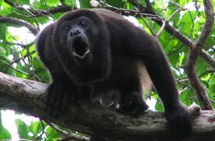
Howler Monkey
Considered to be the loudest monkey in the new world.
Can be heard 3 miles away.
Lives high in the trees. (canopy)
about 20 years lifespan
Diet
mostly leaves
fruits
maggots
(PS: in decline due to habitat loss)

Slide 7
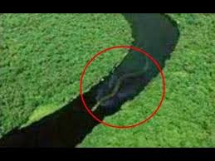
Anaconda aka water boa
Biggest snake in the world
Lives in swampy areas, hidden in shallow water
20-40 babies at once
Diet:
Meat

Slide 8
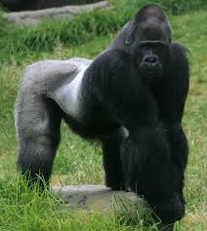
Gorillas/Great apes ;)
Lowland gorillas live in Tropical Rainforests in East & West.
Mountain gorillas live in Dominican Republic of the Congo, Rwanda and Uganda.
up to 30 in a group
1 male, many females, and their offsprings.

Slide 9
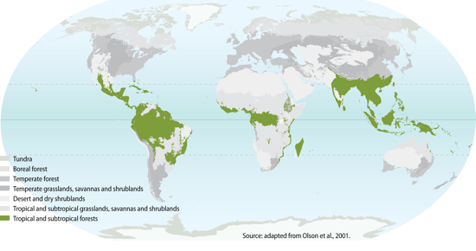
Where is this biome located?

Slide 10
How is climate change affecting this biome?
Due to climate change trees actually become a source of carbon.
due to droughts Trees are are excreting carbon rather absorbing it.
Scientists observed that clouds are forming higher
which is causing the droughts
Increased temperatures it could
influence the spread of disease in the creatures.
more fires and *desiccation*
clouds are forming higher
Evapotranspiration will decline
takes in CO2 from the atmosphere for photosynthesis.
180 molecules of water/CO2
Which is a big factor in creating the clouds (water vapor) *desiccation: the state of extreme dryness*

Slide 11
Interesting Facts About TRopical rainforests :)
One of the oldest Biomes
About ½ of the plants and animals found lives in this biome
Responsible for majority of oxygen production
The droppings of birds grow into plants
insects make up majority of the living creatures

Slide 12
Citations:
http://www.nature.com/news/2009/090305/full/news.2009.136.html
http://e360.yale.edu/feature/the_worlds_tropical_forests_are_already_feeling_the_heat/2397/
http://www.blueplanetbiomes.org/rainforest.htm
http://www.bbc.co.uk/schools/gcsebitesize/geography/ecosystems/tropical_rainforests_rev3.shtml

