Slide 1
SWBAT evaluate how risk management can be improved for nail salon workers.
APES 4/19/16

Slide 2
Agenda:
Close Reading
Socratic Seminar

Slide 3
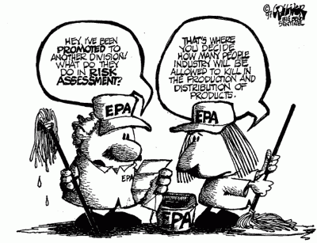
Risk Management

Slide 4
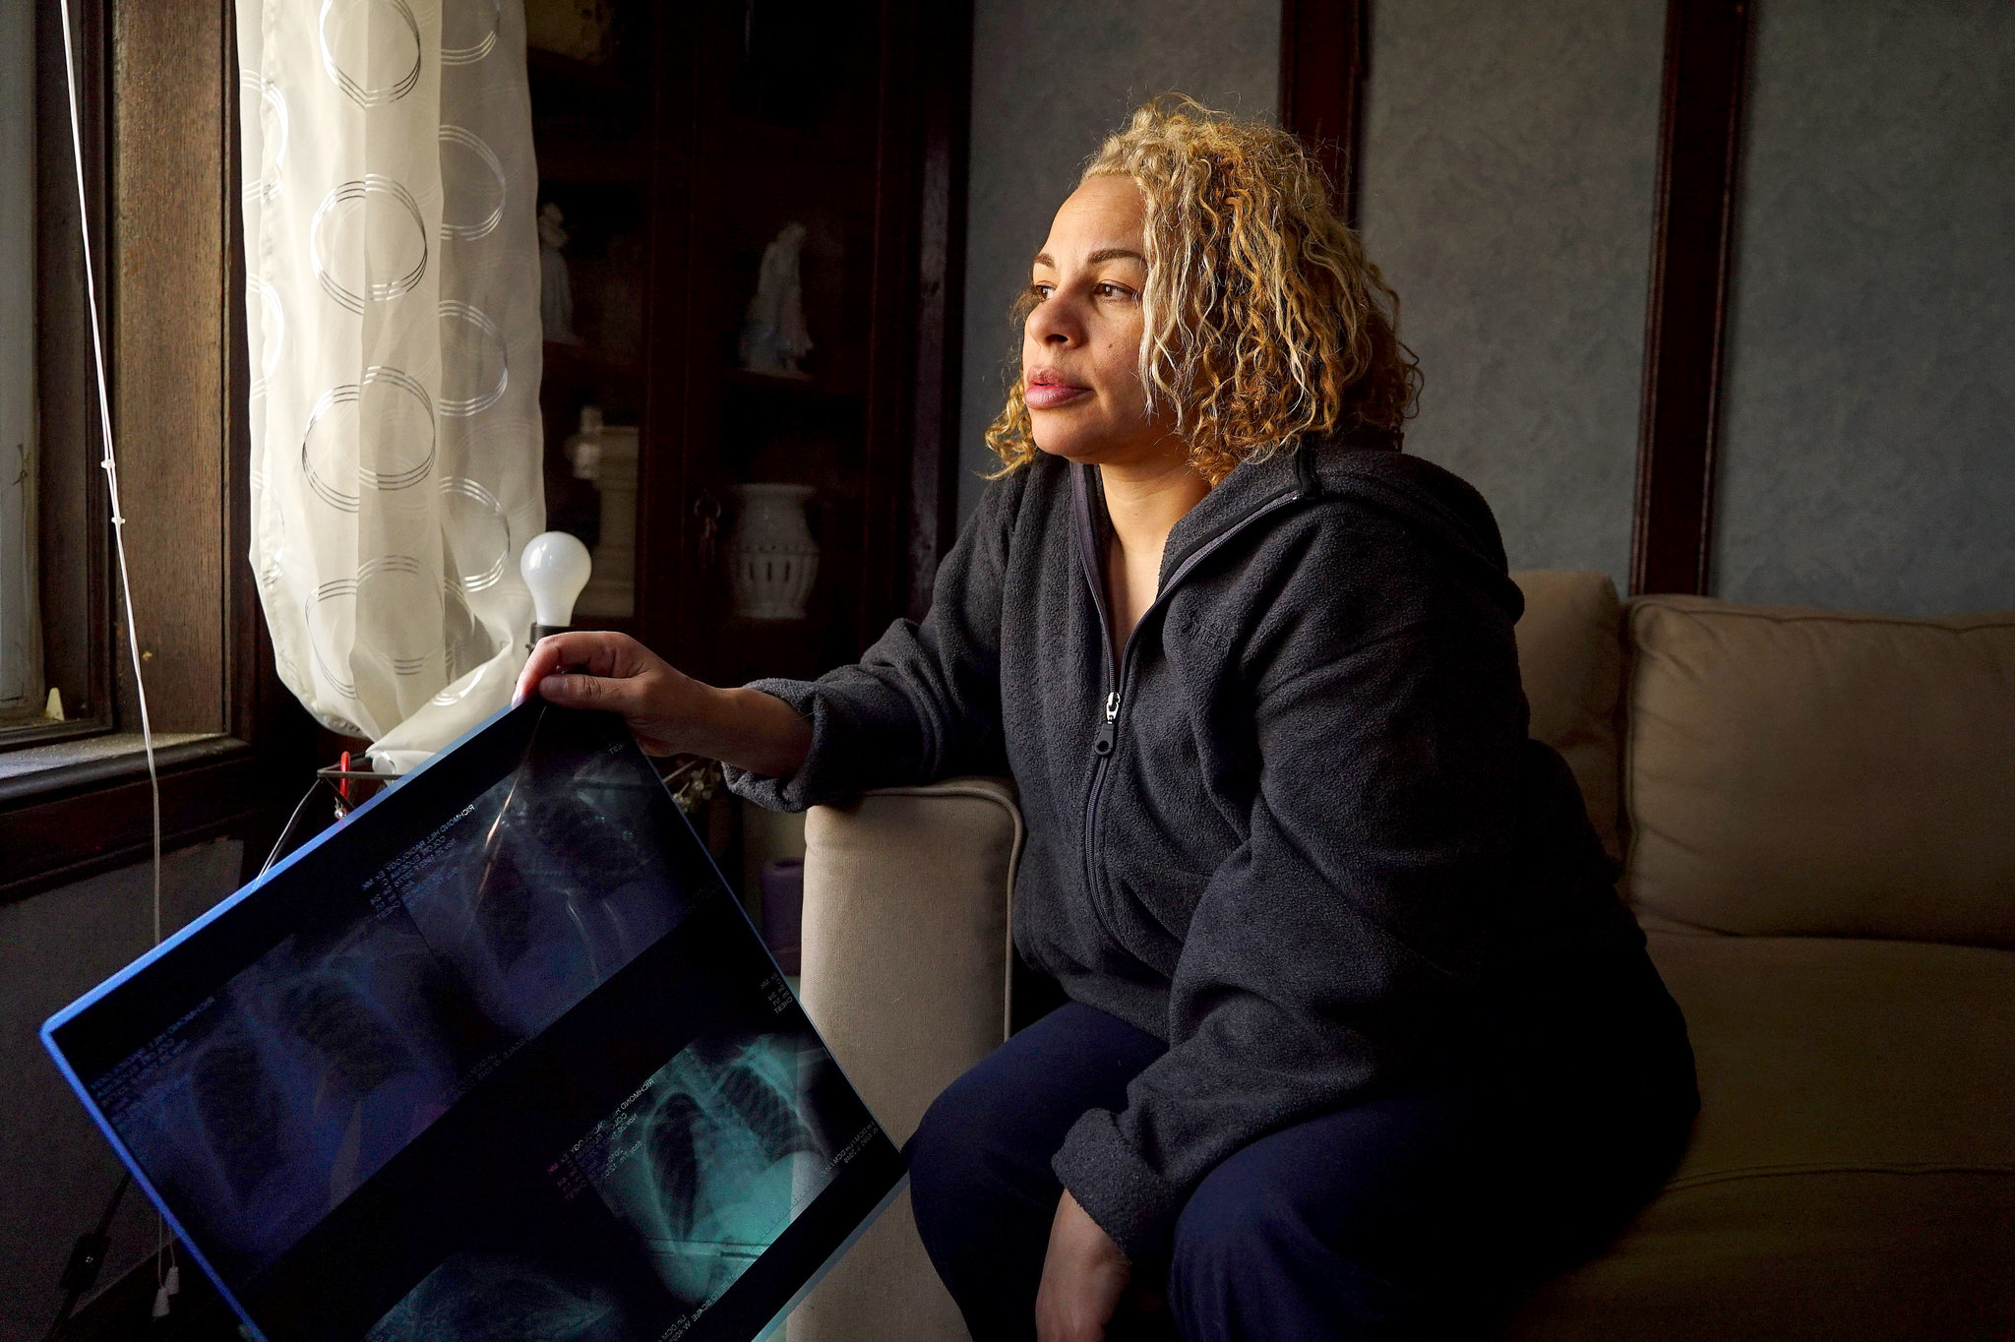
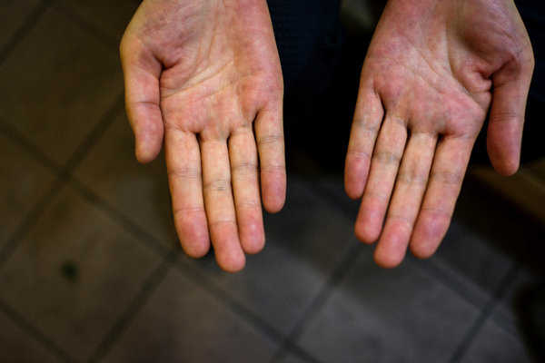
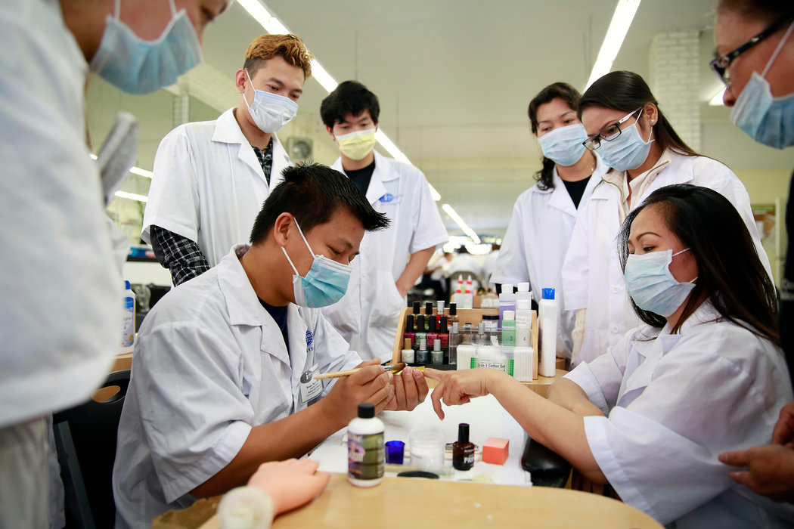
Perfect Nails, Poisoned Workers

Slide 5
Preparation for Socratic Seminar
Underline or highlight two pieces of evidence that you would like to use in the Socratic seminar

