Slide 1
Don’t Drink The Water; It’s Poison
Shayna Neville

Slide 2
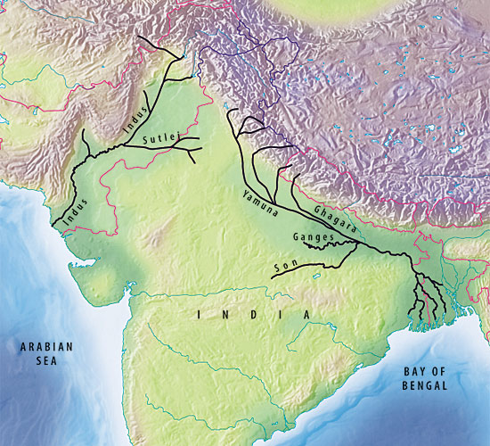
Where?
India to be exact.
The Ganges and Yamuna rivers are two of the world’s most polluted rivers.

Slide 3
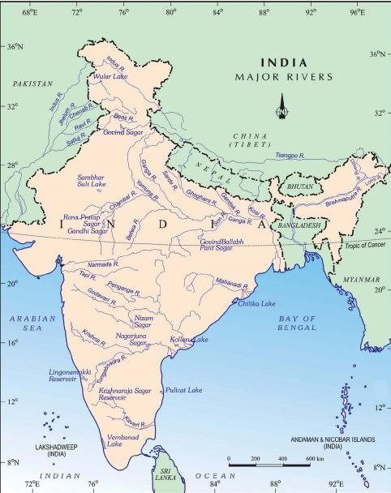
What’s The Issue?
The rivers pollution levels have reached all time highs.
It has come to the point where the water is almost equivalent to poison.
But the real issue is how widespread it is!

Slide 4
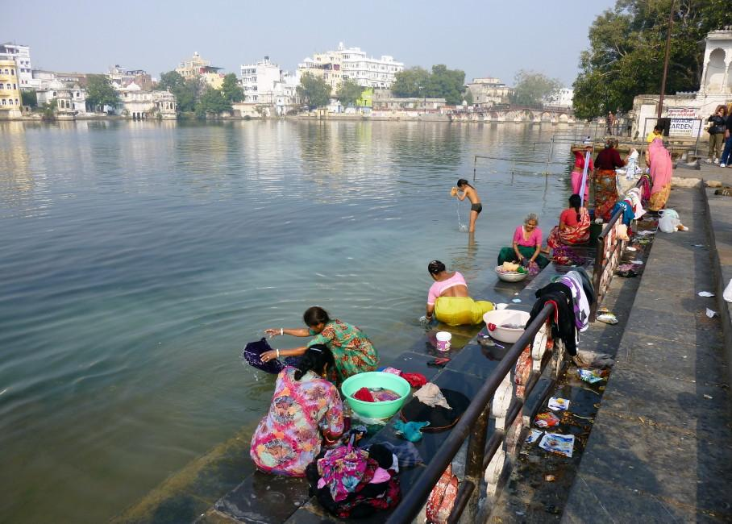
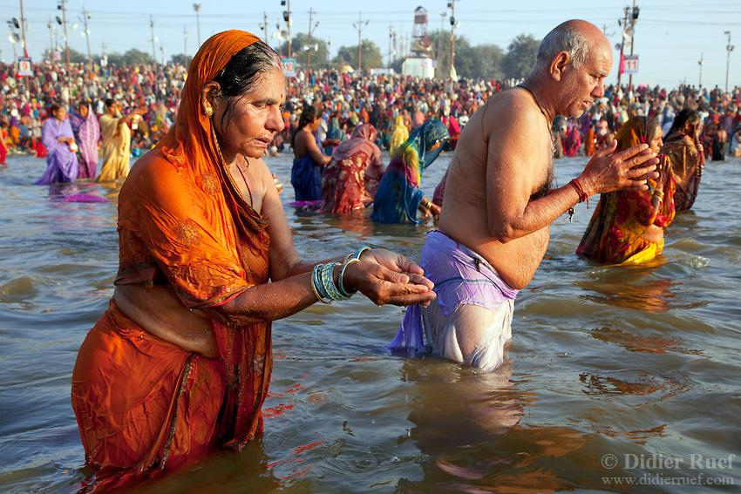
So What’s The Real Problem?
Well, there’s a few hazards to this flowing source of disease and illness:
These rivers are all used by the locals for as a source of water.
Not to mention the Ganges river is considered the holiest river by Hindus.
In fact most who come into intimate contact with the waters will get sick.

Slide 5
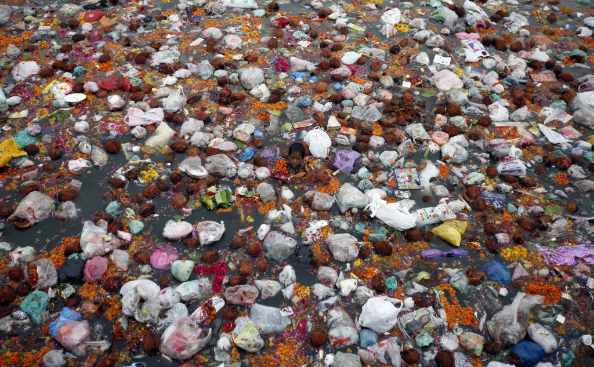
Can You See The Issue

Slide 6
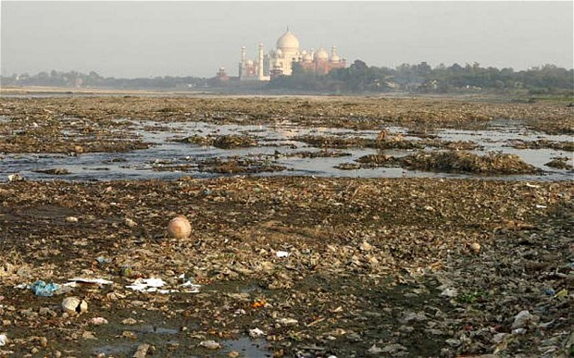

Slide 8
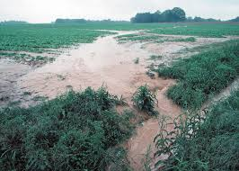
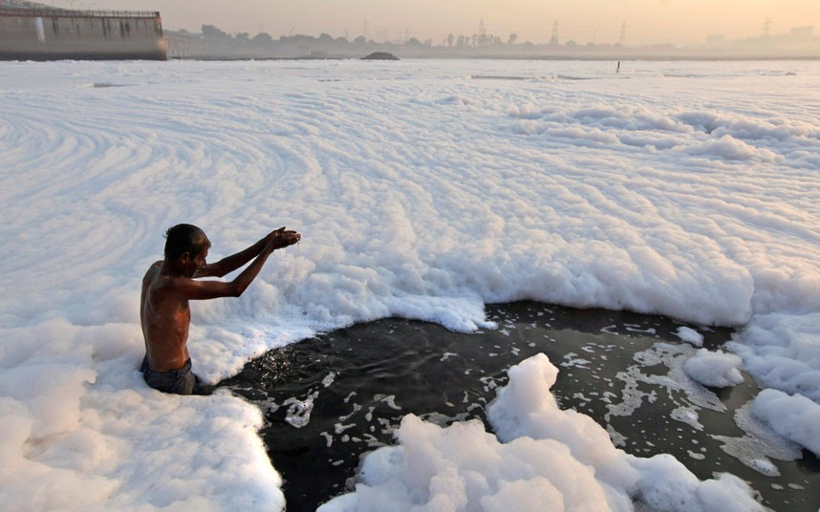
The Source?
Interesting thing about the pollution source, it’s both a point source and a nonpoint source.
Industrial waste-chemical dumping
Urbanization- no treatment
Agricultural Runoff- fertilizer
Religious Purposes- Holy River

Slide 9
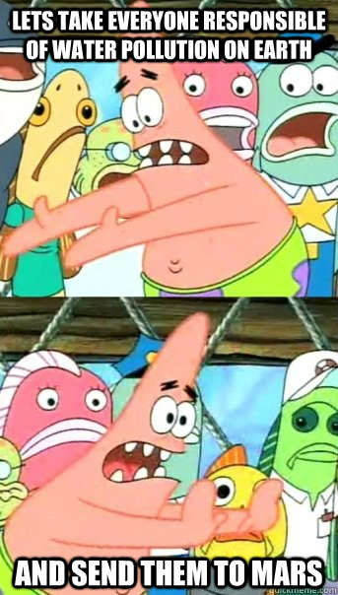
Can We Fix It?
They plan to reduce water waste by using a more a more efficient irrigation technique.
There has been talk about implementing a legislation that prevents pollutants from being dumped into the waters.

Slide 10
Sources
http://www.yourarticlelibrary.com/water-pollution/5-major-causes-of-water-pollution-in-india/19764/
http://www.yourarticlelibrary.com/rivers/the-yamuna-river-case-study-of-a-polluted-river-in-india/31894/
http://www.dw.com/en/indias-polluted-ganges-river-threatens-peoples-livelihoods/a-17237276
http://timesofindia.indiatimes.com/home/environment/pollution/80-of-Indias-surface-water-may-be-polluted-report-by-international-body-says/articleshow/47848532.cms
http://www.dailymail.co.uk/news/article-2240307/An-industrial-bubble-bath-Hindus-dive-foam-coated-polluted-Yamuna-River-pray-new-moon-ritual.html
http://www.huffingtonpost.com/2013/03/05/india-river-pollution-sewage_n_2810213.html
http://wwf.panda.org/about_our_earth/about_freshwater/freshwater_problems/river_decline/10_rivers_risk/ganges/ganges_solutions/
http://www.gangaaction.org/actions/issues/

