Slide 1
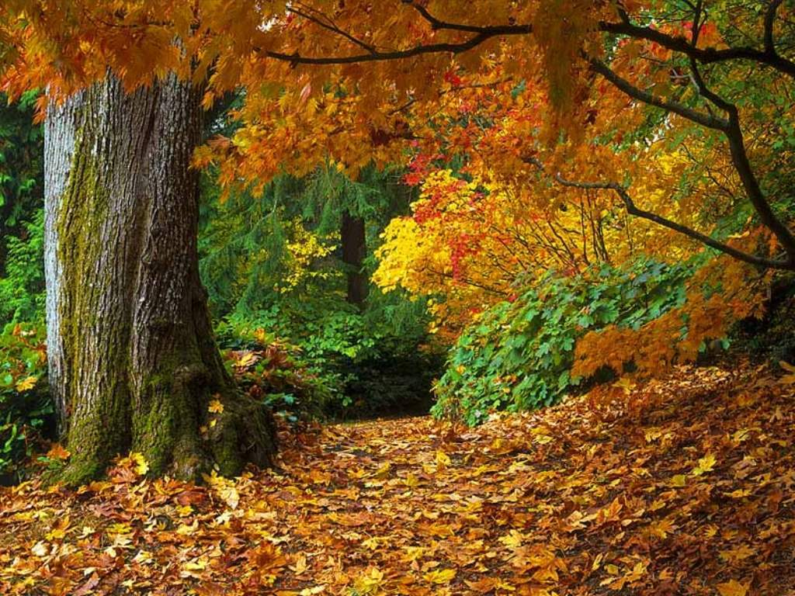
Paradise For lovers of the seasons
By: Cynthia Crichlow

Slide 2
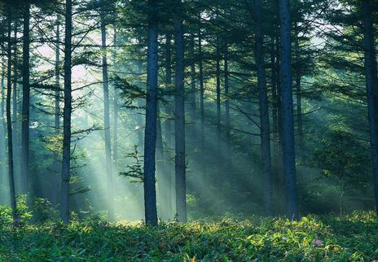
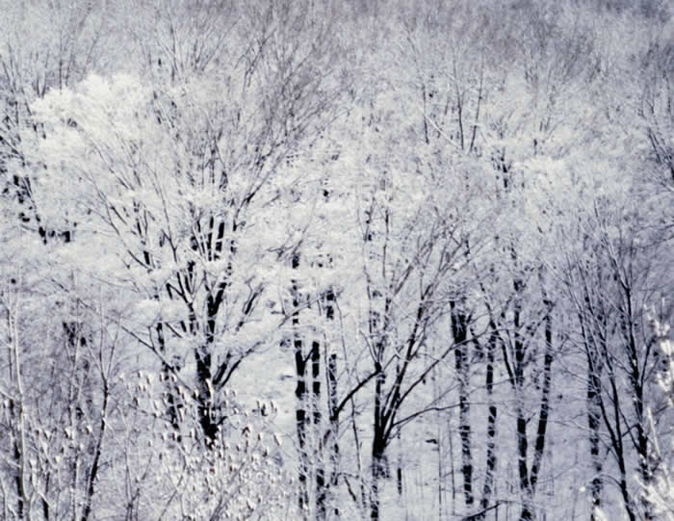
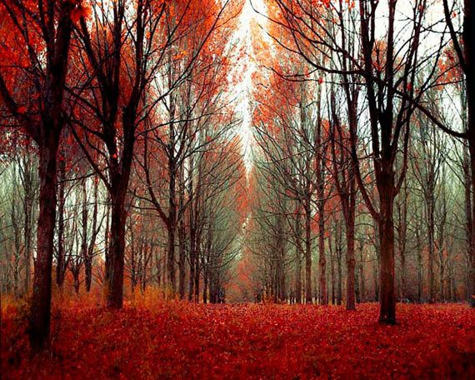
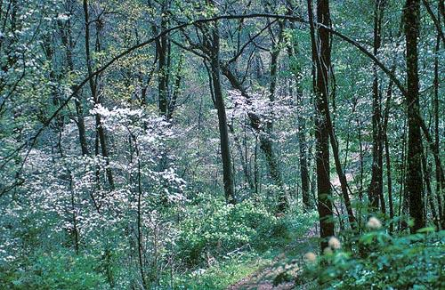
Close your eyes for a minute Go through all the seasons Experience it all See the world change around you

Slide 3
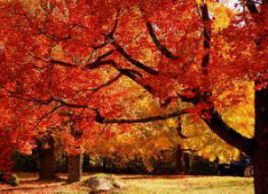
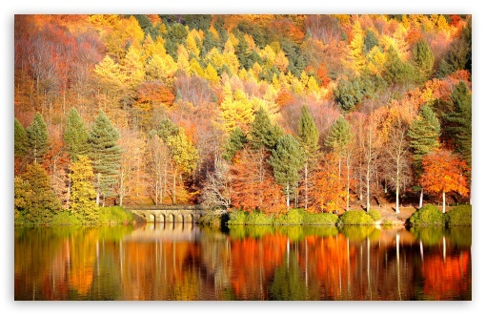
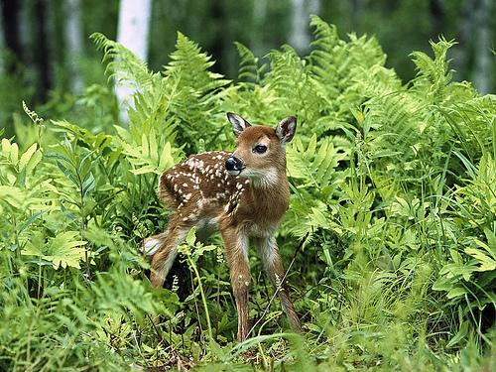
“WHAT BEAUTIFUL PLACE CAN THIS BE?” YOU MUST BE THINKING.
TEMPERATE DECIDUOUS FOREST

Slide 4
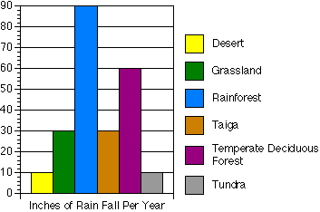
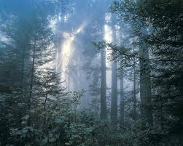
Climate
Always changing (seasonal)
Winter, summer, spring and fall
30in – 60 in per year (2.5ft-5ft)
Changing because of the burning of fossil fuels.
Average temp: 50 degrees Fahrenheit
Have cold winters
Warm summers

Slide 5
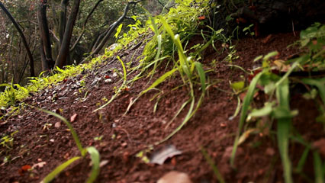
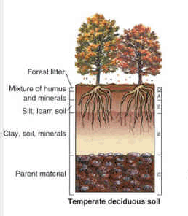
Soil Quality
Not that good for farming
Soil is only good for the plants that are there
Organic matter in soil is taken up by the trees and plants

Slide 6
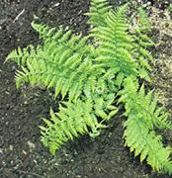
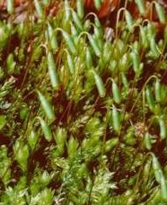
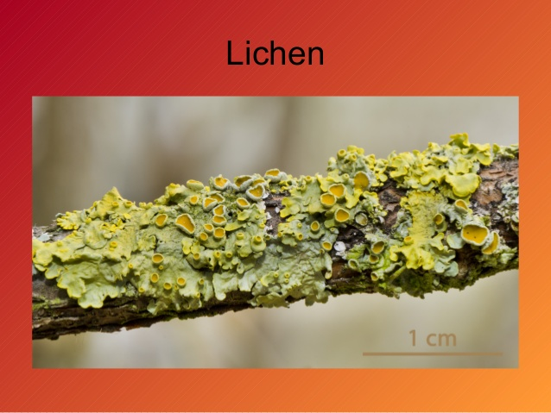
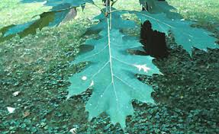
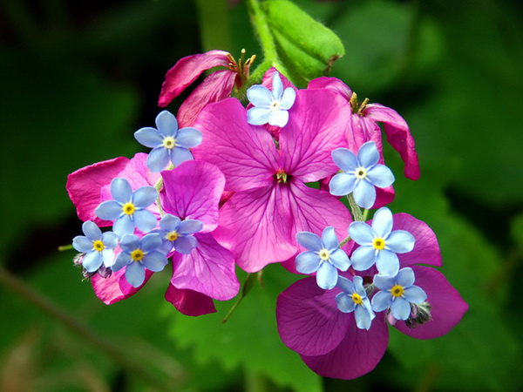
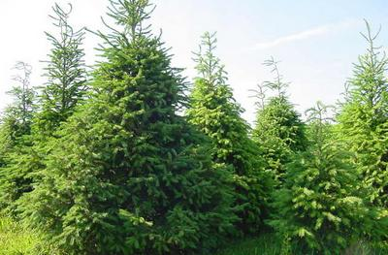
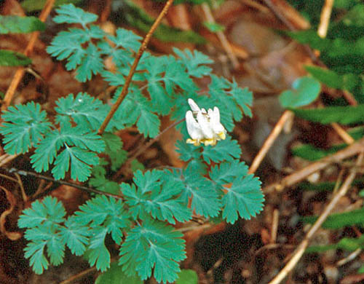
Beautiful plants
The seasons change and so do the color of the leaves. During winter the water freezes so there is not enough water to keep the leaves of the plants alive. This causes the leaves to fall off.
THERE IS AN EXCEPTION TO THIS!
Evergreens
They have special adaptations.
Has a great variety of plants. They have 3 levels of vegetation:
Floor: lichen, moss, fern, Misha green sunflower
Middle: Shrubs
Third level: Maple, oak, and breech
FUN FACT:
The trees provide shelter for the animals (provide food and water. Because of this reliance trees have thick barks to keep the animals from damaging their bark and killing the tree.

Slide 7
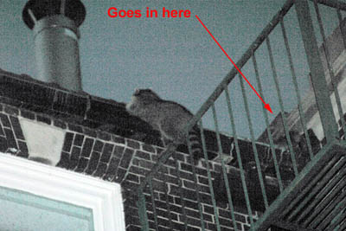
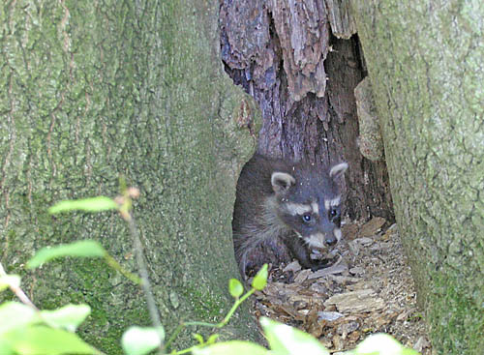
FOREST FRIENDS!
Many friends in the forest.
Never feel lonely because you are surrounded by these little critters
Raccoons-
For when you are extremely lonely. They sneak right up into your home and stay to cuddle up all cozy with you.

Slide 8
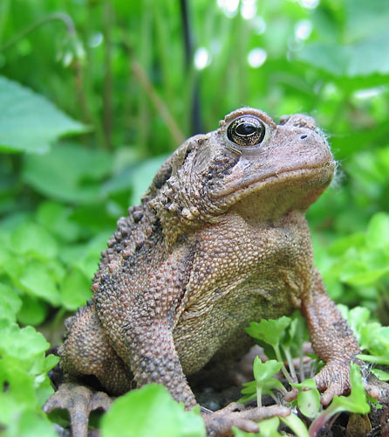
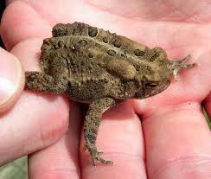
American toad
Clean up, eat dead fallen leaves, depend on the forest floor to survive, unlike many amphibians.

Slide 9
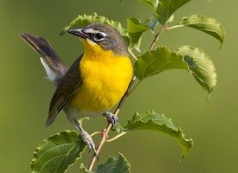
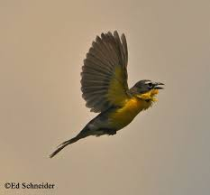
Yellow breast chat
Migrate to Central and South America during the winter up north.
They sing

Slide 10
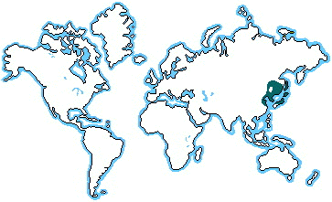
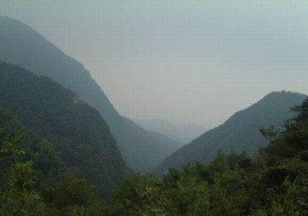
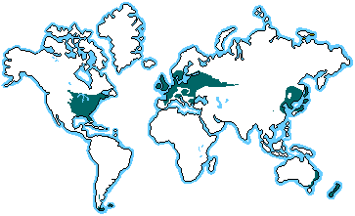
So where can you find this beautiful forest
Eastern Canada
Eastern Unites States
Most of Europe
Parts of Asia (Korea, China, Russia and Japan)

Slide 11
Links
http://www.nhptv.org/natureworks/nwep8c.htm
http://earthobservatory.nasa.gov/Experiments/Biome/biotemperate.php
http://ths.sps.lane.edu/biomes/deciduous3/deciduous3.html
http://www.marietta.edu/~biol/biomes/tempded.htm
http://www.blueplanetbiomes.org/deciduous_plant_page.htm

