Slide 1
Temperate Rainforest...
Wendy Carmona

Slide 2
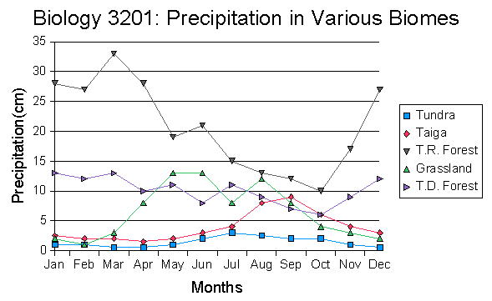
Precipitation
At least 200 centimeters of precipitation
In warmer areas it can have up to 350 centimeters
Can be in the form of rain or snow
However it is most likely to see snow in higher elevations

Slide 3
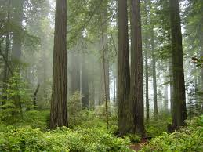
Temperature
Often located near the ocean
Therefore the average annual temperature is 32°F
And in warmer parts it is 68°F

Slide 4
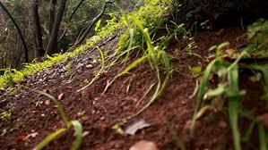
Soil Quality
Dark and damp
Has less biodiversity than rainforest, and in rainforest trees have stretched out roots that cause them to take up all the nutrients.
Plants in temperate rainforest do not do this.
Therefore the soil in temperate rainforest is much richer.

Slide 5
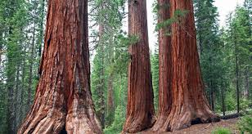
Vegetation found in this biome
Coastal redwood
Extremely tall
roots 100 ft or more - helps stay stable in case of winds or floods
Fog helps them survive

Slide 6
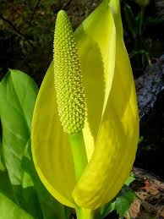
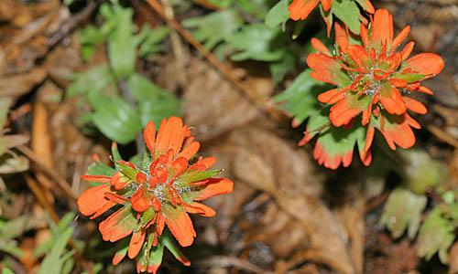
More plants...
Indian Paintbrush Western skunk cabbage (Attracts animals to pollinate it, roots food for bears, as medicine for burns, food

Slide 7
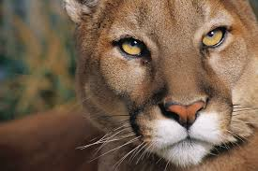
Species found here
Mountain lions
Eat animals like deer and elk
Hunt at dusk or dawn for the most part
Sometimes they keep the remains of their prey and eat it over a couple of days.

Slide 8
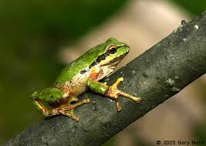
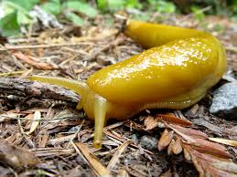
More species
Pacific tree frogs Banana Slug

Slide 9
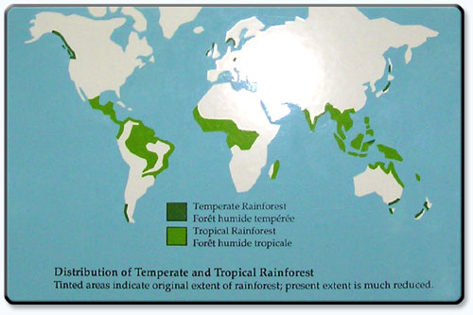
Where this biome is found
Northern pacific coast
Chile
South America
Japan
Australia

Slide 10
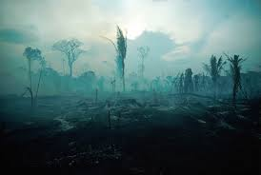
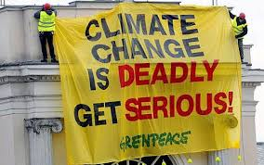
How it is being affected by climate change
many species can not handle high temperatures
die, adapt or migrate
the trees manage warmer temperatures good (growth speed)
precipitation shifts such as severe rain and flooding
this can destroy forest

Slide 11
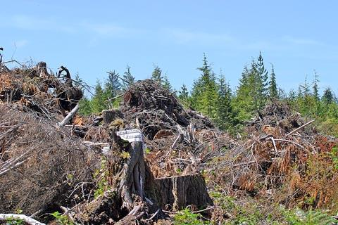
Interesting facts about this biome
“The value of timber is proportionate to their size”.
major threat
steep mountain slopes
soil erosion

Slide 12
Sources
http://www.marietta.edu/~biol/biomes/temprain.htm
http://temperaterainforestelynam.weebly.com/temperature.html
http://temperate-rainforest-facts.com/Temperate-Rainforest-Biome/Temperate-Rainforest-Soil.shtml
http://education.seattlepi.com/type-effect-global-warming-temperate-forests-4689.html
http://www.wildernesscollege.com/temperate-rainforest-plants.html

