Slide 1
Precipitation/Temperature
around 10 in annually
High
Ranges between 21-32 degrees celsius
Air can be dry at times

Slide 2
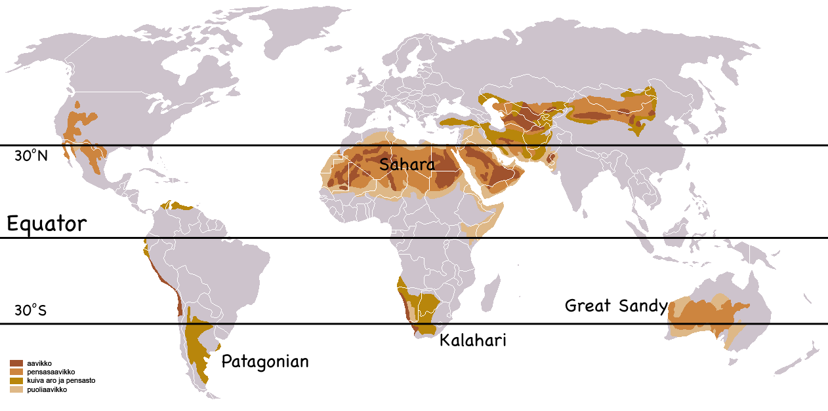
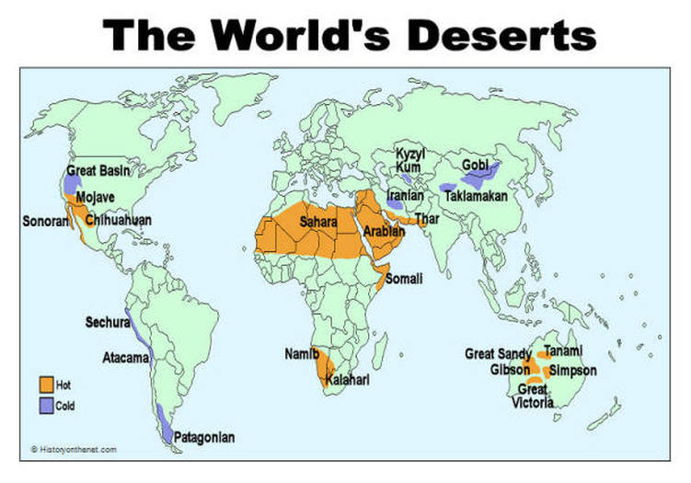
Where

Slide 3
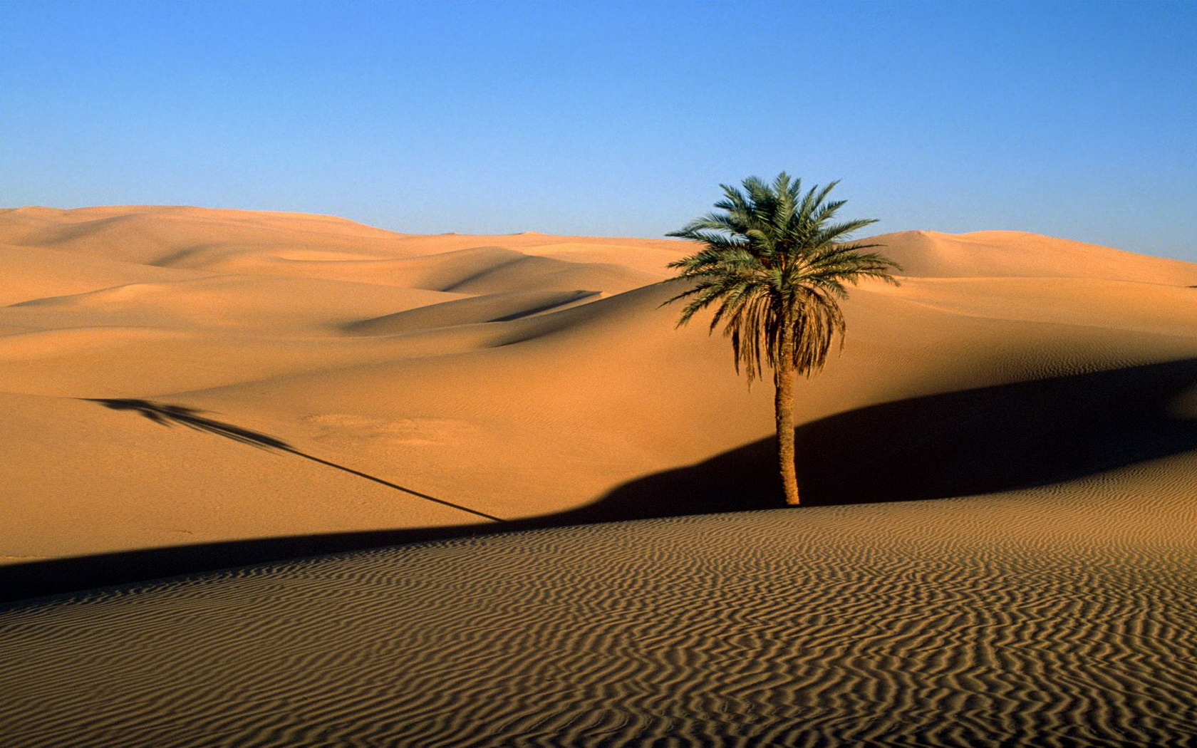
Soil
Does it look like there’s any soil there?
It’s all sand

Slide 4
Vegetation
Saguaro Cactus
Fishhook cactus
Trichomes

Slide 5
Animals
Dromedary Camel
Rock Hyrax
Zebra Tail lizard

Slide 6
Effect of Climate Change
Spread of desert
Article written in 2009 predicted spread of conditions between 138-338 miles
Spread of tropical diseases such as dengue fever which is spread by tropical mosquitoes and could eventually lead to death in extreme cases .

Slide 7
Facts
The driest desert on earth receives about 1 cm of rainfall every 5 to 20 years
There is a desert biome on every continent except for Europe
If you want water from a cactus, take a machete with you and don’t drink from the wrong species otherwise you get diarrhea and headaches
More safe to drink from a Pear Cactus

