Slide 1
Starfish Committing Suicide?
By Desire Priddie
WHAAAT?!

Slide 2
What is the issue?
Millions of starfish are dying due to a disease.
Named Sea Star Associated Densovirus
Which makes sea stars kill themselves
White lesions start appearing
then their arms start spreading outwards
eventually the starfish's body explodes spilling out their internal organisms.
This virus has been around for 70 years.
“The Wasting” ( starfish ) has been happening for at least 2 years.

Slide 3
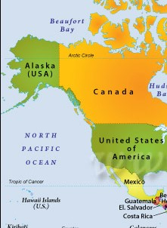
Where in the world?
on the Pacific Coast
from Mexico to Alaska

Slide 4
Why does it matter?/ Environmental concerns
This is very unusual.
This epidemic isn't allowing starfish to regenerate their limbs.
They are predators:
mussels
clams
sea cucumbers
other starfish
Could be a sign of unhealthy ecosystems
definitely change the seascape.
Scientist believe that increased water temp. is a cause

Slide 5
Social / Economic concerns
No one really knows why this is happening.
Therefore, there isn’t an answer on how this epidemic would hurt human health, social structure or quality of life.
For now it’s more of a waiting process. Scientist believe it’s too soon to really understand the causes.

Slide 6
What’s being done to help?
An app
iNaturalist : helps allow people upload pictures of any starfish and scientist will able to take this photo and get information to help keep track.
about 2,000 observations to help endangered starfish

Slide 7
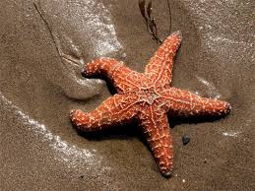
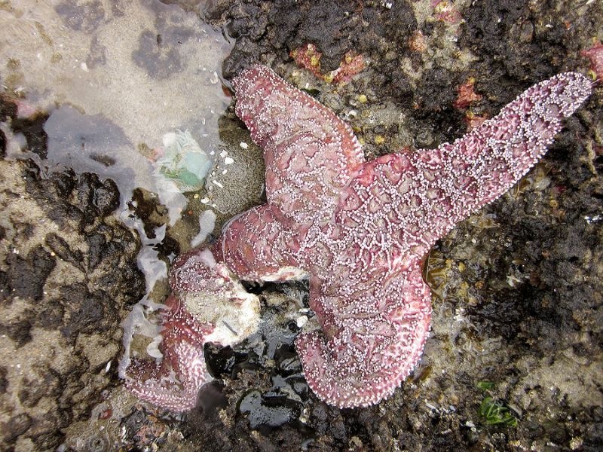
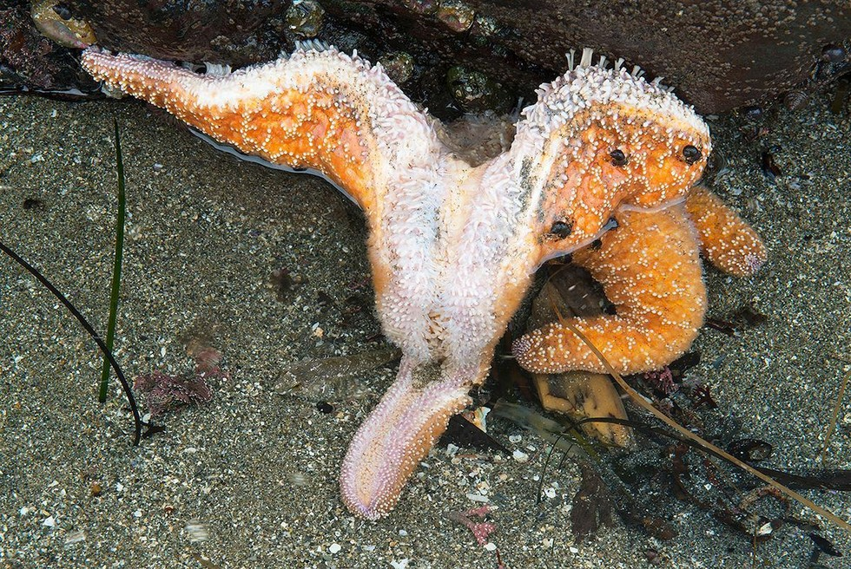
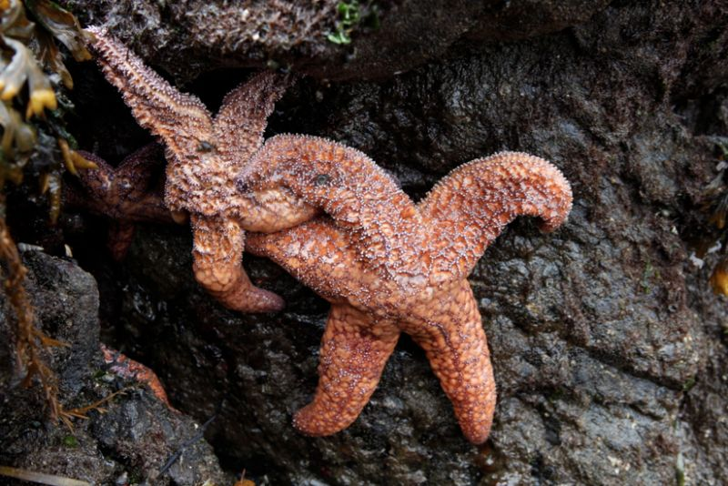

Slide 8
Sources
http://www.pbs.org/newshour/bb/mysterious-epidemic-devastates-starfish-population-pacific-coast/
https://www.yahoo.com/travel/starfish-committing-suicide-on-west-coast-how-can-033558804.html
http://www.dailymail.co.uk/news/article-3297102/Millions-starfish-Pacific-coast-dying-mysterious-disease-causes-sea-stars-essentially-devour-themselves.html *** VIDEO : http://www.dailymail.co.uk/video/news/video-1063482/Mysterious-disease-turning-starfish-goo-Canadian-coast.html

