Slide 1
Tropical Seasonal Forest/Savanna …… Open House!
Real Estate Agent: Harmanpreet Kaur (contact information will be given out at the end) Please keep in mind that I need my commission!!!

Slide 2
Do you like staying in warm temperatures? Would you like to have cool summers? Then, Tropical Seasonal Forests/Savanna is your hot spot dream destination!

Slide 4
Amount of precipitation
Rainfall is seasonal , most of it falling from May to November. May is both the end of the dry season and the wettest month of all.
The seasonal movement of the ITCZ tracks most of the intense sunlight , which passes overhead and drops precipitation only during the summer.
Trees produce new leaves during wet seasons
Tropical Deciduous Forests
Low amounts of precipitation – constrains plants from using soil nutrients released
Varies from less then 50 cm per year to over 300 cm per year
Savannas occupy dryer part of the range

Slide 5
Temperature Range
Average annual temperatures are over 20 degrees Celsius.
Wet and dry seasons
Cooler summers

Slide 6
Soil Quality
Trees naturally recycle their leaves, which makes the soil of good condition and of good quality.
BUT….. Due to deforestations (Sorry for the inconvenience caused by humans… there are just too many of them in the world!) , the soil loses its rich quality because the trees aren’t there to hold them together.

Slide 7
Savannas
Areas that experience moderately long dry seasons that support shrubs and trees that have high density levels.
It leads to the formation of savannas, which are open landscapes filled with grasses and deciduous trees
Deciduous Trees are trees that lose their leaves seasonally.

Slide 8
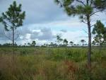

Slide 9
Vegetation
The deciduousness of the tree species is one of the most significant difference in the tropical forests. In this zone, a lot of evergreen trees become deciduous.
Droughts- when it’s extreme, trees become less dense.
Lianas are less common in tropical forests and don’t have important growth form.
Lianas are long-stemmed, woody vines that are at ground level soil and use trees to access well-lit areas of the forests.

Slide 10
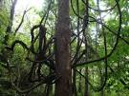

Slide 11
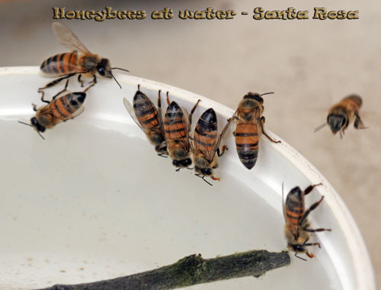
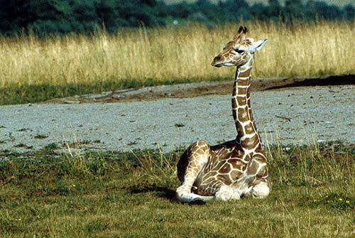
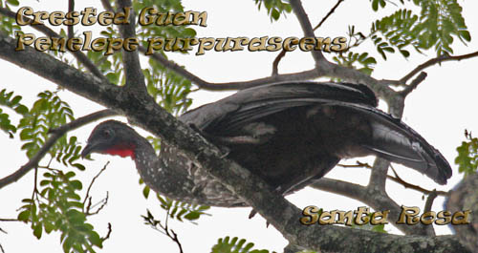
Let’s talk about your neighbors!
Honeybees (Costa Rica)
Giraffes (Ohio)
Crested Guan (Costa Rica)

Slide 12
Where in the world do you find these types of biomes?
Common in much of Central America, Atlantic Coast of South America, southern Asia, Northwestern Australia, and sub-saharan Africa
Mexico, Brazil,
Argentina, India

Slide 13
Climate Change (sorry☹)
Cause shorter life spans of our species ( We’re sorry that you won’t have any friends!... And you might have to die alone!)
Trees are trying to migrate upslope- it might sound as good news but they will soon run out of places to migrate (there just went your oxygen source!)

Slide 14
Beware….. Of the Scorpions!!!

Slide 15
Fun Facts!!!!!
During the dry season, almost all of the trees drop their leaves to conserve water.
Suitable for agriculture- much of it was burned to make way for farmlands.
Tropical dry forests make up the majority of tropical forests on Earth.
Even though there are endangered species, public awareness isn’t radical.
Contain more then 15 million species and plants

Slide 16
Contact Information: Call Toll free: 1 800 000 0000 Email: hk25@biomesweetbiome.com Discounts are available…….but I need my commission as well!

Slide 17
Citations
http://traveltips.usatoday.com/tropical-rain-forest-biome-62329.html
http://www.marietta.edu/~biol/biomes/tropdry.htm
http://thetropicaldryforest14.weebly.com/fun-facts.html

