Slide 1
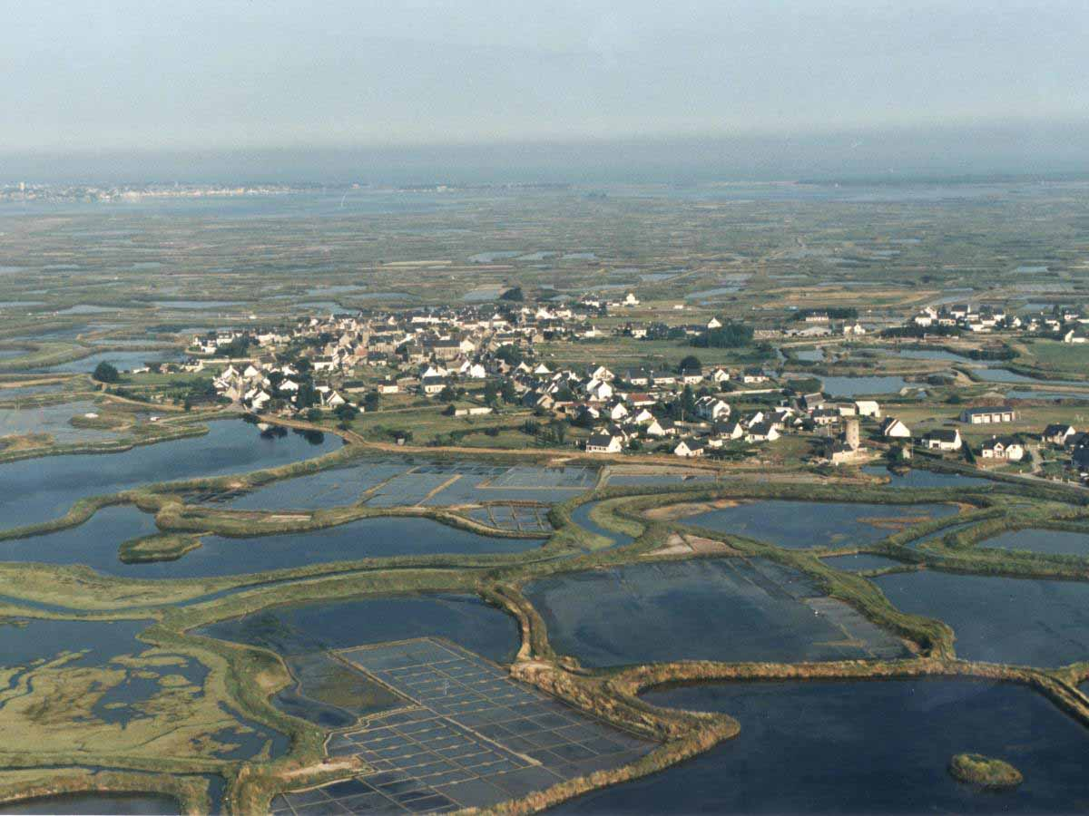
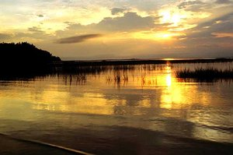
SALT MARSHES
Saliha Noor

Slide 2
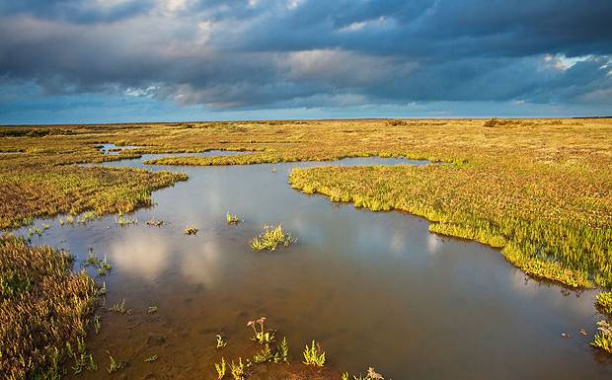

Slide 3
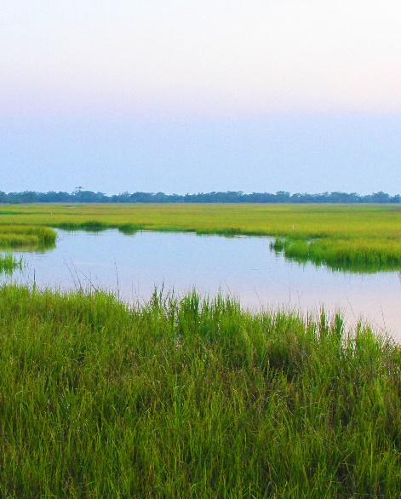
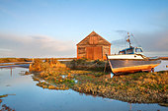
SO WHAT ARE SALT MARSHES?
Salt marshes are coastal wetlands that are flooded and drained by salt water brought in by the tides
They are marshy because the soil might be composed of deep mud and peat.
Peat is made of decomposing plant matter that is often few feet thick. Peat is waterlogged, root-filled, and very spongy.

Slide 4
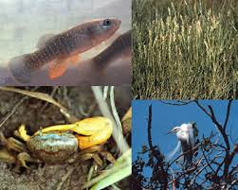
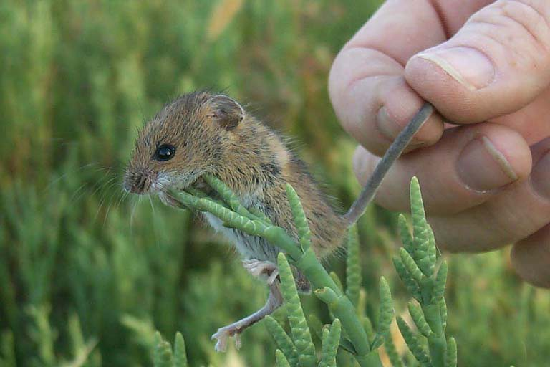
MORE INFO!
The abiotic factors in salt marshes are extremely flexible, as the salinity can is changed a lot. The estuary (bay) is a place where incoming fresh water and ocean water mix, and the salinity can vary depending on the phase in the tidal cycle and the amount of rainfall. Salt marshes may experience salinities ranging from almost freshwater to full seawater, and anything living there must be able to tolerate these wide swings in environmental conditions.
Soil is very fine-grain clay mixed with humus, carried to the estuary and coastline from freshwater rivers and land.
Temperature can also be usually flexible, the air in summer is much warmer than the water, and the air in winter is much colder than the water. Air temperature may be below freezing in winter and over 90° F in the summer.
Animals and plants in salt marshes include some that have terrestrial origins, like grasses, insects, birds and mammals, and others with marine origins like algae, mollusks, harvest mouse and fish.

Slide 5
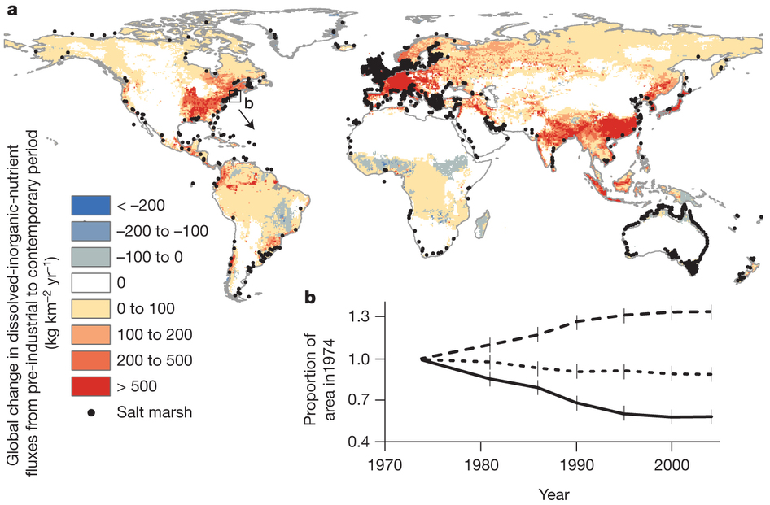

Slide 6
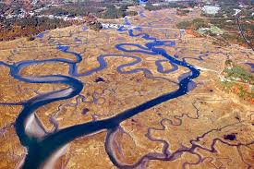
WHY LIVE HERE?
The most productive biome in the world.
Its on the edge of the oceans, a salt marsh is like a shield, which protects the land from the severe weather.
Plants are able to survive much longer in the marsh. They are very beneficial during dangerous flooding and hurricanes.
Its also an area where the air and the water is purified.
They are very beneficial and that is the reason why in some places around the world, salt marshes are now protected and attempts are being made to restore them to their original state.
Because the river contains organic material, estuaries (many salt marshes are found there) are very productive places for algae and plants.
It also provides significant habitat for fishes, like shellfish, marine fish.

Slide 7
This salt marsh is in Plum Island Sound in Massachusetts.

Slide 8
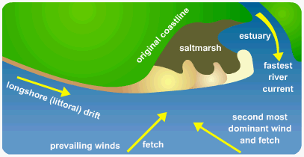
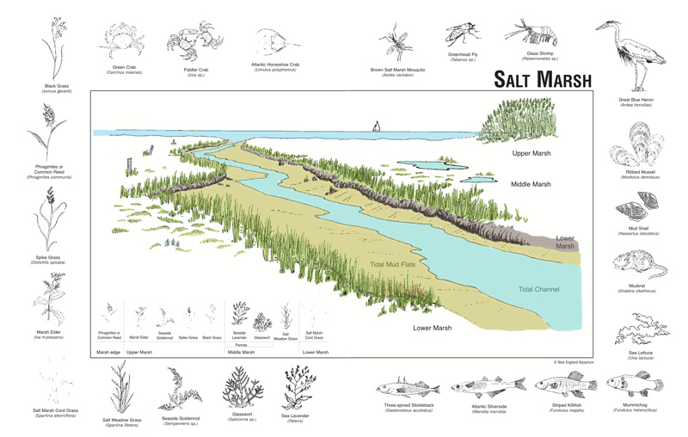

Slide 9
SUMMARY
In Salt Marshes - A Valuable Ecosystem, by Michael Cullinan, Nikki LaBella and Margaret Schott, which stated: “Salt marshes are one of the most important ecosystems on the planet. These marshes serve as a buffer against the elements of the shoreline, a natural filtering system, and a safe haven for different organisms. Many studies have proven that various chemical effects and physical efforts affect the survival rate of the salt marshes such as salinity and restoration. Salt marshes have been faced with a lot of destruction, which is mainly anthropogenic. Human activity has directly and indirectly affected the marshes through grazing, dredging, development, salt-water intrusion, and the dumping of chemicals into water systems. In order to protect these valuable marshes, education, legislative action, and further research needs to take place.”

Slide 10
http://www.researchgate.net/publication/247441019_Salt_Marshes_-_A_Valuable_Ecosystem
https://soils.ifas.ufl.edu/wetlandextension/types/gulfcoastmarsh.htm
http://water.epa.gov/type/wetlands/marsh.cfm
http://www.laspilitas.com/nature-of-california/communities/coastal-salt-marsh
http://science360.gov/obj/video/b21806ef-e6ed-4f09-a5d9-b0b8d042def0/grass-reef-true-value-salt-marsh

