Slide 1
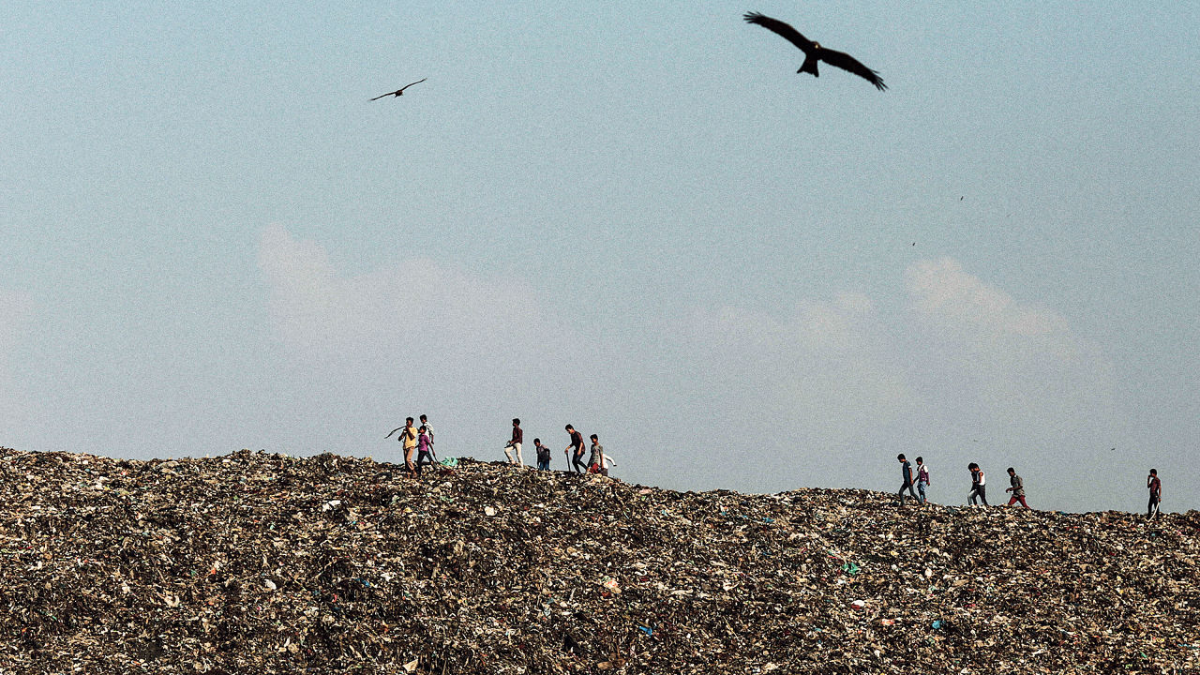

Slide 2
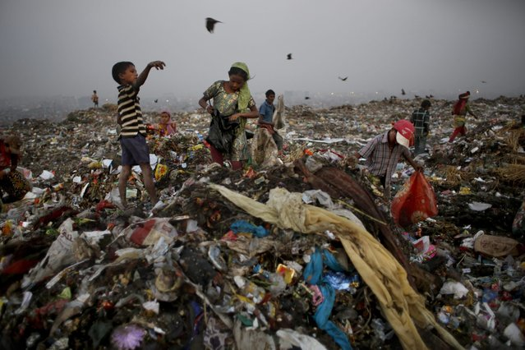
WASTE PICKERS By: Saliha Noor

Slide 3
Who are they?
They are people from low-income and disadvantage communities. They make a living by collecting and sorting waste, and then selling the retrieved waste through intermediaries to the recycling industry.
Millions of people worldwide make a living by collecting, sorting and selling what others have thrown away. These informal waste pickers do a great service for their cities but are often overlooked, maltreated and even criminalized.
Waste pickers are all ages.

Slide 4
Recycling waste helps the environment by decreasing greenhouse emissions and stimulates the economy by supplying raw materials and packaging materials.
“Waste pickers are the principal actors in reclaiming waste for the recycling industry.”
They are good at sorting, bundling different types of waste by color, weight and end use to sell to the recycling industry.

Slide 5
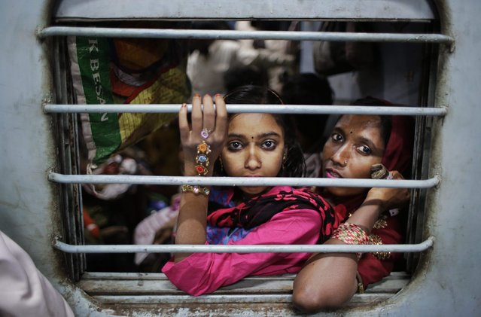
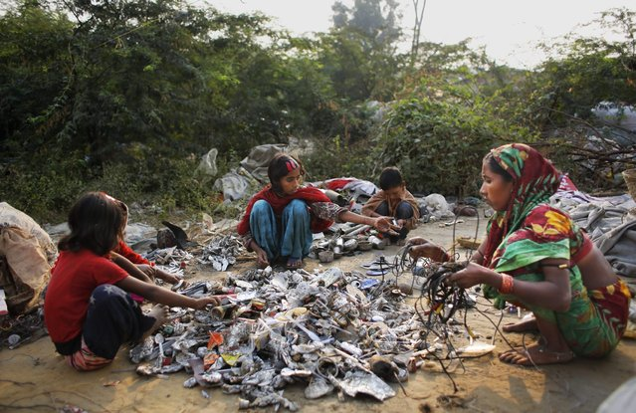
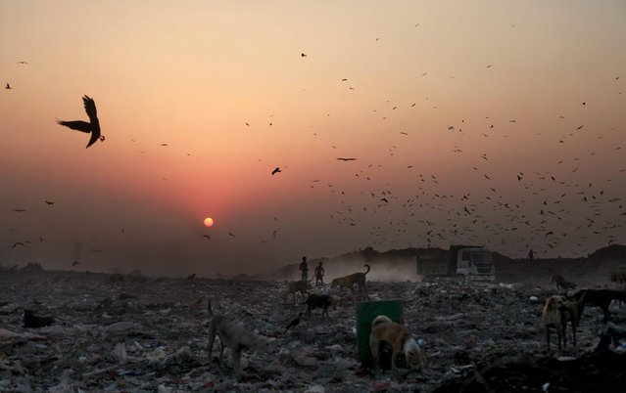
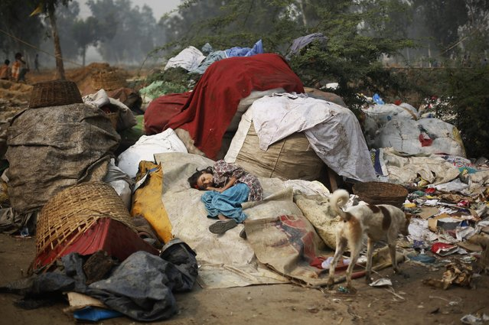
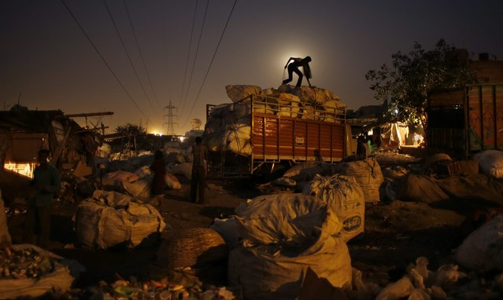
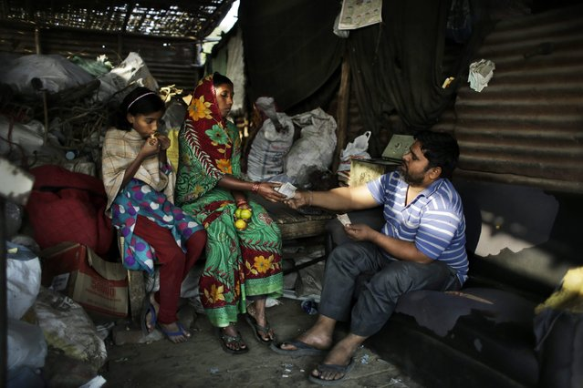
In November 18, 2014, Murshia and her two children decide to move back from New Delhi to their hometown after six months of poverty, illness and shame.

Slide 6
Pickers Encounter:
Toxic fumes
Sharp objects
Medical waste
Suffer repetitive stress injuries from bending, carrying heavy loads, and walking long distances
Might be injured by motor vehicles on roadsides, or in dumps when unstable trash heaps slide.
OVER 5 MILLION people are estimated to die every year in the South of India from diseases related to the poor disposal of waste.

Slide 7
…
Waste may be contaminated with faecal material. This may include biological pathogens such as parasites and bacteria related to the gastro-intestinal tract. This can be passed from hands to the mouth.
Hospital waste often constitutes part of the waste which pickers sort through. This can be hazardous in terms of biological and chemical contamination including exposure to used syringes, dressings, discarded medicines and sometimes body parts.
Industrial waste may include toxic materials such as heavy metals and their associated health effects.
Edible materials in the waste can be hazardous when eaten. This can lead to food poisoning and gastro-enteric problems.
Sharp objects can cause cuts which, in turn, may lead to tetanus or other infections.
Children are more at risk than adults.

Slide 8
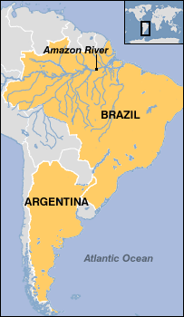
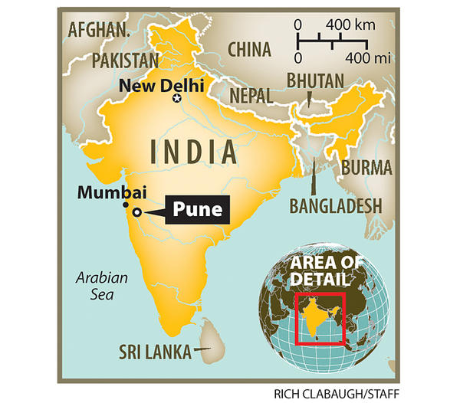
Many waste pickers weren’t paid at all and some are still not paid. The government of Brazil granted the work legal recognition in 2001, and Argentina now offers many waste-pickers a monthly stipend. Other, independent initiatives have combined healthcare with social inclusion. In Brazil, a crowdfunded project called “Pimp my Carroça” has offered free healthcare, dental care and even massages to self-employed trash pickers, while also providing free decorations for the hand-pulled trash carts.
Another example is in Pune, India where a group of women wanted to get recognition, income and healthcare for picking waste. The government ended up giving them healthcare. They later decided to go 48,000 homes afraid that they would loose their waste picking jobs because the government required municipalities to collect waste from door to door. The method by the waste pickers was very effective because it builds relations, with both the waste pickers and the residents to be more involved in making decisions about how waste is managed. It also increased their earnings by 40%.

Slide 9
Why is there so much waste?
Only approximately between 25 and 55 per cent of all waste generated in the cities in the South of India is collected by municipal authorities. Most of the remainder is thrown onto open dumpsites where hazardous materials contaminate the air, soil and water
Every year developing nations spend some US$46 billion on managing their municipal solid waste, and these investments could exceed US$150 billion per year by 2025. Public authorities are finding it difficult to raise the necessary finance to meet these costs. Often they are compelled to concentrate on urgent needs
The scale of the task can be enormous. Most municipalities have no experience of controlled disposal. They may identify disposal sites but few actively manage them
Solid waste management is much more than a technical issue; it has implications for local taxation, employment, regulation, and any changes need political support to be effective.
Development of a sanitary landfill site represents a major investment and it may be difficult to give it priority over other resource demands

Slide 10
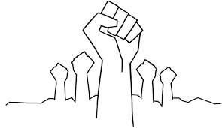
WHAT THEY WANT!
What the waste pickers have to offer is quite clear: waste collection, sorting, reclaiming, and recycling services at a reasonable cost.
recognition for the services they provide
access to waste
the right to bid for solid waste management contracts
trucks for hauling waste
a safe space and equipment for storing
Compacting
Bundling
processing waste
fair prices for the waste they collect and the recycled materials that they reclaim, process, and sell.

Slide 11
SOURCES
http://www.theguardian.com/environment/2016/jan/20/buenos-aires-litter-pickers-cartoneros-recycling-argentina-environment
http://www.no-burn.org/downloads/ZW%20Pune.pdf
http://globalrec.org/2016/03/01/waste-picker-day-2016-just-recycling/
http://www.motherjones.com/environment/2012/07/trash-charts-world-bank-report-economy
https://www.causesinternational.com/ewaste/e-waste-facts
http://avax.news/sad/Young_Waste_Pickers_in_India.html

Slide 12
VIDEO
http://globalrec.org/2016/03/01/waste-picker-day-2016-just-recycling/

