Slide 1
WHAT in the world are Streams and Rivers?
Streams and Rivers are bodies of fresh water moving in one direction (downhill).
Water may have originated from *underground spring *runoff from rain or *melting snow
Both Streams and Rivers start at headwater/source and flow all the way to it’s mouth which is usually connected with another water channel
Fresh water has little or no salt which means it has low salinity
Streams are narrow and carries less water

Slide 2
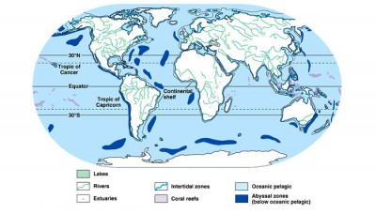
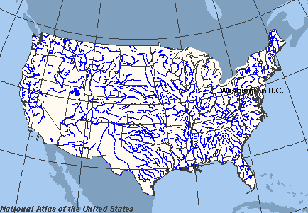
WHERE in the world are Streams and Rivers?
Streams and Rivers are found EVERYWHERE
All you need is a rain, snow or an underground spring water to form Streams/ River

Slide 3
Travel from the Source to the Mouth
Temp. is cooler at the source that it is at the mouth
Water is clear due to high oxygen levels
Freshwater fish such as trout and heterotrophs are found here
Middle of the stream/river the width increase and so does biodiversity
Numerous aquatic green plants are found here and algae
At the mouth of the stream/river the water becomes murky due to high amount of sediments
So less light will penetrate->Less oxygen will be dissolved->Less biodiversity
Carp and catfish that requires less oxygen can be found here

Slide 4
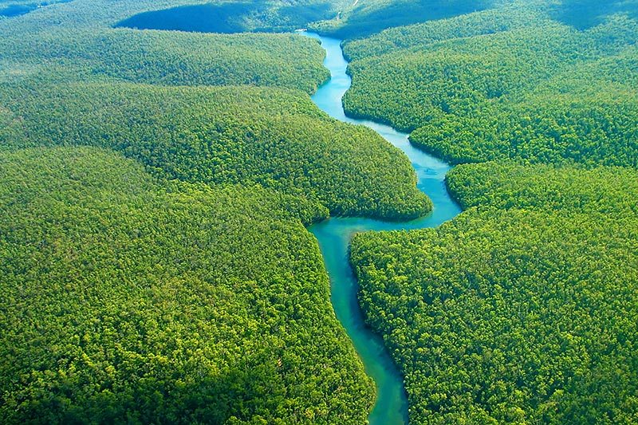
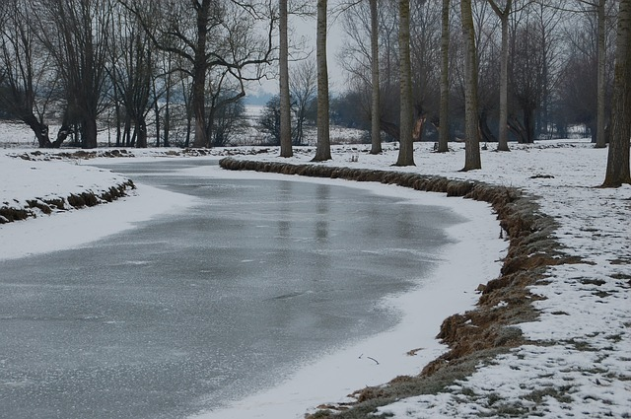
Climate/Temperature
Stream flow is always changing due to amount of precipitation
The amount of precipitation and temperature depends on the region rivers and streams found in
Temperature can go from 0°C to 22°C
If the stream/river is found in Brazil like the Amazon River the climate will be tropical or equatorial climate.
Heavy rain, hot temperatures year around
Warm water Less oxygen dissolved in water Low biodiversity
If it’s found in Europe then it will be subpolar climate.
Long and cold winters, little or no rain, the water is frozen at the top
But underneath life thriving
Cold Increase in oxygen

Slide 5
Are frozen rivers are great shortcuts to your destination?
In january 2015 a 10 year old kid tried to walk across frozen Bronx River suddenly got stuck as the ice broke off

Slide 6
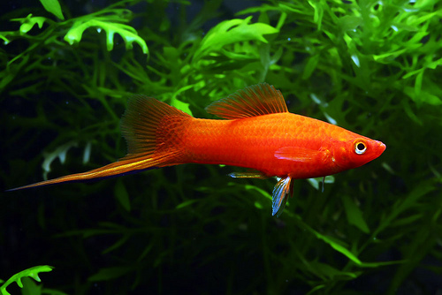
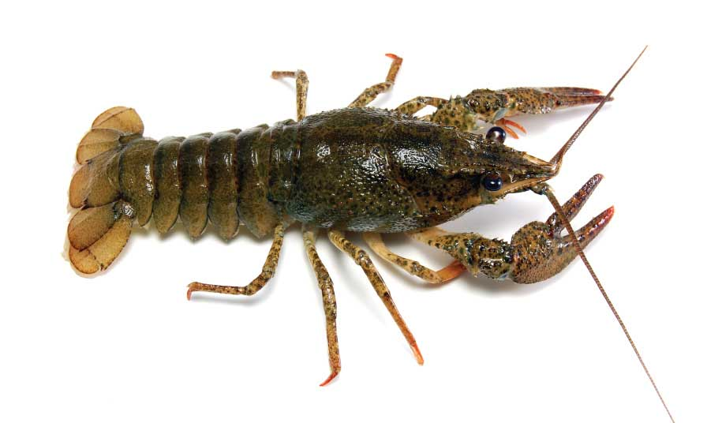
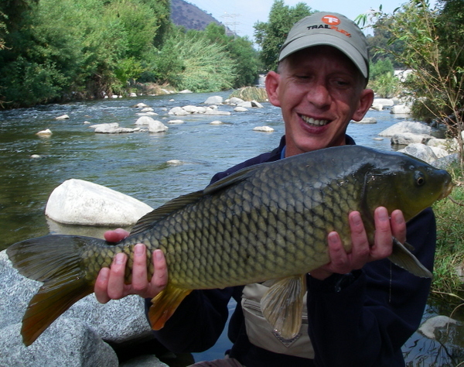
Interested about your kind neighbors that can feed you?
Turtles
Red Swordtail
Mekong Giant Catfish
Crayfish
Eel
Carp
Algae/Plants
Ruffe
Freshwater Stingray

Slide 7
Global Warming/Climate Change
Species in subpolar climates will die out and streams/rivers there will become uninhabitable
Some fish lay their eggs in stream bed however glaciers melting and rivers over flowing will wash off the offsprings
Rivers that are already in warmer areas will become dead zone (loses its ability to sustain life

Slide 8
Fun Facts/Jokes
River Pirates? In mid 18century in America, pirates terrorized the Ohio River and Mississippi River Valley
Nile River is the longest river in the world 6650km (Amazon is the 2nd)
In 2009 US Airways plane managed to make an emergency land in the Hudson River
Most of the world’s major cities are located near the banks of rivers.
The Ganges, Yangtze and Indus rivers are three of the most polluted rivers on Earth.

