Slide 1
Zero Point Energy Taming the Power
By Ramlah Ahmad

Slide 2
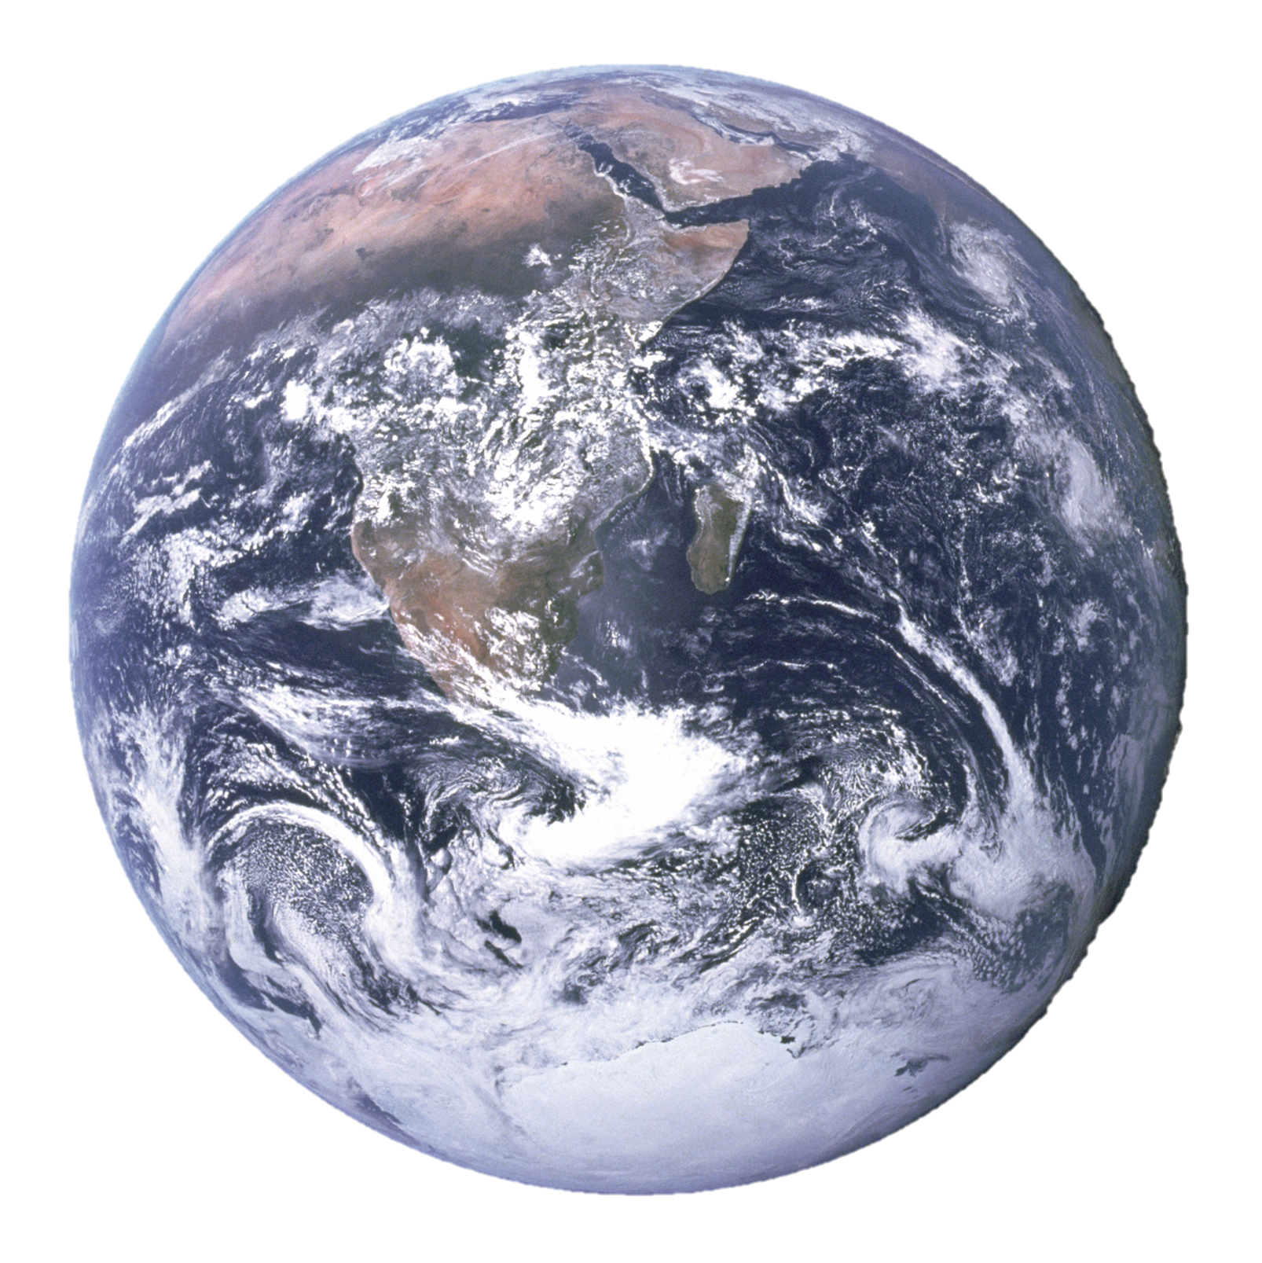
The Earth is sick and frail…
WHY?

Slide 3
Because of a bunch of imbeciles called homo-sapiens
Who have triggered global warming by means of burning fossil fuels and the earth’s eminent death is becoming a reality.

Slide 4
Well we can stop the end from coming before its time by means of:
Killing all homo-sapiens
Finding an unlimited and a harmless alternative to fossil fuels
Something else

Slide 5
Killing all homo-sapiens
Not a cool idea because I am a homo-sapien.

Slide 6
Finding an unlimited and a harmless alternative to fossil fuels
Maybe plausible, let us see the facts.

Slide 7
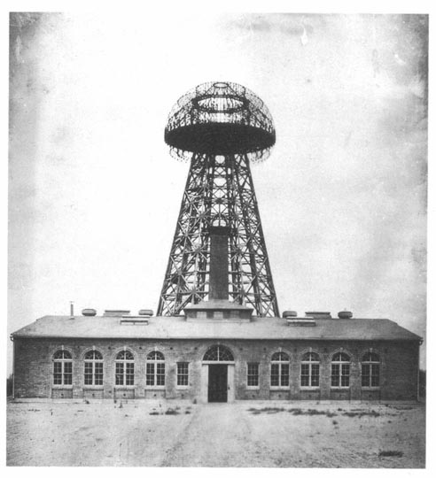
Nikola Tesla
The Free Energy Conspiracy
Nikola Tesla with his Wardenclyffe Tower was to give everyone “free energy”
But then construction because JP Morgan figured out that this was not going to make him any money
He had a nervous breakdown and the government shut him up….
Pictures from Wikimedia Commons

Slide 8
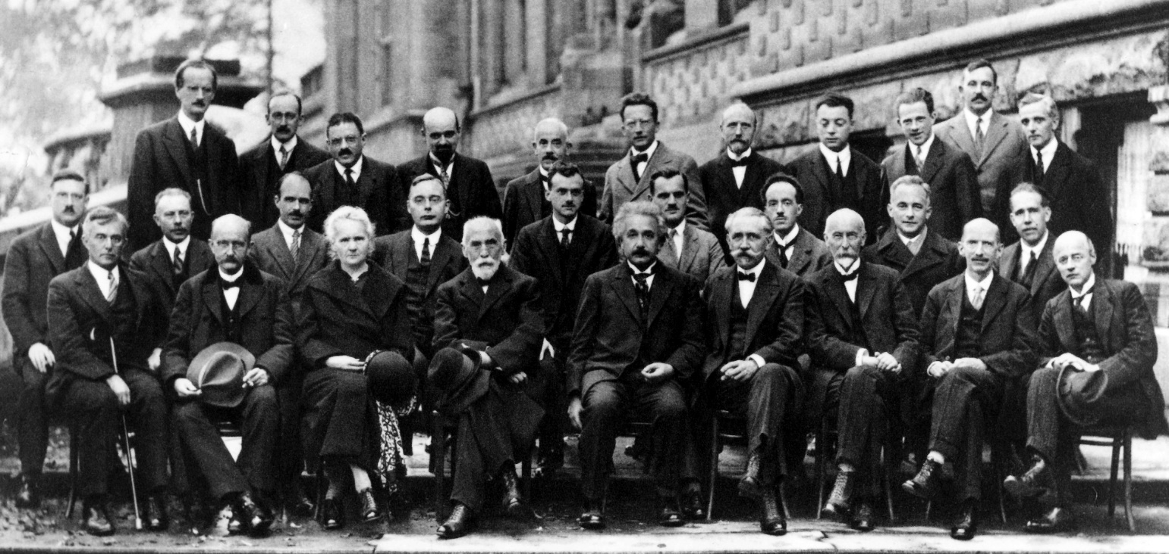
Quantum Mechanics
There are elementary particles which atoms are made out of and are the smallest particles
Higgs Boson particles or the God Particle proved this
String Theory everything is just a bunch of waves
Heisenberg’s Uncertainty Principle: The motion and position of a particle can never be known

Slide 9
Zero Point Energy
Why Scientist Can’t Sleep at Night?
Casimir Effect
Ground State energy is when energy is at its lowest state of energy to exist which can never be zero because that is against the Uncertainty Principle. Thus “absolute zero” energy can never be reached
There is thus still energy in a Vacuum—think black hole—even though the definition of a vacuum is nothing.
Zero Point energy is the lowest amount of energy within a particular field or energy of a particle in the ground state
Proved that through in experiment using vacuums that there must absolute lower level of energy by seeing that there is energy still in a vacuum.
Implications
There is a bunch of energy all around us which can be harnessed because even if we take away energy from the ground state there st

Slide 10
Well what if we could tap into this energy that would mean unlimited renewable energy!
Oh God I should invest into this like right NOW!

Slide 11
I just hate it when science is misunderstood and represented.
Ignorance of Quantum Mechanics
Ignorance of Tesla
This only if anything is a mathematical tool, created by Quantum Physicist to explain a certain situation.
Casmir Principle and it bringing plates together could make some energy but it would use energy to pull them apart.
Maybe it is possible and if you want to believe it you can—there is merit in this theory but not much reality.
Tesla through the Wardenclyffe tower was not trying to harness energy but send electrical power transmission some thing like todays Wi-fi or phones
He stopped funding him because JP Morgan said only $150,000 and he meant it.
“Throughout space there is energy. Is this energy static or kinetic! If static our hopes are in vain; if kinetic — and this we know it is, for certain — then it is a mere question of time when men will succeed in attaching their machinery to the very wheelwork of nature. Experiments With Alternate Currents Of High Potential And High Frequency (February 1892)”

Slide 12
“Research in a Vacuum: DARPA Tries to Tap Elusive Casimir Effect for Breakthrough Technology”
An article on Scientific American
By Adam Marcus on October 12, 2009
The project was called the “Casimir Effect Enhancement program”
The scientist in the article seemed to not have much hope for the project but stated “baby steps” for science
After going on the DARPA website and seeing nothing the project was most likely terminated because it unfeasibility was realized.
So basically after the Casimir effect was proved by and accepted by scientist and one more research done on it by Harvard University and Vrije University Amsterdam DARPA gave 10 million in funding to this project

Slide 13
Amazing examples of stupidity
Video
My favorite pseudo-scientist John Hutchinson
http://www.space.com/9857-free-energy-point-harness-dark-energy.html
Guess when this video starts spouting pseudoscience?
Lol I found this on an actual websites well as many others with tons of other pseudo-scientist asking for investors
Apparently found the Hutchinson Effect where things randomly start levitating.
He claimed to have created a battery which never runs out.
He also vehemently claims that he has found out how to tap into Zero Point Energy.
He cannot make a profit on his inventions because the government has stopped him from doing so and he needs your support.
It all had something to do with 9-11 too.

Slide 14
Something else
I guess that is the only alternative left.

Slide 15
What we can learn from Tesla?
Tesla’s Hydroelectric Endeavors
“Cosmic Ray Motor”
Tesla was one of the main inventors behind the hydroelectric power created from Niagara Falls
At the time this was a great feat because of the size of Niagara falls.
Many of theoretically proven this invention to not work
That the idea that metal would actually get charged is a very low chance of creating energy.
The idea behind the invention was to get energy from this “ether” which has been disproven by quantum physics.
Some claim this was his next big invention which was stopped by big money. It was more of the work of a sick old man.

Slide 16
We Should Keep on Investing into Renewable Energy
Social
Economic
Political
We get a population of people who are aware of what is happening in this world and why we need to change it. By making renewable energy the everyday topic in society we create greater awareness. So that one day our future can have a better life, then which we will leave them in as of the moment. This will create public disgust of fossil fuels which as of the moment is not great enough.
We create more jobs for the bright minds of our world. Instead of these minds being wasted in a job which uses not even high of these people’s skills by investing money into them we let them have creative freedom to work on something instead of them having to worry about how to support themselves.
This is an agenda which if anything fits Politics because like in America they have been supporting more studying into the STEM fields. By focusing more on those fields there is more likely of a chance for more children to get involved in those fields. More public schools need to have more STEM based classes which have something to do with the technical part of STEM. Also more technical schools should be open which provide adults the chance to learn these skills.

Slide 17
Now Please Give my Fund Some Money
You can right any checks straight out to “Ramlah Ahmad.”
I do appreciate Cold Hard Cash.
This will go towards me carting a sustainable future for you and your children.
Do not be shy and had the money over.

Slide 18
Bibliography
http://www.treehugger.com/renewable-energy/teslas-gigafactory-will-produce-much-renewable-energy-it-uses-net-zero-energy.html
http://www.nuenergy.org/nikola-tesla-radiant-energy-system/
https://van.physics.illinois.edu/qa/listing.php?id=1256
http://www.scientificamerican.com/article/follow-up-what-is-the-zer/
Picture of earth from Wikipedia
https://www.youtube.com/watch?v=pNS9v_0pXuo
http://www.pbs.org/tesla/ll/
http://home.earthlink.net/~drestinblack/tesfreee.htm
http://www.scientificamerican.com/article/darpa-casimir-effect-research/
https://www.physicsforums.com/threads/zero-point-energy-dark-energy-and-space.394459/

