Slide 1
India vs. China
By: Rahila Rehman

Slide 2
THE PROBLEM
India and China are facing the issue of rapid population growth, causing many issues for both countries.
China currently holds the highest population in the world, but India follows closely behind.
Overpopulation in these countries is leading to:
Bad air quality
Strain of food and water sources
Overuse of fossil fuels
Spread of diseases and illnesses

Slide 3
WHY IS THIS IMPORTANT?
This is important because such a large population leads to a strain on resources.
These countries are an example of why we should maintain a stable growth in our population.
India and China should be used to give an incentive to the government of developing nations to try and maintain a stable population growth.

Slide 4
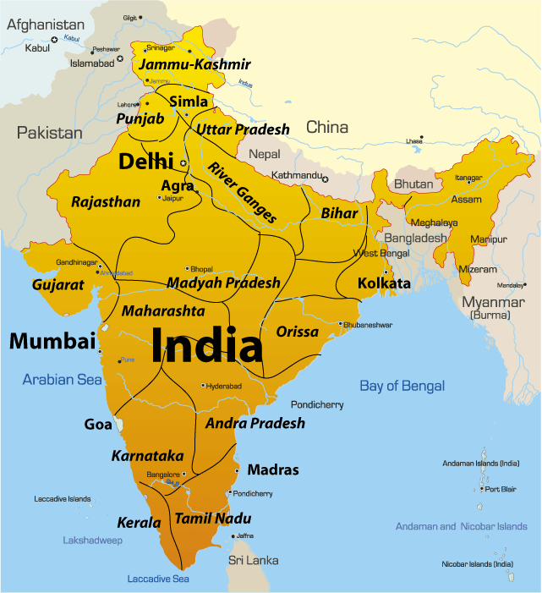
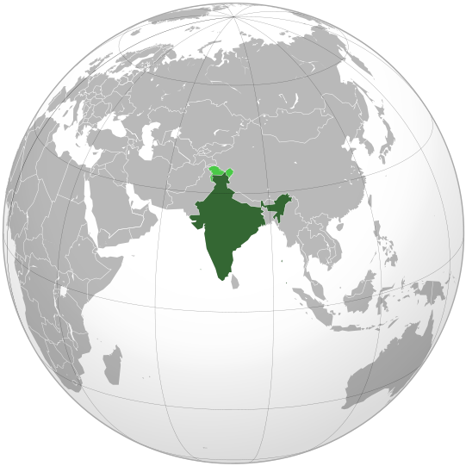
INDIA

Slide 5
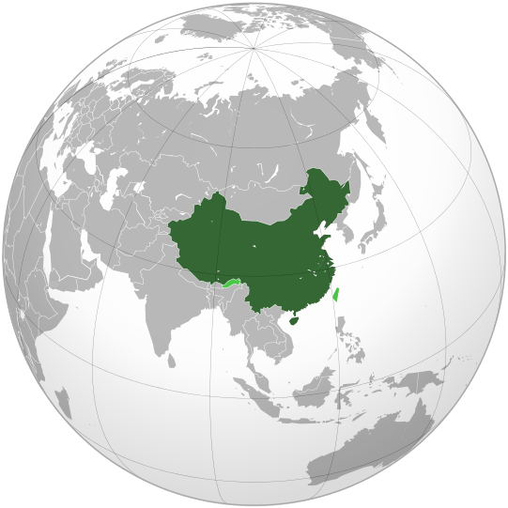
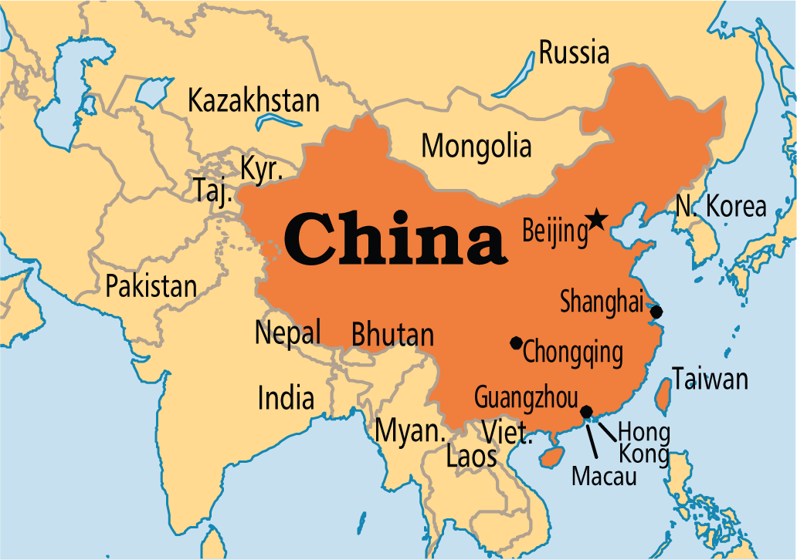
CHINA

Slide 6
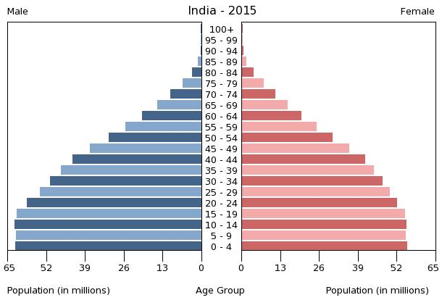
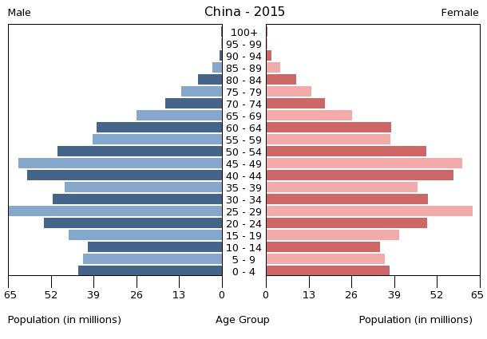
POPULATION PYRAMIDS

Slide 7
INDIA STATISTICS
Population: 1,251,695,584 (July 2015)
Infant Mortality: 41.81 deaths/ 1,000 births
Life expectancy: 68.13 years
Birth rate: 9.55 births/ 1,000 population
Death rate: 7.32 deaths/ 1,000 population

Slide 8
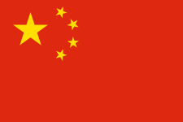
CHINA STATISTICS
Population: 1,367,485,388 (July 2015)
Infant Mortality: 12.44 deaths/ 1,000 births
Life expectancy: 75.41 years
Birth rate: 12.49 births/ 1,000 population
Death rate: 7.53 deaths/ 1,000 population

Slide 9
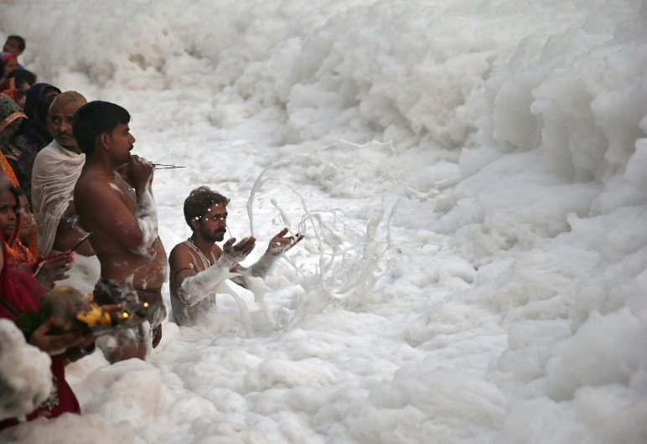
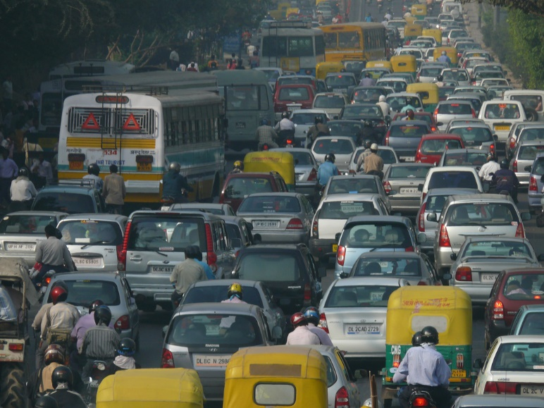
INDIA POPULATION
Many things attribute to the overpopulation in India:
Poverty- A majority of the country is living in poverty and believe having multiple children will lead to multiple streams of income.
Education- Many do not have an education and that directly correlates with having more children.
Beliefs- Procreating until a male child is born because female children leave the family after marriage, and male children are supposed to take care of their elderly parents

Slide 10
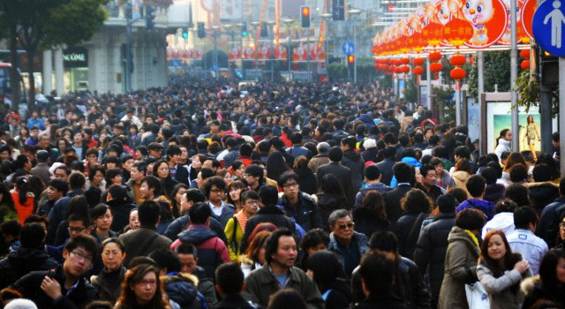
CHINA POPULATION
Overpopulation in China is not as alarming as India, in fact the government has taken many steps to control the population and that has had some negative implications.
There is a disparity in certain age groups, the difference between the amount of men and women is large.
China is still overcrowded, but not as much as it was before, there are a lot of coal factories and many cars being used.

Slide 11
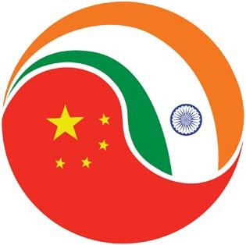
SIMILARITIES
Both countries have:
Unequal distribution of wealth
Male preference
Poverty
Lack of educational system
Increased respiratory issues for children

Slide 12
ENVIRONMENTAL CONCERNS: INDIA
Increased deforestation More land required for agriculture.
Increased air pollution Coal used to create energy.
“Delhi had pollution levels some 50% higher than Beijing - 15 times the safe limit - yet there had been no public warnings of the health dangers, and no restrictions imposed of any kind.” (BBC News)
Cars lead to more carbon dioxide emissions.
Contamination of environment due to waste disposal.

Slide 13
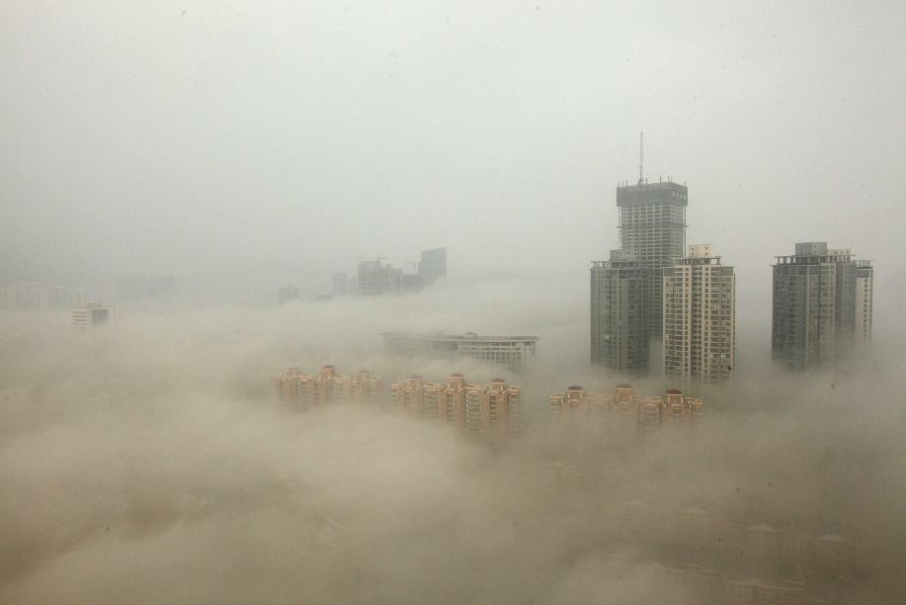
ENVIRONMENTAL CONCERNS: CHINA
“ Only 1 percent of the country’s 560 million city dwellers breathe air considered safe by the European Union.”(NY Times)
Recently, Beijing “declared their first ever red alert for pollution.”(NY Times)
The environment is contaminated with “heavy metals”, so resources like drinking water will be unsafe to consume. (The Guardian)

Slide 14
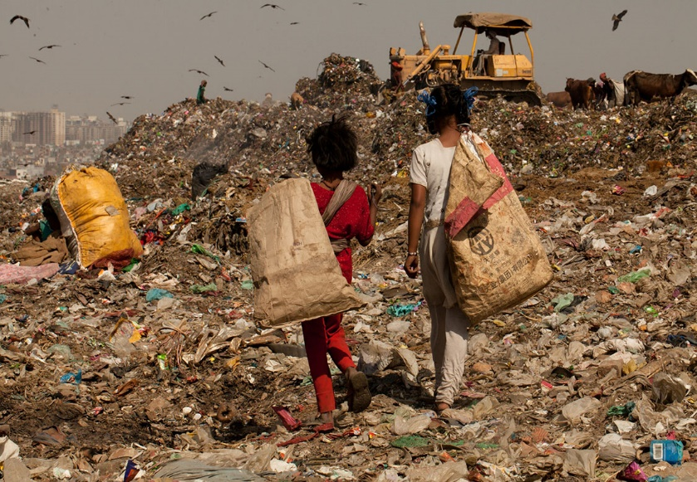
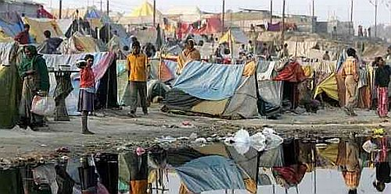
SOCIAL CONCERNS: INDIA
Human Rights Violations- Women were being paid to be sterilized and some of them ended up dying, the government was responsible for this.
There is NO middle class. There is a very high rate of poverty and if the population continues on this route, then the poverty will effect the next generation as well.
The quality of life will decrease because there will be more waste being disposed of in a unsanitary method. Resources will be even more scarce, clean water sources will rapidly decrease.

Slide 15
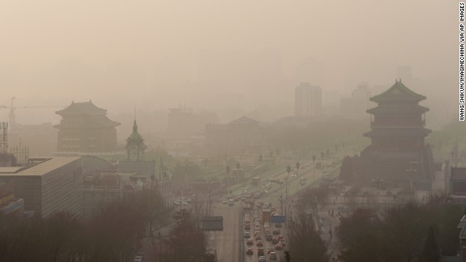
SOCIAL CONCERNS: CHINA
Standard of living may decrease due to air pollution.
There are more men then women.
Cancer rates are rising in China.
The government is getting a lot of backlash from the people on China.

Slide 16
ECONOMIC CONCERNS: INDIA
Poverty- Less consumers because there is less money circulating the economy, so people are not buying things.
Unemployment- If there is such a large population, and most are uneducated, it is hard to provide employment because that many laborers are not needed.
It will be expensive to clean the air pollution and the environment.

Slide 17
ECONOMIC CONCERNS: CHINA
There is a gap for certain age groups, and as the older generations cannot work anymore, the is not a large enough number of people in the workforce from the age group.
It will also be costly to deal with the air pollution.

Slide 18
WHAT IS BEING DONE?(CHINA)
In China, the government is trying to control the issue of pollution through:
$275 billion dollars only to improve air quality (CFR.ORG)
Rid of the One Child Policy, and their population growth improved, but a baby boom is expected because more children are allowed now.
Have a stable middle class now.
Creating stricter punishments for polluting the environment.

Slide 19
WHAT IS BEING DONE?(INDIA)
Government is promoting family planning in rural areas. (Times of India)
The government is also creating sterilization programs, but only women are taking advantage of them.

Slide 20
SOURCES
https://www.cia.gov/library/publications/the-world-factbook/geos/in.html
http://www.mapsofindia.com/my-india/india/overpopulation-in-india-causes-effects-and-how-to-control-it
http://www.cnbc.com/2015/06/25/india-vs-china-its-not-all-about-growth.html
http://www.nytimes.com/2007/08/26/world/asia/26china.html
http://www.ibtimes.com/breathing-space-why-chinas-population-worries-about-air-pollution-ignores-climate-2216055
http://www.bbc.com/news/world-asia-india-35230187
http://www.fsdinternational.org/country/india/envissues
http://www.cfr.org/china/chinas-environmental-crisis/p12608
http://www.nbcnews.com/news/china/china-braces-baby-boom-under-new-two-child-rule-n489641
http://www.cnn.com/2016/01/04/asia/china-one-child-lawyer-choir/
http://timesofindia.indiatimes.com/india/India-records-higher-sterilization-than-US-China-reveals-govt-data/articleshow/50251765.cms
http://www.cnn.com/2014/11/11/world/asia/india-sterilization-deaths/
http://timesofindia.indiatimes.com/world/china/Worlds-most-populous-country-to-boost-numbers/articleshow/50401198.cms

