Slide 1
The Golden Toad
Monica Tatacoya

Slide 2
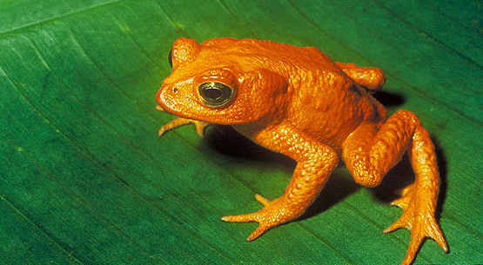
Amphibians
Amphibians in general are sensitive to airborne and water contaminants.
Their skin takes in water and oxygen in the atmosphere.
As a result, they are likely to be severely impacted by any change in the environment, thus making them an effective indicator to environmental changes.

Slide 3
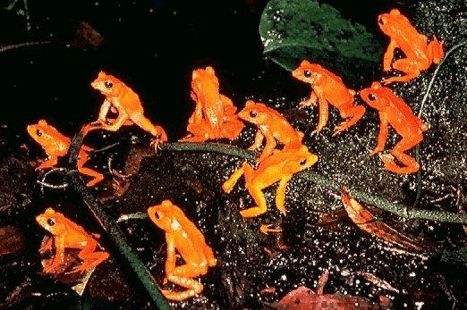
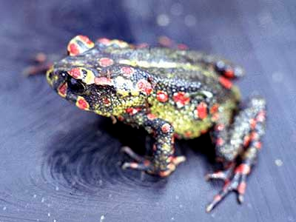
Golden Toads
They have trouble reproducing seeing that the male toads can’t tell which toads are the female golden toads.
When they finally get a chance to reproduce, the females lay from 200 to 400 eggs which are likely to die because of lack of water.
They were only observed during April, when the golden toads bred.
1500 toads were counted n1987 and no golden toads were observed since then.
It was suspected that they were extinct due to climate change, pollution, and fungal skin infections.

Slide 4
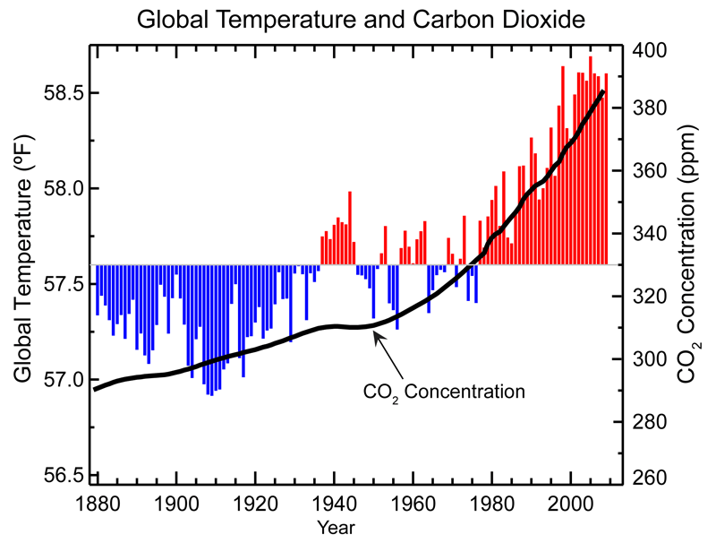
Climate Change
1986-1987: El Nino was the cause of the lowest recorded rainfall at Monteverde. Temperatures also reached record highs.
The warm and dry climates could led to a decline in the toad population through various ways.
Golden toad tadpoles require around five weeks in wet areas before they can mature. During the dry season, toad tadpoles would have died off due to lack of sufficient water.
An increase in CO2 and global temperature caused by human activity would have also made the effects of El Nino more severe.

Slide 6
Pollution
Golden toads lived in a habitat which seemed to be untouched by humans. However, it is possible that golden toad came into contact with pesticides which can be extremely harmful to toads.
Atrazine, a very common pesticide, causes irreparable damage to amphibians. A study conducted showed how low concentrations of atrazine (.1 parts per billion) can render leopard frog sterile.
There are three ways in which the pesticide could have entered the atmosphere. they could have become airborne, pesticide-carrying dust particles could have entered the atmosphere, or through evaporation.
Seeing that golden toads took in oxygen through their skin, it is likely that they suffered various unknown consequences due to the unintentional intake f airborne pesticides.

Slide 7
Diseases
Chytridiomycosis is a fungus disease that leads to skin damage. This could lead to skin thickening and eventual death either by suffocation or dehydration.
The spread of this infection could be a result of two things.
The chytrid fungus thrives in warmer and drier climates. At the time of extinction, the climate was much warmer and drier that it would have been.
Also, since the land was getting drier, there was more competition for habitat which would have spread the fungus even faster.

Slide 8
Extinction
The golden toad was classified extinct in 1989, after only on male golden toad was spotted
There is the theory that golden toads didn’t go extinct entirely because of climate change.
However, many of our actions did lead up to their extinction and could possibly lead up to the extinction of other organisms.

Slide 9
Bibliography
http://jrscience.wcp.muohio.edu/fieldcourses05/PapersCostaRicaArticles/TheExtinctionoftheGoldenT.html
http://news.sciencemag.org/paleontology/2010/03/global-warming-didnt-kill-golden-toad

