Slide 1
Mangrove Swamps
By Kaylah Williams

Slide 2
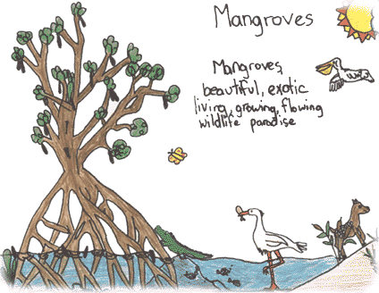
ARE YOU A SCIENTIST? ARE YOU IN NEED OF FRIENDS?
Well come on down and try living in a exotic biome, Mangrove Swamps!

Slide 3
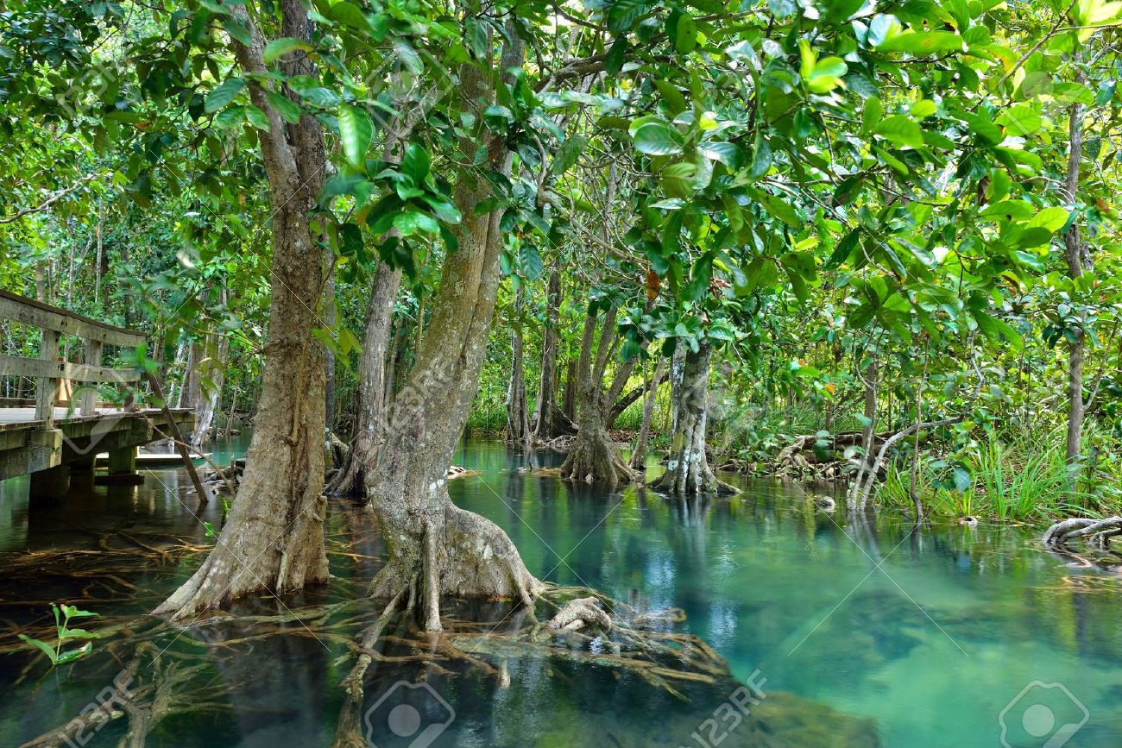
Fun facts!
Houses different types of algae.
The swamps contain a mixture of both salt and fresh water.
Very saline. (salty)
It has a varying range of tide levels .
The mud contain low oxygen levels.
Contains high levels of bacteria… Yay?
Maintain water quality by trapping sediments and nutrients

Slide 4
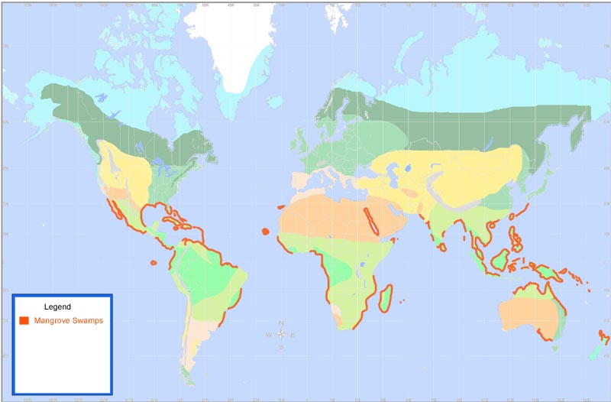
Where on Earth Would I Find This Biome?
Now as you see Mangrove swamps could be found along the shore among a lot of continents.

Slide 5
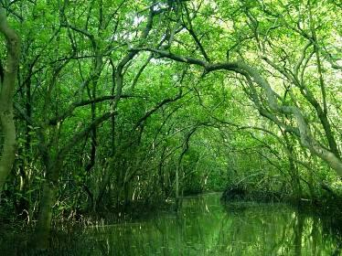
Soil Quality
Mangrove soils prevent erosion, so it is pretty sturdy.
The soil is almost in a liquid type form.
Mangrove soil contain a mixture of sand, silt and clay.

Slide 6
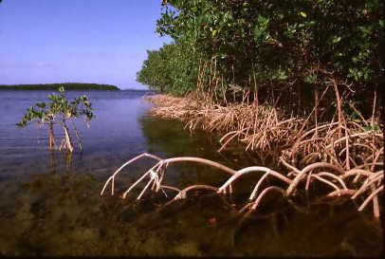
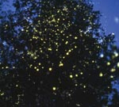
Vegetation
Mangrove palm grows on the side of the river in swamps.
The Mangrove apple are meant to be food for animals but if you’re up for it.. Knock yourself out and try it! It’s rumored to taste like cheese.
The Red Mangrove grows here as well and it is easily distinguished because of it’s reddish shade.

Slide 7
Temperature/Precipitation?
Mangrove swamps grow their best at 66 degrees fahrenheit or higher.
Although if this happens the temperature must increase slowly or decrease slowly, if not then the plants will not adapt and will eventually die out.
The average of precipitation that occurs is about 4.5 meters.
During the rainy seasons tend to cause floods and that causes high tides.
The dry season occurs when water recedes and that causes low tides.

Slide 8
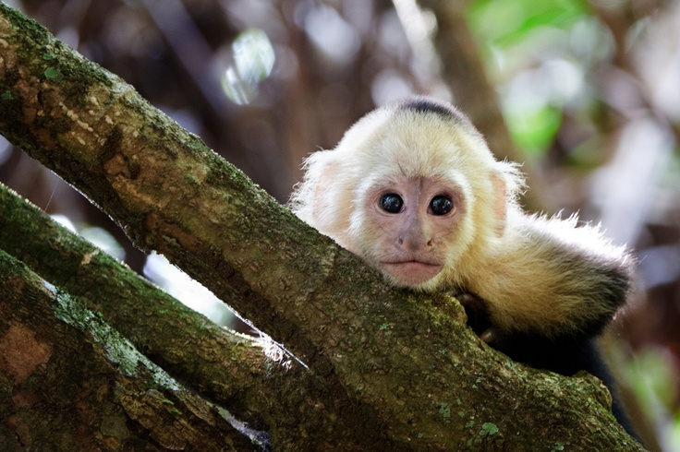
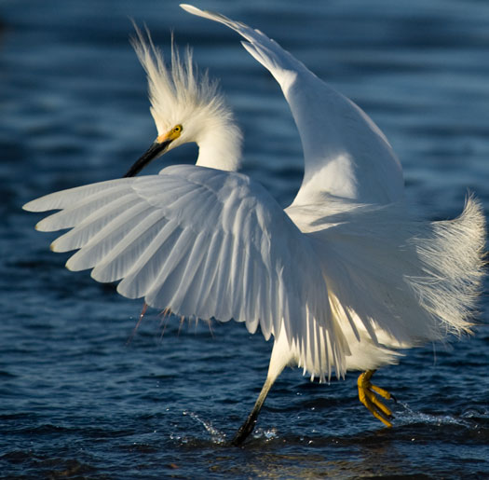
What About The Animals?
White faced monkey.
Erget
Mangrove crab

Slide 9
Climate change?
Nutrient Pollution, oil spills and and thermal pollution as well have all occurred in the Mangrove Swamp.
When thermal pollution occurs it leads to sensitive seeding, reduces the leaf area in the swamp.
Other pollution that occurs in the mangrove lead to harming the animals in the swamp severally.

Slide 10
Sources
http://cchscostarica08.pbworks.com/w/page/10489057/Tidal%20Mangrove%20Swamp
http://www.eoearth.org/view/article/159955/
http://www.academia.edu/6434568/Mangrove_Soils_Species_Relationships_and_Ecosystem_Management
http://water.epa.gov/type/wetlands/mangrove.cfm

