Slide 1
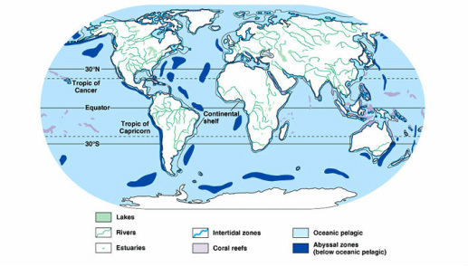
What and Where on Earth?!
Lakes and Ponds = freshwater biome
Lakes > Ponds
Total Surface Area of Lakes = approx. 4,200,000 km squared
Lakes and Ponds take up less than 1% of the Earth’s total surface area.
Ponds can be seasonal (lasting a few months)
Lakes may exist for decades or centuries
Limited biodiversity due to a system that works like a closed-system (isolated)

Slide 2
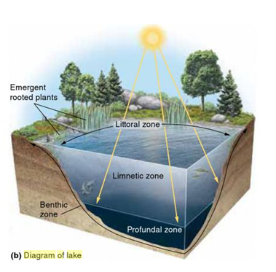
What’ll be your new zone?
Lentic ecosystem = standing/still water
Zones based on temperature (due to the heating of water surface-distance from shore and depth)
Littoral zone=shallow area near the shore → hosts greatest amount of photosynthesis occurrence → home to fish, algae, amphibians, emergent vegetation, snails, clams, insects, crustaceans, fishes, amphibians, dragonflies, and mosquito eggs and larvae

Slide 3
What’ll be your new zone?
Limnetic zone=open water area → emergent vegetation isn’t prevalent →plankton (zooplankton and phytoplankton)=only photosynthetic organisms and some fish→ zone extends to as deep as sunlight can reach
Profundal zone= no sunlight → no producers → nutrients aren’t easily recycled → bacteria decompose the remains that reach the zone (take up oxygen) → dissolved oxygen concentrations = insufficient = cannot sustain most life
Benthic zone=sediment/muddy bottom layer -can find some crustaceans

Slide 4
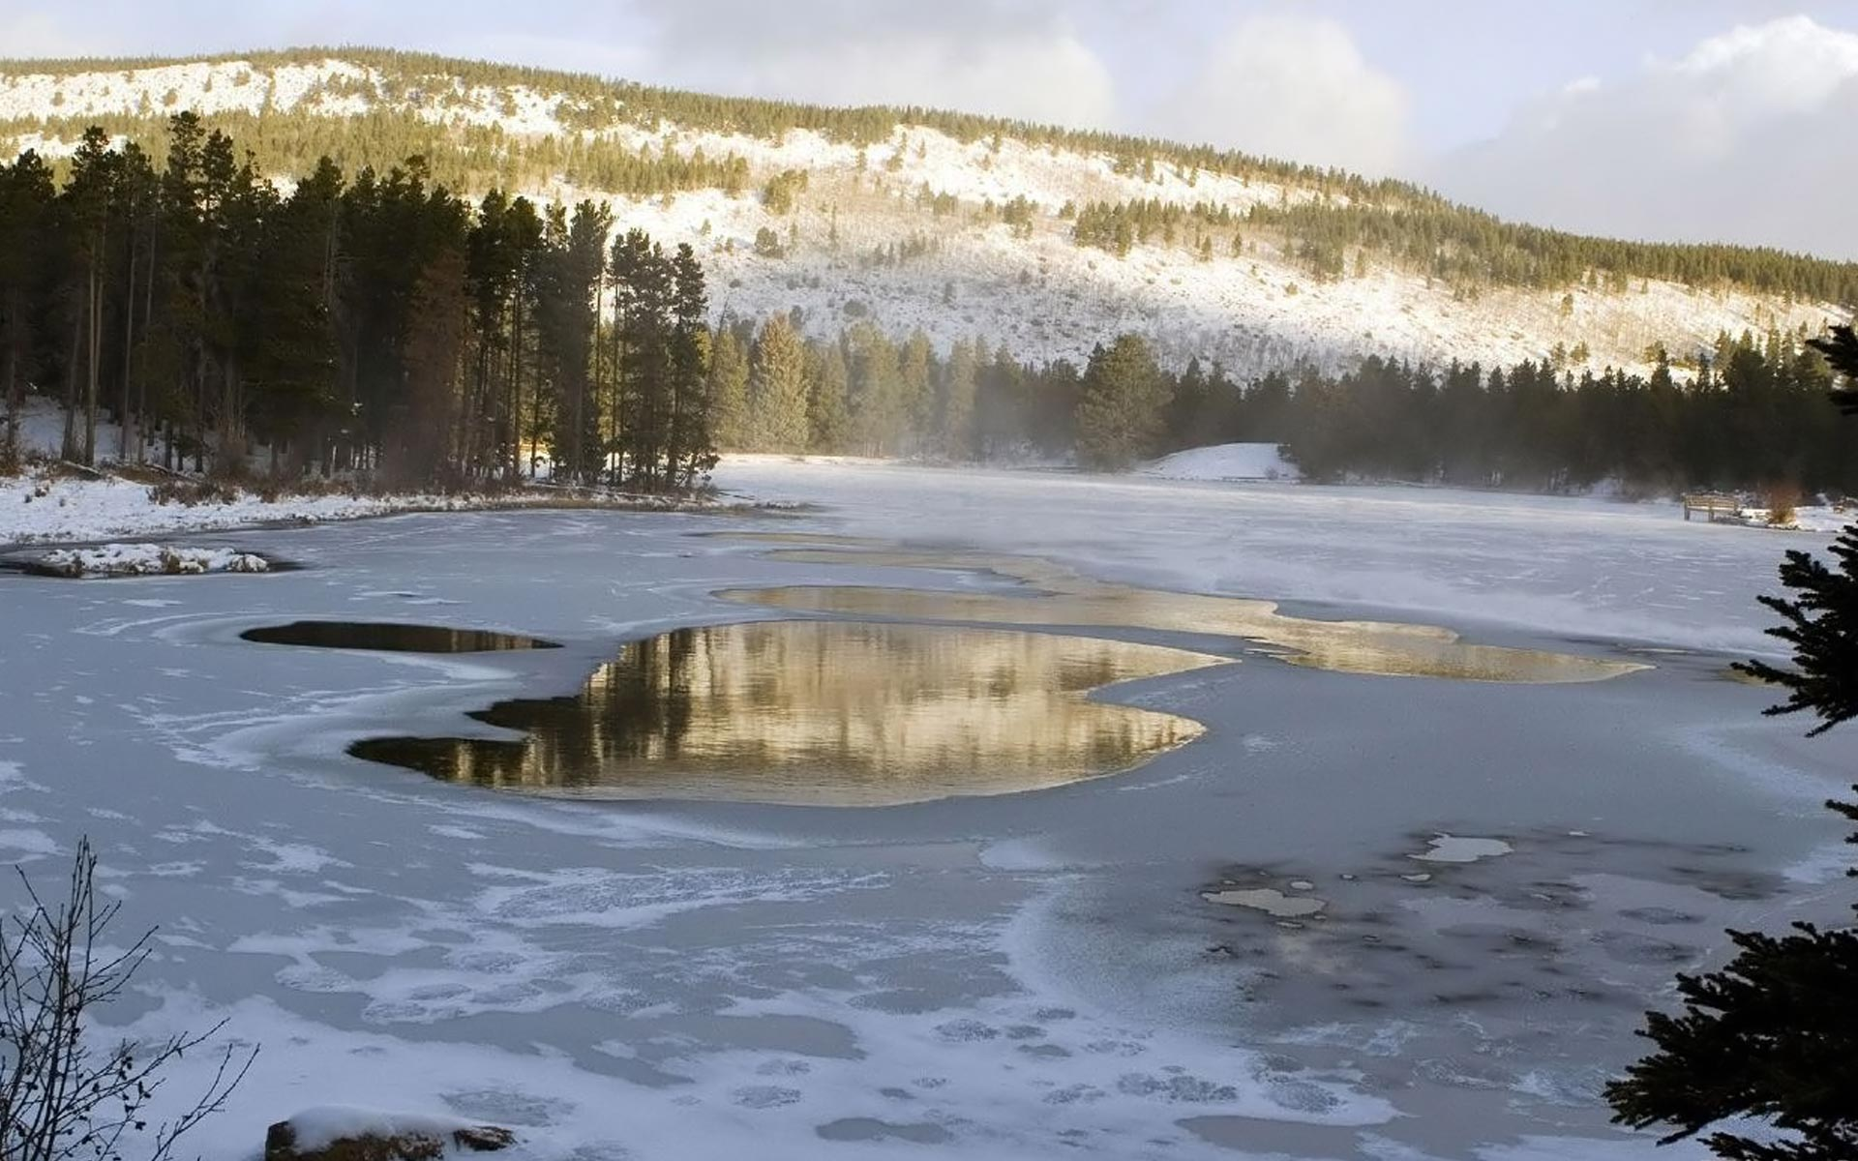
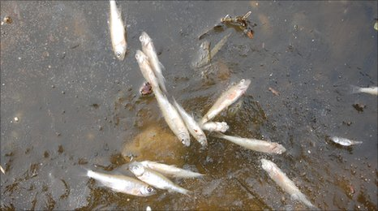
And our weather forecasts are...
Temperature changes occurs depending on season
Summer months: 4° C (at bottom) to 22° C at the top - top layer has plentiful sources of food
Winter months: 4° C (bottom) while the top is 0°C (ice) -creature hibernate
Thermocline: narrow zone with temperature and volatile waters due to wind currents
Ice sheets formation → prevents photosynthesis and survival of some creatures
Our expert advice = vacation!

Slide 5
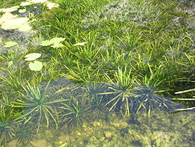
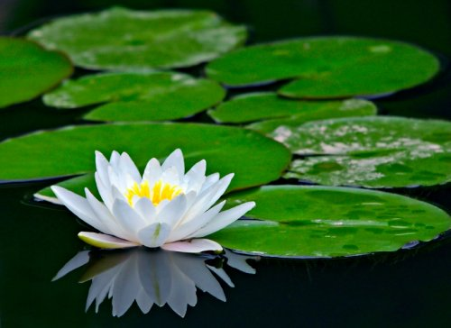
Vegetarian? If not, we’ll get to that later...
Emergent Vegetation: “rooted in the lake bottom, but their leaves and stems extend out of the water”
Examples: Bulrush (reeds) and cattails grow in littoral zone =shelter/protection for birds, reptiles, insects, and amphibians
Invasive Species: Hydrilla, Water Hyacinth, and Eurasian Water Milfoil
Lily pads = cover for fish + shield them from predators such as racoons

Slide 6
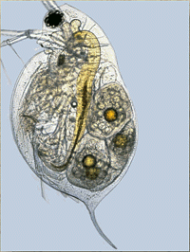
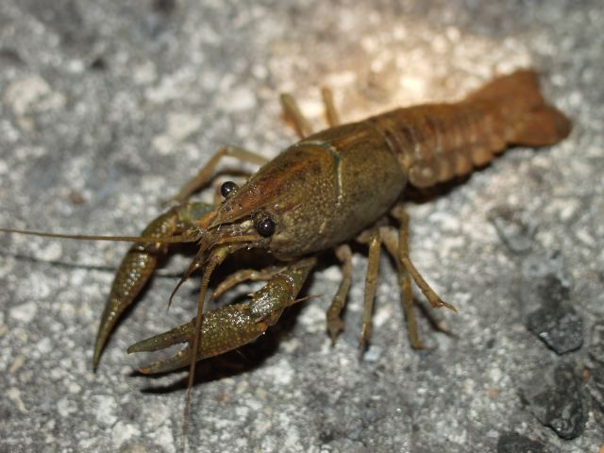
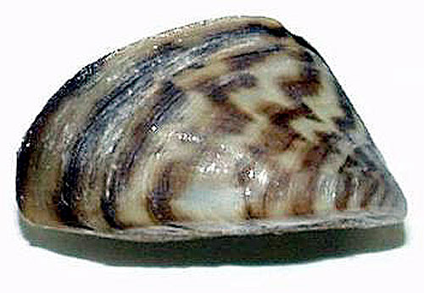
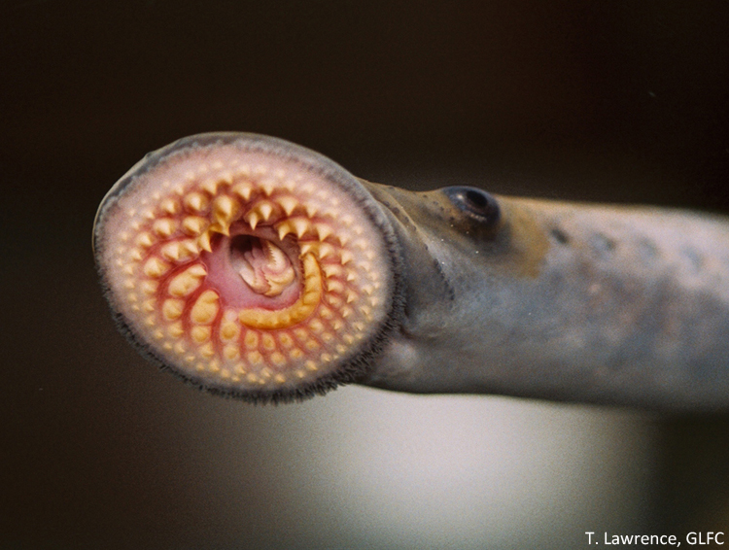
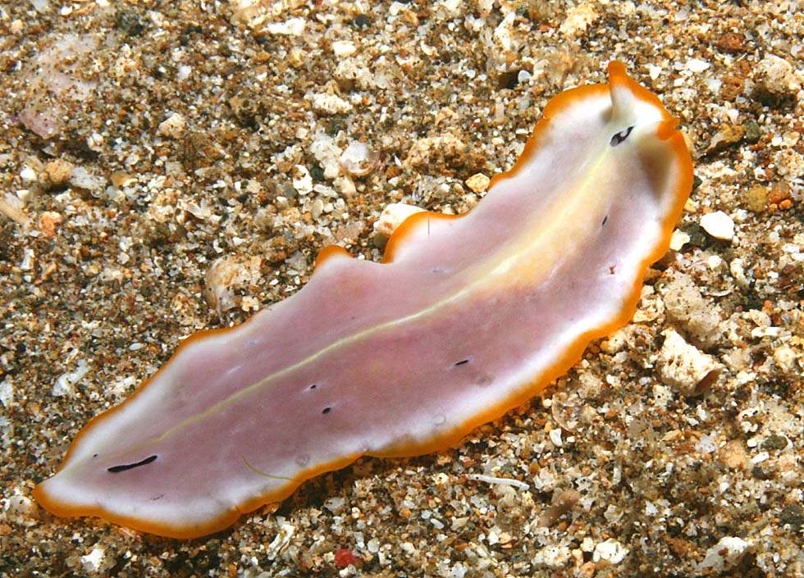
Curious about your neighbors?
Invasive Species: zebra mussels & sea lampreys
Dragonflies & Mosquitoes
Frogs & Tadpoles
Water Flea -eats algae
Snail - also eats algae
Turtles
Flatworms - eat mosquito larva
Racoons
Crayfish
Ducks, geese, swans
Beavers

Slide 7
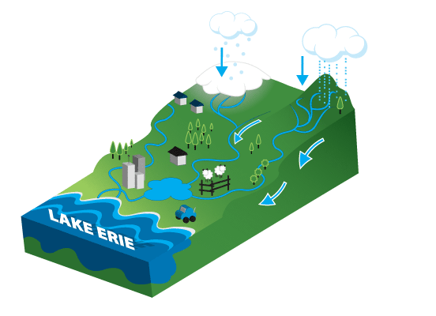
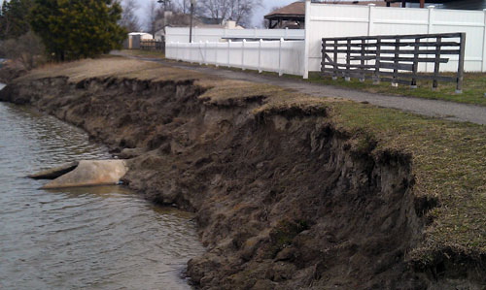
Sigh. Those pesky humans are after us, too.
Industrialization, agriculture, fossil fuel combustion and waste disposal hurt the biome
Runoffs from farmland and cities contain fertilizers and pollutants → algae blooms + hurt species populations
Dead organic matter → dirties water = we depend on the fresh water for sources :(
Increased susceptibility to flooding, erosion, sedimentation, and droughts
Lakes + ponds allow things in through streams, but don’t let things out most of the system (somewhat closed systems)

Slide 8
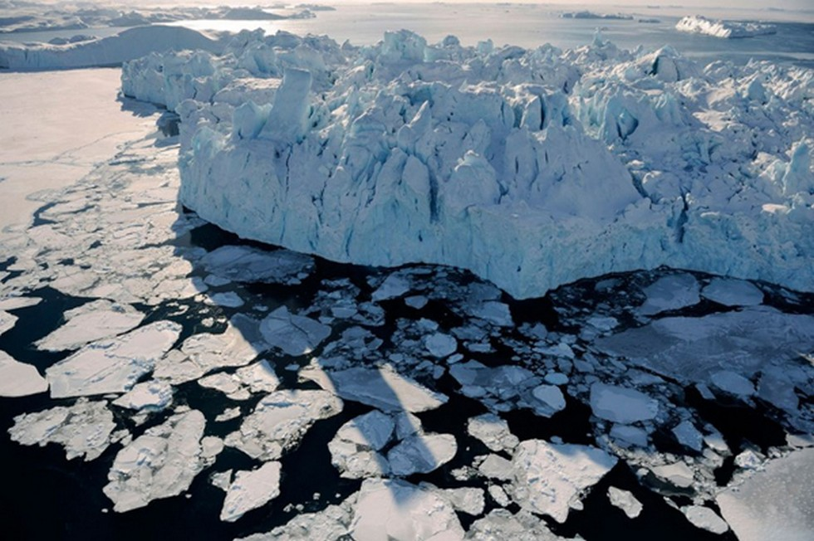
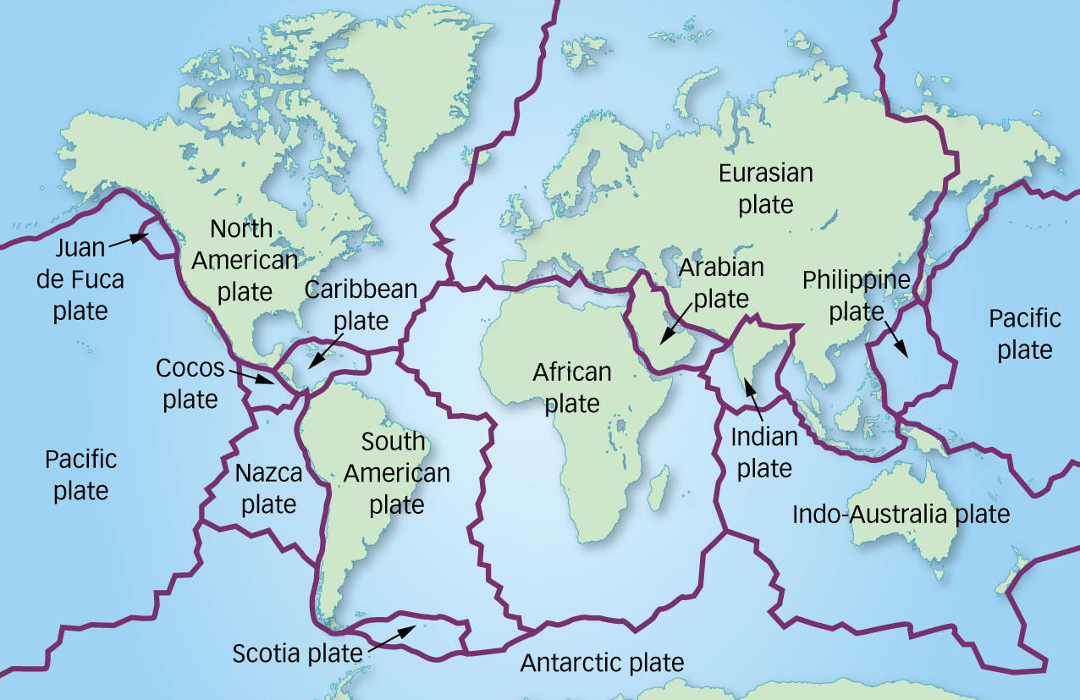
Cool Facts about this Cool Biome!
Lake formation: N. North America = melting of glaciers; Africa = tectonic plates shifting
Lake Death: sediment enters the system (sedimentation)
Deeper lake = needs more sediment for the lake to die
When ponds turn into lakes = gray area

