Slide 1
Welcome to the BEST BIOME!!!
BY: Rahila Rehman

Slide 2
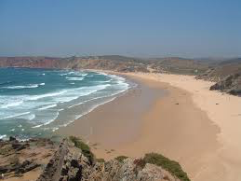
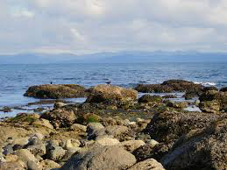
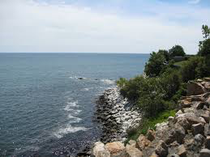
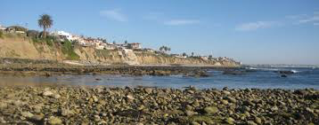
INTERTIDAL ZONES!!!

Slide 3
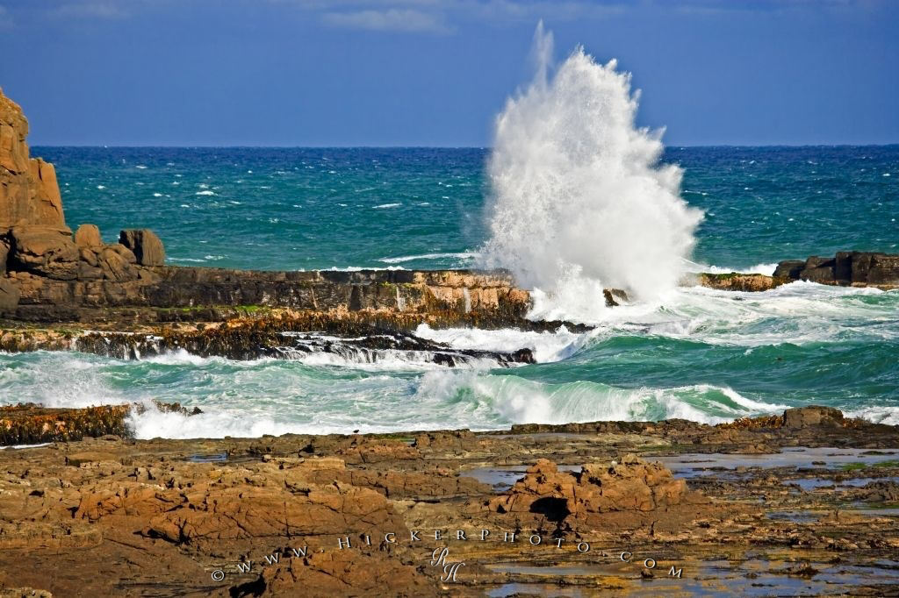
What are Intertidal Zones?
Intertidal Zones are: - SEASHORES/ COASTLINES - LITTORAL ZONES - BEACHES - BEST BIOME!

Slide 4
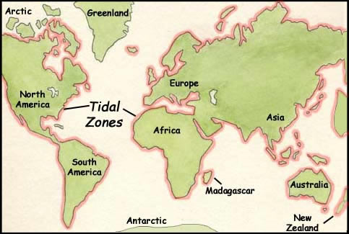
Where?

Slide 5
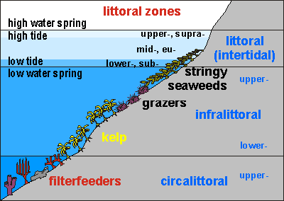
Location
It is located between high and low tides.

Slide 6
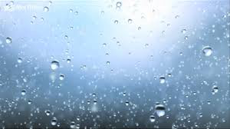
Precipitation
It has a moderate amount of rain yearly, but due to all the different locations, you can not pinpoint a certain amount. It depends on the location.

Slide 7
Temperature
The temperatures varies quite frequently.
Due to the “moody” temperature, the organisms in this biome adapt to the changes in the environment quickly.
20- 40 degrees Celsius (70- 100 degrees Fahrenheit)

Slide 8
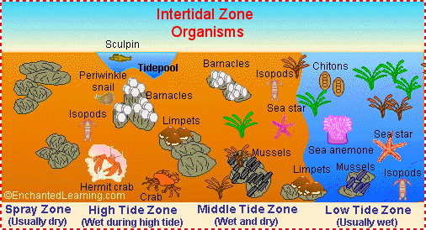
Soil
VERY RICH nutrients, and oxygen, the sun’s rays reach the sediment in the littoral zone, helping plants and other vegetation blossom.
It is where the “land and sea meet”, and this may also effect the richness of the soil.

Slide 10
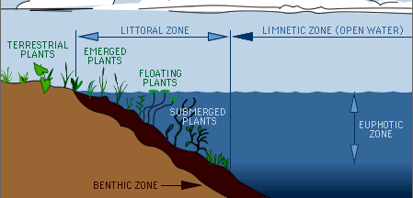
WHAT IS A LITTORAL ZONE?
The Littoral Zone is where sunlight reaches the bottom of the water, thus leading to the growth of vegetation.

Slide 11
Climate Change
There is already very severe weather changes that organisms need to deal with, and if the temperature increases even more, it will push the limit for these organisms.

Slide 12
Sea Stars

Slide 13
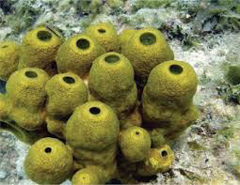
Sea Sponges

Slide 14
Crabs

Slide 15
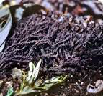
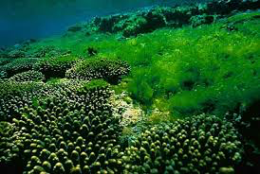
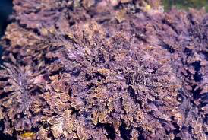
Algae, Black Pine, and Nail Brush Seaweed

Slide 16
FUN FACTS
It is were the characters from Spongebob Squarepants live.
They are ALL over the world!
Salinity is VERY high in intertidal zones.
ALSO, IT’S THE BEST BIOME!!!

Slide 17
I WILL BE WAITING FOR YOU!!!

Slide 18
I’M TALKING ABOUT YOU!!!

Slide 19
ONE LAST THING…
TO MOVE TO A INTERTIDAL ZONE, GO TO MY WEBSITE:
RAHILAHASTHEBESTBIOME.COM

Slide 20
SOURCES
http://www.lakeaccess.org/ecology/lakeecologyprim9.html
http://www.beachapedia.org/Intertidal_Zone
http://izprojecttna.blogspot.com/2008/03/fun-facts.htm
http://public.wsu.edu/~rlee/ocean/chapt11lecture.pdf
http://www.bbc.co.uk/nature/habitats/Intertidal_zone
Textbook
http://www.enchantedlearning.com/biomes/intertidal/intertidal.shtml

