Slide 1
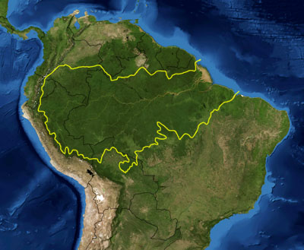
What? where?
Brazil’s Amazon Rainforest
Balbina Dam - est. 1989, Uatuma River - NW Brazil
Artificial Archipelago of 3,546 Islands
Creation of Balbina Lake - one of the largest hydroelectric reservoirs
Hydroelectric Dams = green sources of renewable energy
Turbine → water movement → mechanical energy
Mechanical Energy → Electrical energy via Generator

Slide 2
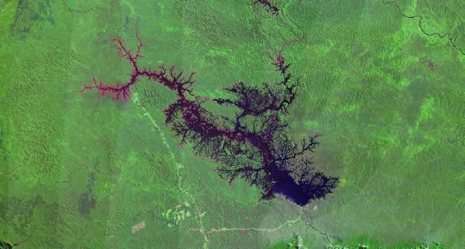
research on balbina dam
Research conducted by the University of East Anglia
Biodiversity surveys for two years
Monitored species populations on 37 islands
Also studied 40 forest sites
Used satellite images to follow distribution of islands
Images: Hidden cameras took photos of animals

Slide 3
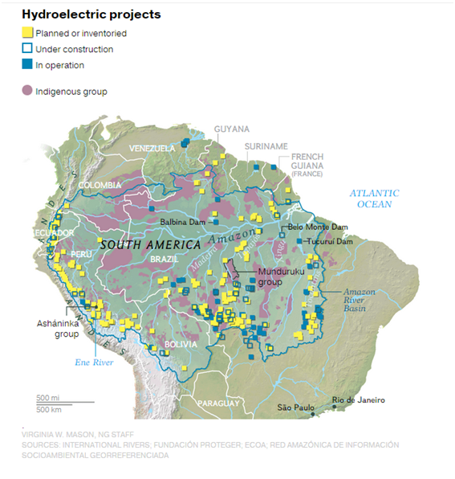
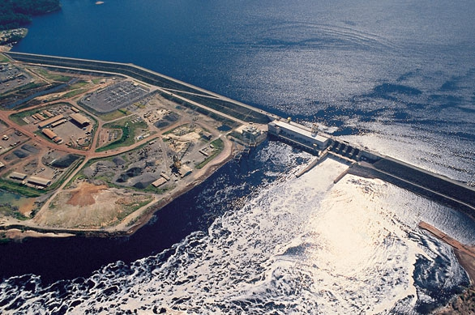
*South American nations are proposing and constructing countless hydroelectric dams

Slide 4
Research Outcome + Biodiversity impacts
26 years of isolation → widespread of animal population loss → large vertebrates (mammals, birds, and tortoises) essentially vanished from the majority of the islands
25/3,546 islands still inhabit about 80 percent of the 35 species under study
Only 0.7 percent of all islands were 475 hectares & still harbored a diverse ecosystem
Scientists predicted a 70% + extinction rate of the 124,110 species throughout all of the islands

Slide 5
Environmental Concerns
Balbina Dam flooded 3,128 km squared of forests post-construction
Separated lands → floods → kills trees, destroys habitats → increases greenhouse gas emissions, loss of biodiversity
Separated lands → disruption of naturally flowing rivers → hurts biodiversity
Smaller islands prone to winds and fires → further makes restoration impossible
Only species used to small habitat ranges coped well with forest loss
Some species swam long distances to get to other islands

Slide 6
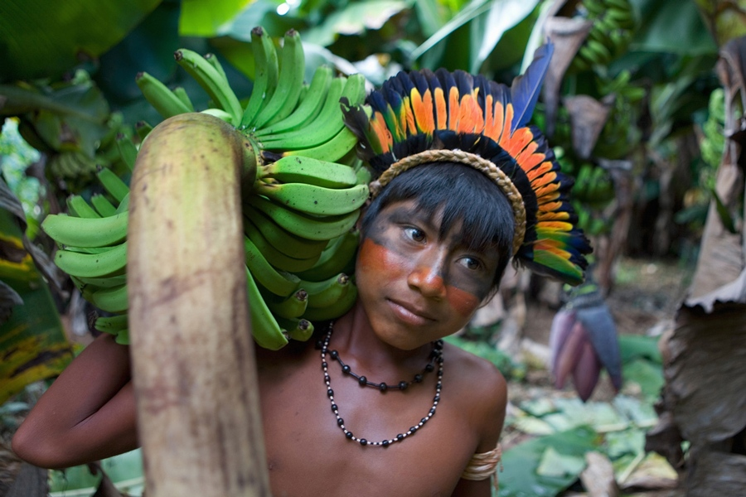
Social concerns
Alteration in landscapes, topography and habitats → depreciating populations of mammals, birds and tortoises
Limits food supply for Indigenous populations
Broken up land = displacement of indigenous people
Increases costs of restoration for communities experiencing flooding, fires, biodiversity loss, etc.

Slide 7
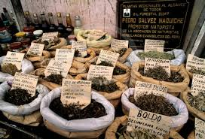
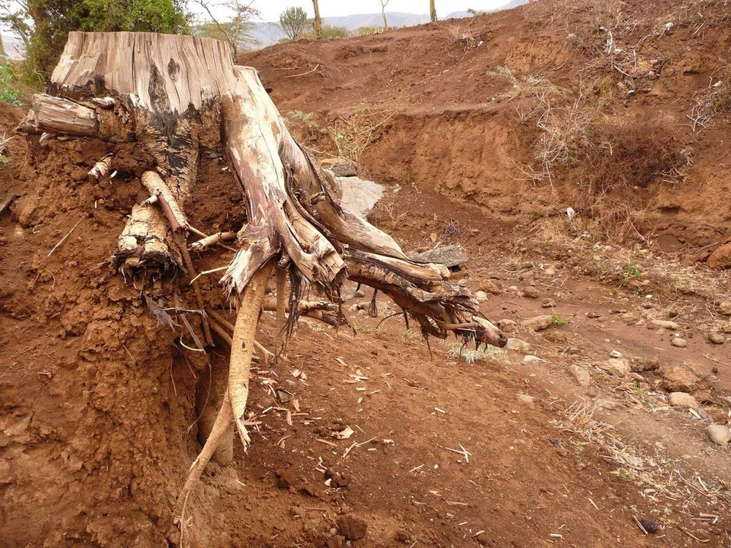
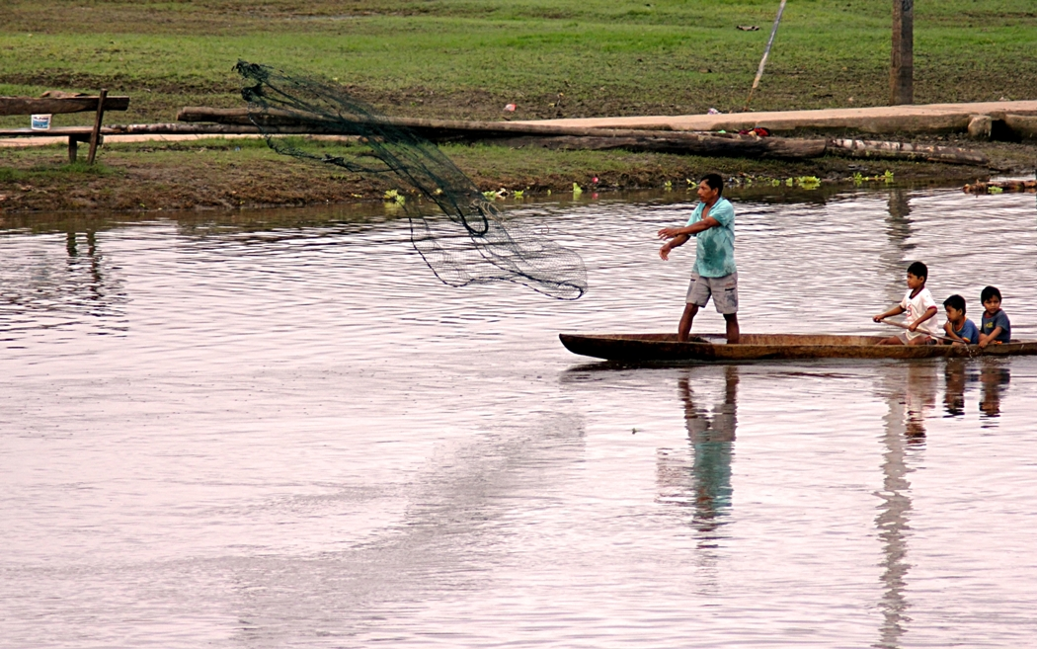
economic concerns
Researchers says = hydroelectric dams are globally known to be environmental friendly + renewable source of energy
Supports the “burgeoning energy demands of emergent tropical countries” - such as Brazil
Yet the effects of dams will cause...Low fishery revenues
Lost resources (trees for timber and loss of soil)
Lost biodiversity = fewer resources for medicines
Small islands →floods→deforestation→soil erosion→the farming that is possible=impossible

Slide 8
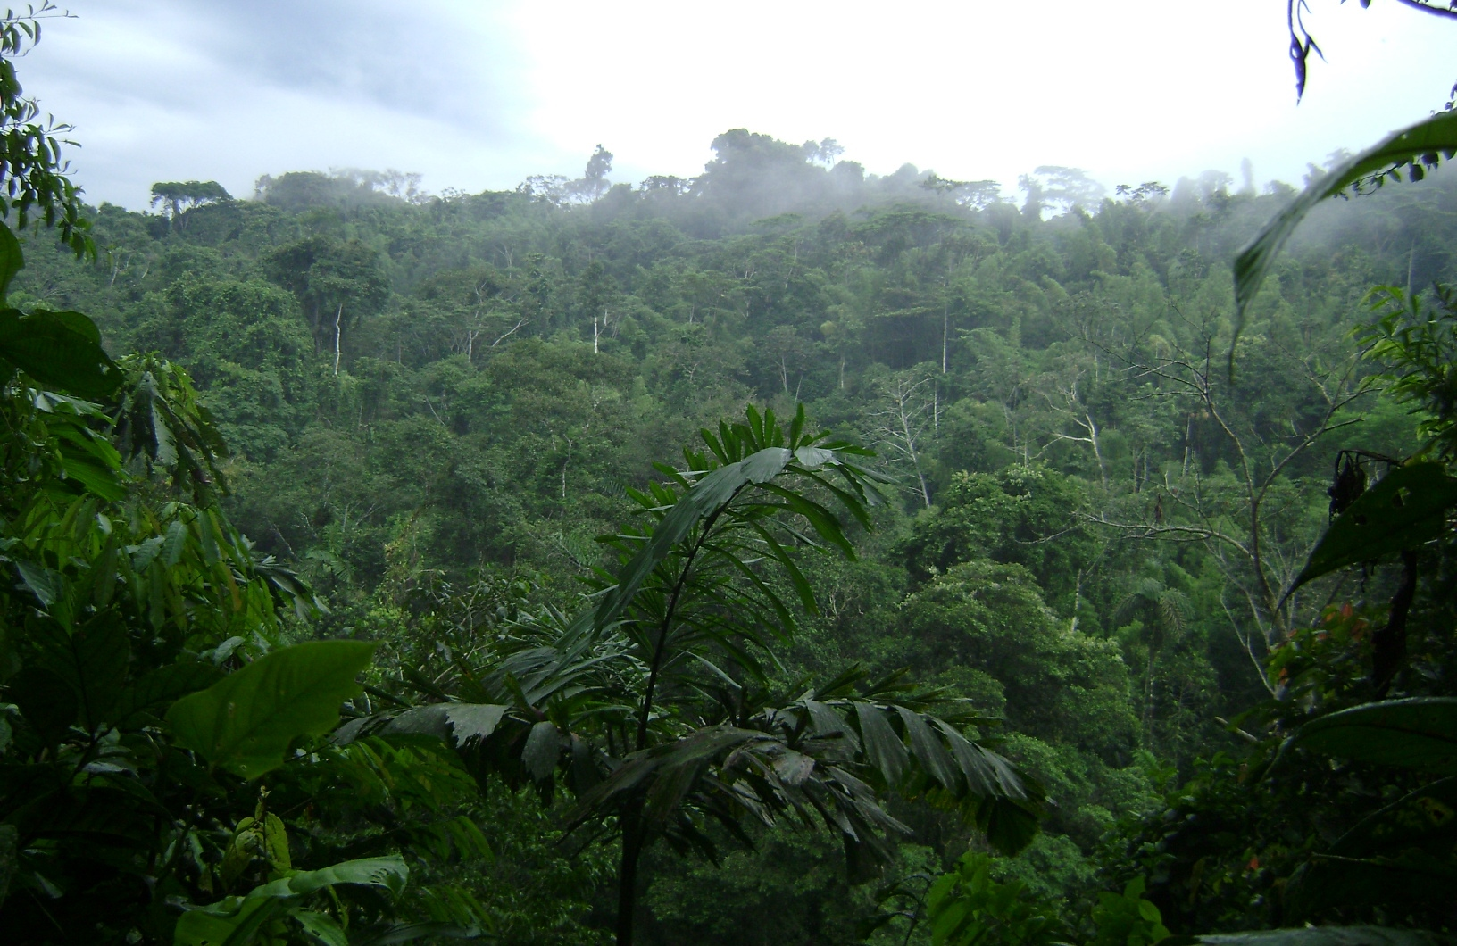
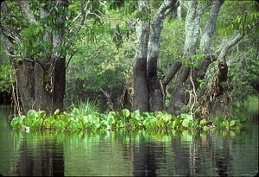
What to do?!
“We’re watching extinction unfold right in front of us...we uncovered astounding local extinction rates...even in areas that belong to a biological reserve and are protected from hunting.”
- Carlos Peres, professor at University of East Anglia, School of Environmental Sciences

Slide 9
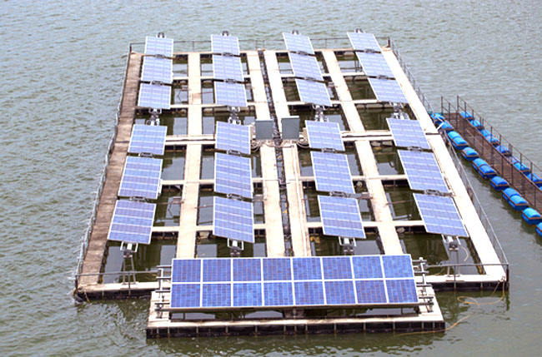
resolving the issue...
Brazil and U.S. pledged to restore 12 million hectares (46,332) of brazil’s forests by 2030
Area = the size of England- by 2030
Also promised to increase utilization of solar wind and geothermal energy
One study claims that Balbina Dam produces 2x the amount methane and C02 emissions of a modern coal power plant
Due to rotting and decomposing vegetation and debris by shores
Still, 950,000+ dams have been built globally
2,215 new hydroelectric dams have been proposed/under construction in South America
B/C of high energy demand-75% of Brazil’s energy derives from hydropower
Countering effect by installing floating solar panels
Will cover a 2,360 km squared surface
However, the damage to the biodiversity is 99.99% irreversible

