Slide 1
Bangladesh vs. Global Warming!
By: Bukurie Huseinovic

Slide 2
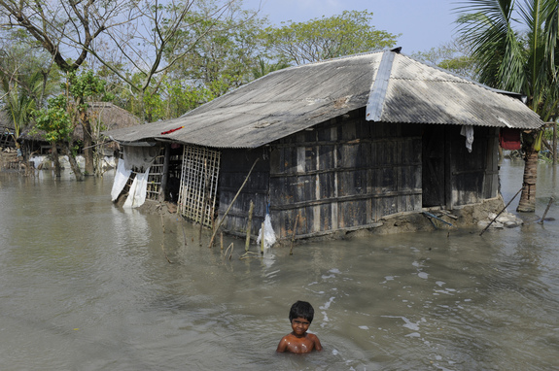
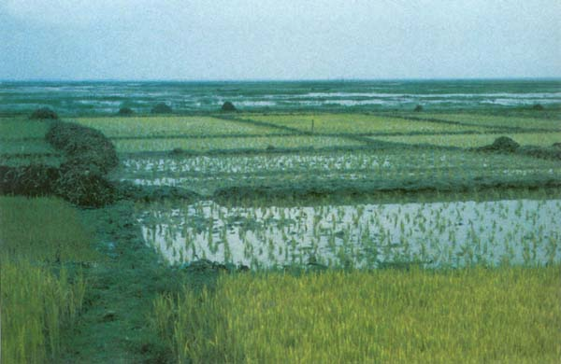
What is the issue?
Climate change is affecting Bangladesh
land consists of floodplains (80%) which leads to more flooding during the rainy season
Rising sea levels

Slide 3
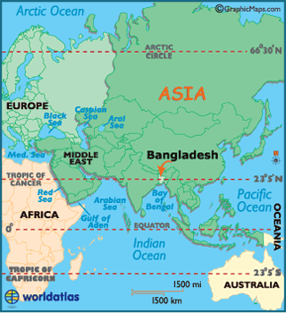
Where?
Bangladesh is a country located in South Asia
bordered by India

Slide 4
Why does it matter?
This issue matters because there are 150 million people living in this country and two thirds of the population engage in farming
if this land is destroyed their livestock will be affected
produce will be reduced
people will begin to starve
The climate is characterized by high temperatures, heavy rain full, and high humidity
highly vulnerable to natural disasters
homes destroyed
poverty

Slide 5
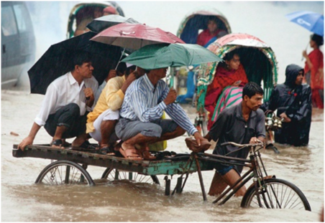
Environmental concerns
Since there are more floods this leads to:
crops being drowned in water
Increase in temperature leads to:
droughts (North and North western regions of the country are suffering the most)
Salt and freshwater conditions
almost all fish are sensitive to these types of water

Slide 6
Social concerns
40% of 150 million live below the poverty line
Since people live in slums they are more prone to diseases
Not enough food being produced
becoming difficult for people to feed their families
Women are more vulnerable than men
death rate was 5 times higher for women than men

Slide 7
Economic concerns
Fishery sector has been affected
they contribute about 3.5% of the GDP in Bangladesh
people depend on fish products in order to meet the majority of their daily protein requirements
People have lost jobs due to all of the floods and misplacement
unemployment
migration to other cities
Floods destroyed and damaged about 2 million tons of food
about 65 percent of the population is employed in agriculture
decrease in workers and production

Slide 8
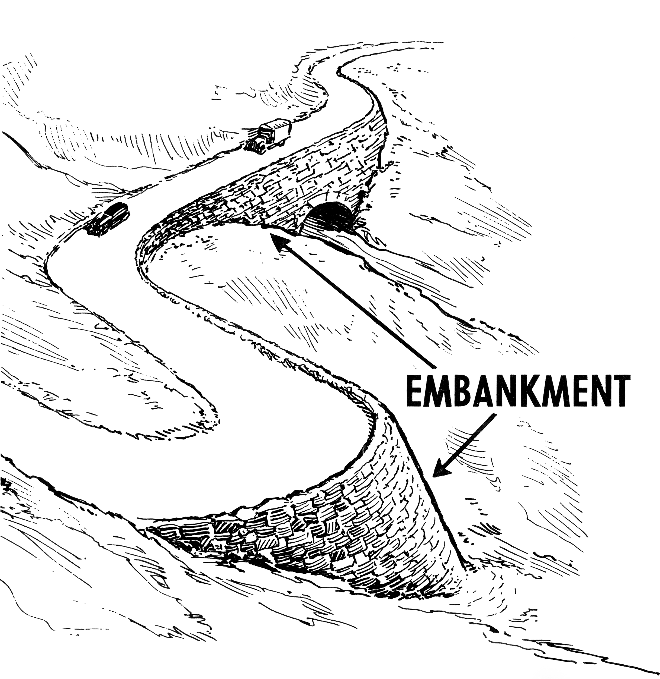
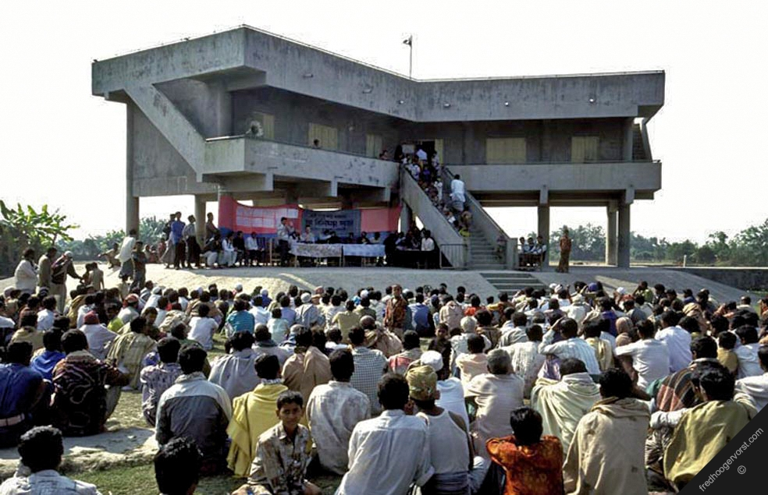
What’s being done?
They are trying to grow food in the tidal saline areas (containing salt)
with the use of “sweet-water harvesting”
Developing technology to capture freshwater during the monsoon season
to be used to irrigate rice
Developing salt-strains of food crops
ex. rice
Bangladesh officials are appealing for more aid from fossil-fuel-burning industrialized countries- largest emitters of greenhouse gases
They have invested $10 million to reduce vulnerability to natural disasters
built embankments and cyclone shelters

Slide 9
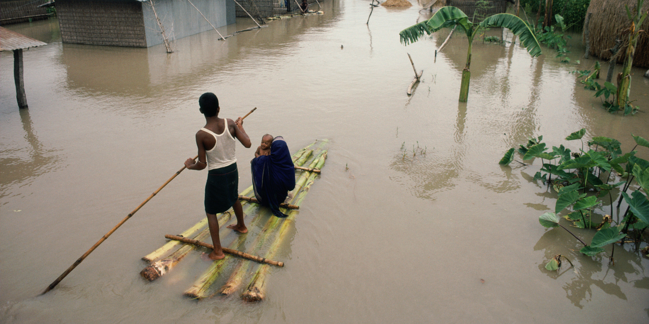
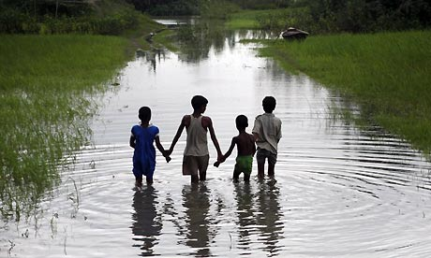
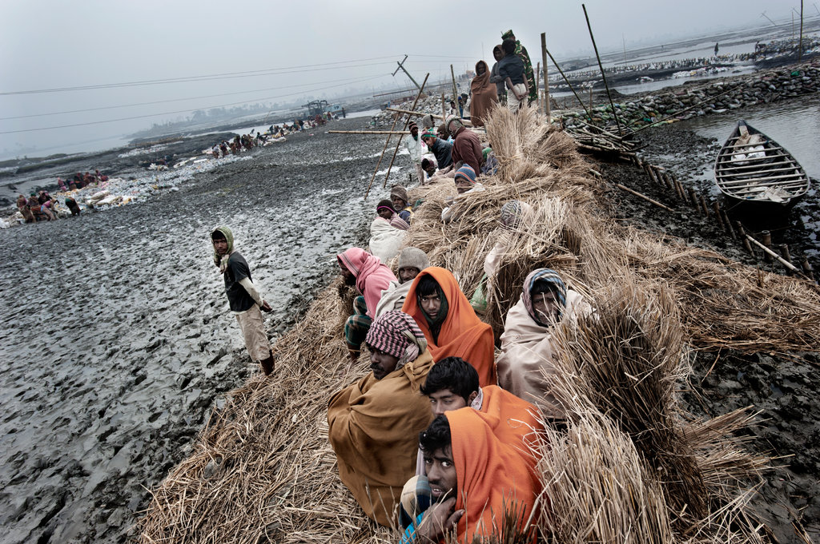
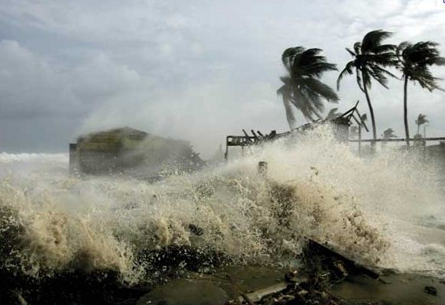
Pictures

Slide 10
Sources...
http://beforeitsnews.com/alternative/2013/06/top-10-countries-most-affected-by-global-warming-2682796.html
http://www.nytimes.com/2014/03/29/world/asia/facing-rising-seas-bangladesh-confronts-the-consequences-of-climate-change.html?_r=0
http://www.ncdo.nl/artikel/climate-change-its-impacts-bangladesh
https://www.google.com/search?q=embankments&biw=1434&bih=731&source=lnms&tbm=isch&sa=X&ved=0ahUKEwjhwoHSl7LKAhVCez4KHezbA74Q_AUIBigB#tbm=isch&q=cyclone+shelters+in+bangladesh&imgrc=cIVnHF8OcLM5JM%3A
http://www.usnews.com/news/energy/articles/2009/03/26/how-global-warming-threatens-millions-in-bangladesh?page=2

