Slide 1
SWBAT different chemical pollutants of drinking water and materials for water filtration. Do Now: What are some similarities between the lead contamination in Newark public schools and Flint?
ES Unit 9 3/31/16
Lesson 7

Slide 2
Agenda
Lecture
Video
Reading
Pass Back Unit 8 Exams

Slide 3
Vocab:
Maximum Contaminant Level Goal(MCLG): level of a contaminant in drinking water below which there is no known or expected health risk.

Slide 4
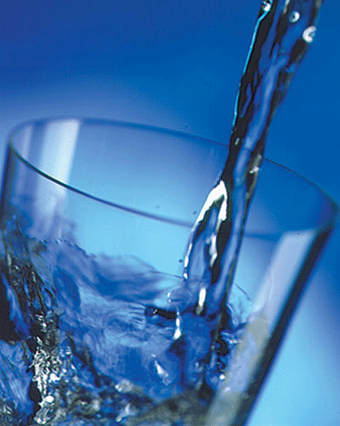
Drinking Water Regulation
Safe Water Drinking Act
Regulates the nation’s public drinking water supply
EPA has set standards to control over 90 chemicals.

Slide 5
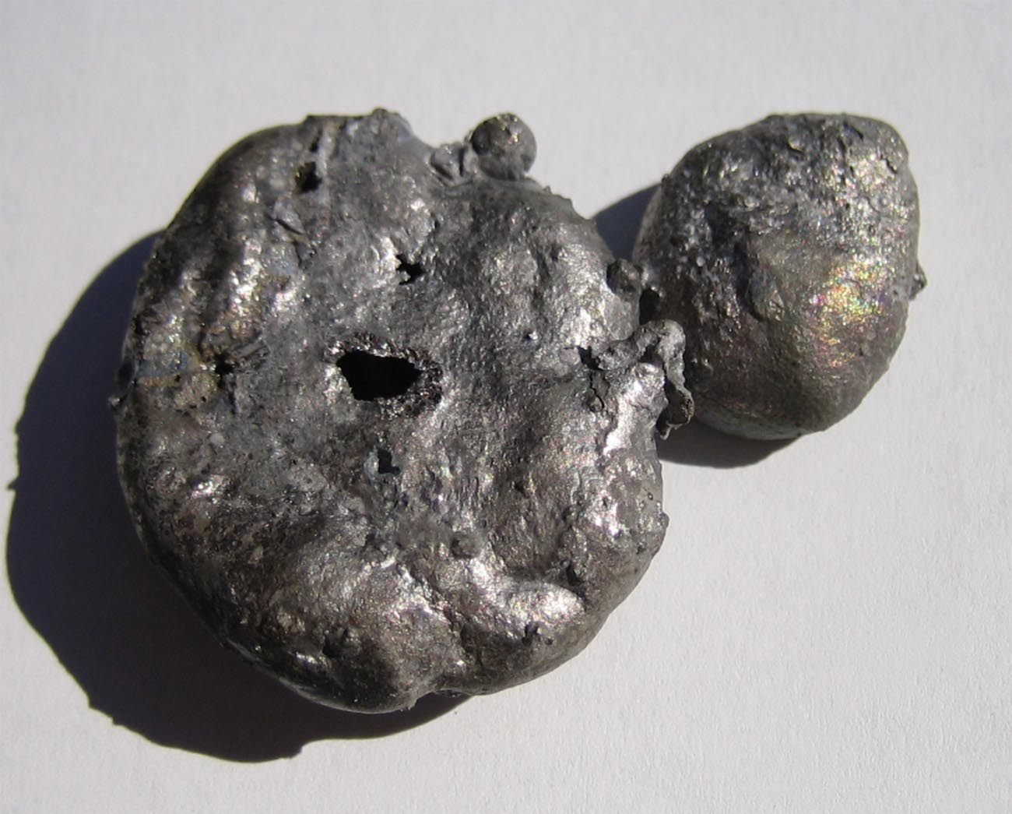
Water Impurities
Chlorine: MCLG is 4 mg/L
Can cause eye/nose irritation, stomach discomfort
Used to control microbes
Iron : MCLG is .3 mg/L
Rusty color and metallic taste

Slide 6
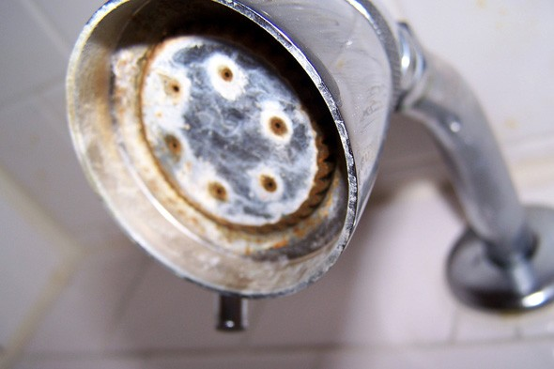
Water Hardness
Hard water has high mineral content
Minerals: calcium and magnesium
Not harmful to human health

Slide 7
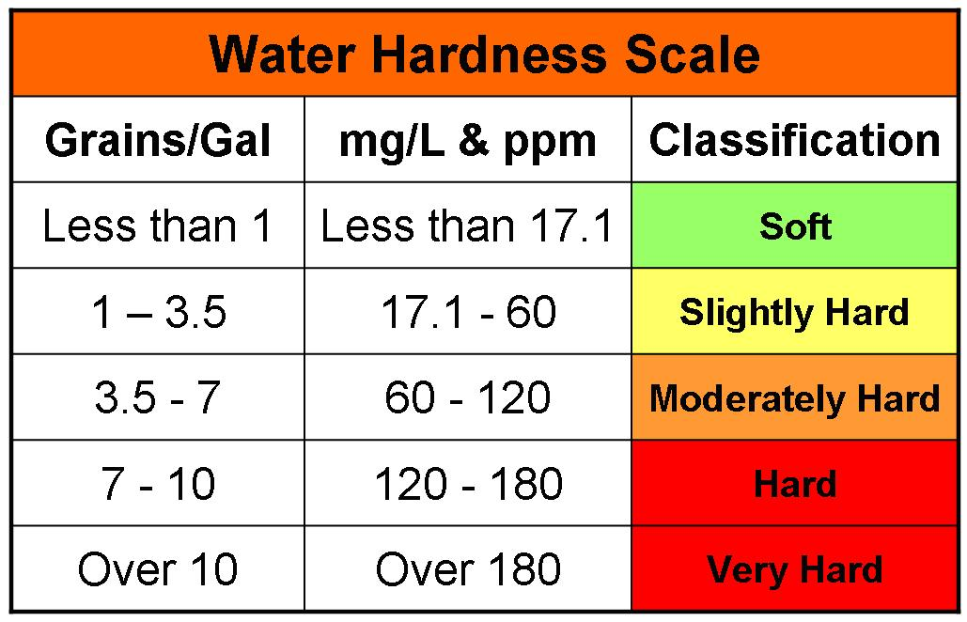

Slide 8
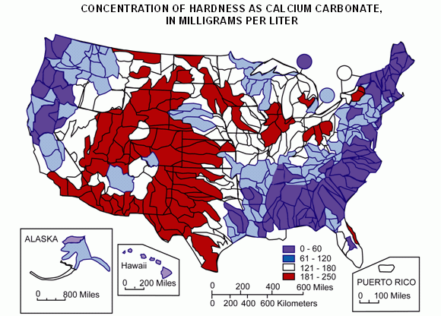

Slide 9
pH of Drinking Water
Ideal pH: 6.5 to 8.5
Low pH: bitter, metallic taste; corrosion
High pH: soda taste
Contaminated water tends to be more acidic.

Slide 10
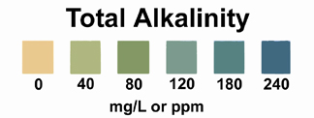
Alkalinity
Measure of substances that can neutralize an acid
Alkalinity in streams is influenced by rocks, salts and plant activities.

Slide 11
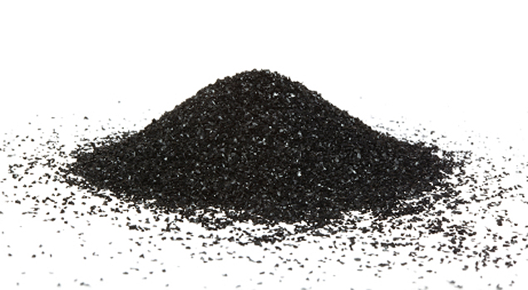
Filter Methods: Activated Charcoal
Absorbs impurities: chlorine, sediment, VOCs, taste and odor
Filters some pathogens (something that can produce disease)

Slide 12
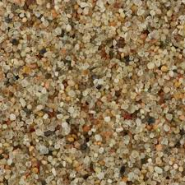
Filtering Method: Sand
One of the oldest water treatments
Slow sand filter: can filter out some pathogens and small particles.

Slide 13
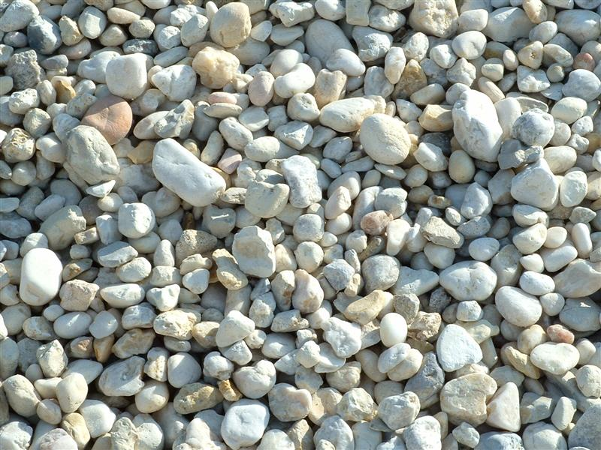
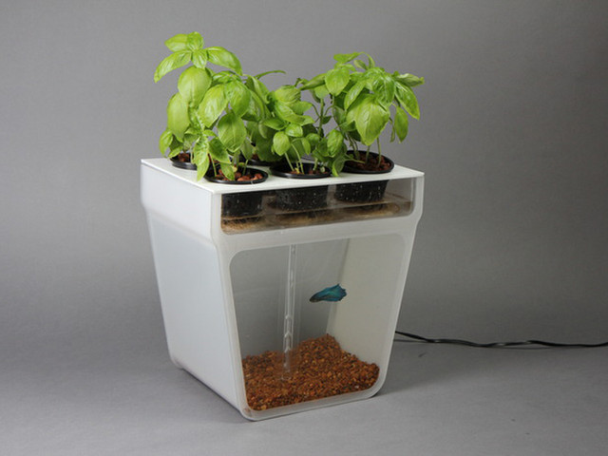
Gravel
Lightweight and porous
Traps bugs, sediment, large particles
Allows microorganisms and some chemicals to pass through

Slide 14
Water Filter Video

Slide 15
West Virginia Water Contamination
http://thedailyshow.cc.com/videos/umqysw/coal-miner-s-water

Slide 16
Unit 8 Exams
If you scored below a 65, you can do test corrections to get no higher than a 65
Come up today or tomorrow at lunch!

