Slide 1
SWBAT evaluate the cause and effects of the Flint Water crisis. Do Now: If you were one of the families whose water was contaminated by fracking, what would you do?
ES Unit 9 3/29/16 Lesson 7

Slide 2
Agenda
Reading
Video
Discussion
Reminders:
LAST day to make up lab today during the second half of lunch
Socratic seminar make up tomorrow at lunch!

Slide 3
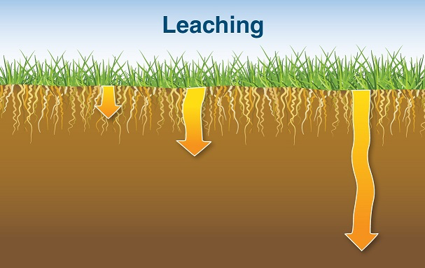
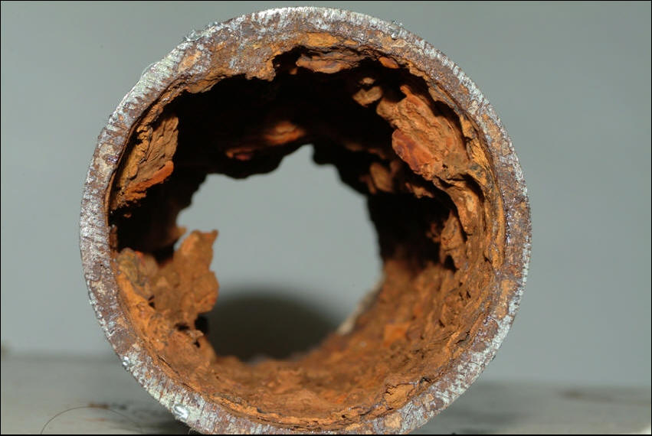
Vocab:
Corrosive: a substance that will destroy and damage other substances with which it comes into contact.
Leaching: the movement of contaminants carried downward by water

Slide 4
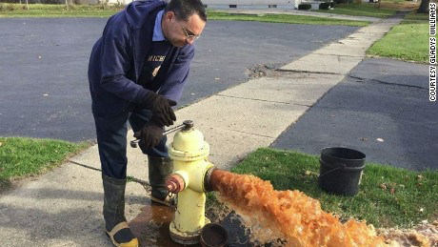
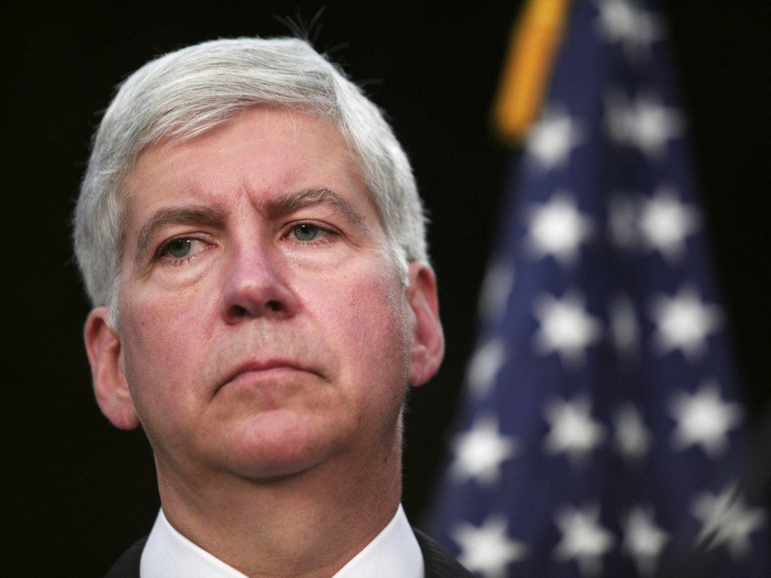
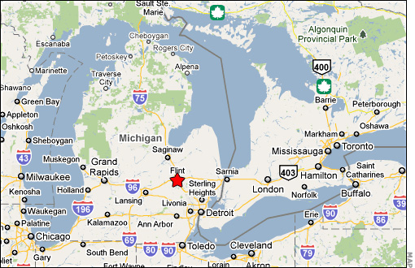
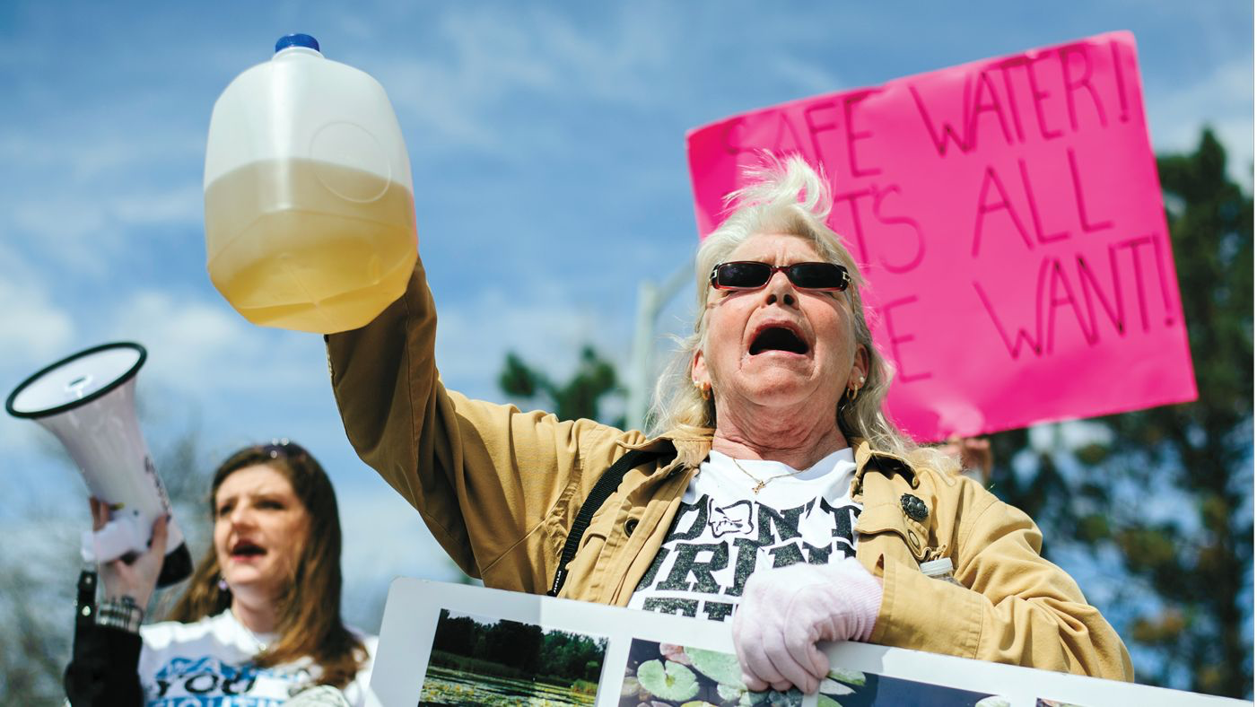
Flint Water Crisis

Slide 5
Discussion
The New York Times Editorial Board states that the “principal cause of the water crisis in Flint, Mich.: the state government’s blatant disregard for the lives and health of poor and black residents of a distressed city”. Do you agree with this statement? Why or why not?
Who do you think is to blame for the Flint water crisis? Why?
Do you think the governor, Rick Snyder, should resign? Why or why not?
Should the people of Flint whose drinking water was contaminated be compensated? Why or why not?

Slide 6
Exit Ticket
What should the government do to prevent a crisis like Flint from happening in the future?

Slide 7
Homework
Research an organization that is providing relief to citizens of Flint. Explain how they are helping.
Cite your source in APA format

