Slide 1
SWBAT to perform a close reading to assess whether or not we should allow hydraulic fracturing (fracking). Do Now: Explain two conclusions you can make from yesterday’s lab
ES Unit 9 3/23/16
Lesson 4

Slide 2
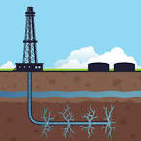

Slide 3
Hydrologic Fracturing (Fracking)
Drill vertically and horizontally into rock
Inject water into rocks along with chemicals
Opens fissures (cracks) in rocks
Allows oil and natural gas to flow into well
Pollutes ground water

Slide 4
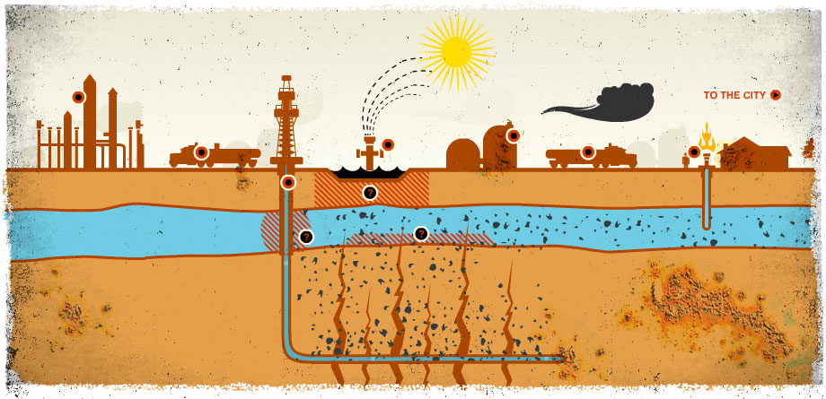
Hydraulic Fracturing

Slide 5
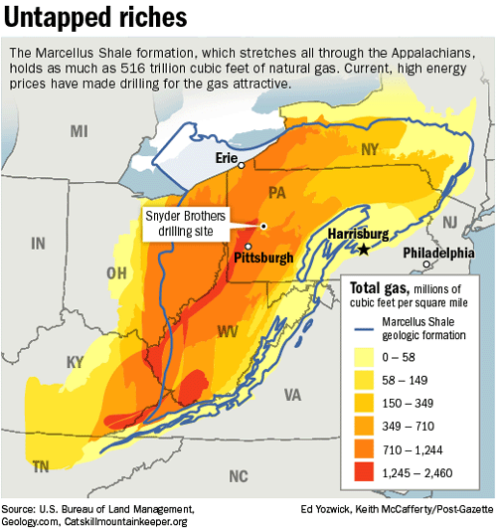
Marcellus Shale

Slide 6
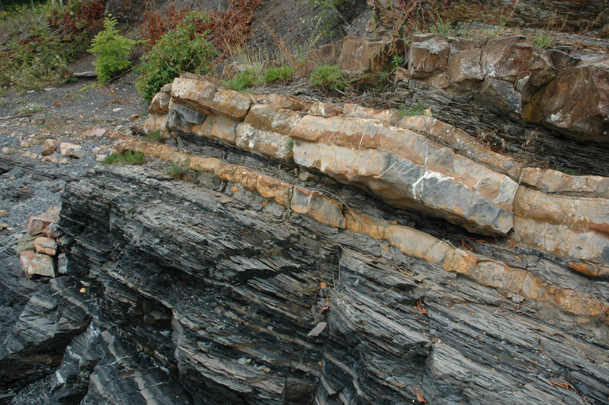
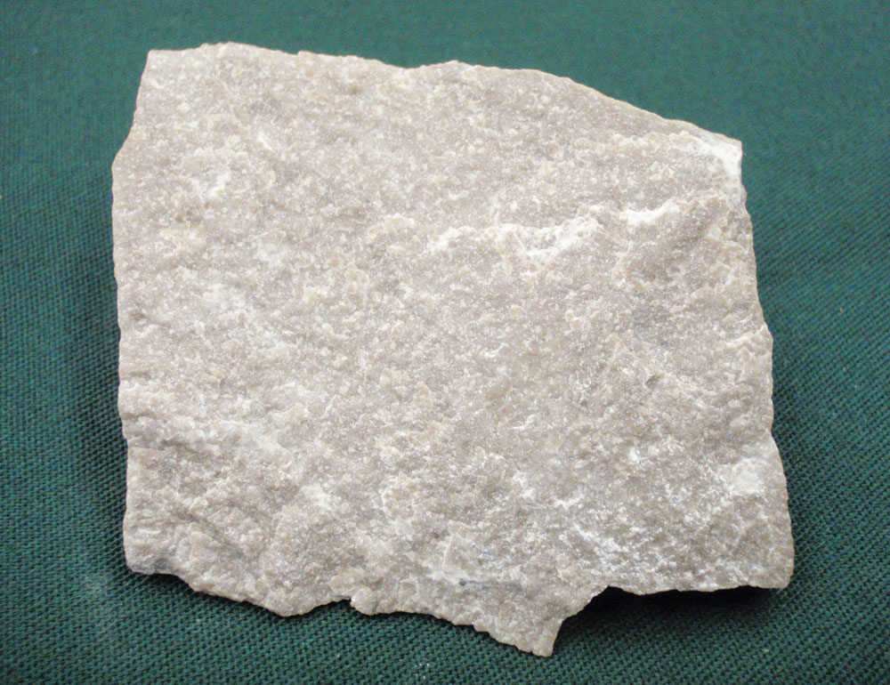
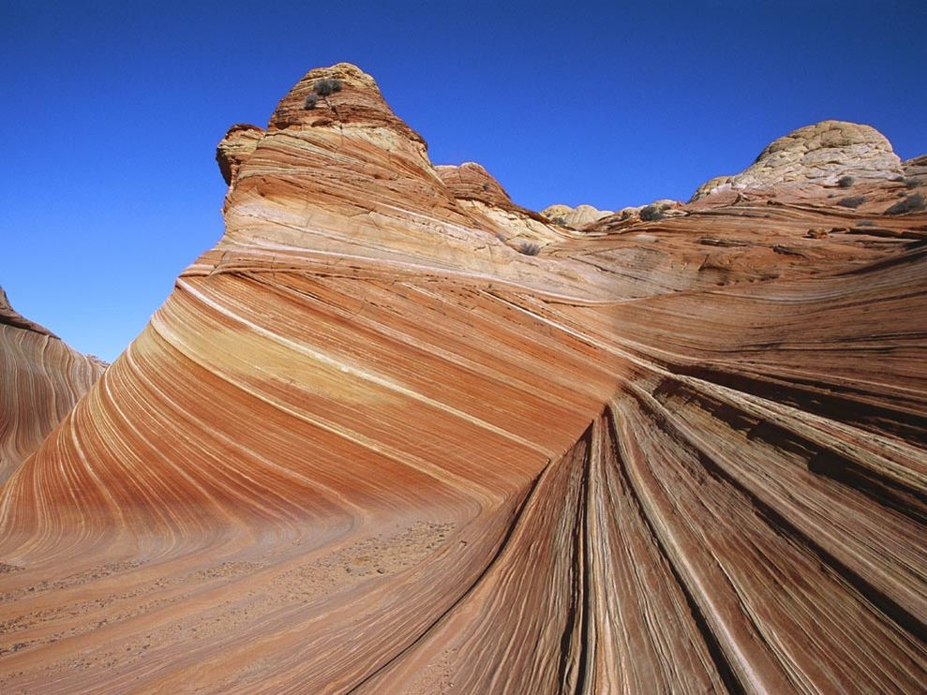
Chunk #1

Slide 7
Chunk # 2
Underline any evidence for or against fracking.
Turn and talk to your neighbors to compare the evidence.
Answer the questions and compare answer with neighbors

Slide 8
Chunk #3
Underline evidence for or against fracking
Turn and talk to your neighbors to compare the evidence.
Answer the questions and compare answer with neighbors

Slide 9
Chunk #4
Underline evidence for or against fracking

