Slide 1
SWBAT: observe the effect that many common pollutants have on groundwater. observe the effectiveness of soil as a filter for water contaminants. Do Now: Explain three reasons why groundwater is difficult to clean.
ES Unit 9 3/22/16
Lesson 3

Slide 2
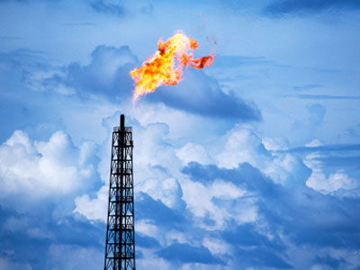
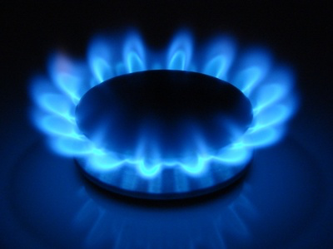
Natural Gas

Slide 3
Let’s review
What is a qualitative observation?

Slide 4
Agenda
Lab
Answer analysis questions
Clean up

Slide 5
Lab Safety
Do not drink any chemicals.
Waft- don’t smell!!!

Slide 6
Lab Roles
Person closest to the bench: grab one cup each of oil, vinegar, and laundry detergent
Person in the middle: grab a beaker of water and a graduated cylinder
Person closest to the aisle: grab four cups of soil
Runner
Closest to the aisle
Will dump out water in between uses

Slide 7
Clean up
Don’t throw out the plastic cups!
Put the cups that held oil, laundry detergent and vinegar BACK on the counter where you found them.
Put the soil cups Back where you found them
Fill up the beakers with water
Put the graduated cylinders back
Wipe up any spills (soil or liquids)

