Slide 1
SWBAT identify how ground water can be polluted. Do Now: What are ways in which ocean water can be polluted?
ES Unit 9 3/20/16
Lesson 2

Slide 2
Homework Share Out

Slide 3
Agenda
Lecture
Reading
Video
Discussion

Slide 4
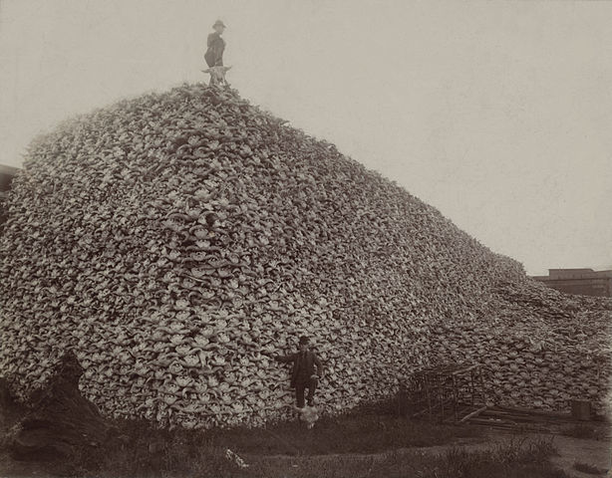
Vocab:
Overexploitation: the over use of wildlife, plant species and natural resources by people.

Slide 5
Ground Water Pollution
Why should we care about ground water pollution?
It’s our drinking water!
It can be very difficult to clean

Slide 6
Common Pollutants
Fertilizers and pesticides
Gasoline
Compounds from sedimentary rocks
Magnesium and calcium

Slide 7
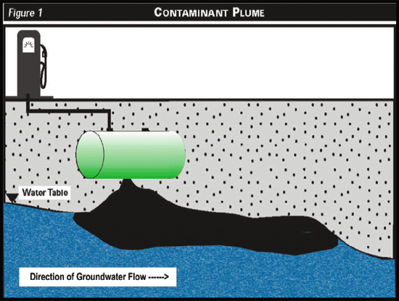
Groundwater Pollution
Groundwater cannot clean itself very well.
Slower chemical reactions in groundwater due to:
Slow flow: contaminants are not diluted
Less oxygen
Fewer decomposing bacteria
Low temperatures

Slide 8
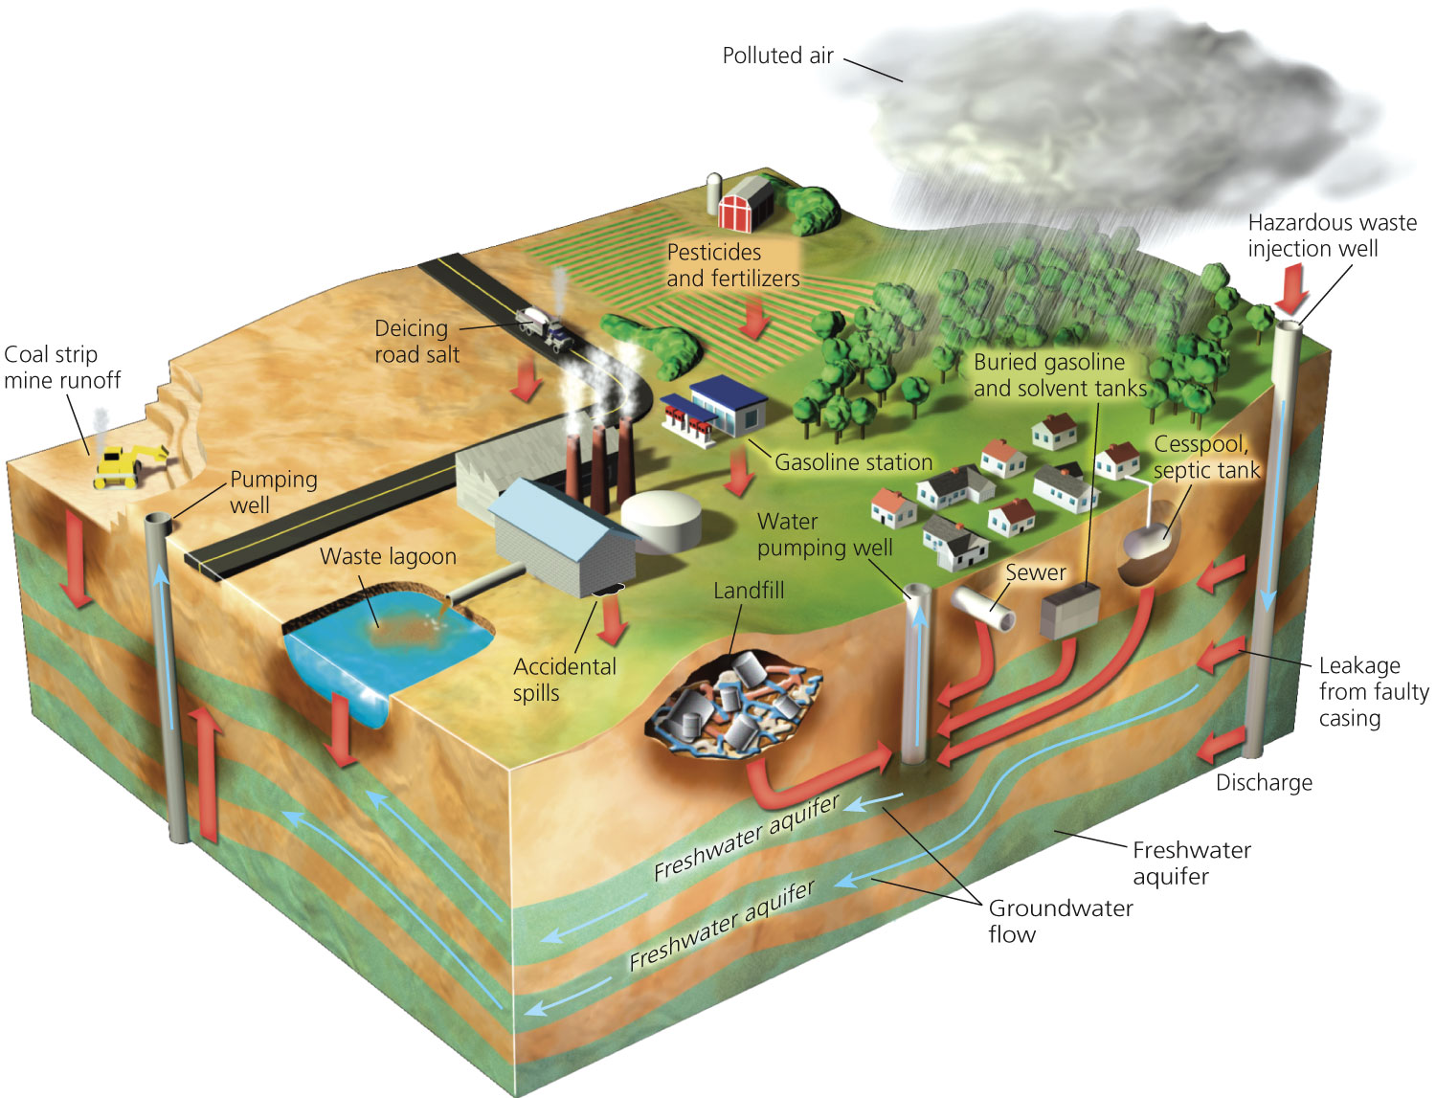

Slide 9
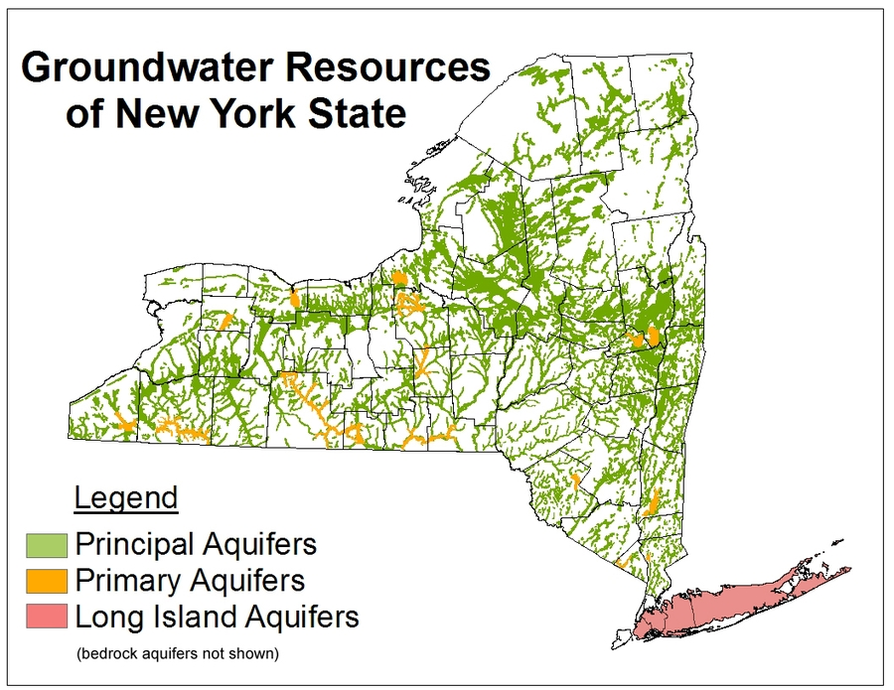
New York Ground Water
1 in 4 people get their drinking water from groundwater

Slide 10
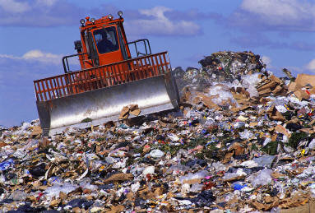
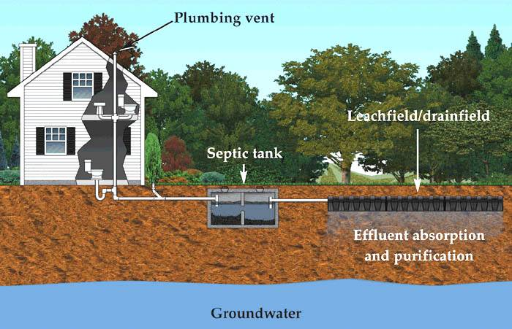
Major Contaminants in New York State
Pesticides
Landfills
Sewage
Hazardous waste sites

Slide 11
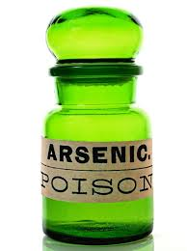
The Threat of Groundwater Pollution
China: 90% of urban aquifers are contaminated or overexploited.
US: FDA reports of toxins found in many aquifers:
Gasoline
Nitrate ions
Arsenic

Slide 12
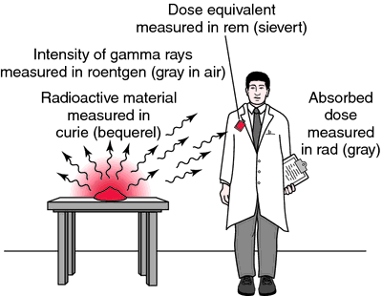
Definition
Radioactive: a material that emits energy that can harm living organisms

Slide 13
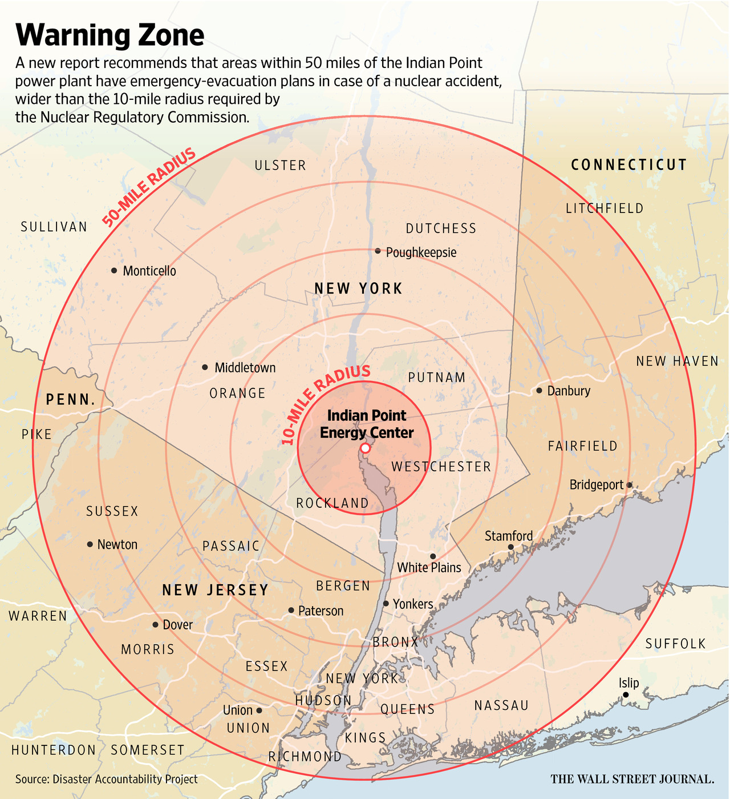
Indian Point Nuclear Facility

Slide 14
Groundwater Contamination
http://newyork.cbslocal.com/2016/02/08/indian-point-water-contamination-probe/

Slide 15
Sum it up!
What are some common pollutants of groundwater?
Why should we care about groundwater pollution?
Why is it difficult to clean groundwater pollution?

Slide 16
Homework
Define what natural gas is and what it is used for
Cite your source in APA format

