Slide 1
SWBAT understand the ways in which the ocean can be polluted. Do Now: From prior knowledge, what are ways in which the ocean can be polluted?
ES Unit 9 3/18/16
Lesson 1

Slide 2
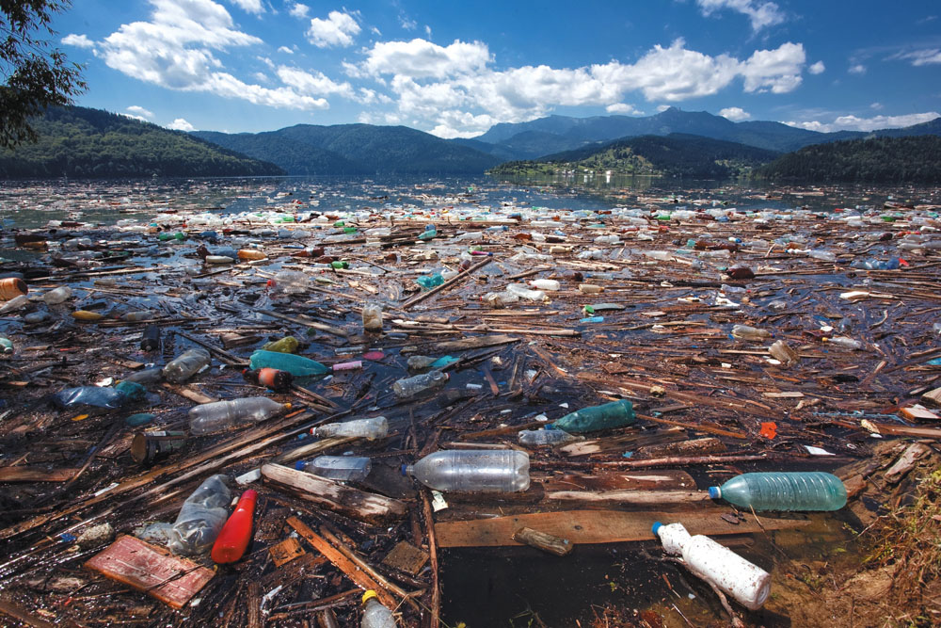
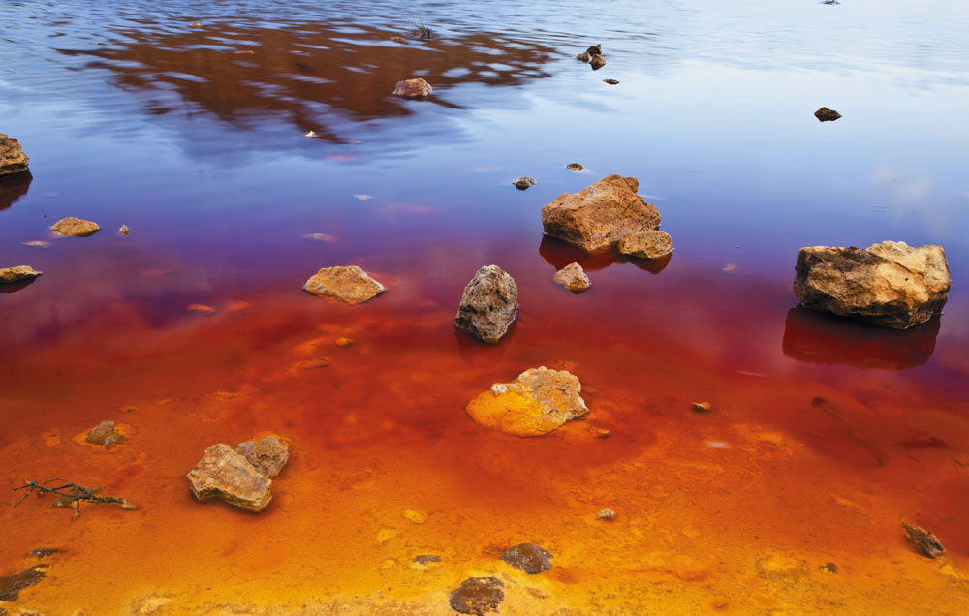
Unit 9: Pollution
3 weeks
Water pollution
Air pollution
More labs!
Essential Questions:
How are humans responsible for water pollution and air pollution?
How does pollution disproportionately affect poor populations in the U.S.?

Slide 3
Agenda
Lecture
Videos
Reading
Exit Ticket

Slide 4
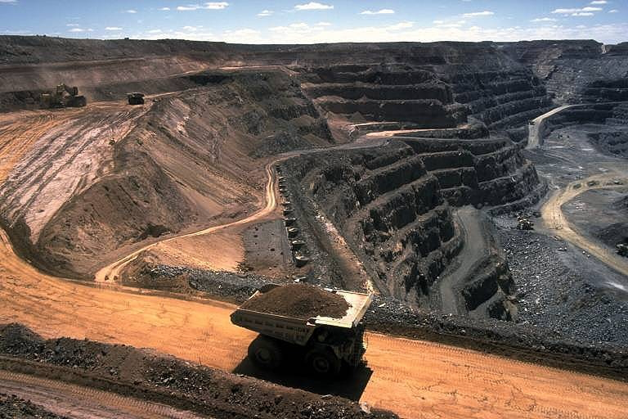
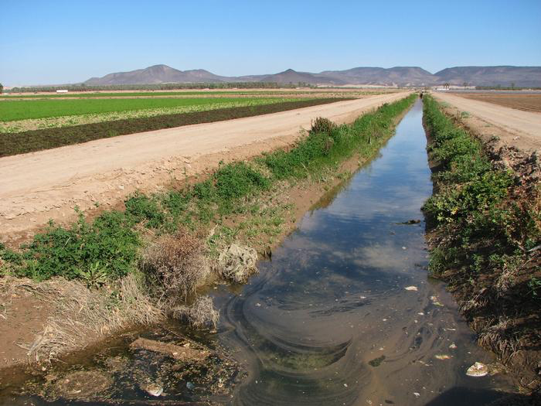
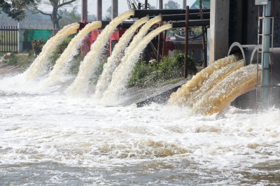
Water Pollution
Change in water quality that can cause harm to organisms or make water unfit for human use.
Contamination with chemicals
Waterborne Diseases
Major sources
Agricultural activities, industrial facilities and mining

Slide 5
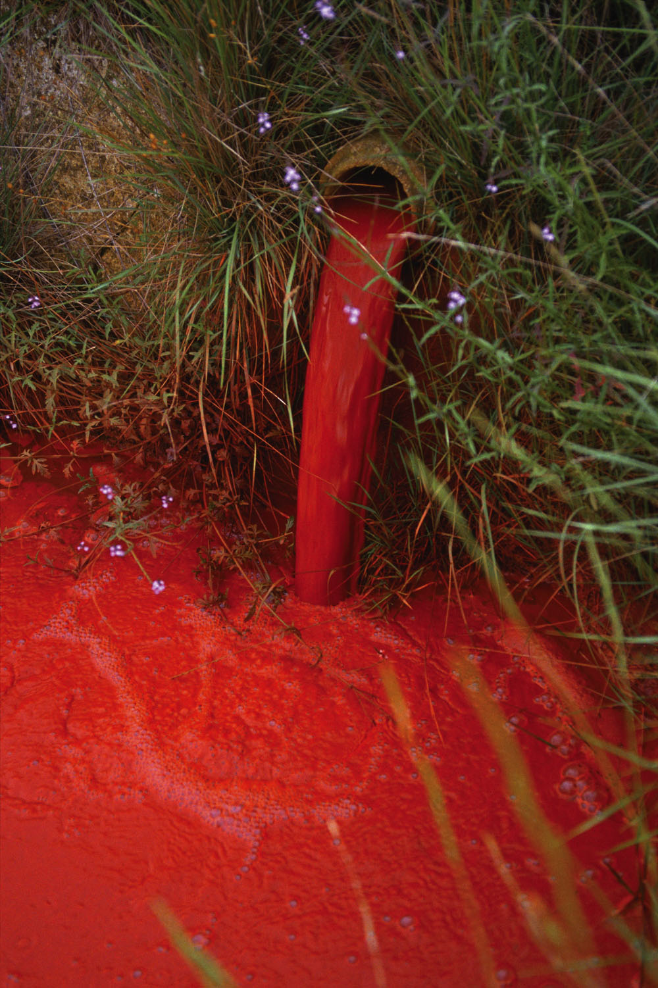
Point sources
Located at specific places
Easy to identify and regulate

Slide 6
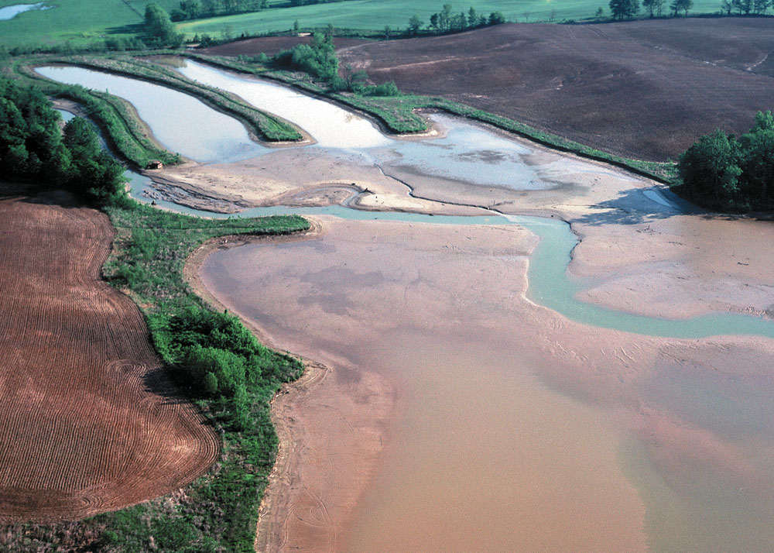
Non-point sources
Broad areas
Difficult to identify and control
Expensive to clean up

Slide 7
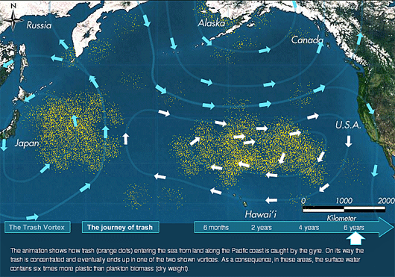
Ocean Pollution
Huge mass of plastic in the sea
Sewage runoff
Agricultural runoff
Oil spills

Slide 8
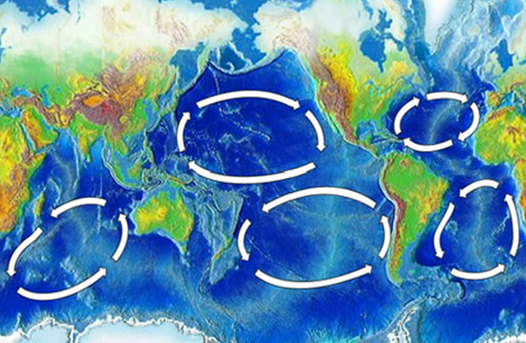
Garbage Patches

Slide 9
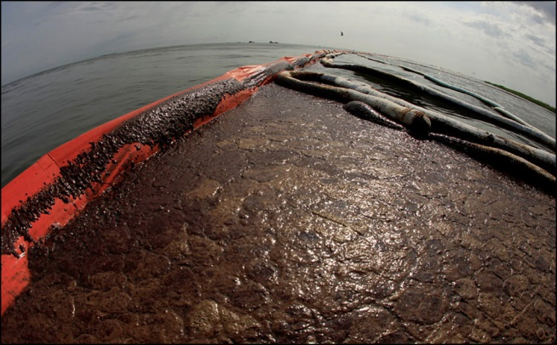
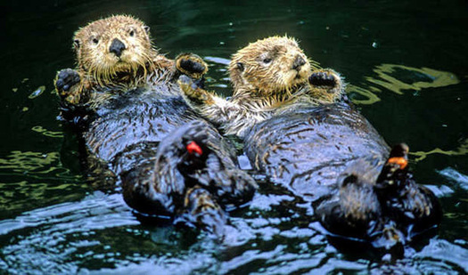
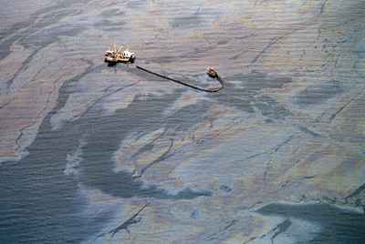
Ocean Pollution: Oil Spills
Volatile Organic Hydrocarbons (VOCs)→ kill many aquatic organisms
Tar-like globs on ocean surface→ coat the animals
Heavy oil components sink→ affects animals on the bottom of the ocean

Slide 10
B.P. Oil Spill Video

Slide 11
Stop and think
Was the B.P. oil spill a point source or non point source of water pollution? Justify your answer.

Slide 12
Exit Ticket
A factory is spewing a toxic chemical into a river. Is this an example of a point or nonpoint source of water pollution? Why?

Slide 13
Homework
Research a recent article about water pollution and summarize it in one paragraph (at least 5 sentences)
Cite it in the source in APA format ☺

