Slide 1
SWBAT understand indoor air pollution. Do Now: In which layer of the atmosphere is ozone supposed to be found? In which layer of the atmosphere is ozone considered to be air pollution? In which type of smog is CO found?
ES Unit 9 4/20/16
Lesson 17

Slide 2
Agenda
Lecture
Video
Reading
Review!

Slide 3
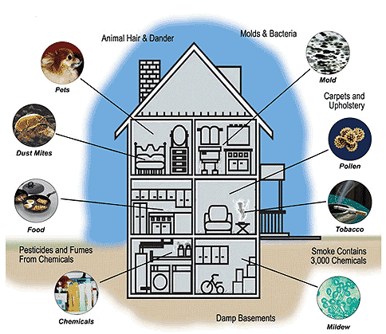
Indoor Air Pollution

Slide 4
Indoor Air Pollution: The Facts
WHO estimates that 1 in 3 people work in a building that causes them to become sick.
Affects 20% of public schools in the U.S.

Slide 5
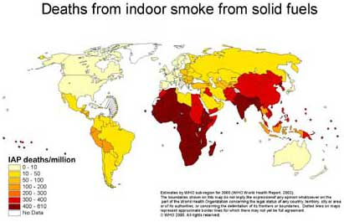
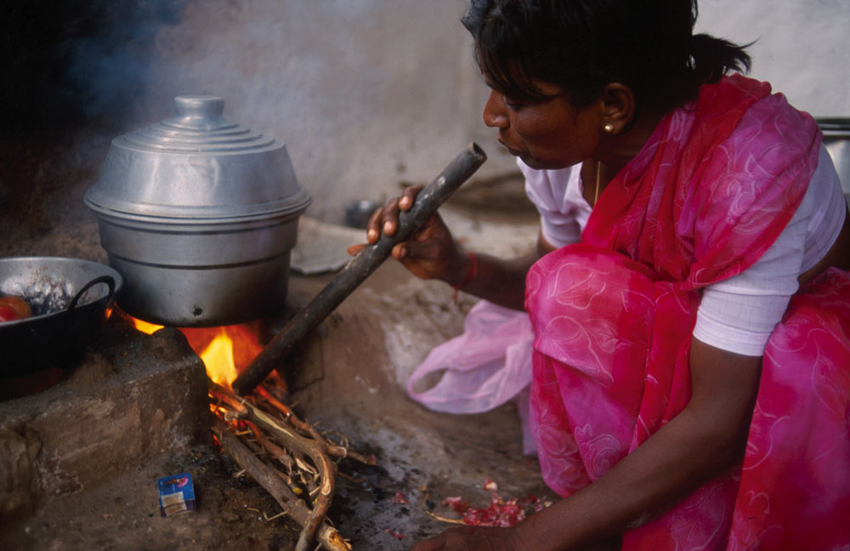
Indoor Air Pollution
Developing countries
Indoor burning of wood, charcoal, dung, coal
Poor affected the greatest

Slide 6
Indoor Pollution
Developed Countries
Indoor pollution is greater than outdoor pollution
11 common air pollutants higher inside that outside
People spend most of their time indoors or in cars

Slide 7
Indoor Air Pollution
Who is at greatest risk?
Children under 5 and elderly
Sick
Pregnant women
Smokers
Factory workers

Slide 8
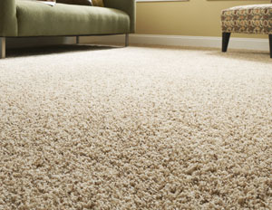
Most dangerous indoor air pollutants
Tobacco smoke
Formaldehyde
Source: furniture stuffing and carpets, paneling

Slide 9
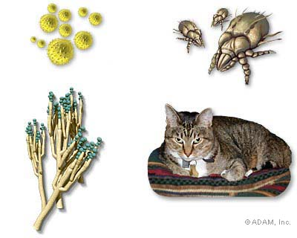
Most dangerous indoor air pollutants
Radon gas
Enters from soil and rock surrounding foundation of house
Small particles
Pollen, dust mites, pet dander

Slide 10
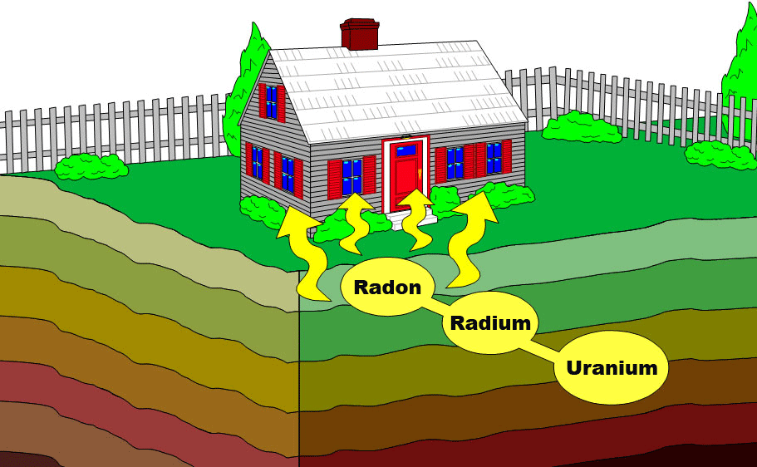
Radon Gas

Slide 11
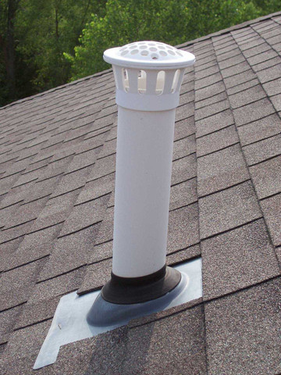
Case Study: Radon
Can cause lung cancer
Can migrate from soil or dissolve in groundwater
Test for radon: as low as $12
Test results: high amount of radon you should install vent pipe or fan

Slide 12
Video time!

Slide 13
What can you do?
Test for radon and formaldehyde
Remove shoes before entering the house
Smoke outdoors
Put carbon monoxide detectors in sleeping areas
Don’t store gasoline or hazardous materials in your home

Slide 14
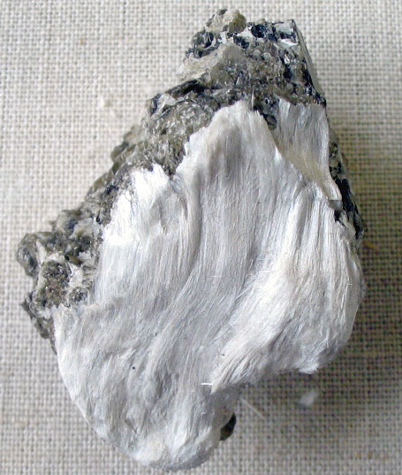
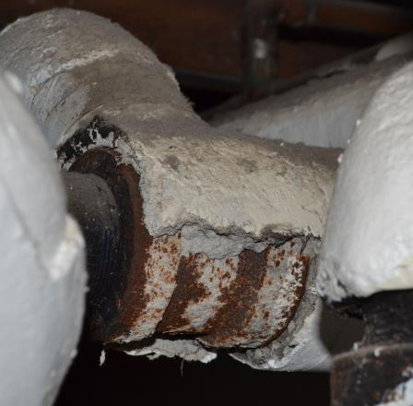
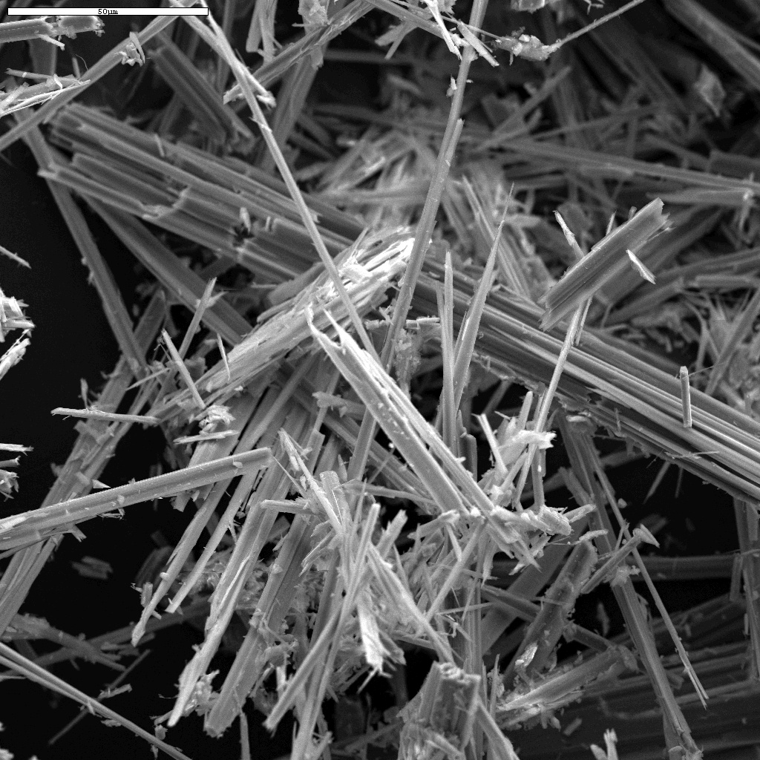
Asbestos

Slide 15
Review
How can radon enter a home?
How are people in developing countries affected by indoor air pollution?
Why does indoor air pollution affect people more than outdoor air pollution?

Slide 16
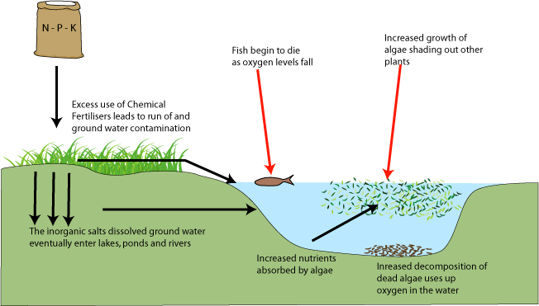
Let’s review for the exam!
How can we pollute the ocean?
Describe eutrophication
How can acid rain affect the environment?

Slide 17
Homework: Study for the exam!

