Slide 1
SWBAT evaluate the advantages and disadvantages of drilling in the Artic National Wildlife Reserve. Do Now: How do you think drilling for oil on land could negatively impact the environment?
ES Unit 9 4/19/16
Lesson 17

Slide 2
Agenda
Close Reading
Discussion
Exit Ticket

Slide 3
Vocab:
The Alaskan Wildlife National Refuge: A large area in Northern Alaska set aside to protect wildlife.
Seismic Survey: A technology that produces images of rocks beneath Earth’s surface to determine the size and location of gas reservoirs
Recoverable oil: Proven oil reserves

Slide 4
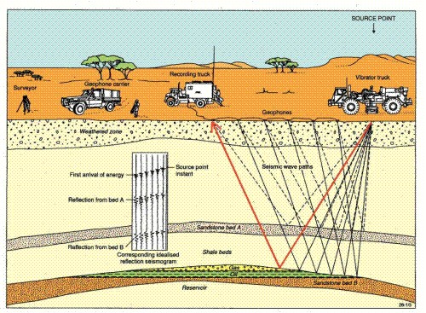
Oil Drilling

Slide 5
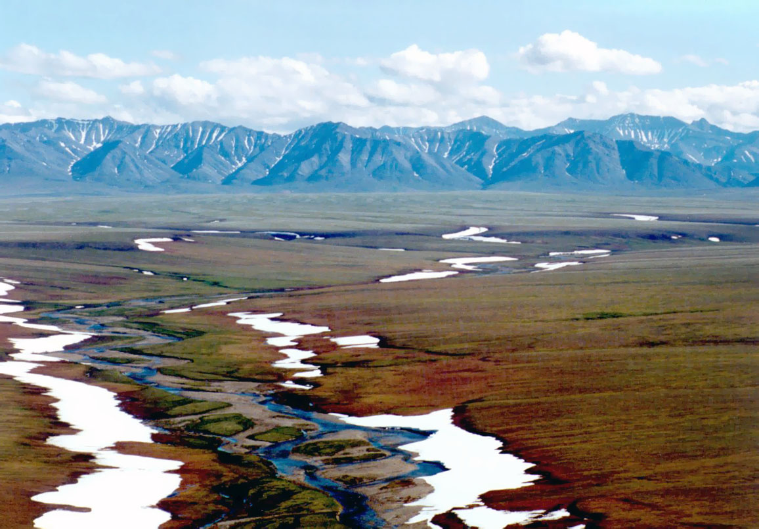
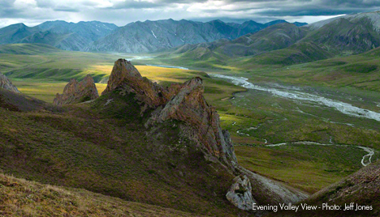
Artic National Wildlife Reserve:

Slide 6
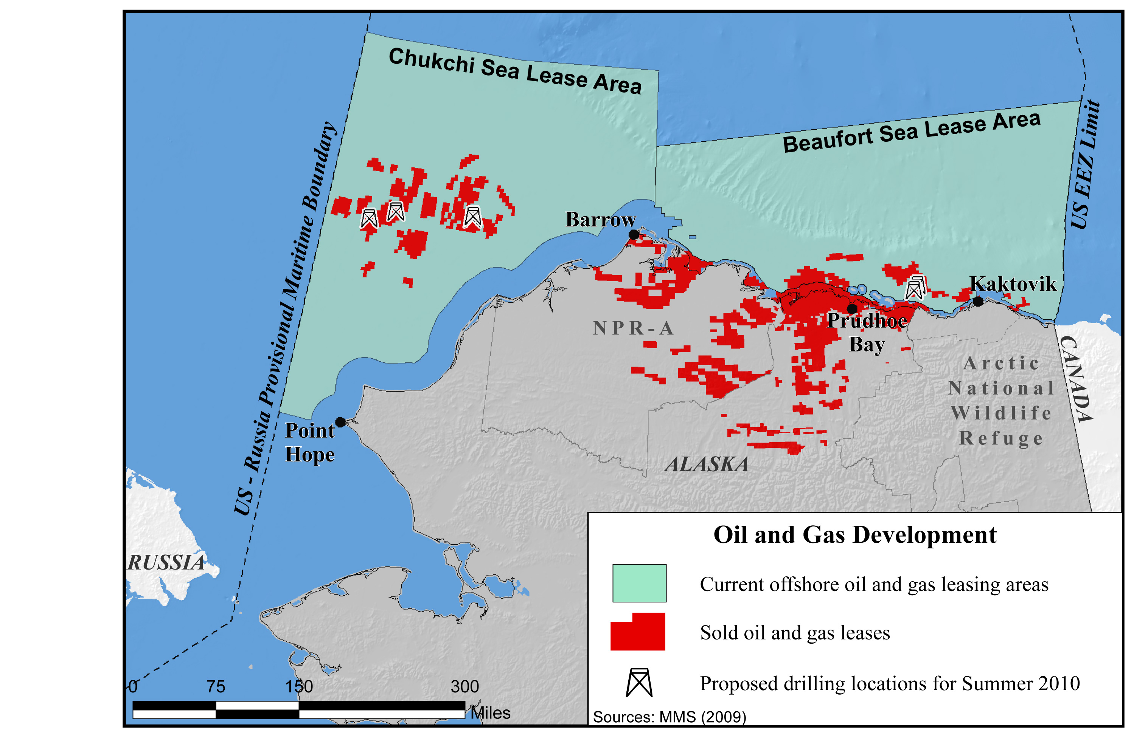
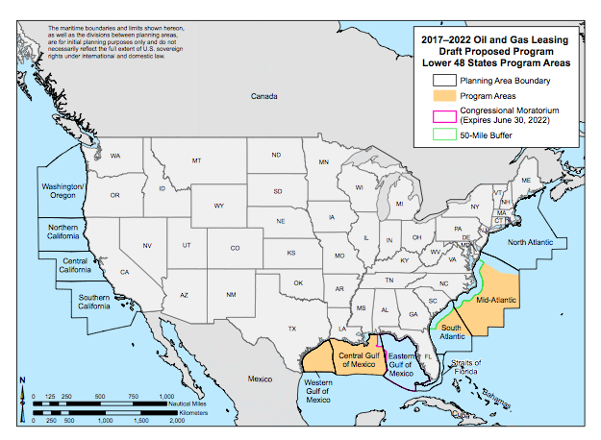
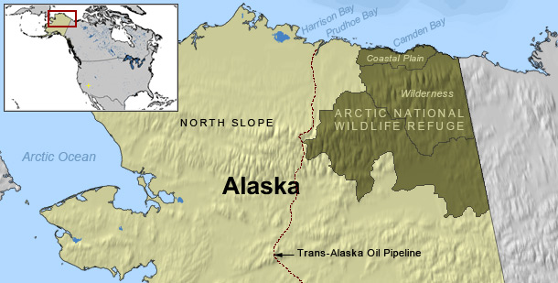
Arctic National Wildlife Refuge

Slide 7
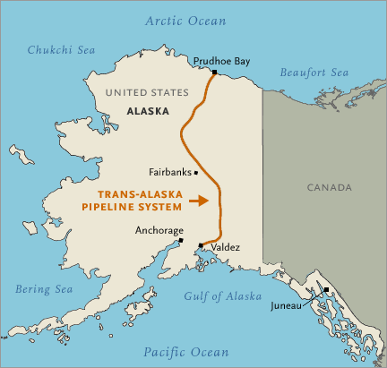
Alaska Needs Money

Slide 8
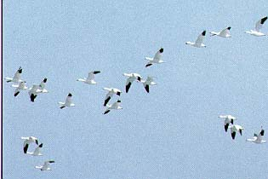
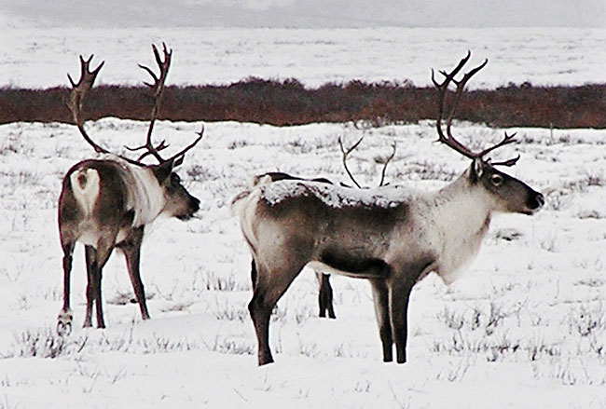
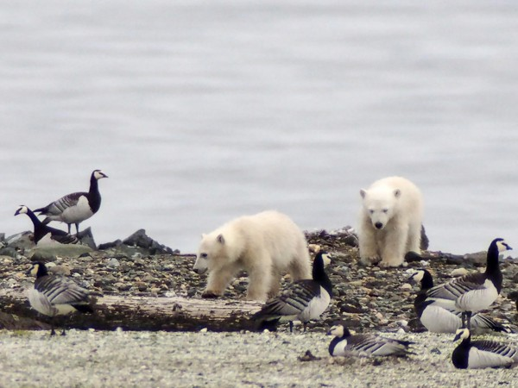
ANWR Wildlife

Slide 9
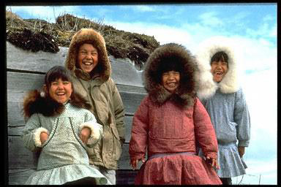
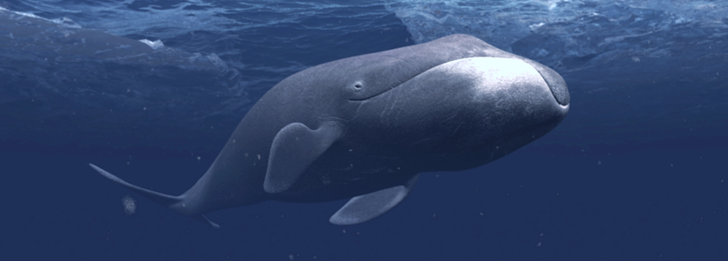
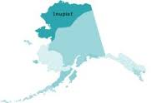
Mixed Feeling Locally

Slide 10
Discussion
Do you believe Obama should support drilling in the ANWR? Why or why not?
Do you believe the Obama administration should have approved offshore drilling in the mid-Atlantic and the Gulf of Mexico? Why or why not?

Slide 11
Exit Ticket
Whether you are for or against drilling in the ANWR, cite the strongest piece of evidence in support of your position and explain why it is the strongest.

