Slide 1
SWBAT identify the causes and effects of acid rain. Do Now: What is the difference between industrial smog and photochemical smog?
ES Unit 9 4/18/16
Lesson 14

Slide 2
Agenda
Lecture
Textbook reading
Announcements:
You have to take home your binder again today
Unit 9 Exam on Thursday

Slide 3
Homework Share Out
Share out your homework on the polluted city

Slide 4
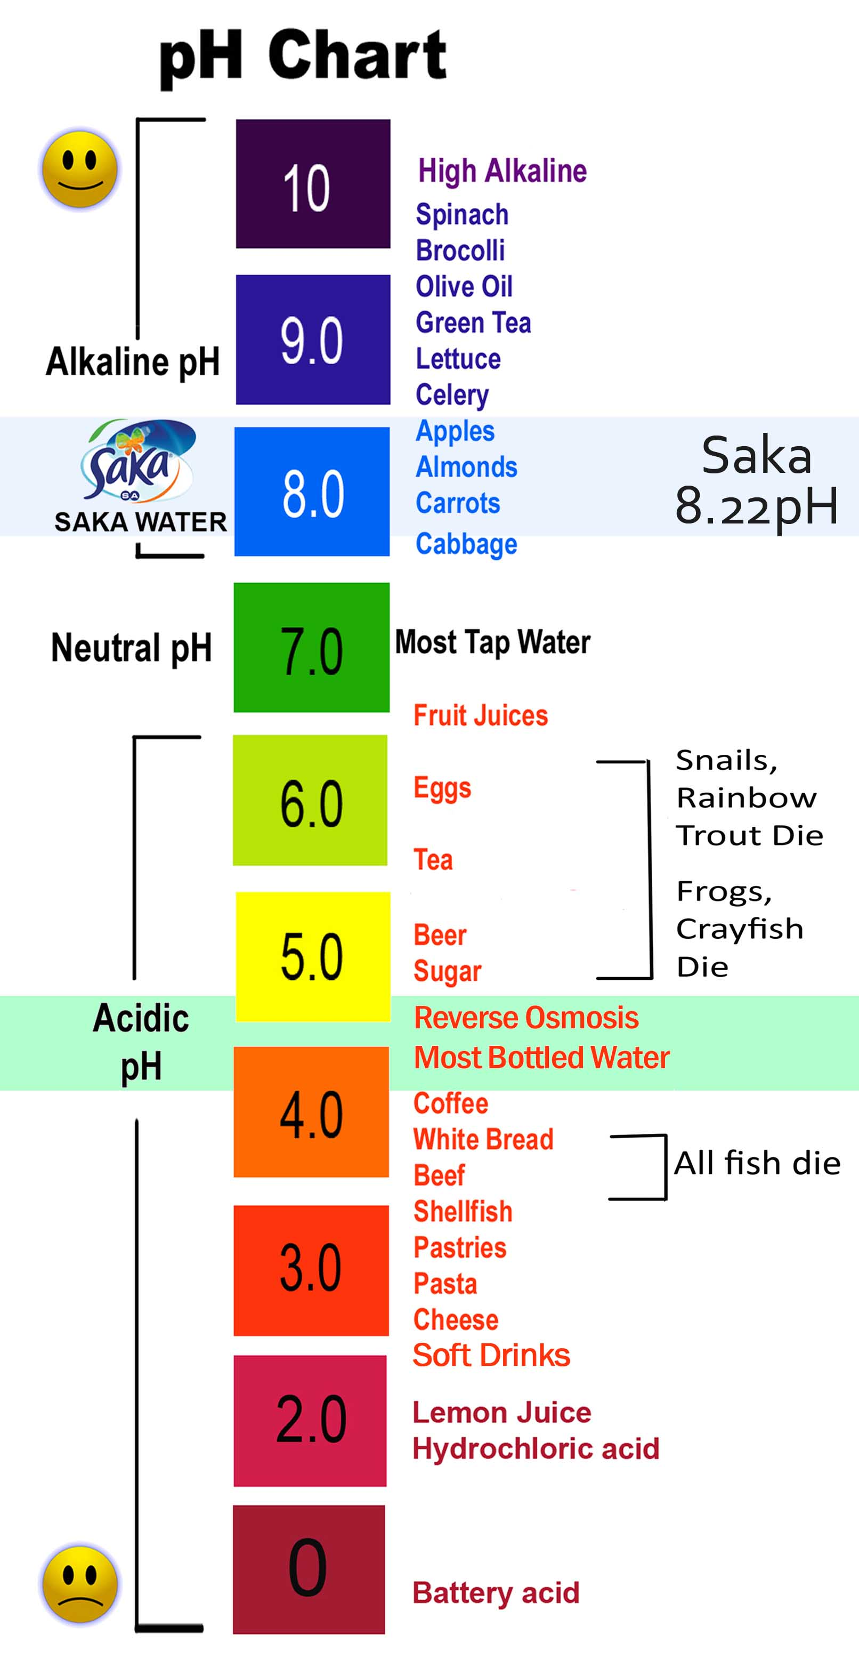
Air Pollution: Acid Rain
Normal pH of rain = 5.6 - 7
pH of acid rain = below 5.6
Acid Deposition:
Acid rain, snow and fog

Slide 5
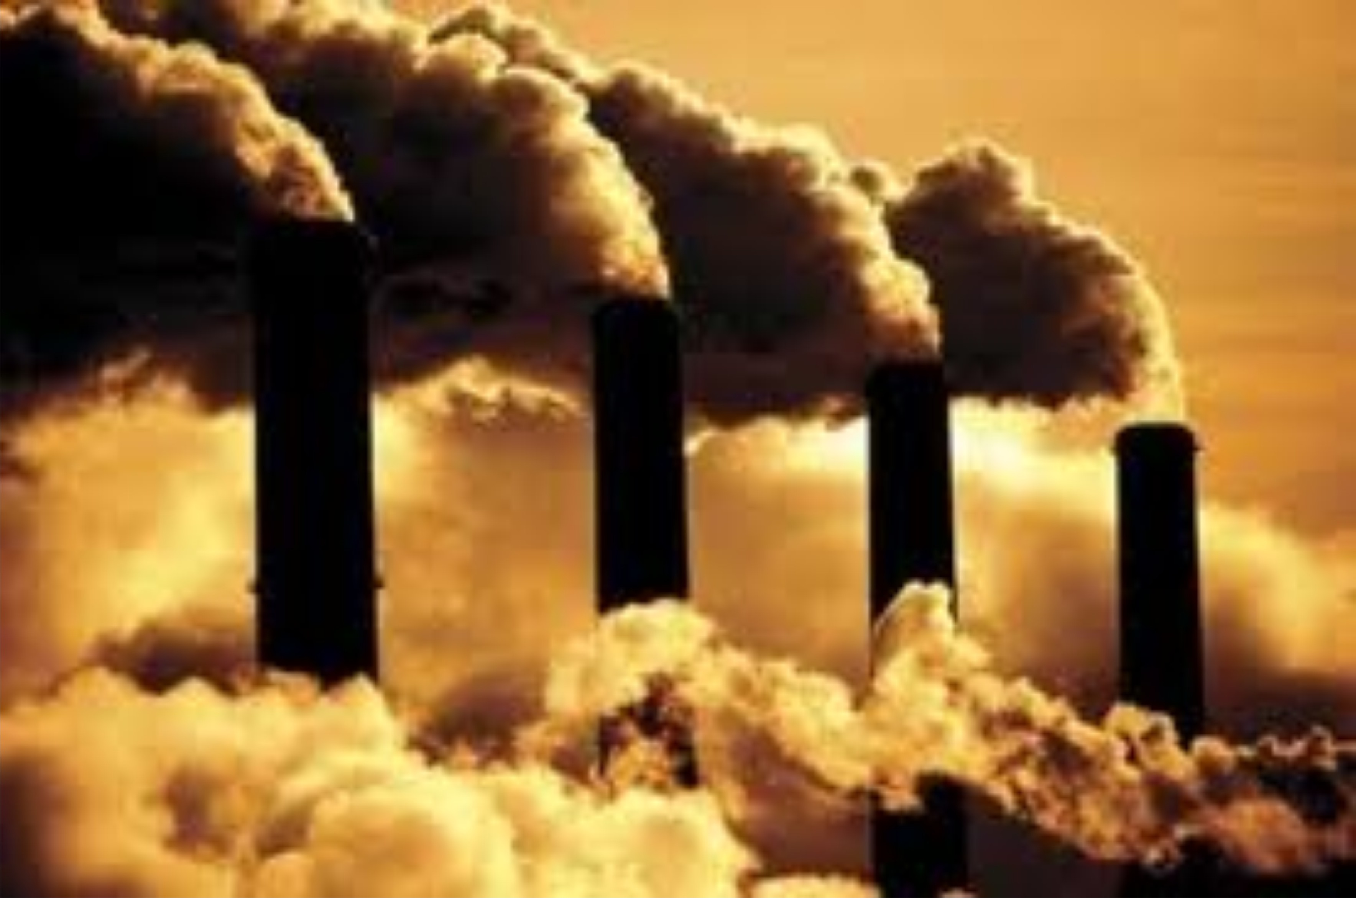
Causes of Acid Rain
Burning fossil fuels:
Coal burning plants release SO₂ (sulfur dioxide)
Coal burning plants and cars release NO (nitric oxide)

Slide 6
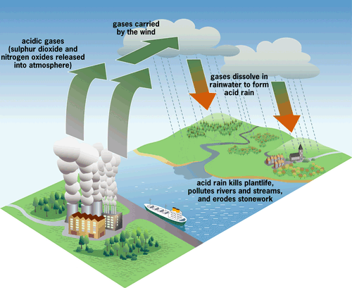

Slide 7
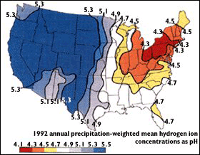
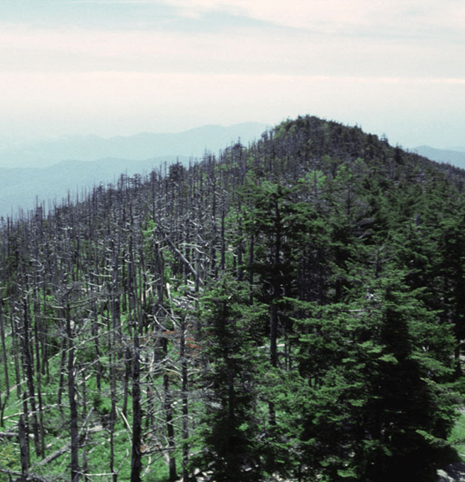
Effects of Acid Rain
Negative effect on trees→ slow tree growth, needles and leaves fall off, possible death.

Slide 8
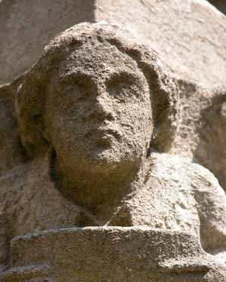
Effects of Acid Rain
Leaching (washing out) of soil nutrients
Lower crop yields
Damage to buildings, statues, monuments

Slide 9
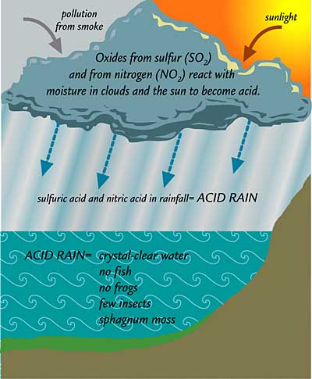
Effects of Acid Rain
Negative effects on lakes
Decrease in fish and amphibians
Decrease in algae

Slide 10
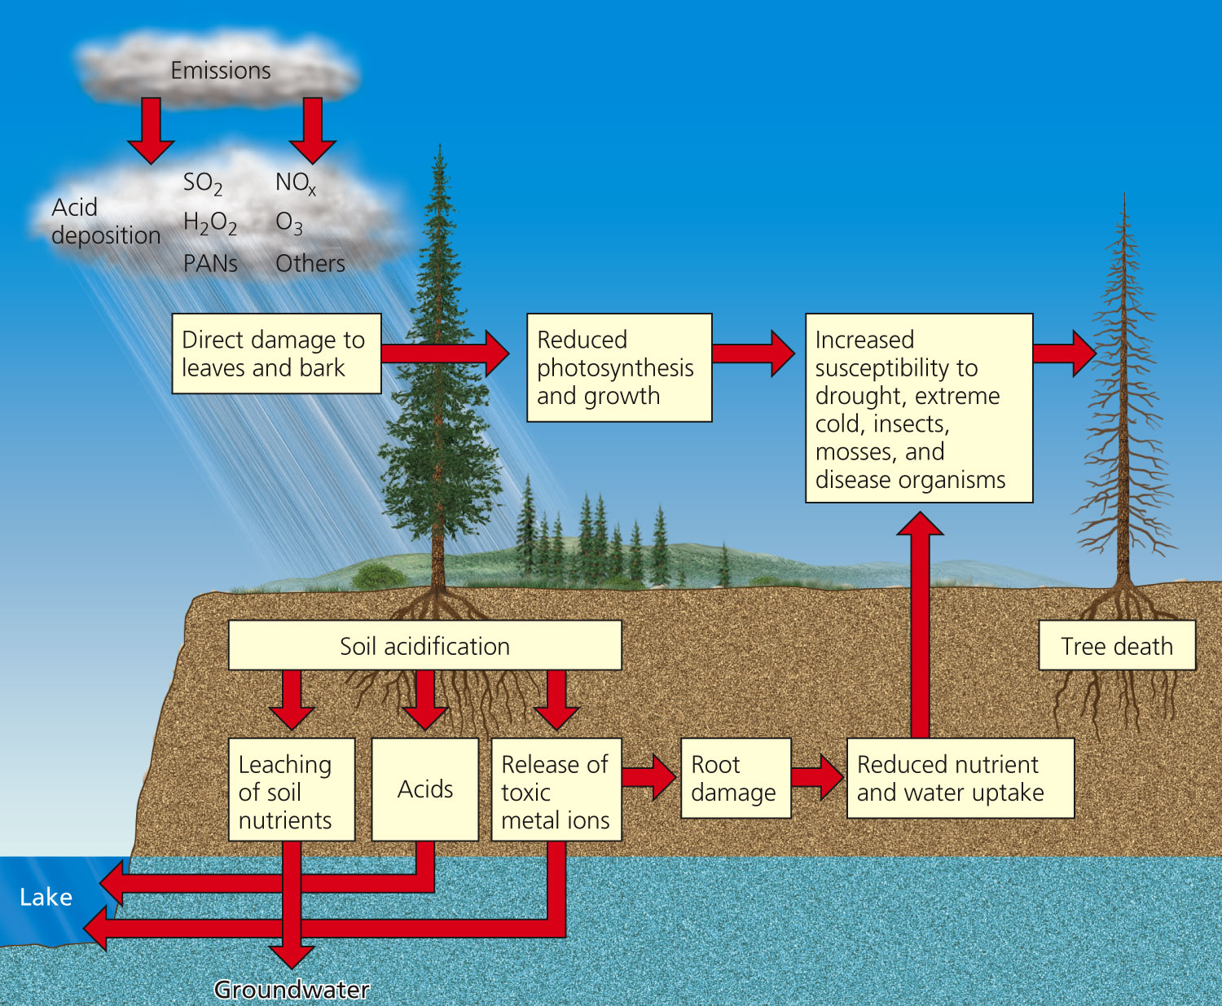

Slide 11
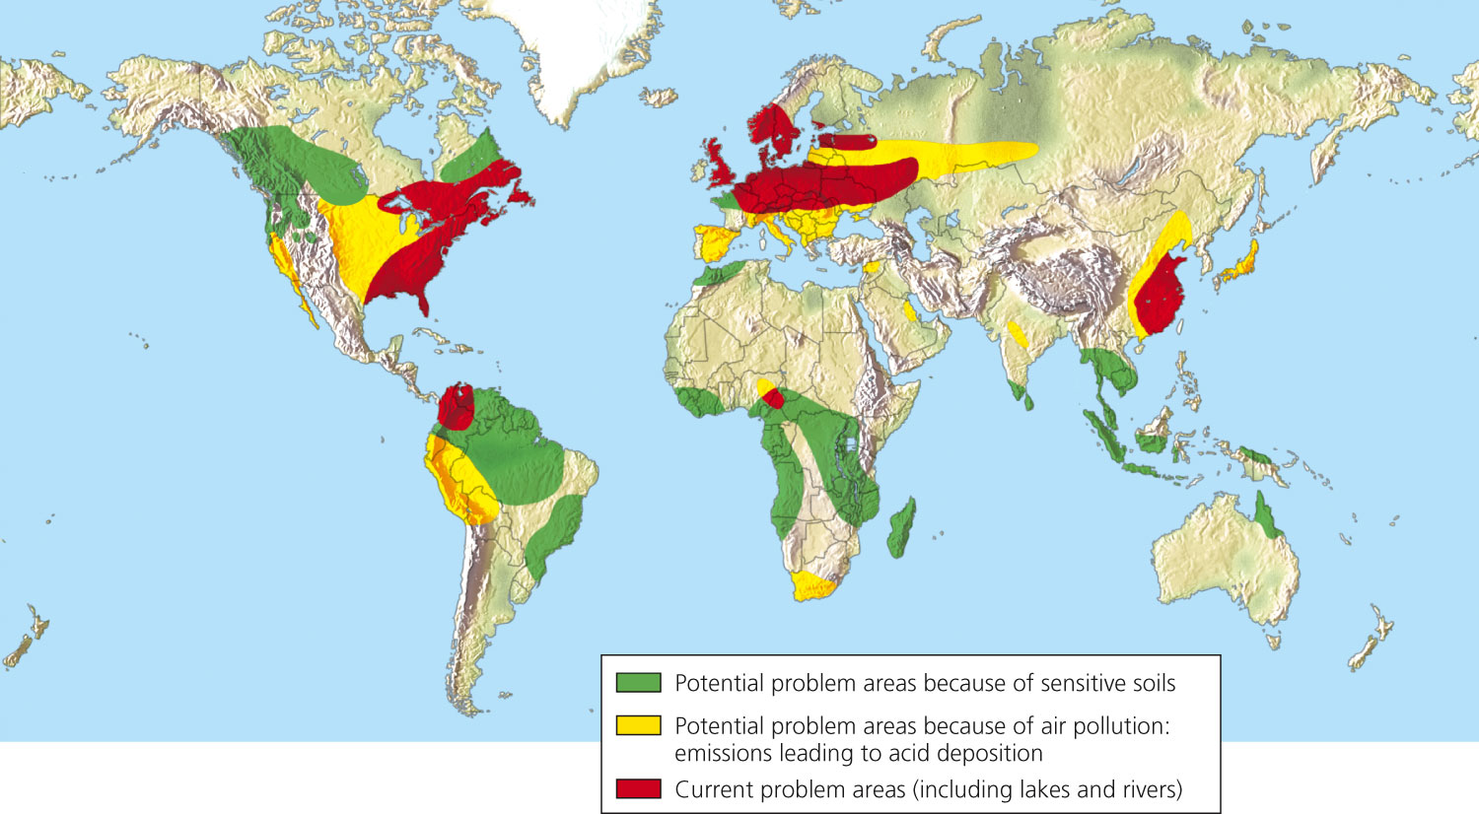
Current and Future Acid Rain Problems

Slide 12
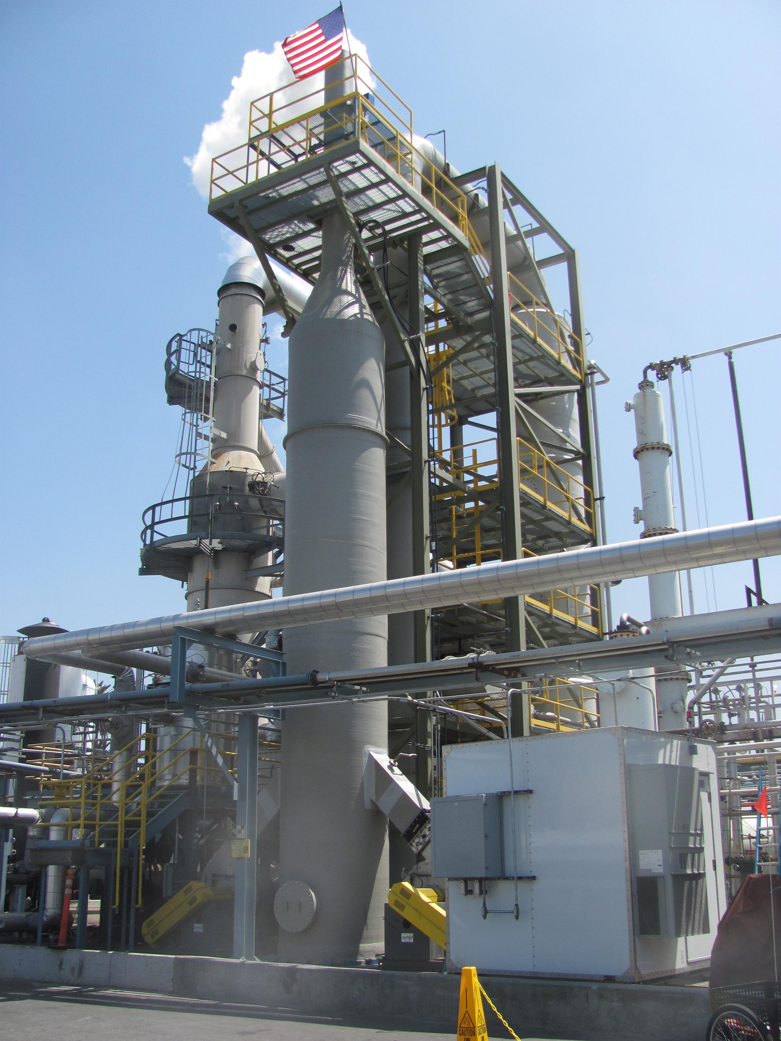
Acid Rain: Solutions
Prevention
Reduce coal use
Burn low sulfur coal
SO₂ scrubbers in coal plants
Drive less!

Slide 13
Textbook Reading
Turn to page 427 and read A Closer Look
Read through page 429
What types of buildings are most susceptible (likely to be harmed by something) to acid rain?
How does acid rain affect forest ecosystems?
How does acid rain affect lake ecosystems?

Slide 14
Review
What two pollutants cause acid rain?
Sulfur dioxide (SO₂) and nitrous oxide (NO)
At what pH is rain considered to be acid rain?
Less than 5.6
How does acid rain affect trees?
Causes leaves the fall off, depletes nutrients from soil which affects growth

Slide 15
Acid Rain
Find an article about acid rain and write a two paragraph summary
Cite your source in APA format

