Slide 1
SWBAT identify the causes of industrial (gray) smog and photochemical (brown) smog. Do Now: How does an algal bloom lead to hypoxic conditions?
ES Unit 9 4/12/16
Lesson 14

Slide 2
Turn and Talk
Share out Eutrophication research

Slide 3
Agenda
Lecture
Reading
Video
Analyze benchmark Data
Announcements:
Take home binders today!!
Next Monday (4/18) will be the last day I accept any late/absent lab reports!

Slide 4
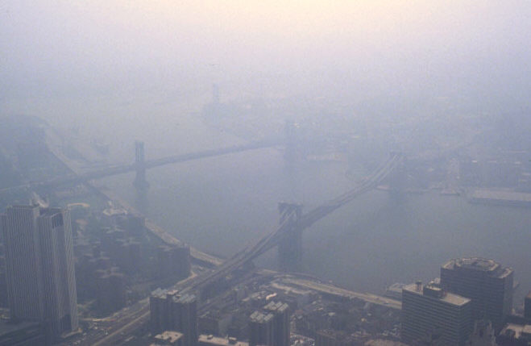
Smog
Smoke + fog = smog

Slide 5
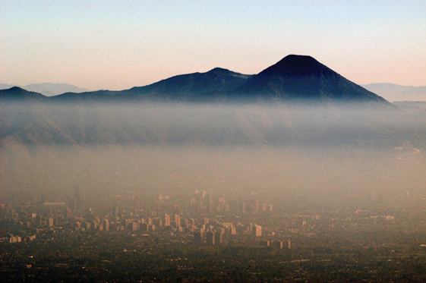
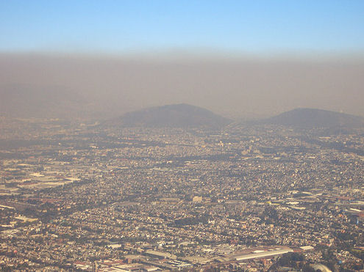
Photochemical Smog (brown smog)
Sunlight + cars = photochemical smog

Slide 6
Photochemical smog contributor
NO_{x} + VOCs + sunlight → Ozone (O₃) → smog

Slide 7
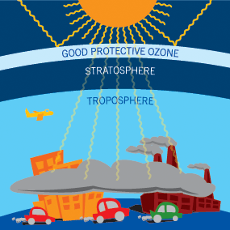
Photochemical smog contributor
Ozone (O₃)
Ozone in the stratosphere = good
Ozone in the troposphere = bad
Respiratory Irritant
Decreases immune function

Slide 8
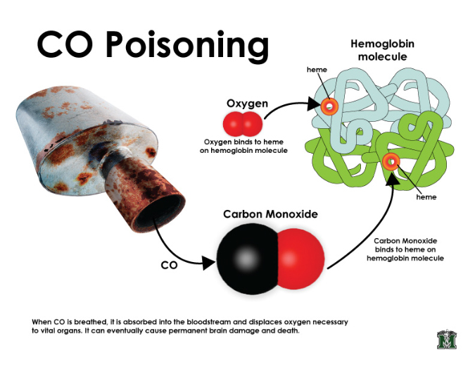
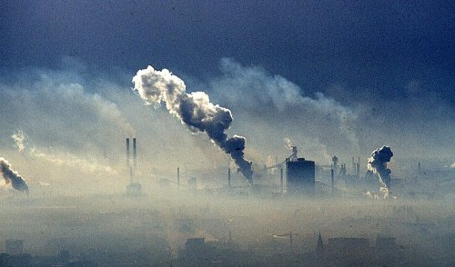
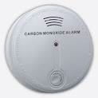
Industrial (grey) Smog
Sulfur dioxide (SO₂) and sulfuric acid (H₂SO₄)
Coal burning, oil refining
Lung and eye irritant, inhibits plant growth
Carbon monoxide (CO)
Exhaust from cars, inefficient stoves and heaters
Inhibits ability of hemoglobin to take up oxygen

Slide 9
Solutions to reduce smog
Bike or walk
Take public transportation
Carpool
Limit the amount of cars on the road
Stop burning coal
Regulations on factory emissions

Slide 10
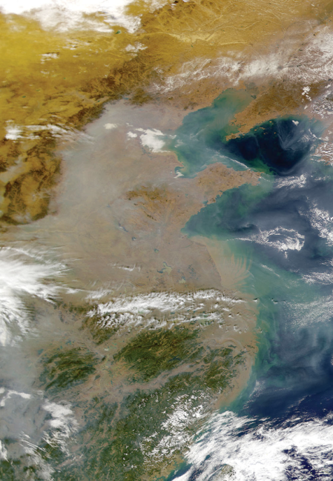
South Asian Brown Cloud

Slide 11
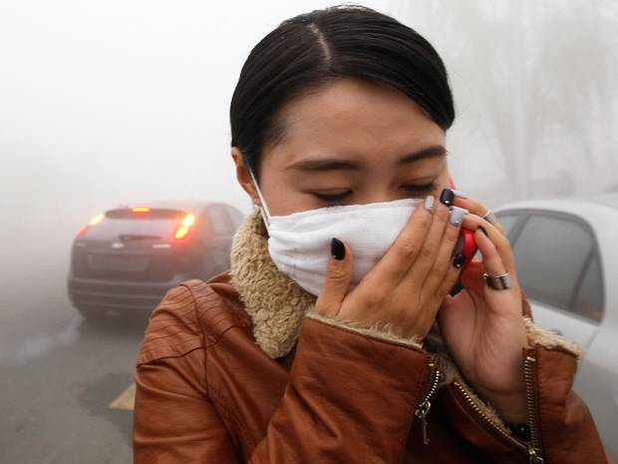
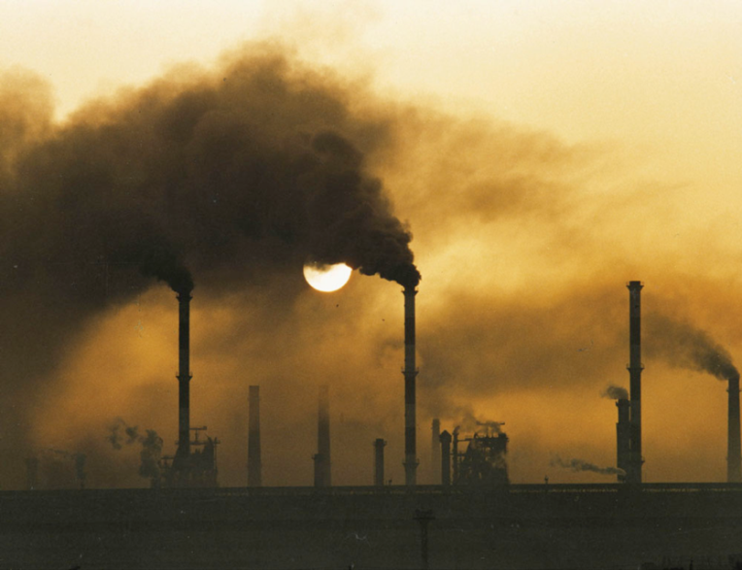
China and Smog
2.4 million deaths per year worldwide from air pollution
750,000 are in China

Slide 12
Benchmark Data
Put your name on the piece of paper
Count up how many you got right for each section

Slide 13
Review
What compounds are found in brown smog?
What compounds are found in industrial smog?
How is carbon monoxide poisonous?

