Slide 1
SWBAT write a procedure for their water filtration experiment. Do Now: Write a procedure for making a peanut butter and jelly sandwich.
ES Unit 9 4/4/16
Lesson 11

Slide 2
Homework Check
Your data table should include:
Different amounts of your independent variable
Your dependent variable
Your control

Slide 3
Measurements
Water use: 150ml (milliliters) per filter
Sand, Charcoal and Gravel: 40-60 grams
Take out a half sheet of paper per group
Write your group members names at the top
Write down the total amount for each of the materials
Charcoal:
Sand:
Gravel:
Write down what type of test strips you will be using

Slide 4
Procedures
Which procedure is strongest and why?
What is the weaker procedure missing?

Slide 5
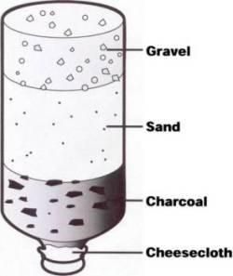
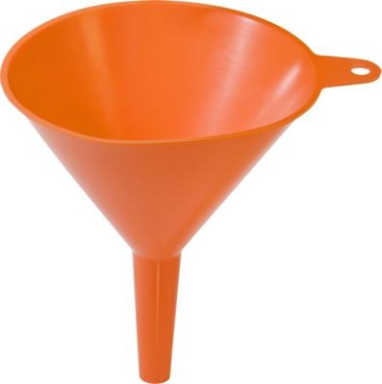
Things to consider
Measuring pH/phosphate/test strips
Weighing charcoal, sand, gravel etc.
Cotton balls/filter paper

Slide 6
Homework
Have all your bottles by Friday– that is when we will be running the experiment!
Finish writing your procedure!

