Slide 1
SWBAT describe the causes and effects of eutrophication. Do Now: Why do you believe it is important to have oxygen dissolved in bodies of water? How do you think oxygen ends up in bodies of water?
ES Unit 9 4/11/16
Lesson 13

Slide 2
Agenda
Graphing
Lecture
Video
Article
Announcement: Come up at lunch tomorrow to make up the water filtration lab

Slide 3
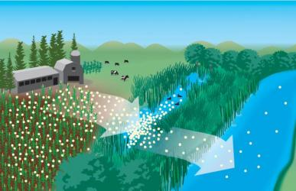
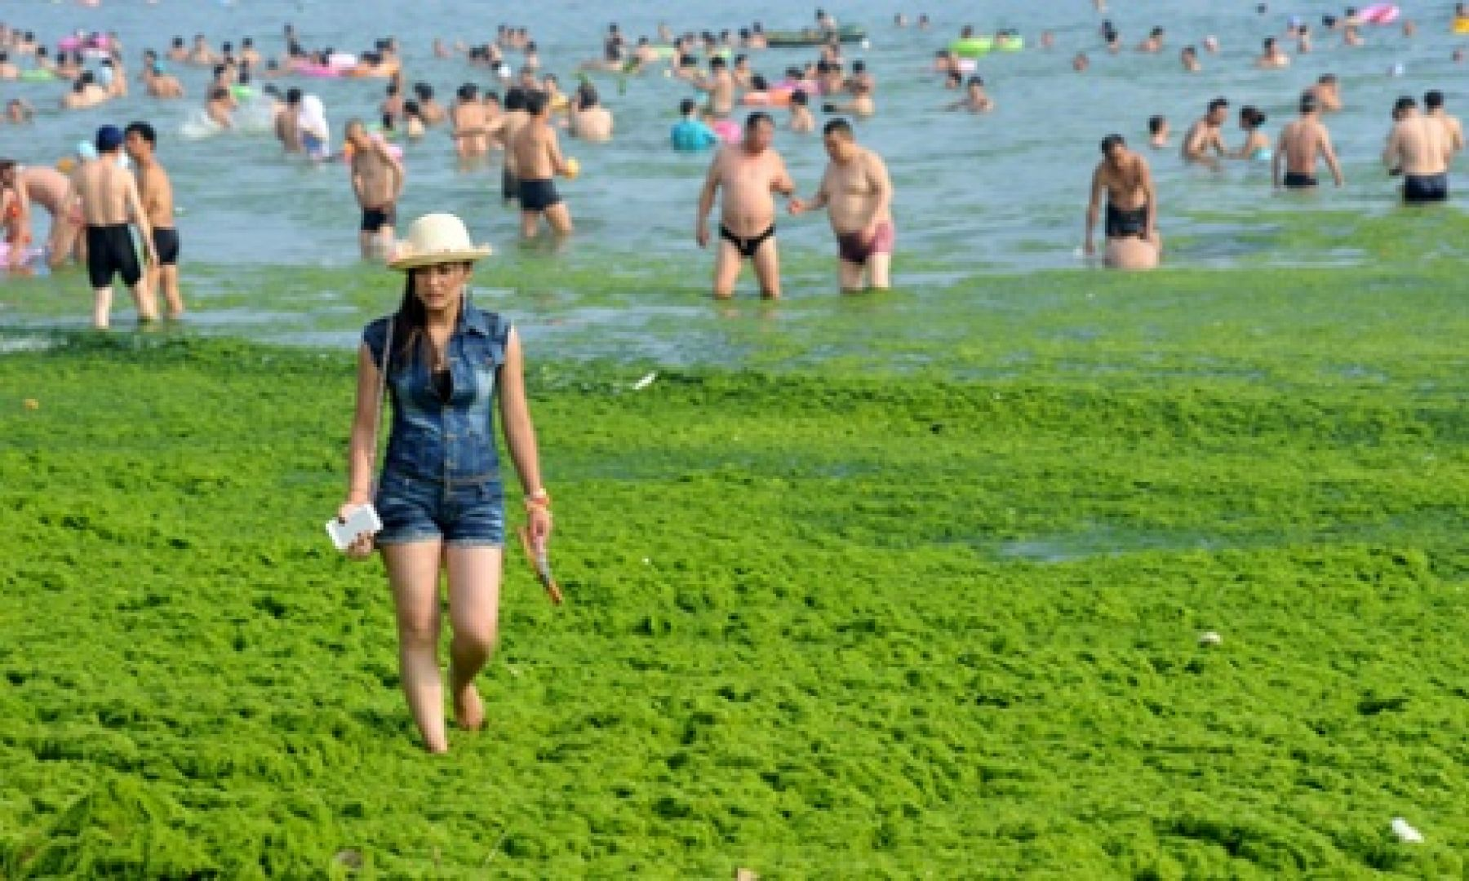
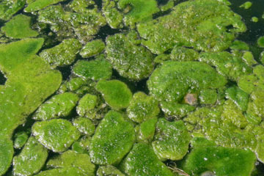
Algal Bloom
Excess nutrients) from fertilizers end up in surface waters
Extra nutrients→ more algae grow

Slide 4
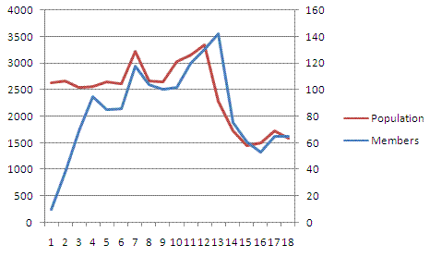
Graphing time!
Make two line graphs on the same graph
You will have two y-axes
Use a different color (or pen and pencil) for the amount of algae and the amount of dissolved oxygen

Slide 5
Graphing Time!
Label the x-axis time (weeks)
Scale the x axis
Label the left hand y-axis dissolved oxygen
Scale the axis appropriately
Graph the points for dissolved oxygen
Label the right hand y-axis amount of algae
Scale the axis appropriately
Graph the points for amount of algae

Slide 6
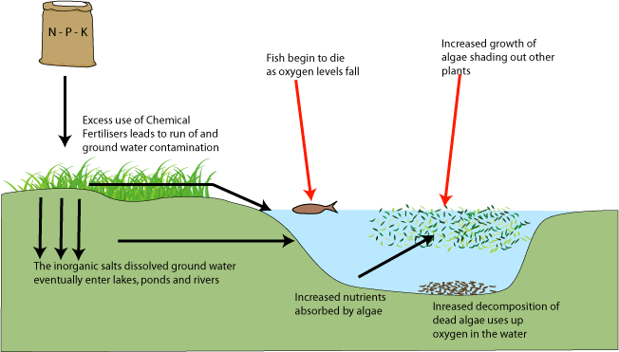
Eutrophication

Slide 7
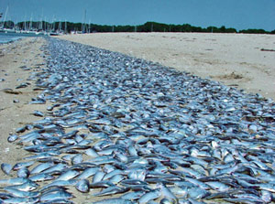
Eutrophication
A body of water develops a high concentration of nutrients (nitrogen and phosphorous).
More nutrients→ more algae bloom
Algae die→ bacteria decompose algae
Bacteria use up oxygen when decomposing algae
Lack of oxygen= hypoxic conditions
Lack of oxygen→ shellfish, crabs, fish and snails are killed

Slide 8
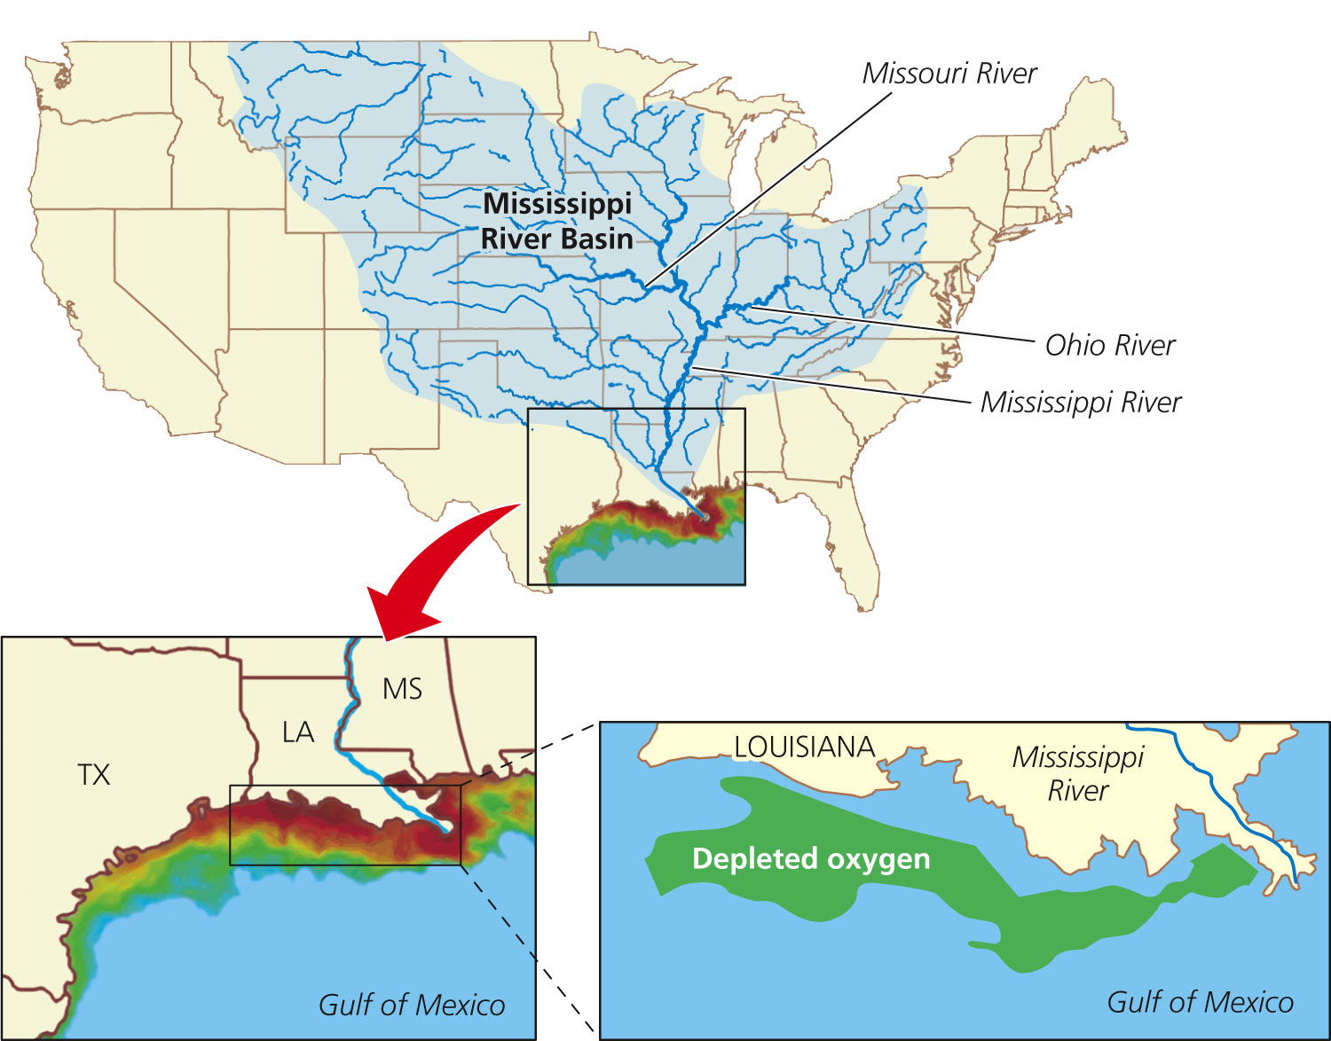
Gulf of Mexico: Dead Zones

Slide 9
Exit Ticket
What causes Eutrophication?

Slide 10
Homework
Research one body of water that is being affected by eutrophication other than the Gulf of Mexico.
Explain how eutrophication is affecting the local ecosystem
Cite your source

