Slide 1
SWBAT design and conduct an investigation to determine the best method for water filtration. Do Now: In an experiment, what variable do you control: the independent or dependent variable? What is a control? What is a trial?
ES Unit 9 4/1/16
Lesson 10

Slide 2
Agenda
Design lab!

Slide 3
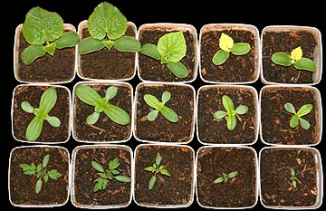
Control
Experimental group that is not affected by the independent variable.
Ex: How does fertilizer affect the growth of a tomato plant?
Control: plant grown without any fertilizer.

Slide 4
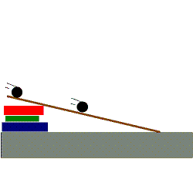
Trial
Trial: Number of times the experiment is repeated to determine how the independent variable affected the dependent variable.
Ex: How does slope affect the rate at which a marble roles down a plank?

Slide 5
Water Filtration Inquiry Lab
Question/Purpose
What does this Design Challenge represent/simulate?
Why is water filtration important in the real world?

Slide 6
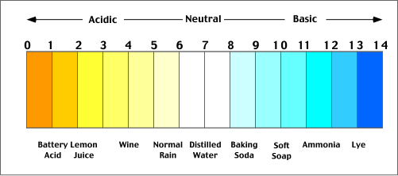
Available Materials:
Gravel
Sand
Activated Charcoal
pH paper
Phosphate test strips
3 in 1 test strips (pH, alkalinity and hardness)
Funnels or plastic bottles
Contaminated Water

Slide 7
Lab Design
Work with your group members!
If I’m busy with another group, raise your hand and wait patiently
Keep the volume down to a minimum
Things to keep in mind when designing an experiment:
Only change one variable at a time

Slide 8
Experimental Design
Independent variable:
Dependent variable:
Testable question:
How does________ affect _______?
STOP! Call me over to check.
Hypothesis: If……. Then…. Because.

Slide 9
Experimental Design
Control:
Constants:
STOP and call me over to check.

Slide 10
Homework
Construct a data table for your results

