Slide 1
SWBAT evaluate solutions for water shortages. Do Now: How can water be considered a renewable resource? How can water be considered a nonrenewable resource?
ES Unit 8 3/14/16
Lesson 9

Slide 2
Do Now

Slide 3
Agenda
Review Sheet
Lecture
Videos

Slide 4
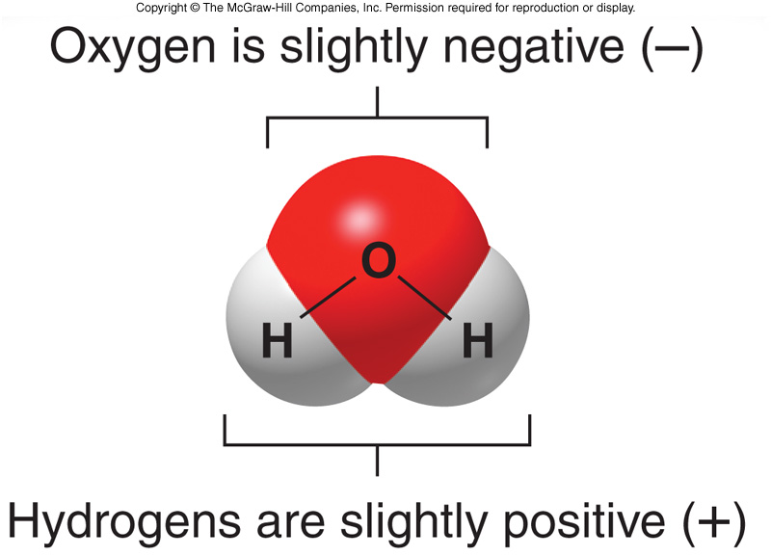
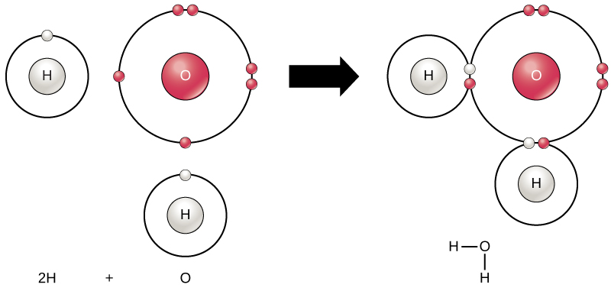
Turn and talk
Share out your answers to the review sheet

Slide 5
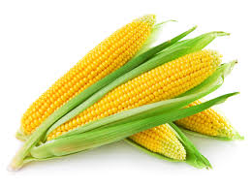
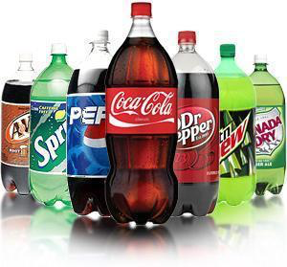
Vocab
Subsidy: money that is paid usually by a government to keep the price of a product or service low.

Slide 6
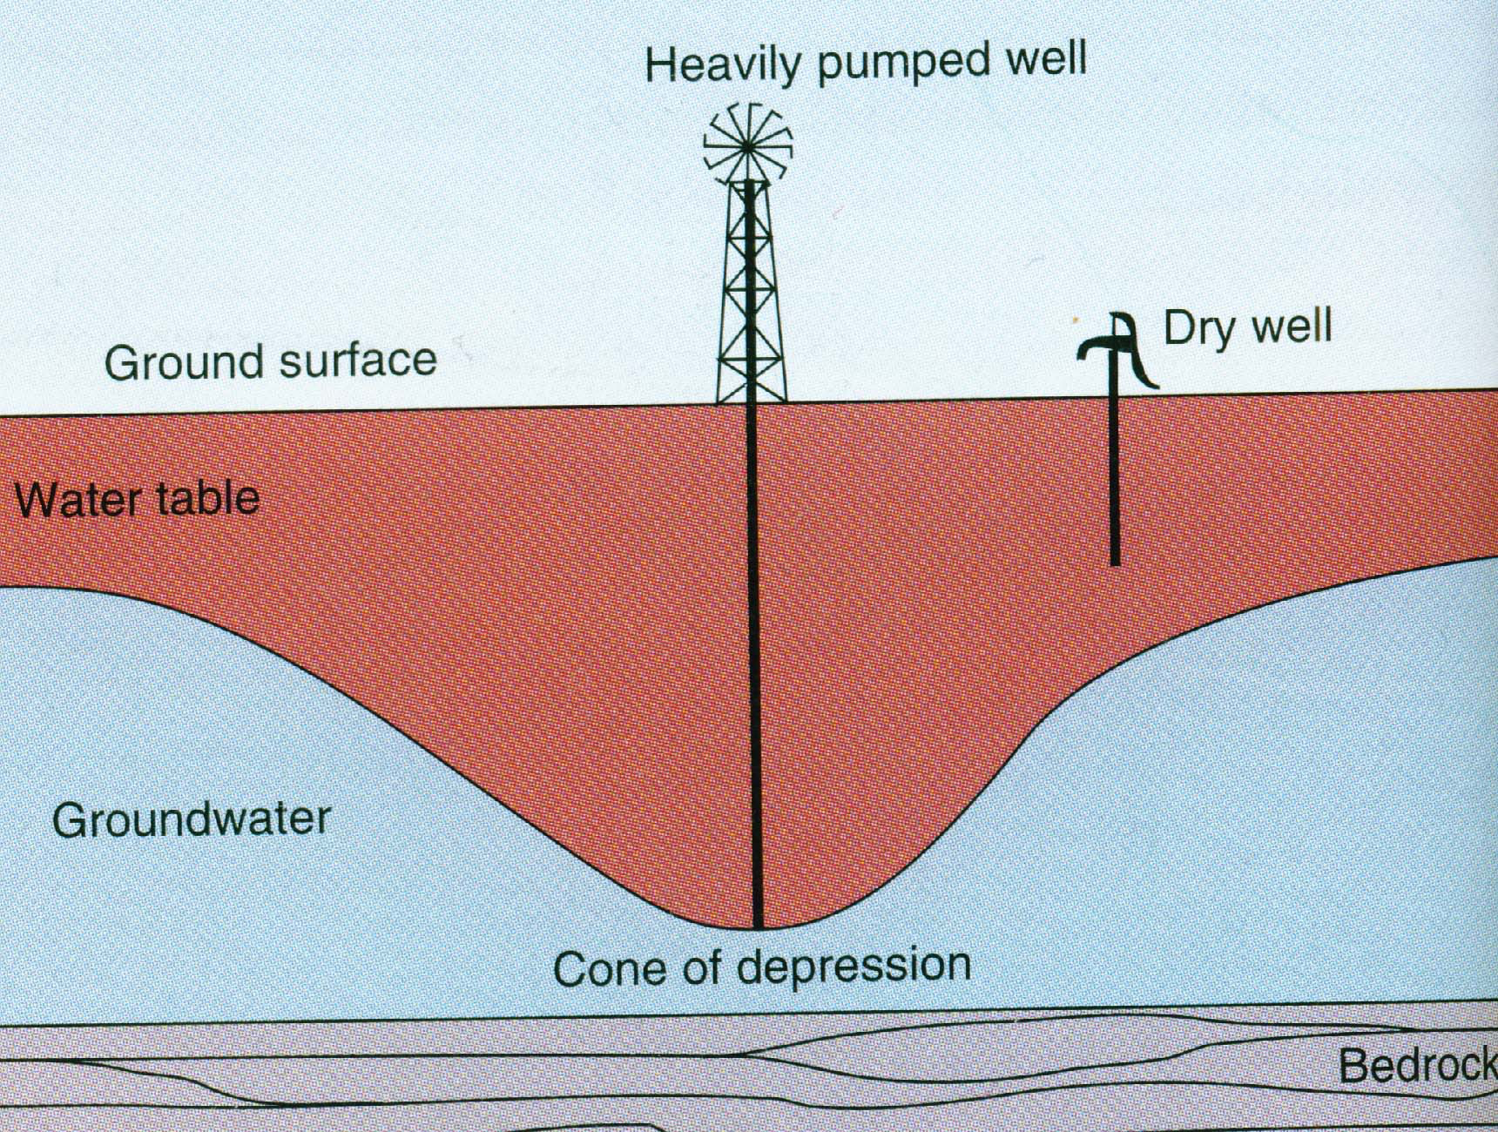
Stop and think

Slide 7
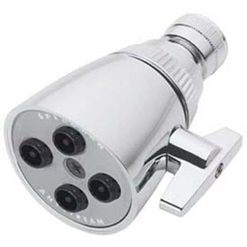
Prevent Ground Water Depletion
Waste less water!
Take shorter showers
Turn OFF the faucet when not in use
Turn off the lights
Use low flow toilets and shower heads

Slide 8
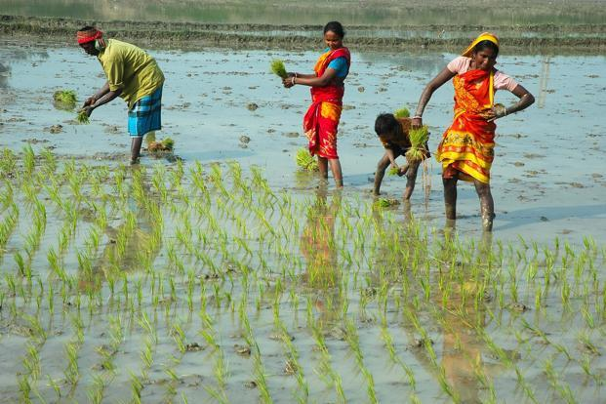
Prevent Groundwater Depletion
Do not grow water-intensive crops in dry areas.
Tomatoes
Rice
Sugar cane
Cotton

Slide 9
Prevent Ground Water Depletion
Raise price of water to discourage waste.
Do you think if we made water bills more expensive people would waste less water? Why or why not?

Slide 10
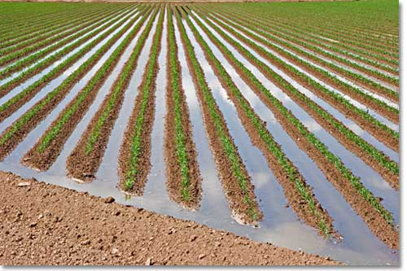
Prevent Ground Water Depletion
Stop subsidizing crop irrigation…..
Subsidize water conservation!!

Slide 11
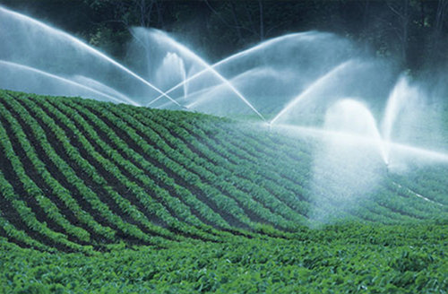
Reduce Irrigation Water Waste
Irrigate at night --> reduces evaporation
Irrigate with treated waste water
Monitor soil→ add water only when necessary
Encourage organic farming

Slide 12
Use Engineering!
New Shower
http://www.cnn.com/2013/11/11/tech/innovation/futuristic-water-recycling-shower-orbsys/
How does the shower save water?

Slide 13
Water-less washing machine
http://www.dailymail.co.uk/sciencetech/article-2548677/The-washing-machine-WITHOUT-water-System-uses-tiny-plastic-beads-clean-clothes-works-better-detergent.html
What technology does this this washing machine use in order to reduce water?

Slide 14
Discussion
Which design to reduce water usage do you think was the best? Why?
What do you think is the best strategy that individuals could use to reduce water usage? Why?

Slide 15
Exit Ticket
Do you think engineering and new technology should play a role in water conservation? Why or why not?

Slide 16
Homework
Study for your exam!

