Slide 1
SWBAT assess the advantages and disadvantages of using plastic water bottles. Do Now: About how many plastic water bottles do you use a week? Do you own a reusable water bottle?
ES Unit 8 3/11/16
Lesson 8

Slide 2
Share Out
Share out your drought homework research
Share out two interesting facts you learned from the webquest yesterday

Slide 3
Agenda
Read
Discussion
Pass back Unit 8 Exams

Slide 4
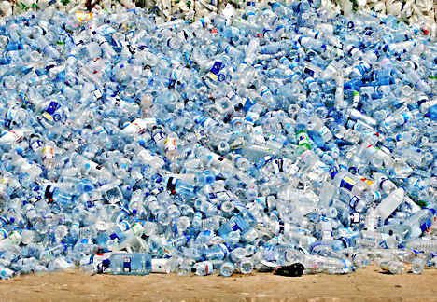
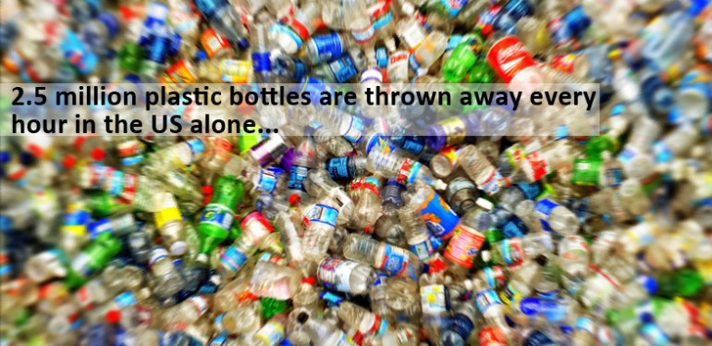
The Bottled Water Debate

Slide 5
Discussion
Why do you think people drink water from plastic bottles rather than using a reusable water bottle?
Do you think that water bottle companies are making an unfair profit from selling bottled water? Why or why not?
Do you think we should discourage people from buying plastic water bottles? Why or why not?
How could we encourage more people to buy reusable water bottles?

Slide 6
Unit 7 Exam Notes
Average: 80%
MC was high!
Great understanding of CAFOS
Common misconceptions:
Fertilizers emit greenhouse gases, not pesticides
Biological control--- introduce a predator of the pest, NOT an invasive species

Slide 7
Homework
Reviews sheet!
Take home binders!!

