Slide 1
SWBAT determine how water diversion affects the environment and the economy through a webquest. Do Now: What is reverse osmosis? What is brine?
ES Unit 8 3/10/16

Slide 2
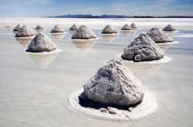

Slide 3
Announcements
Unit Exam on Tuesday!
Come make up the labs at lunch if you haven’t already
Take home binders tomorrow!

Slide 4
Homework Share Out
Turn and talk to share out homework

Slide 5
Webquest Vocab
Diversion: changing the direction or use of something
Example: Diverting a river
Remediate: to correct or make right
Ex: if you accidentally run over someone’s bike with your car, you’d remediate the situation by paying for the bike

Slide 6
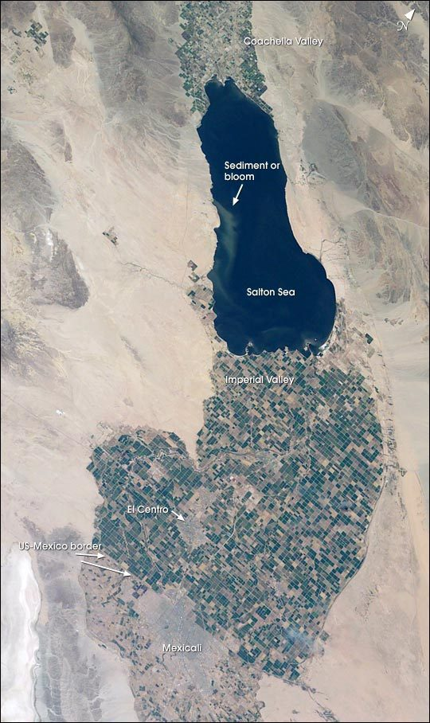
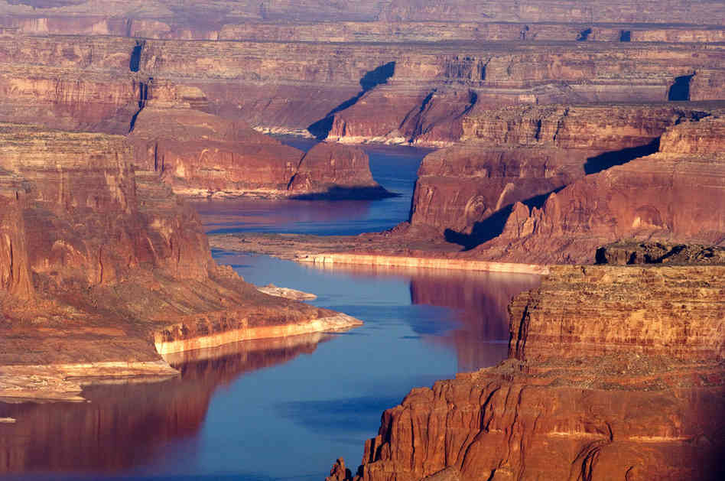
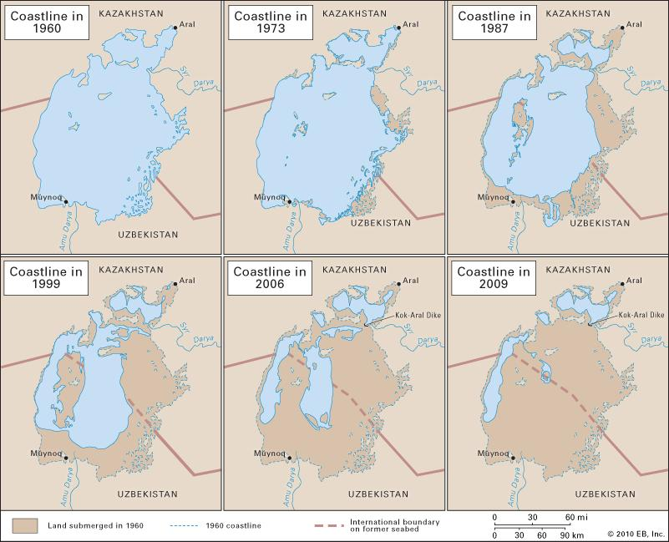
Webquest

Slide 7
Webquest Rules
No wikipedia or blogs (weebly)
List your sources (the name of the website)
If your computer won’t connect to the internet- restart it!
If you read more than five words in a row that you don’t understand, go to a different website
If you can’t find the information…. Keep looking!

Slide 8
Homework
Finish the homework from last night!
Turn in any late work!!

