Slide 1
SWBAT evaluate whether or not California should use desalination to deal with the drought. Do Now: Did learning about the California drought make you want to conserve more water? Why or why not?
ES Unit 4 3/9/16
Lesson 6

Slide 2
Agenda
Reading
Video
Discussion

Slide 3
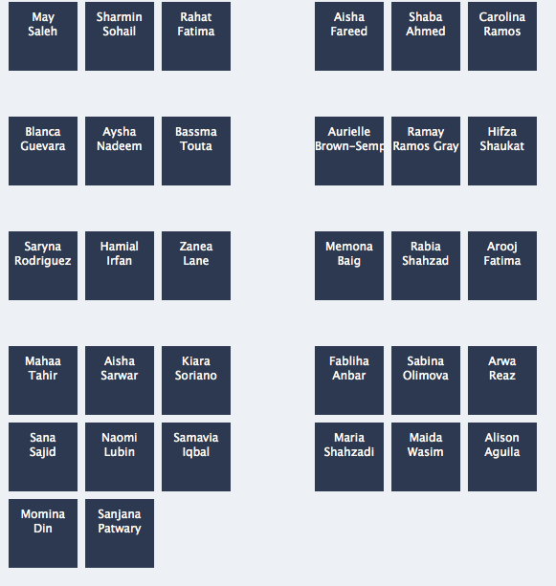

Slide 4
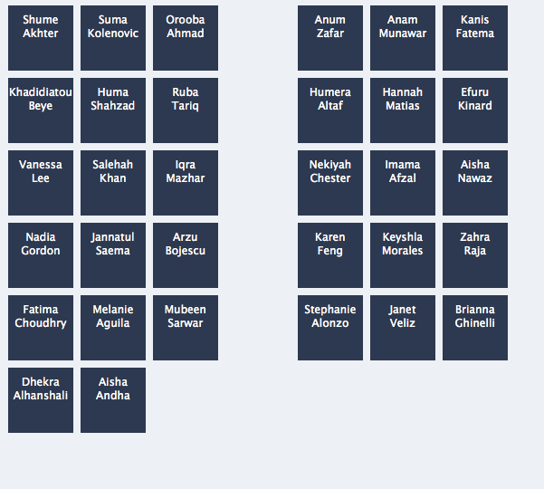
New Seats!

Slide 5
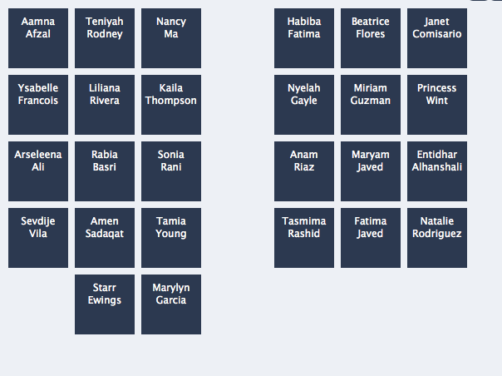

Slide 6
Turn and talk
Share out your homework on the Australian drought

Slide 7
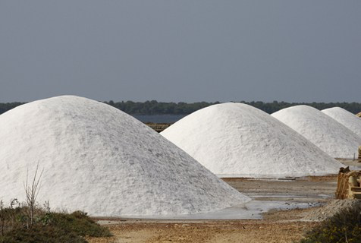
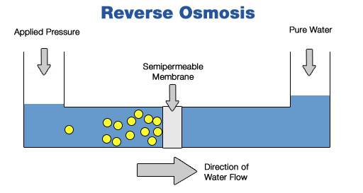

Slide 8
Stop and Jot
What do you think is the strongest piece of evidence for investing in desalination plants?
What do you think is the strongest piece of evidence against investing in desalination plants?
Do you think California should invest in more desalination plants? Why or why not?

Slide 9
Homework
Research one country (other than the U.S. and Australia) that has recently experience a drought. Write one paragraph summarizing the effects and cite your source

