Slide 1
SWBAT identify the negative effects of the California drought. Do Now: What is the differences between indirect and direct water use? Give an example of each.
ES Unit 8 3/8/16
Lesson 5

Slide 2
Agenda
Reading
Video
Reading
Discussion
Reminder: Make up penny lab and universal dissolvent lab tomorrow during lunch!

Slide 3
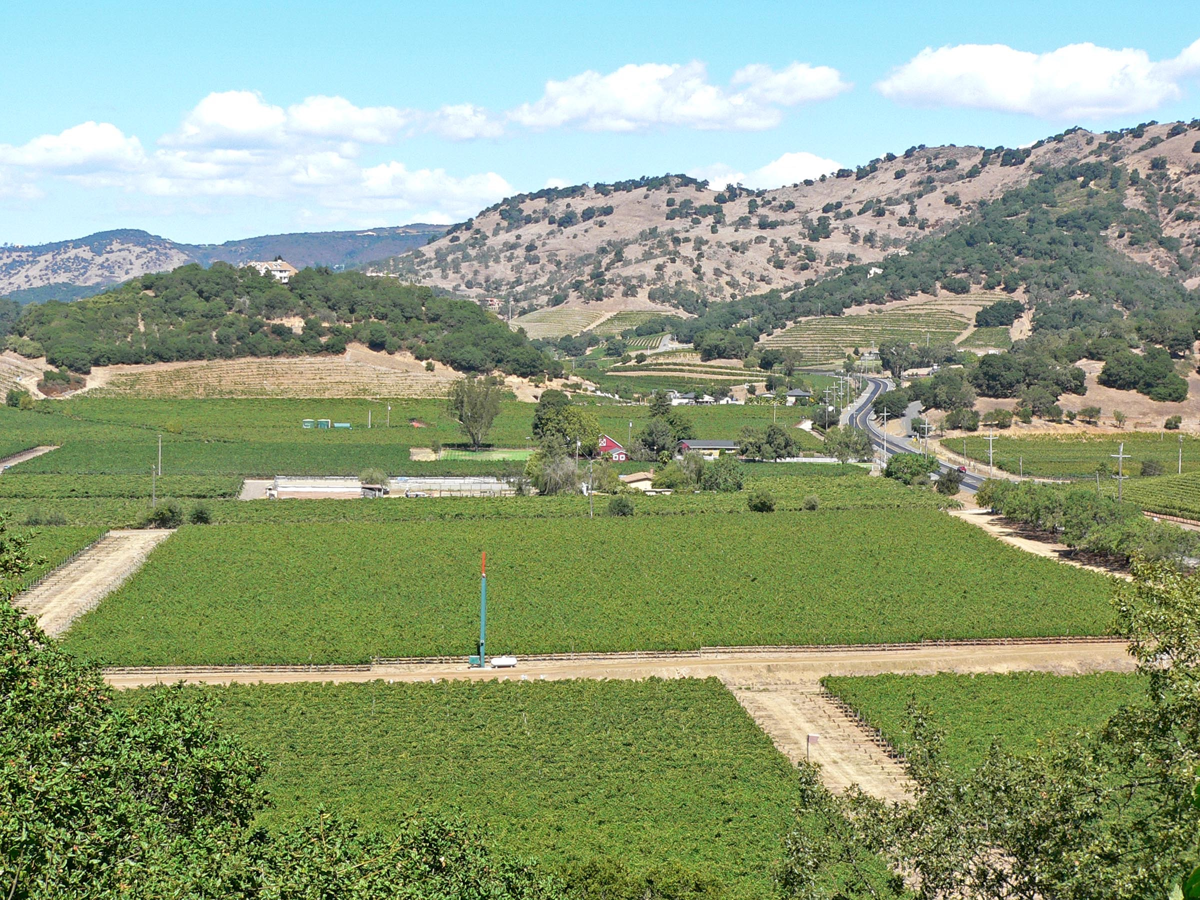
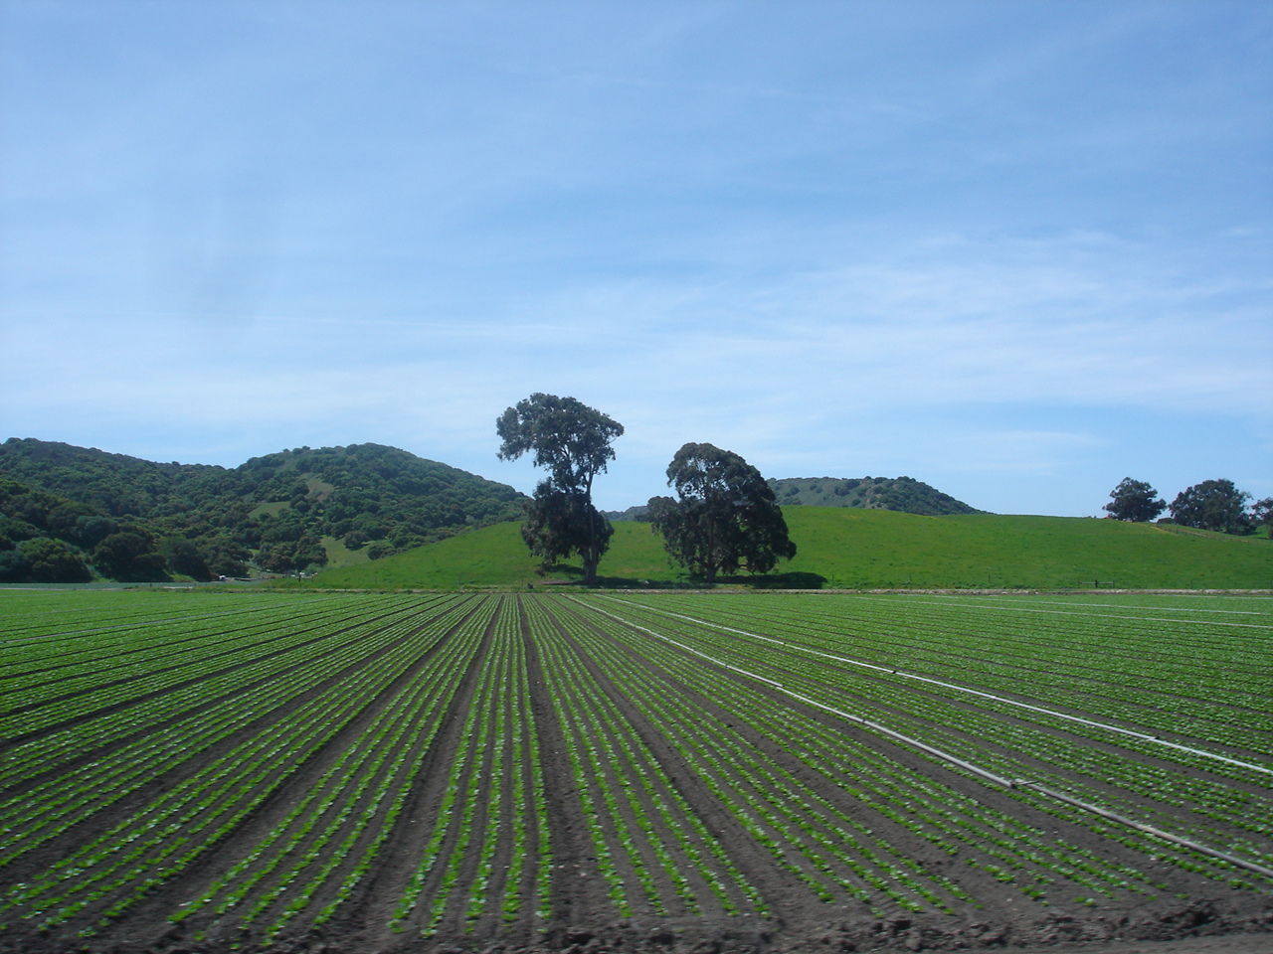
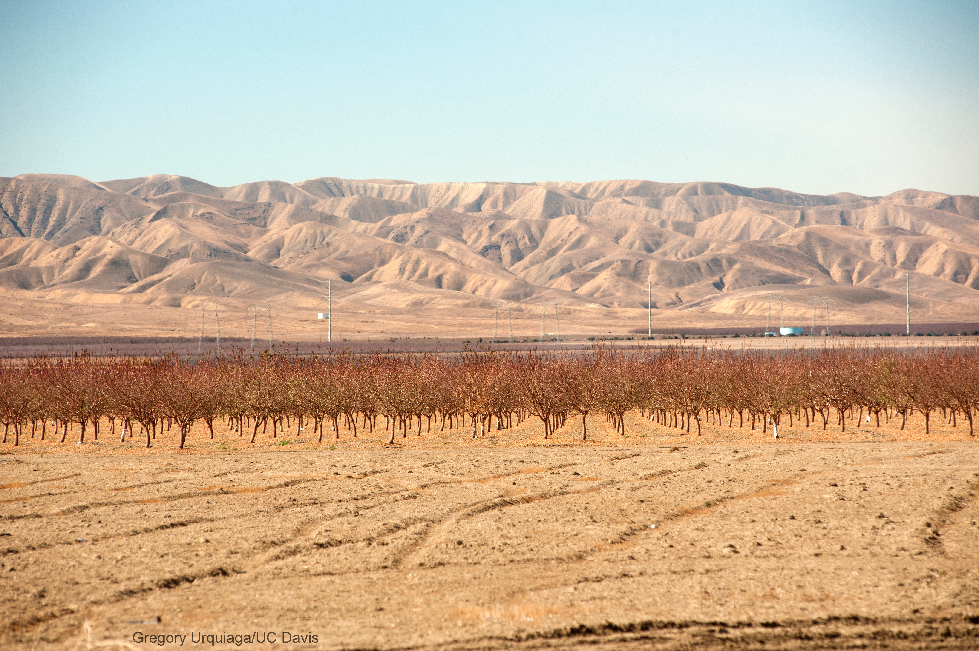

Slide 4
California Drought
http://www.huffingtonpost.com/2014/09/18/california-drought-gifs_n_5843534.html

Slide 5
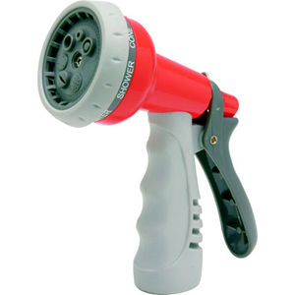
Reading

Slide 6
Videos
http://www.newyorker.com/culture/photo-booth/california-paradise-burning

Slide 7
Discuss:
Ms. Serrato said “you don’t think of water as privilege until you don’t have it anymore.” Do you believe that there are other resources that humans take for granted? If so, which ones?

