Slide 1
Do Now:
Unit 8 3/4/16
Lesson 3
Objective: SWBAT identify how cohesion and polarity allow water to be a solvent.
SWBAT explain why ice is less dense than water.
How is cohesion related to surface tension?

Slide 2
agenda
Mini-lecture
Video
lab

Slide 3
Universal Solvent
Water is known as the universal solvent.
more substances dissolve in water than in any other chemical.
Notes:
Water can dissolve salts, sugar, acid, and gases such as oxygen and carbon dioxide. The human body is more than 60% water.

Slide 4
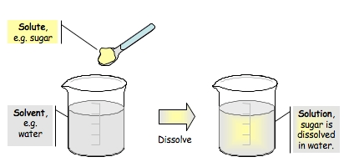
The Sol family
Solvent: liquid that is doing the dissolving
Solute: substance that is dissolved in the liquid (solvent)
Solution: resulting mixture
Solvent + Solute = Solution (mixture)

Slide 5
Ice Ice BAby
H₂0 is the only substance on Earth that is found Naturally in three different states of matter:
Liquid – water
Solid – Ice
Gas – Water Vapor (clouds)
Has different densities at different states

Slide 6
The fours steps of Ice Density
When you freeze liquid water:
(1) the hydrogen bonds expand.
(2) expansion creates more space between water molecules.
(3) makes Ice LESS dense than water
(4) it will float on top of liquid water instead of sink

Slide 7
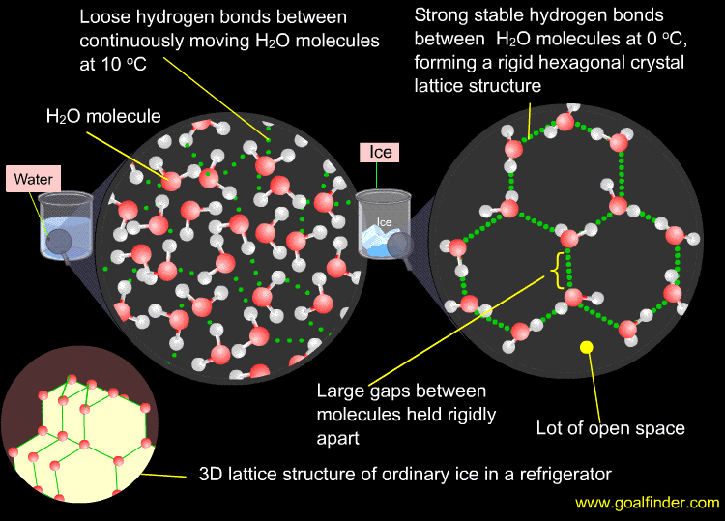

Slide 8
Solvent/solute Mini-Lab Roles
Person closest to the countertop grab a cup of alcohol and a cup of oil
Person closest to the aisle grab a beaker of water
Person in the middle grab a tray
Try not to use all the salt, alcohol, oil, etc.
Runner: person closest to the aisle

Slide 9
Review
Water is known as the universal solvent.
Adhesion: Water attracted to other substances
Solvent (Liquid) + Solute (Solid) = Solution (mixture)
Has different densities at different states
Molecules expand during freezing and creates more space between water molecules = Less density

Slide 10
Exit ticket
How does adhesion and polarity affect water’s ability to dissolve other substances?

