Slide 1
Do Now:
ES Unit 8 3/3/16
Lesson 2
SWBAT differentiate between adhesion and cohesion
What is the name of the bonds between different molecules of water?
Is sugar polar or nonpolar? How do you know?

Slide 2
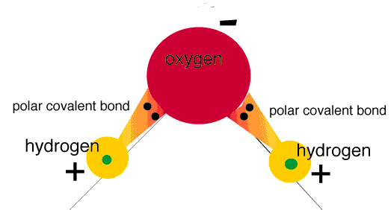
Let’s Review
Polar substances have an unequal sharing of electrons between atoms
Nonpolar substances have an equal sharing of electrons between atoms

Slide 3
How many binder clips will fit in the cup?

Slide 4
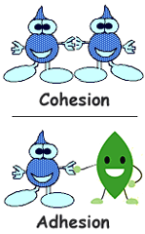
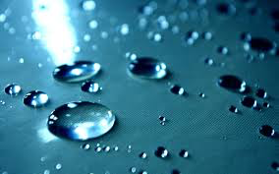
Cohesion
Water molecules are attracted to other water molecules.

Slide 5
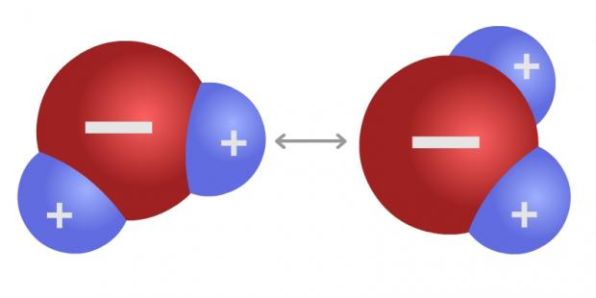
Cohesion
A hydrogen of one water molecule is attracted to the oxygen from other water molecules.
These are hydrogen bonds!

Slide 6
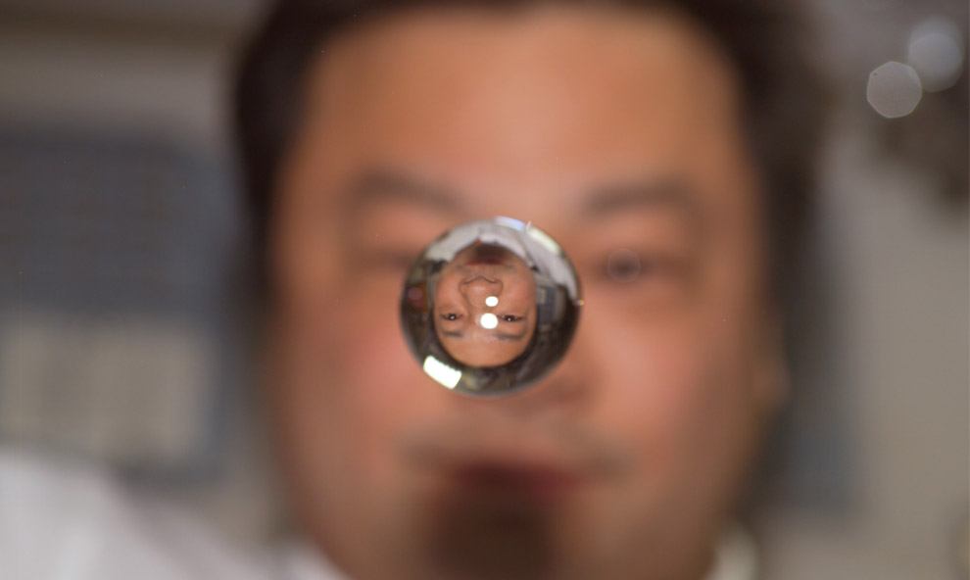
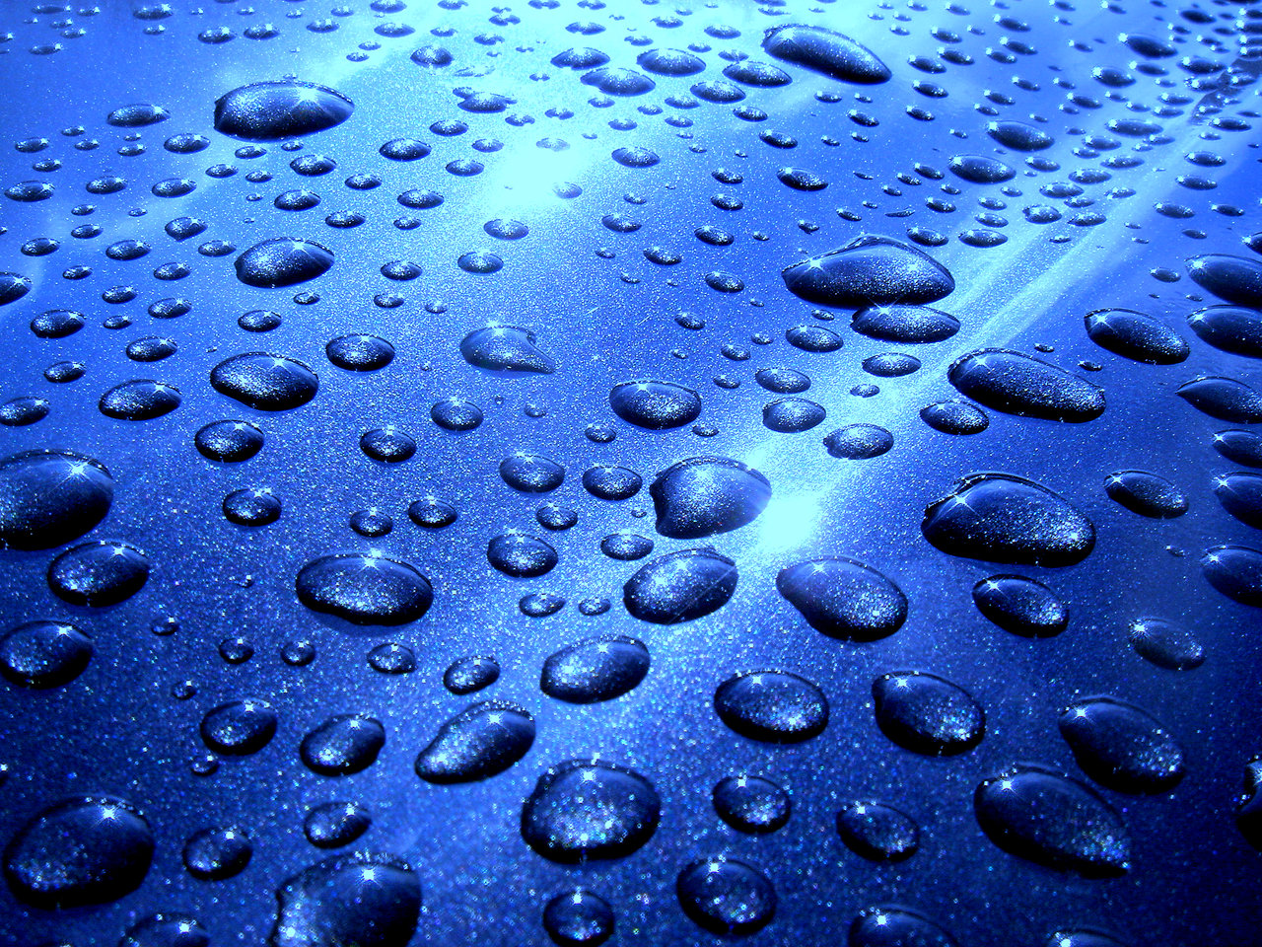
Surface tension
Surface tension is the cohesion of water molecules at the surface of a body of water.

Slide 7
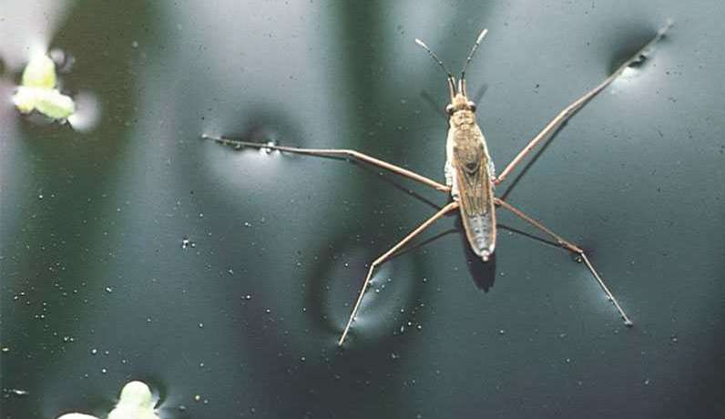
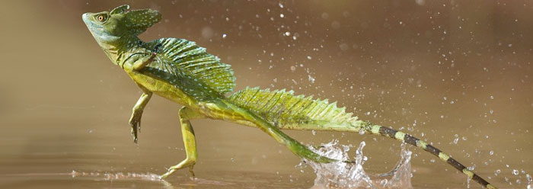
COhesion
The cohesion of water molecules forms a surface "film”.

Slide 8
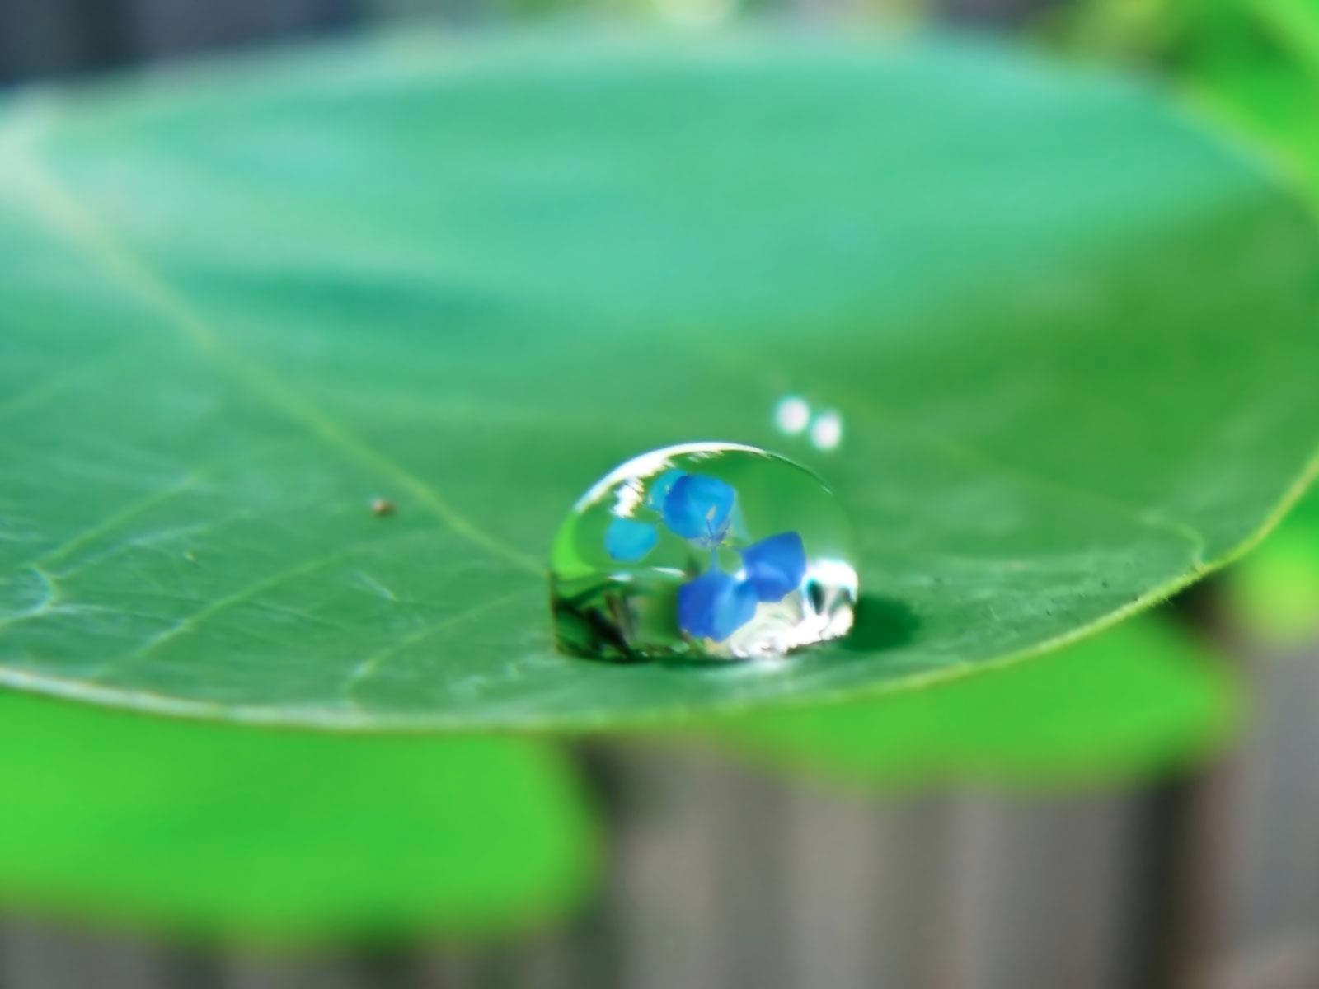
Adhesion
Water attracted to other substances

Slide 9
Cohesion Lab
How many droplets of water fit on the surface of a penny?
Each person gets a chance to drop water on the penny
One person grab a tin tray and one person grab a cup of water
Person in the middle is clean up
Clean up– wipe the penny clean!!

Slide 10
Review
WHat is cohesion?
What is adhesion?
how does polarity affect cohesion?

