Slide 1
SWBAT identify how the polarity of water affects its behavior Do Now:
ES Unit 8
Lesson 1 3/2/16
What happens when you mix water and sugar?

Slide 2
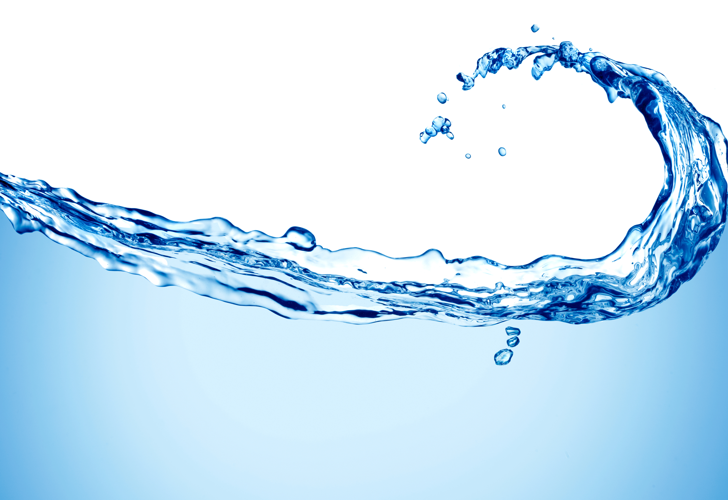
Unit 8: Water use
~ 2 weeks
Essential Questions:
Is water the new oil?
How is climate change affecting the availability of water?
How does the lack of water affect humans and the environment?
First week– molecular properties of water
Second week- Water Use and drought

Slide 3
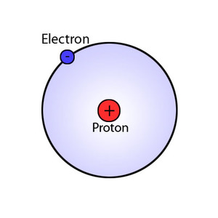
Vocab
Electron: a subatomic (smaller than an atom) particle with a negative charge

Slide 4
Agenda
Lecture
Mini-lab

Slide 5
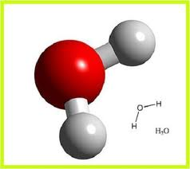
Chemical make-up of Water
Water molecules are made up of one oxygen atom and two hydrogen atoms = H₂0
H₂0 is a polar molecule.

Slide 6
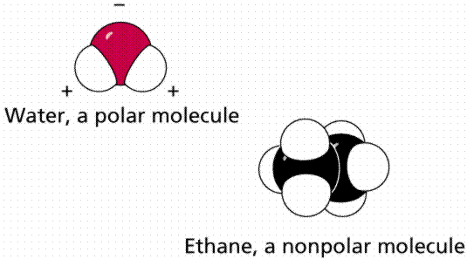
Polarity
Polarity: the unequal sharing of electrons between atoms

Slide 7
Charges
THE OXYGEN ATOM ATTRACTS ELECTRONS MORE STRONGLY THAN THE HYDROGEN ATOM

Slide 8
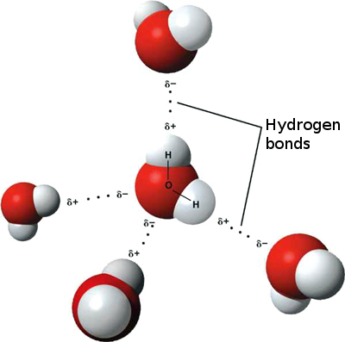
Hydrogen Bond
Because of POLARITY, water molecules attach to each other and form hydrogen bonds.

Slide 9
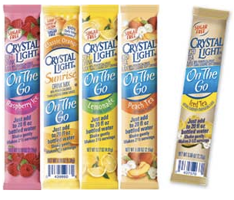
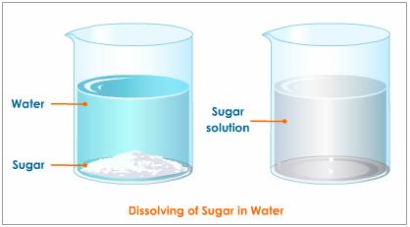
Like dissolves like
Polar substances WILL dissolve in Polar substances.
EX: Sugar + Water
Non-polar substances WILL dissolve in non-polar substances.
EX: Spicy food + Milk

Slide 10
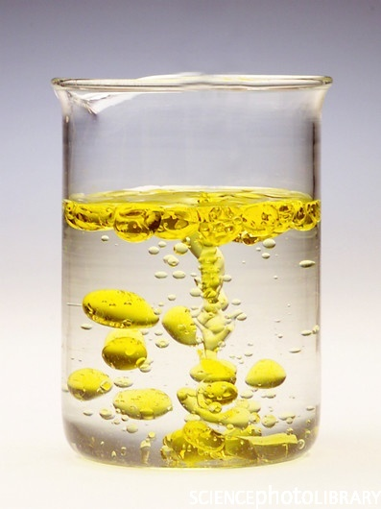
Like dissolves like
Non-polar substances WILL NOT dissolve in polar substances.
Ex: Spicy food + Water

Slide 11
Hands- on Polarity Activity
Complete the worksheet first
Correction to procedure- bubble in one square, not two
Person closest to the countertop grab a cup of water
Clean up: throw Q tips and data table in the trash. Wipe up any spills

Slide 12
Let’s Review!!
What is polarity?
What is an example of a polar molecule?
What does “like dissolve like” mean?

