Slide 1
SWBAT compare different strategies for sustainable farming. Do Now: How is organic farming different from industrialized farming?
ES Unit 7 2/22/16
Lesson 9

Slide 2
Agenda
Jigsaw Reading
Videos!

Slide 3
Jigsaw Guidelines
Read your article and answer the questions in your expert group

Slide 4
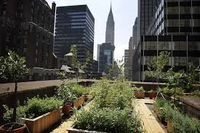
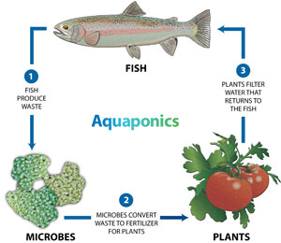
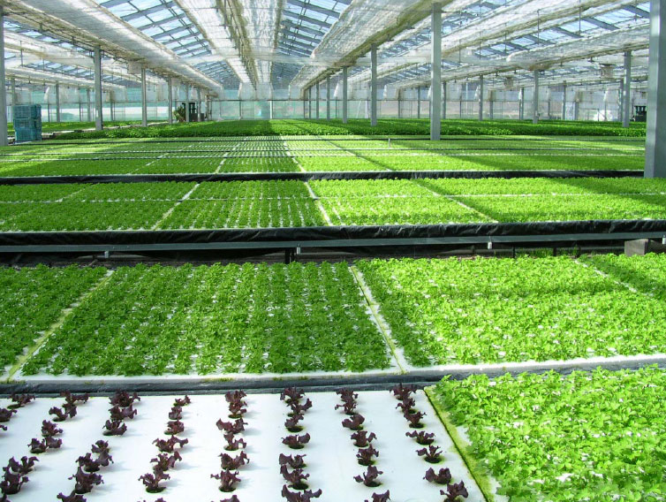

Slide 5
Hydroponics
https://vimeo.com/33264004

Slide 6
Will Allen
https://vimeo.com/15997939

Slide 7
Urban Farming Video
https://vimeo.com/7695240

Slide 8
Urban agriculture AND hydroponics
http://www.smithsonianmag.com/videos/category/innovation/revolutionizing-the-urban-farm/?no-ist

Slide 9
Class Discussion
Which method do you think is the most effective?
Which method do you think would be the least effective? Why?
Do you think these methods represent the future of farming? Why or why not?

