Slide 1
SWBAT understand the components of organic farming. Do Now: What are two advantages of pesticides? What are two disadvantages of pesticides?
ES Unit 7 2/12/16
Lesson 8

Slide 2
Turn and Talk
Share your homework– did Lisa Leo win?

Slide 3
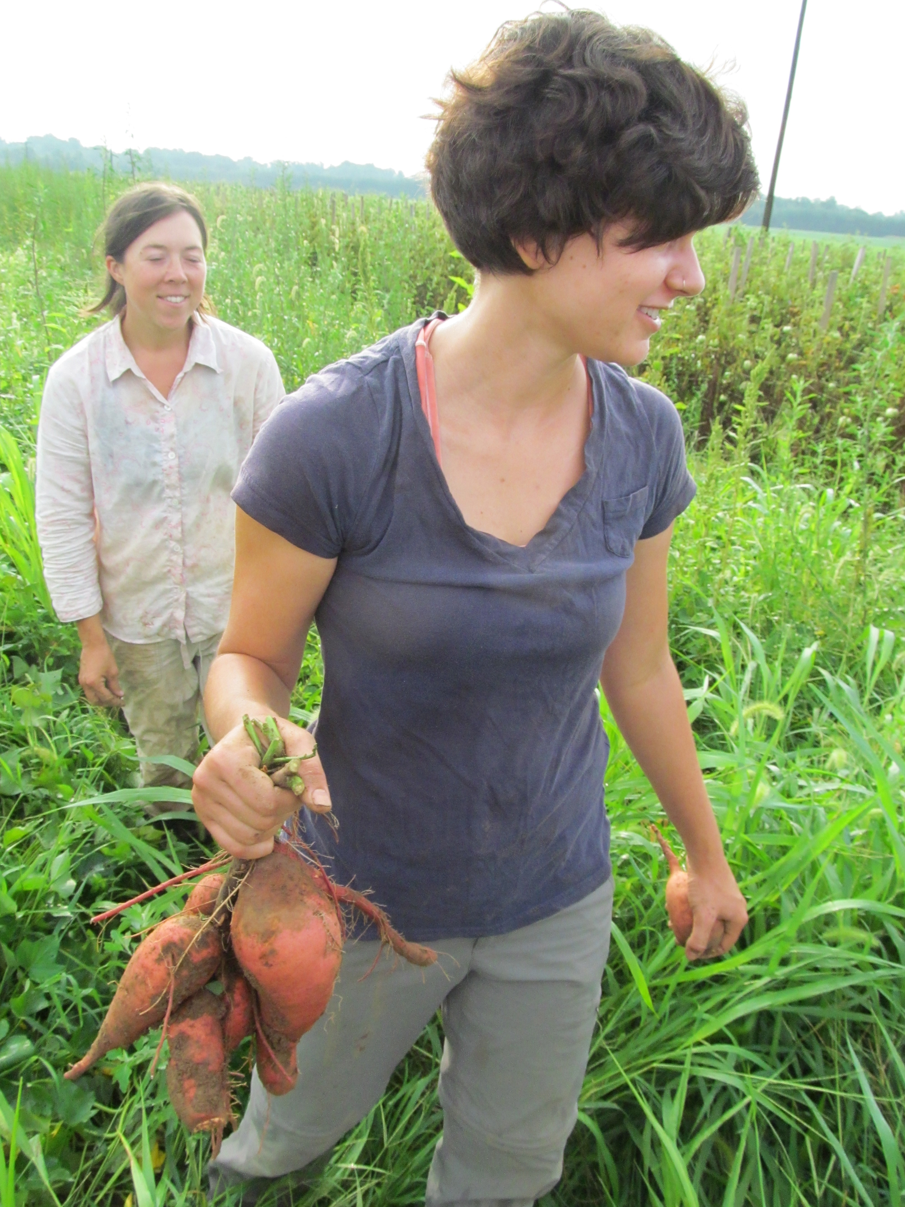
Agenda
Organic food
Video
Reading

Slide 4
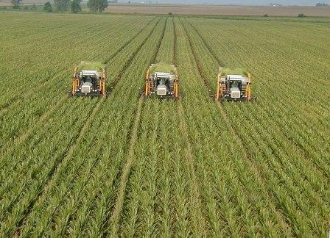
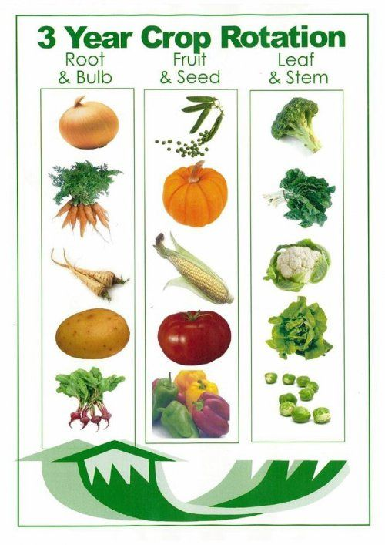
Organic Farming
Use organic fertilizers, such as animal manure and compost.
No synthetic pesticides, use crop rotation and biological pest control.

Slide 5
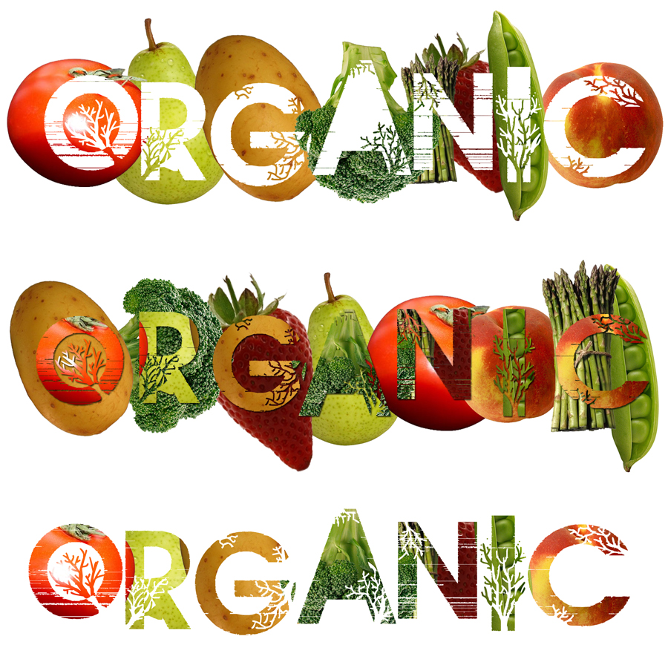
Organic Farming
Less fossil fuel, more renewable energy.
No GMOs
No antibiotics or hormones in meat.
More crop diversity
Often local

Slide 6
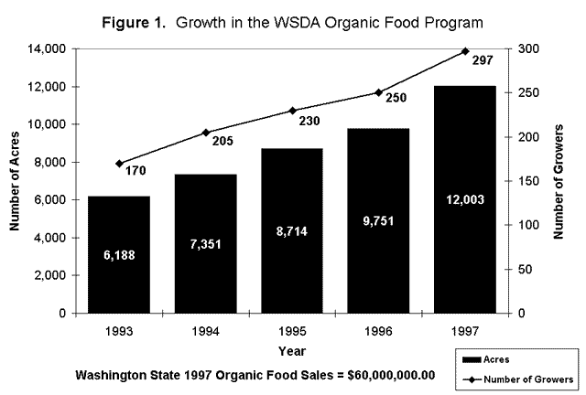
Organic Fever
One of the fastest growing sectors (or parts) in U.S. agriculture

Slide 7
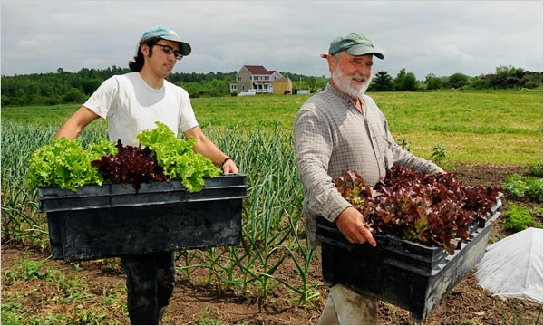
Organic fever
Currently more than 1.3 million acres are certified organic
12,000 organic farmers in the U.S.

Slide 8
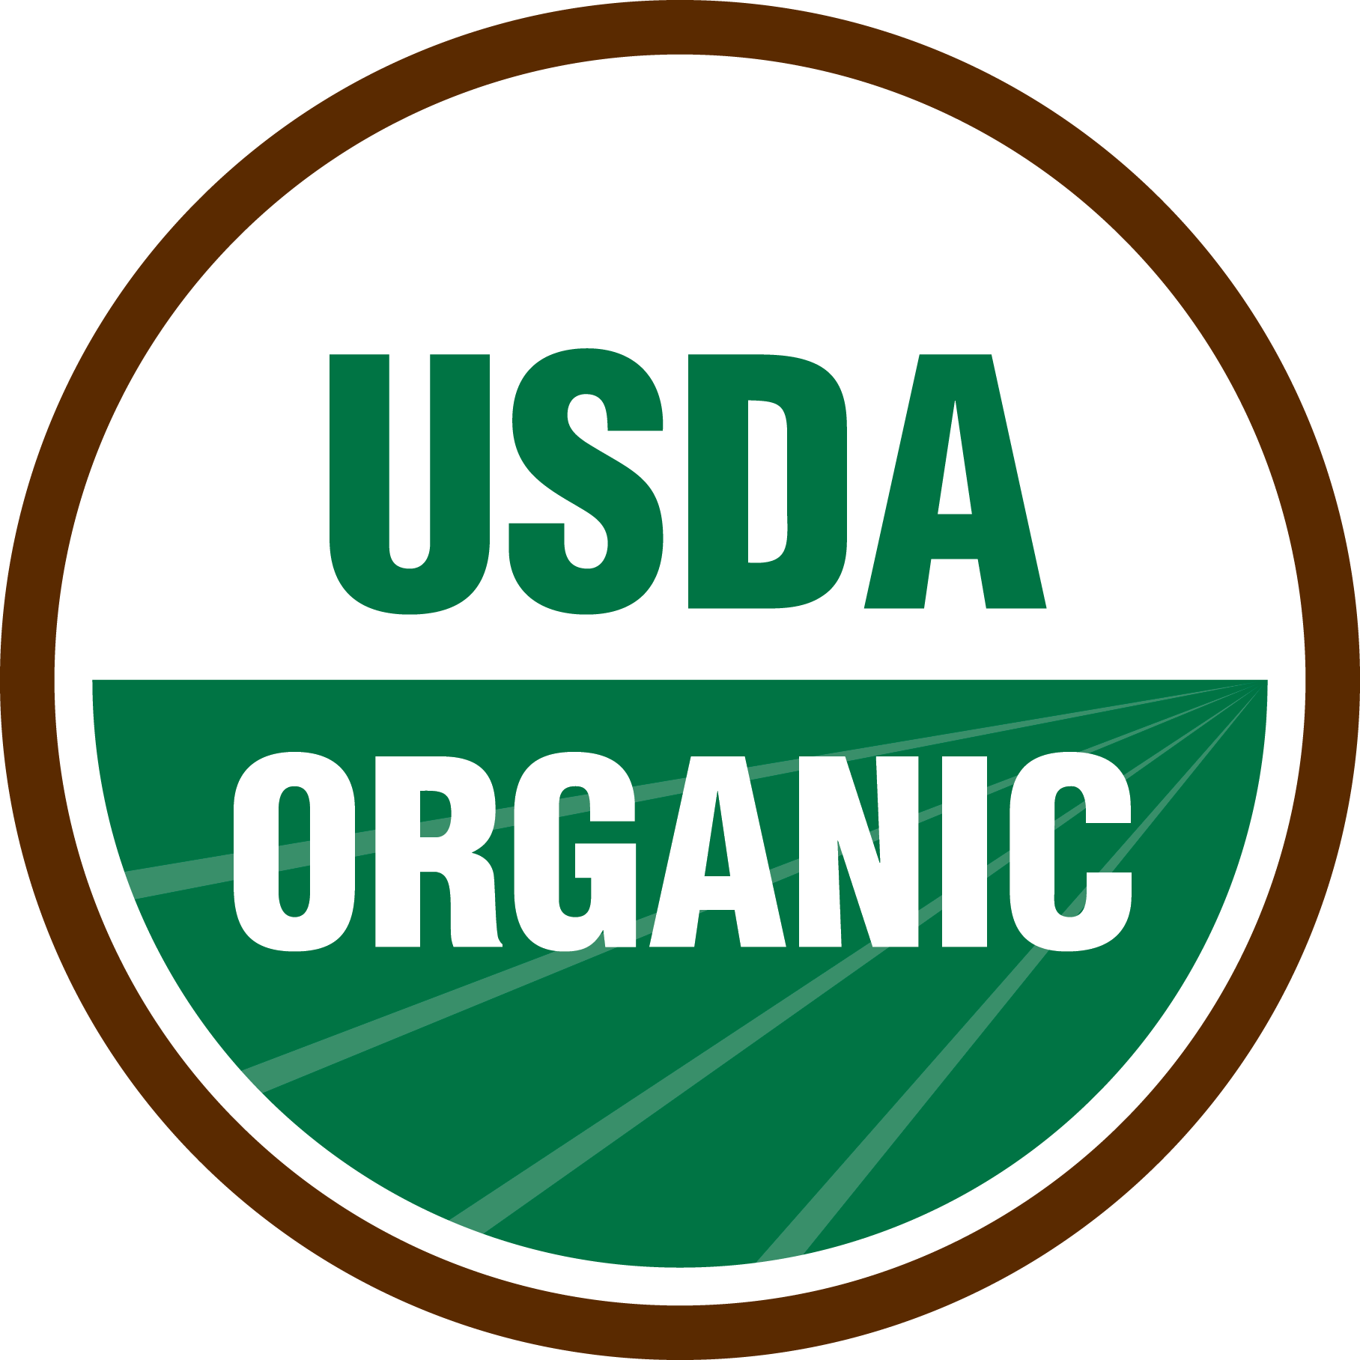
Organic Certification
Land free of synthetic chemicals for at least 3 years
On-site inspections
Separate organic and non-organic products

Slide 9
Turn and Talk
Do you think we should have strict requirements for food to be labeled organic? Why or why not?

Slide 10
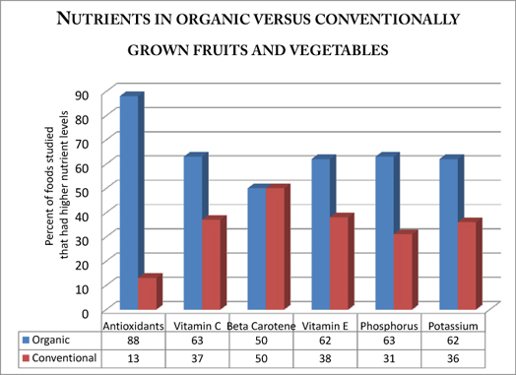
Are organic foods more healthy?

Slide 11
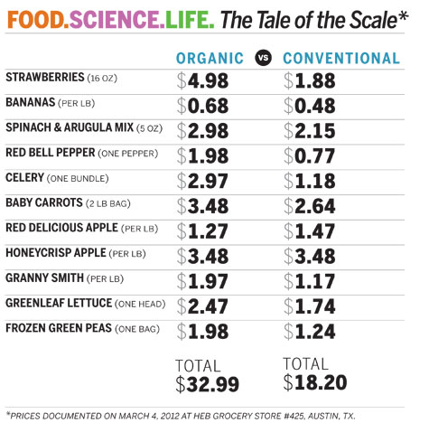
The Price Difference
Organic food tends to be more expensive.
Reasons:
It is more expensive to produce
Requires more labor

Slide 12
Turn and Talk
Do the benefits of organic farming outweigh the negatives? Why or why not?

Slide 13
Homework
Essay

