Slide 1
SWBAT identify advantages and disadvantages of using pesticides. Do Now: What is a counterclaim?Provide an example of a counterclaim you’ve written for another class.
ES Unit 7 2/11/16
Lesson 7

Slide 2
Agenda:
Mini-lecture
Video/discussion
Pass back work!

Slide 3
But first….
Great job on the Socratic seminar yesterday!!! ☺

Slide 4
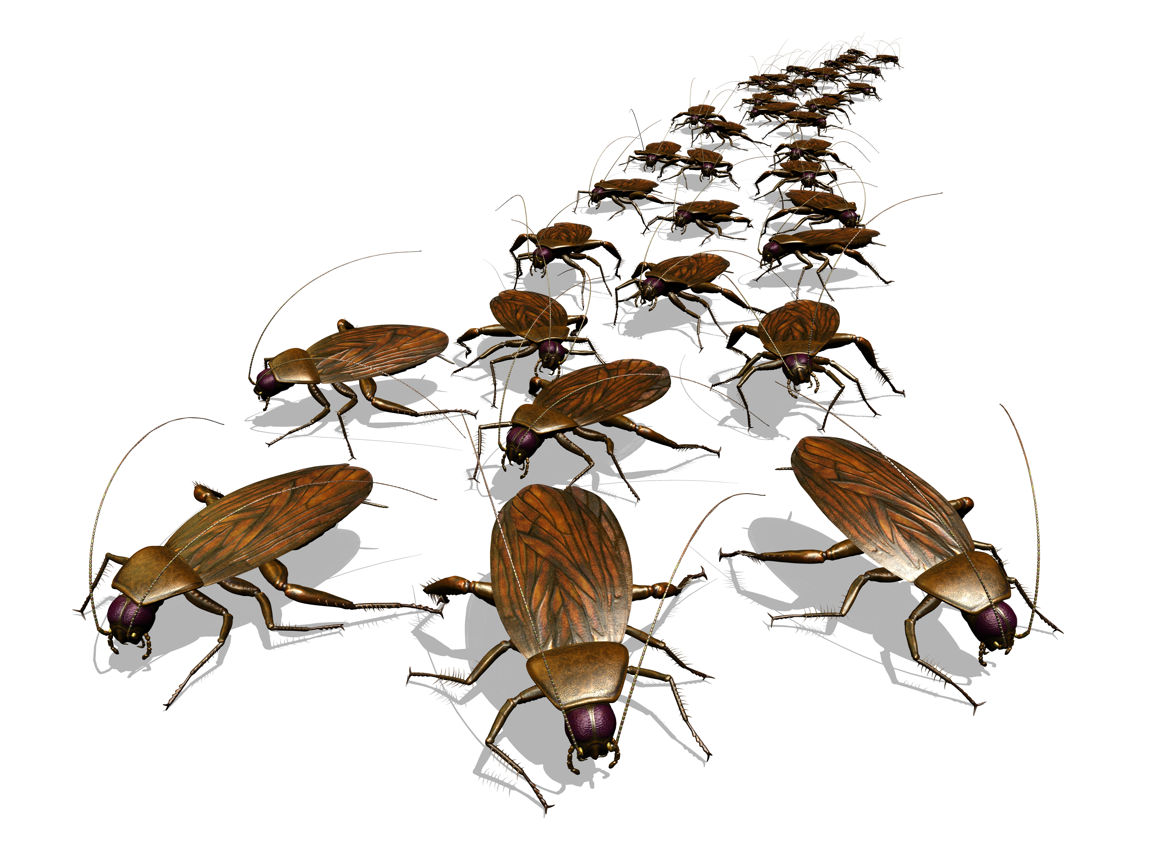
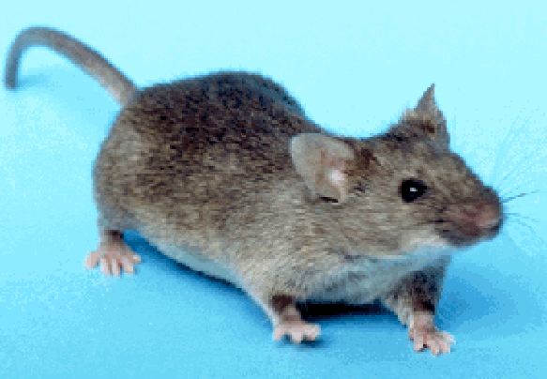
What is a pest?
Mice, locusts, bedbugs, cockroaches, etc.

Slide 5
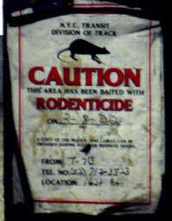
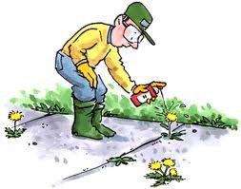
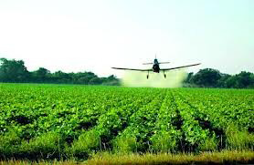
Control pest populations
Pesticides:
Insecticides→ insects
Herbicides→ weeds
Fungicides→ fungi
Rodenticides→ rodents

Slide 6
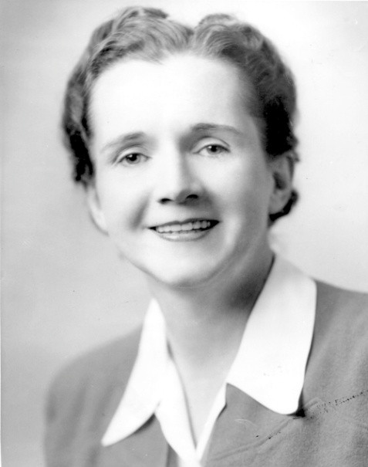
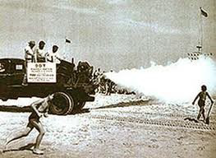
Pesticides 101
First generation pesticides
Ex: arsenic and lead
Borrowed from plants
Con: some are highly toxic to other species (fish and bees)
Second generation pesticides
Created in a lab
Example: DDT

Slide 7
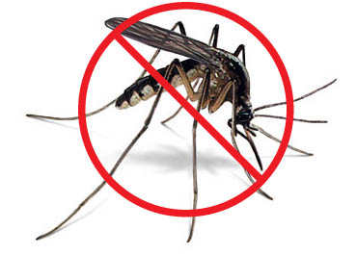
Advantages of Pesticides
Save lives→ controlled malaria
Work fast
Increase food supplies
20 to 40 percent of potential crop production is lost annually due to pests.

Slide 8
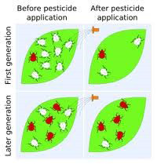
Disadvantages of Pesticides
Promote genetic resistance
Kill natural pest enemies
Pollute the environment
Can harm wildlife and people

Slide 9
Pesticides and Human Health
Pesticides can irritate eyes and skin.
Some pesticides may be carcinogens (cause cancer).
Study showed an association between pesticide residue un urine and ADHD in children.

Slide 10
Video
http://www.today.com/video/today/37187283#37187283

Slide 11
GMO Essay
Due Mon. Feb 22nd
5 paragraphs!
Include a counterclaim!

