Slide 1
SWBAT analyze the advantages and disadvantages of GMOs. Do Now: What do you think is the most dangerous disadvantage of GMOs? Why?
ES Unit 7 2/4/16
Lesson 3

Slide 2
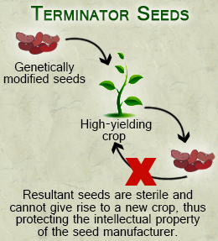
What is a terminator gene?

Slide 3
Video
http://tv.naturalnews.com/v.asp?v=02AE6EE3C01296F40F54EEFD63D453E8

