Slide 1
ES Unit 7 2/3/16 Lesson 2
SWBAT to compare the advantages and disadvantages of GMOs.
Do Now:
What is a GMO?
Name two crops that have been genetically modified.

Slide 2
Agenda
Lecture
Video
Reading

Slide 3
Turn and Talk
Homework share

Slide 4
Monsanto
Company that produces genetically modified crops and pesticides

Slide 5
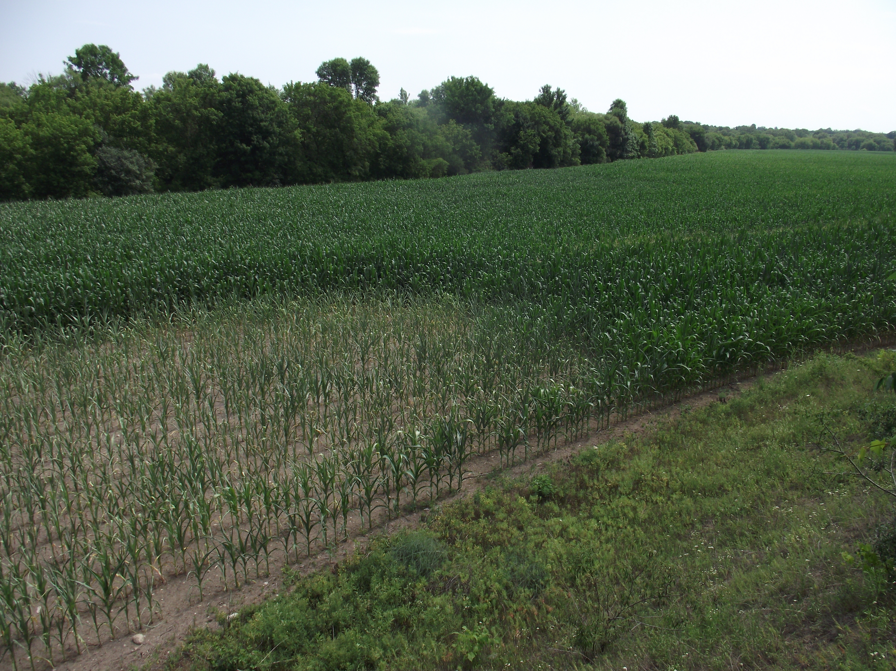
GMO Advantages
More resistant to insects, diseases, frost, and drought.

Slide 6
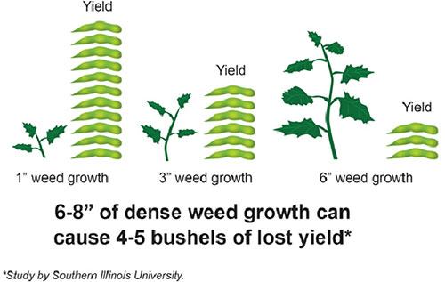
GMO Advantages
There is a higher yield for GMOs
More crops produced in a given area.

Slide 7
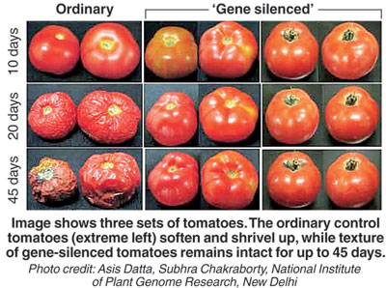
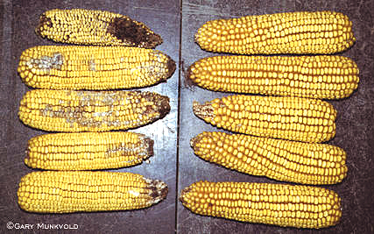
GMO Advantages
Need less fertilizer
Crops may grow faster
Last longer (for transportation and shelf-life)

Slide 8
Stop and Think
Rank the advantages from the greatest to the least.
Turn and talk: Which advantage do you think is the best? Why?

Slide 9
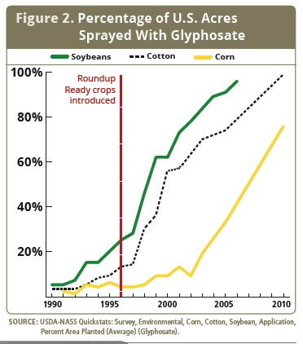
GMO Disadvantages
More herbicide use
Weeds that are resistant to herbicides live and reproduce
Creation of “superweeds”
More pesticide resistant insects

Slide 10
GMO Disadvantages
Lower genetic diversity
Genes from GM crops can spread to organic crops through pollination.
The crops then contain genes from another species (transgenic).

Slide 11
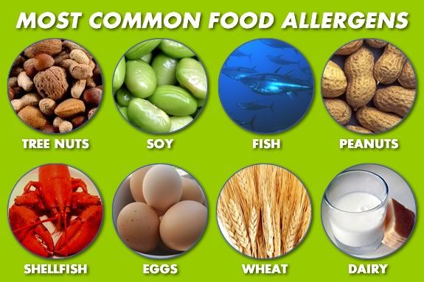
GMO Disadvantages
New food allergies
Recent increase in food allergies among children
UK study found that allergic reactions to soy had increased by 50%

Slide 12
Stop and Think
Rank the disadvantages from the greatest to the least.
Turn and talk: Which disadvantage do you think is the worst? Why?

Slide 13
Video:
Which common items in the supermarket contain GMOs?

Slide 14
Discussion
Do you believe the best advantage outweighs the worst disadvantage? Why or why not?

Slide 15
Homework
Research what a terminator gene is
Cite your source!

