Slide 1
SWBAT identify reasons why humans genetically engineer food. Do Now: Do you think Americans are conscious of the ingredients in the food they eat? Why or why not?
ES Unit 7 2/2/16
Lesson 1

Slide 2
Unit 7: Land and Food
~ 2 weeks
Essential Questions:
How does agriculture and our food choices impact the environment?
What role do GMOs play in feeding the world?

Slide 3
Agenda:
Lecture
Video
Reading
Pass Back Lab Reports

Slide 4
Knowledge Test
Raise your hand if you….
Know what a genetically modified organism is
Think you eat genetically modified food
Notice labels on your food (organic, non GMOs, read the ingredients) before you eat it

Slide 5
Industrialized food production
Efficient food production
Produce food in high yield for little cost.
Americans spend 10 % of income on food.

Slide 6
The First Green Revolution
Selective Breeding (artificial selection)
Intentionally breed strains of plants to obtain the best quality.
Slow process
Great results
Notes:
Think pair share, use information in some way.

Slide 7
Selective Breeding: Example

Slide 8
Second Green Revolution: GMOs
Genetic engineering: taking genes from one species and inserting it into an unrelated species.

Slide 9
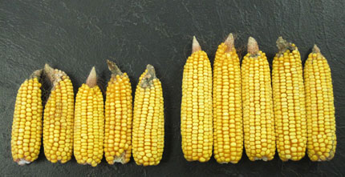
Bt-Corn- Pest resistance
Contains a gene that kills insects
Farmer doesn’t have to use as many pesticides

Slide 10
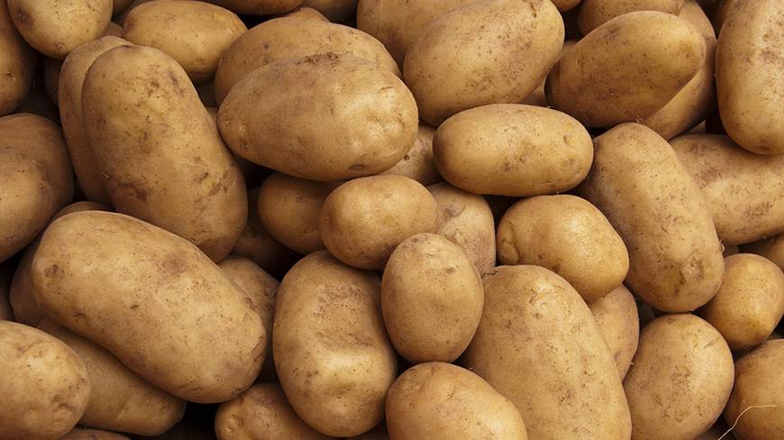
Potatoes: Disease Resistance
Goal: Make resistant to the disease that caused the Irish Potato Famine

Slide 11
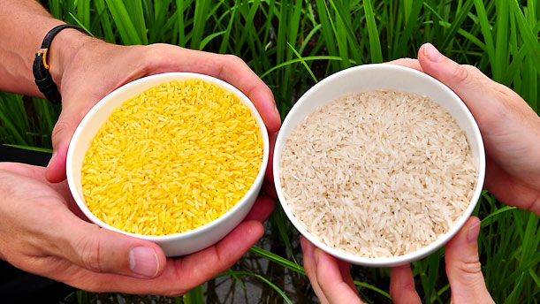
Golden Rice
Enriched with vitamin A
Used in developing countries where people have malnutrition.

Slide 12
Discussion
Was there a certain food that you were surprised to learn was genetically modified? Why or why not?

Slide 13
Let’s review!
How is the first green revolution different form the second green revolution?
What is genetic engineering?

