Slide 1
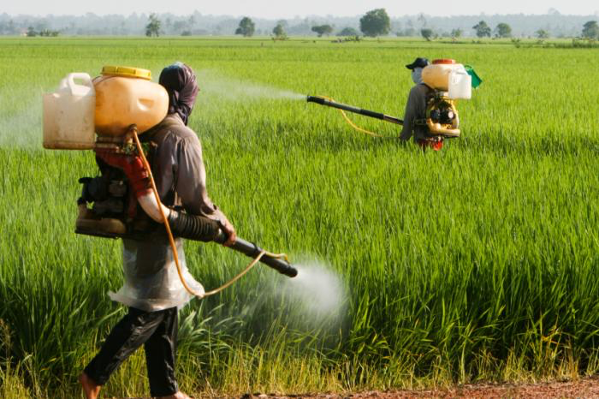
SWBAT evaluate the effects of overfishing. Do Now: What is the difference between first generation and second generation pesticides?
ES Unit 7 2/29/16
Lesson 14

Slide 2
Reminders
Unit exam tomorrow!
ALL late work for this unit due tomorrow!
Agenda:
Lecture
Video
Reading/Discussion

Slide 3
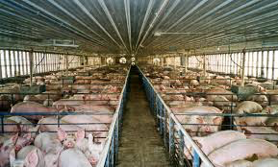
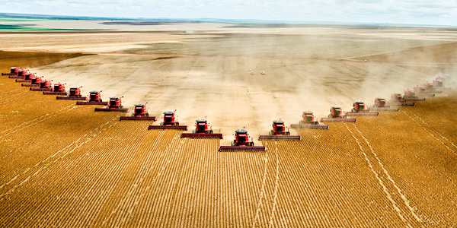
Unit 7 Exam review

Slide 4
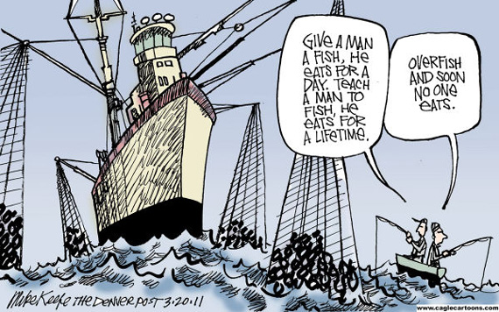
Overfishing….

Slide 5
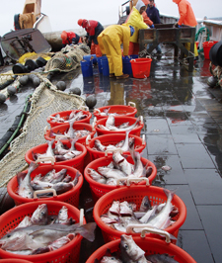
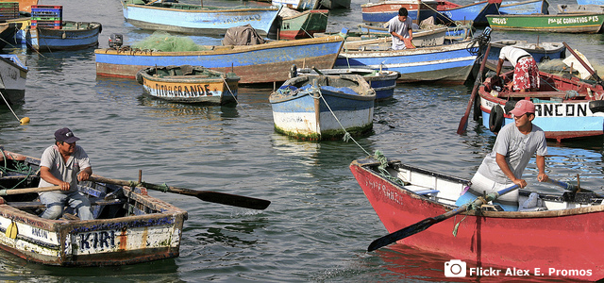
Overfishing: The Facts
Fish is the third major source of food for humans
One billion people worldwide depend on fish as their main source of food

Slide 6
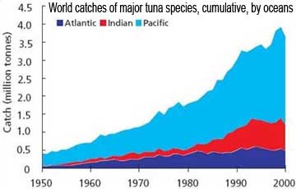
Overfishing Legislation
Countries were limited to fish 12 miles offshore of coast
Now nations can fish up to 200 miles offshore

Slide 7
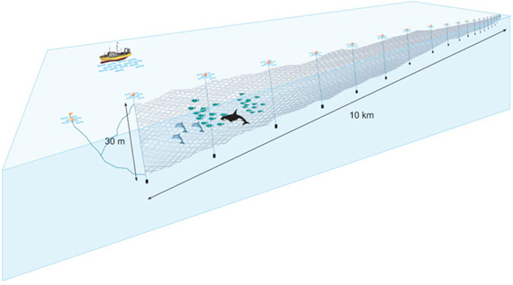
Fishing Methods
Driftnets: drift through the water and catch everything in their path

Slide 8
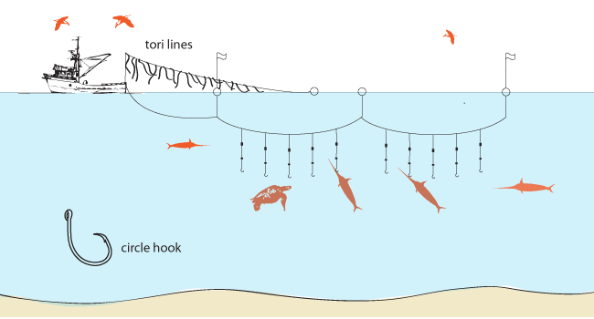
Fishing Methods
Long lining: baited hooks that can catch many organisms

Slide 9
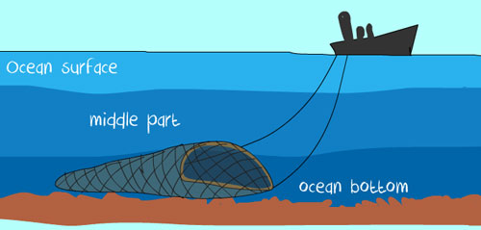
Fishing Methods
Bottom Trawling: Ocean floor is scraped by heavy nets that smash everything in its path

Slide 10
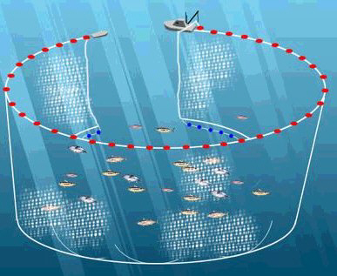
Fishing Methods
Purse seines: large nets drawn up to capture fish in large schools near the ocean surface

Slide 11
Stop and Think
How do you think these methods could have a negative impact on the environment?

Slide 12
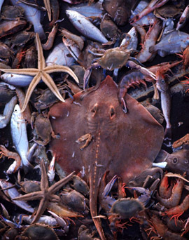
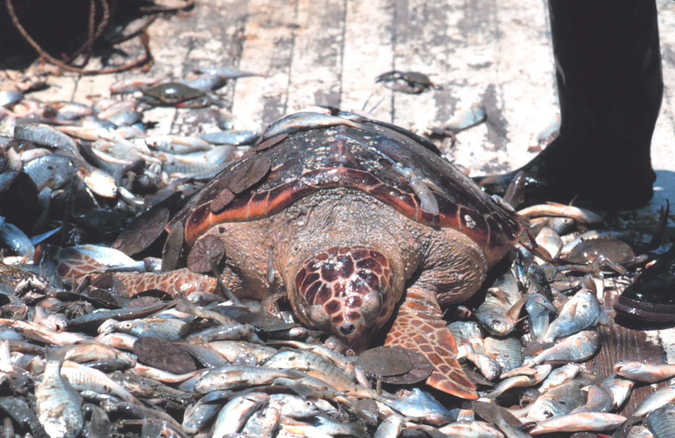
Bycatch
Unintentional catch of species of fish, mammals or birds that are not the target fish

Slide 13
Drop Into the Ocean
Video

Slide 14
Marine Protected Areas
http://ocean.nationalgeographic.com/ocean/take-action/marine-protected-areas/

Slide 15
Stop and Think
What do you think are the long term economic effects of overfishing?
Do you believe making natural reserves out of the ocean will be successful in reversing overfishing? Why or why not?
What other methods do you think could be used to reduce overfishing?
After watching this video, do you want to eat less fish? Why or why not?

Slide 16
Let’s Review!
What is bycatch?
Explain the four types of modern fishing methods.
What is one solution to overfishing?

Slide 17
Homework
Study for your exam!

